Slide 1
Artificial Neural Networks Introduction
Lecture 1
Dr. Tehseen Zia

Slide 2
Neural Networks
Origins: Algorithms that try to mimic the brain.
Very widely used in 80s and early 90s; popularity diminished in late 90s.
Recent resurgence: State-­‐of-­‐the-­‐art technique for many applications of artificial intelligence
Artificial neural networks are not nearly as complex or intricate as the actual brain structure
Based on slide by Andrew Ng
8

Slide 3
Neural Function
Brain function (thought) occurs as the result of the firing of neurons
Neurons connect to each other through synapses, which propagate action potential (electrical impulses) by releasing neurotransmitters
Synapses can be excitatory (potential-­‐increasing) or inhibitory (potential-­‐decreasing), and have varying activation thresholds
Learning occurs as a result of the synapses’ plasticity: They exhibit long-­‐term changes in connection strength
There are about 10¹¹ neurons and about 10¹⁴ synapses in the human brain!
Based on slide by T. Finin, M. desJardins, L Getoor, R. Par
2

Slide 4
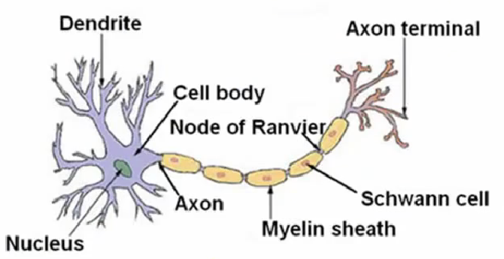
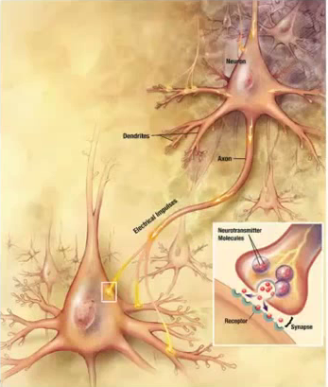
Biological Neuron

Slide 5
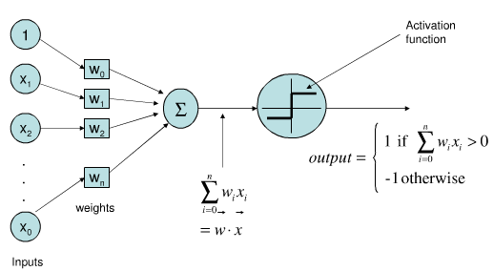
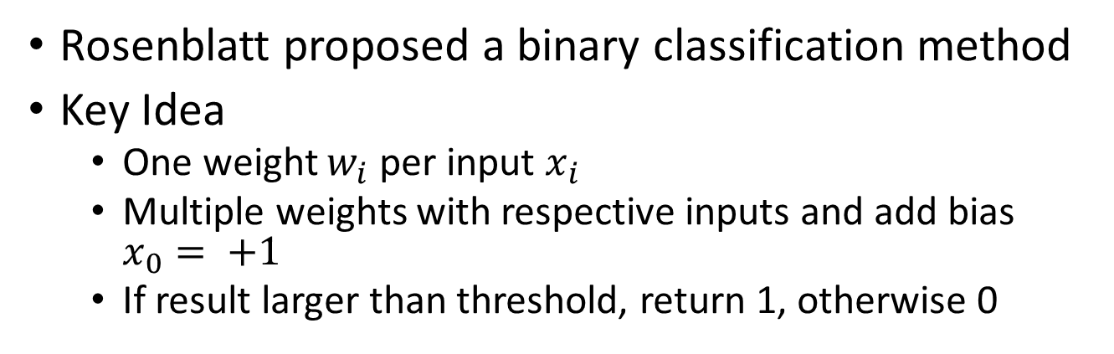
Perceptron
Rosenblatt proposed a binary classification method
Key Idea
One weight $w_{i}$ per input $x_{i}$
Multiple weights with respective inputs and add bias $x_{0}= +1$
If result larger than threshold, return 1, otherwise 0

Slide 6
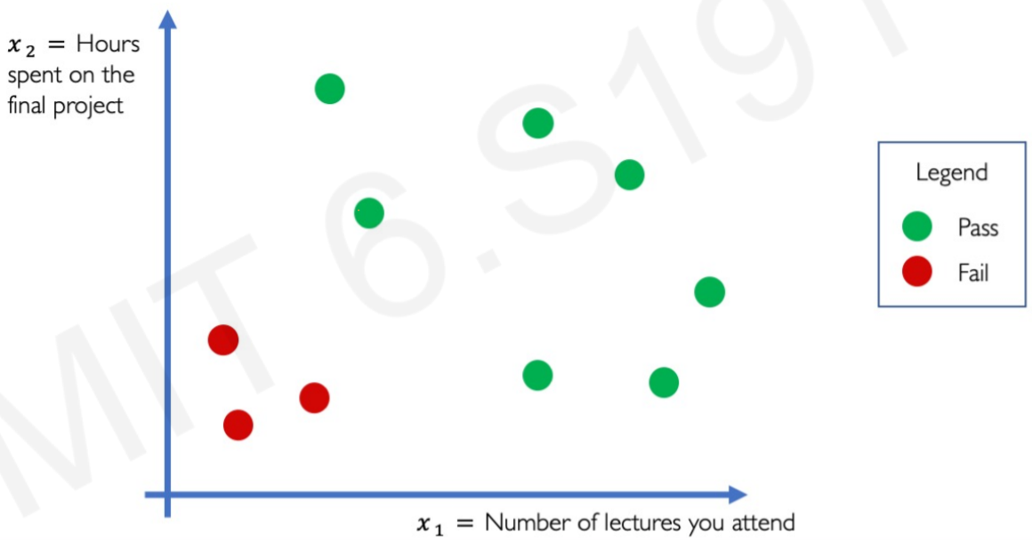
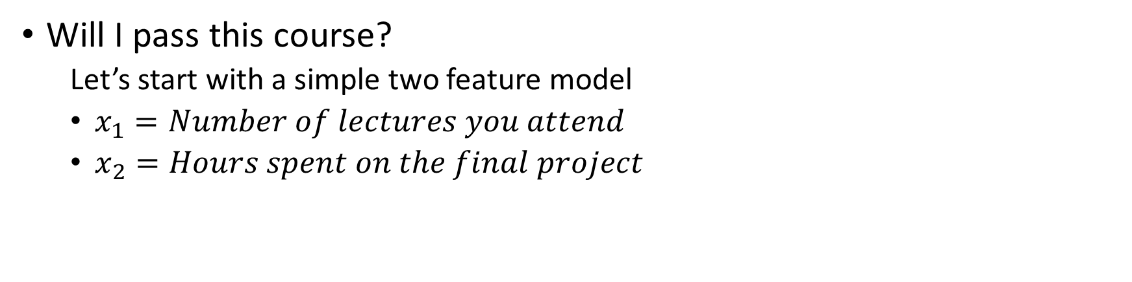
Example Problem
Will I pass this course?
Let’s start with a simple two feature model
$x_{1}=Number of lectures you attend$
$x_{2}=Hours spent on the final project$

Slide 7





Example Problem
Will I pass this course?
Let’s start with a simple two feature model
$x_{1}=Number of lectures you attend$
$x_{2}=Hours spent on the final project$
$$x_{1}$$
$$w_{1}$$
$$Σ$$
$$w_{2}$$
$$x_{2}$$

Slide 8




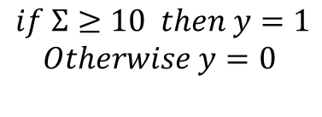
Example Problem
Will I pass this course?
Let’s start with a simple two feature model
$x_{1}=Number of lectures you attend$
$x_{2}=Hours spent on the final project$
$$x_{1}$$
$$w_{1=1}$$
$$Σ$$
$$y$$
$$w_{2=1}$$
$$τ=10$$
$$x_{2}$$
$$if Σ≥10 then y=1$$
$$Otherwise y=0$$

Slide 9
Example Problem
Will I pass this course?
Let’s start with a simple two feature model
$x_{1}=Number of lectures you attend$
$x_{2}=Hours spent on the final project$
What variables of the model are known and not known ?
$$x_{1}$$
$$w_{1=1}$$
$$Σ$$
$$y$$
$$w_{2=1}$$
$$τ=10$$
$$x_{2}$$
$$if Σ≥10 then y=1$$
$$Otherwise y=0$$

Slide 10
Example Problem
Will I pass this course?
Let’s start with a simple two feature model
$x_{1}=Number of lectures you attend$
$x_{2}=Hours spent on the final project$
What variables of the model are known and not known ?
$$x_{1}$$
X
$$w_{1=1}$$
$$Σ$$
$$y$$
X
X
$$w_{2=1}$$
$$τ=10$$
$$x_{2}$$
$$if Σ≥10 then y=1$$
$$Otherwise y=0$$

Slide 11
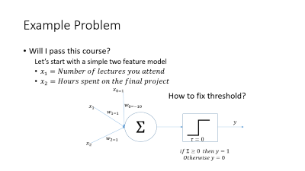
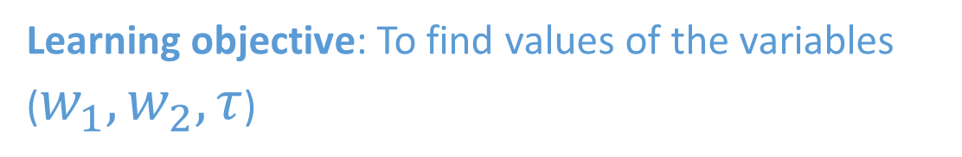
Example Problem
Will I pass this course?
Let’s start with a simple two feature model
$x_{1}=Number of lectures you attend$
$x_{2}=Hours spent on the final project$
What variables of the model are known and not known ?
$$x_{1}$$
X
$$w_{1=1}$$
$$Σ$$
$$y$$
X
X
$$w_{2=1}$$
$$τ=10$$
$$x_{2}$$
Learning objective: To find values of the variables ($w_{1},w_{2}, τ$)
$$if Σ≥10 then y=1$$
$$Otherwise y=0$$

Slide 12



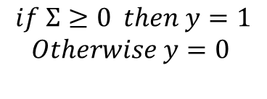
Example Problem
Will I pass this course?
Let’s start with a simple two feature model
$x_{1}=Number of lectures you attend$
$x_{2}=Hours spent on the final project$
$$x_{0=1}$$
How to fix threshold?
$$x_{1}$$
$$w_{0=−10}$$
$$w_{1=1}$$
$$Σ$$
$$y$$
$$w_{2=1}$$
$$τ=0$$
$$x_{2}$$
$$if Σ≥0 then y=1$$
$$Otherwise y=0$$

Slide 13
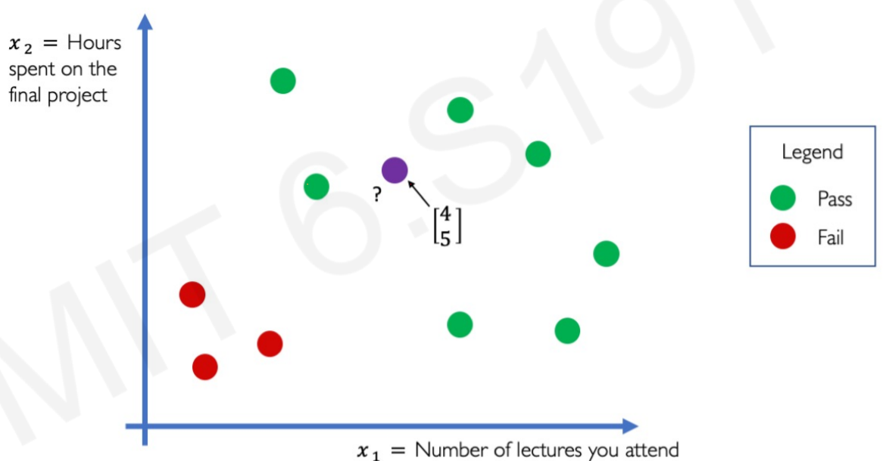



Example Problem
Will I pass this course?
Let’s start with a simple two feature model
$x_{1}=Number of lectures you attend$
$x_{2}=Hours spent on the final project$
$$x_{1}=4$$
$$w_{1=1}$$
$$Σ$$
$y$=0
$$w_{2=1}$$
$$τ=10$$
$$x_{2}=5$$
$$if Σ≥10 then y=1$$
$$Otherwise y=0$$

Slide 14



Example Problem
Will I pass this course?
Let’s start with a simple two feature model
$x_{1}=Number of lectures you attend$
$x_{2}=Hours spent on the final project$
$$x_{0=1}$$
How to fix threshold?
$$x_{1}=4$$
$$b_{=−10}$$
$$w_{1=1}$$
$$Σ$$
$y$=0
$$w_{2=1}$$
$$τ=0$$
$x_{2}$=5
$$if Σ≥0 then y=1$$
$$Otherwise y=0$$

Slide 15
Example Problem
How to implement the model

Slide 16
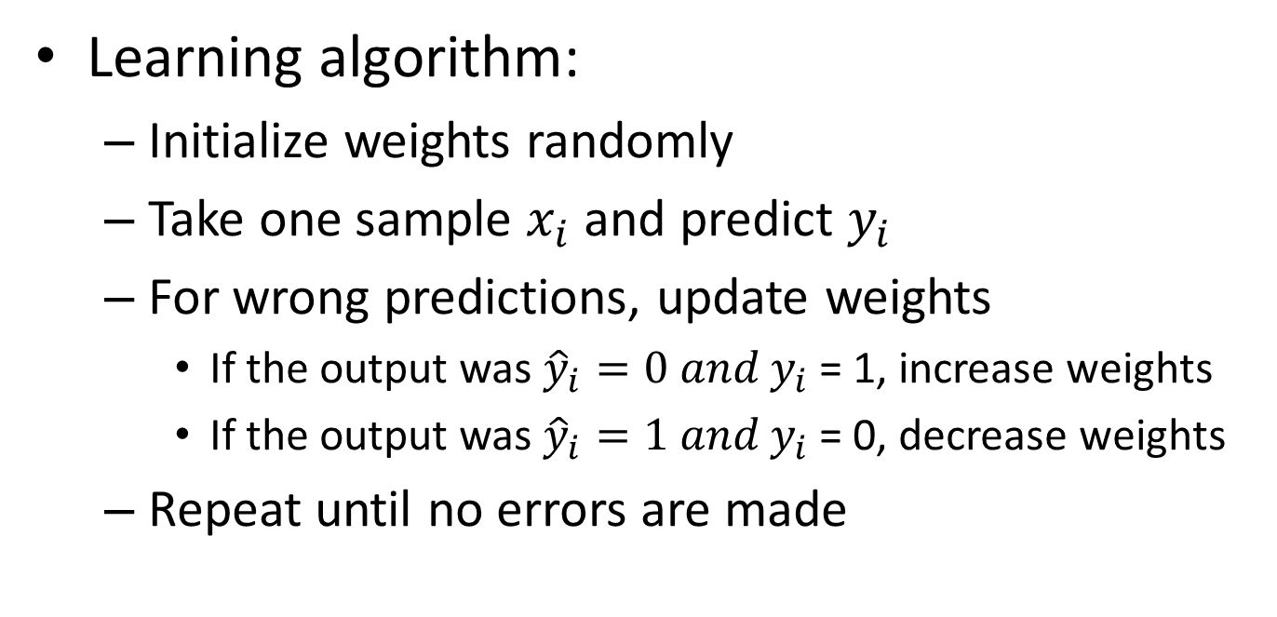
Training a Perceptron
Learning algorithm:
Initialize weights randomly
Take one sample $x_{i}$ and predict $y_{i}$
For wrong predictions, update weights
If the output was ${\hat{y}}_{i}=0 and y_{i}$ = 1, increase weights
If the output was ${\hat{y}}_{i}=1 and y_{i}$ = 0, decrease weights
Repeat until no errors are made

Slide 17
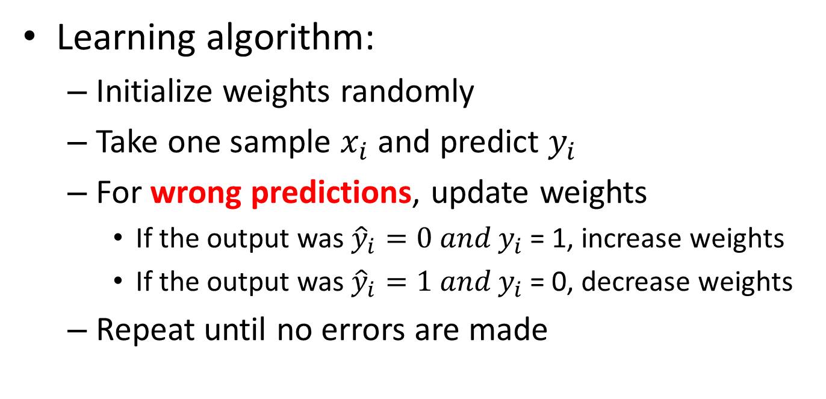
Training a Perceptron
Learning algorithm:
Initialize weights randomly
Take one sample $x_{i}$ and predict $y_{i}$
For wrong predictions, update weights
If the output was ${\hat{y}}_{i}=0 and y_{i}$ = 1, increase weights
If the output was ${\hat{y}}_{i}=1 and y_{i}$ = 0, decrease weights
Repeat until no errors are made
But, how do the algorithm knew that the predictions are wrong?

Slide 18
Training a Perceptron
Learning algorithm:
Initialize weights randomly
Take one sample $x_{i}$ and predict $y_{i}$
For wrong predictions, update weights
If the output was ${\hat{y}}_{i}=0 and y_{i}$ = 1, increase weights
If the output was ${\hat{y}}_{i}=1 and y_{i}$ = 0, decrease weights
Repeat until no errors are made
But, how do the algorithm knew that the predictions are wrong?
Cost function/ loss function tell it

Slide 19
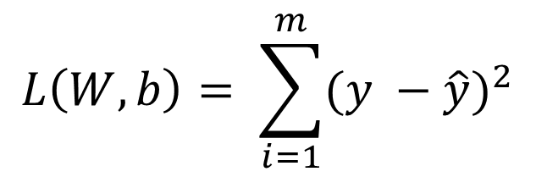
Training a Perceptron
Learning algorithm:
Initialize weights randomly
Take one sample $x_{i}$ and predict $y_{i}$
For wrong predictions, update weights
If the output was ${\hat{y}}_{i}=0 and y_{i}$ = 1, increase weights
If the output was ${\hat{y}}_{i}=1 and y_{i}$ = 0, decrease weights
Repeat until no errors are made
$$L\left(W,b\right)= \sum_{i=1}^{m}{{(y −\hat{y})}^{2}}$$
What is Cost function?

Slide 20
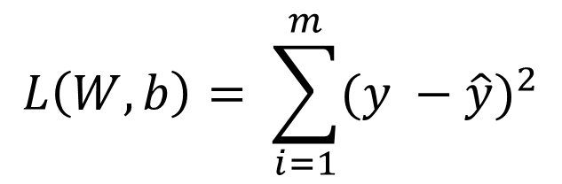
Training a Perceptron
Learning algorithm:
Initialize weights randomly
Take one sample $x_{i}$ and predict $y_{i}$
For wrong predictions, update weights
If the output was ${\hat{y}}_{i}=0 and y_{i}$ = 1, increase weights
If the output was ${\hat{y}}_{i}=1 and y_{i}$ = 0, decrease weights
Repeat until no errors are made
Actual class
Predicted class
$$L\left(W,b\right)= \sum_{i=1}^{m}{{(y −\hat{y})}^{2}}$$
What is Cost function?

Slide 21
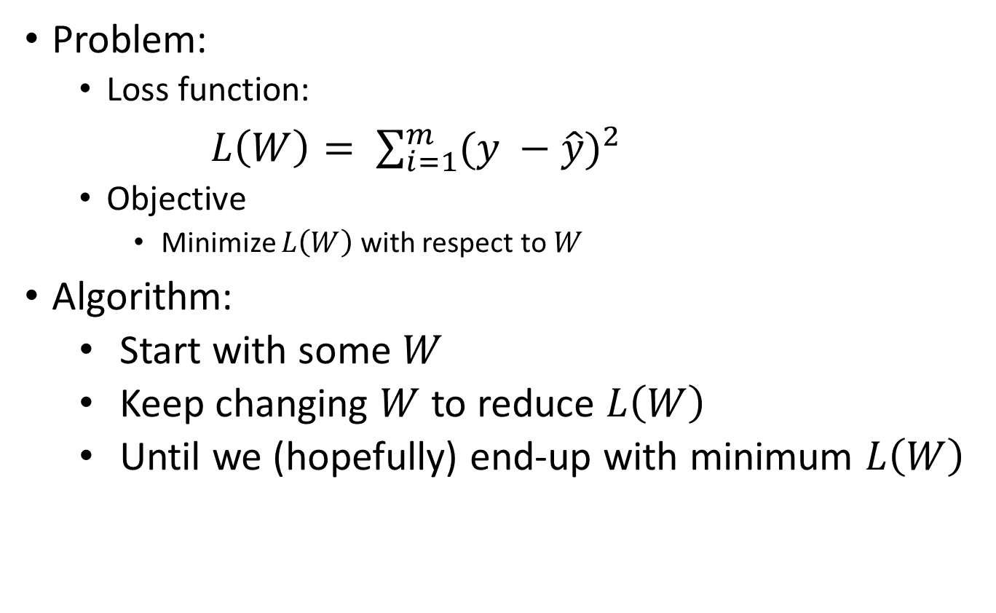
Learning Problem
Problem:
Loss function:
$L\left(W\right)= \sum_{i=1}^{m}{{(y −\hat{y})}^{2}}$
Objective
Minimize $L\left(W\right)$ with respect to $W$
Algorithm:
Start with some $W$
Keep changing $W$ to reduce $L\left(W\right)$
Until we (hopefully) end-up with minimum $L\left(W\right)$

Slide 22
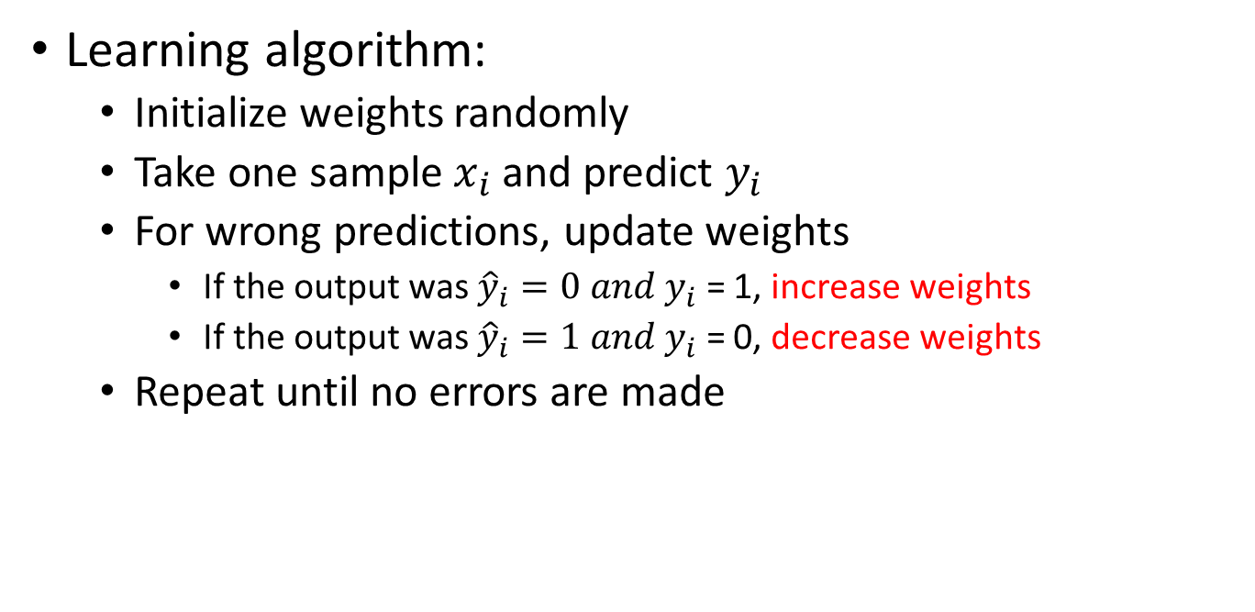
Training a Perceptron
Learning algorithm:
Initialize weights randomly
Take one sample $x_{i}$ and predict $y_{i}$
For wrong predictions, update weights
If the output was ${\hat{y}}_{i}=0 and y_{i}$ = 1, increase weights
If the output was ${\hat{y}}_{i}=1 and y_{i}$ = 0, decrease weights
Repeat until no errors are made
How much weights to increase or decrease ?

Slide 23
Training a Perceptron
Learning algorithm:
Initialize weights randomly
Take one sample $x_{i}$ and predict $y_{i}$
For wrong predictions, update weights
If the output was ${\hat{y}}_{i}=0 and y_{i}$ = 1, increase weights
If the output was ${\hat{y}}_{i}=1 and y_{i}$ = 0, decrease weights
Repeat until no errors are made
Gradient Decent Algorithm

Slide 24
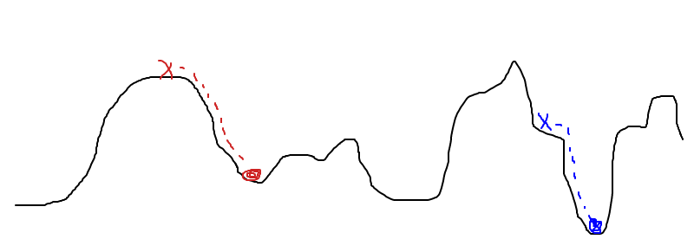



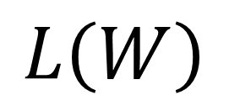

Hill-Descent
$$w$$
$$Σ$$
$$y$$
$$L\left(W\right)$$
$$x$$
$$τ$$
$$L\left(W\right)$$
$$W$$
“Climbing down from Everest in thick fog with amnesia"

Slide 25
Hill-Descent
$$L\left(W\right)$$
$$W$$
Question 1: What we need to take a step downwards ?

Slide 26
Hill-Descent
$$L\left(W\right)$$
$$W$$
Question 1: What we need to take a step downwards ?: Direction and step size

Slide 27
Hill-Descent
$$L\left(W\right)$$
$$W$$
Question 1: What we need to take a step downwards ?: Direction and step size

Slide 28
Hill-Descent
$$L\left(W\right)$$
$$W$$
Question 2: How do we find direction of decreasing $L\left(W\right)$?

Slide 29
From Hill-Descent to Gradient-Descent
$$L\left(W\right)$$
$$W$$
Question 2: How do we find direction of decreasing $L\left(W\right)$?: $\frac{∂(L\left(W\right))}{∂W}$

Slide 30

From Hill-Descent to Gradient-Descent
$$α$$
$$L\left(W\right)$$
$$\frac{∂(L\left(W\right))}{∂W}$$
$$W$$
Knowing direction is not enough, we take a step towards the direction: $α\frac{∂(L\left(W\right))}{∂W}$

Slide 31
From Hill-Descent to Gradient-Descent
$$α$$
$$L\left(W\right)$$
- $\frac{∂(L\left(W\right))}{∂W}$
$$W$$
Knowing direction is not enough, we take a step towards the direction: $−α\frac{∂(L\left(W\right))}{∂W}$

Slide 32
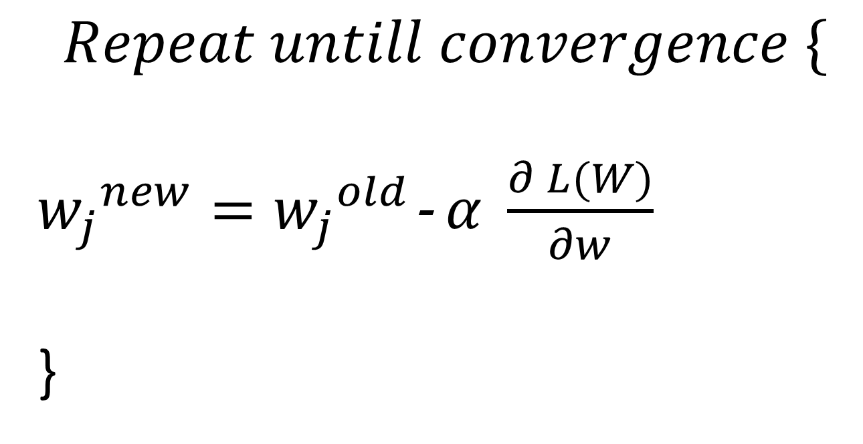
Gradient-Descent Algorithm
$$Repeat untill convergence \{$$
${w_{j}}^{new}={w_{j}}^{old}$- $α \frac{∂ L(W)}{∂w}$
}

Slide 33

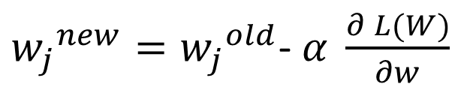

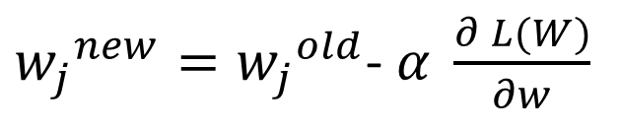


Gradient-Descent Algorithm: Why It Works ?
${w_{j}}^{new}={w_{j}}^{old}$- $α \frac{∂ L(W)}{∂w}$
$$L{(w}_{j})$$
$$w_{j}$$
${w_{j}}^{new}={w_{j}}^{old}$- $α \frac{∂ L(W)}{∂w}$
$$L(w_{j})$$
$$w_{j}$$

Slide 34
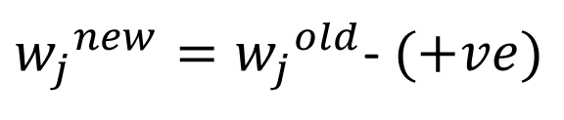


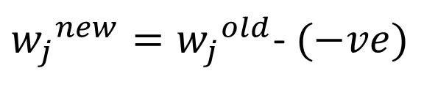
Gradient-Descent Algorithm: Why It Works ?
${w_{j}}^{new}={w_{j}}^{old}$- $α \frac{∂ L(W)}{∂w}$
$$L{(w}_{j})$$
${w_{j}}^{new}={w_{j}}^{old}$- $(+ve)$
$$w_{j}$$
$${w_{j}}^{new}<{w_{j}}^{old}$$
${w_{j}}^{new}={w_{j}}^{old}$- $α \frac{∂ L(W)}{∂w}$
$$L(w_{j})$$
${w_{j}}^{new}={w_{j}}^{old}$- $(−ve)$
$${w_{j}}^{new}>{w_{j}}^{old}$$
$$w_{j}$$

Slide 35

Gradient-Descent Algorithm: Why It Works ?
${w_{j}}^{new}={w_{j}}^{old}$- $α \frac{∂ L(W)}{∂w}$
$$L{(w}_{j})$$
$${w_{j}}^{new}={w_{j}}^{old}$$
Why ?
$$w_{j}$$

Slide 36


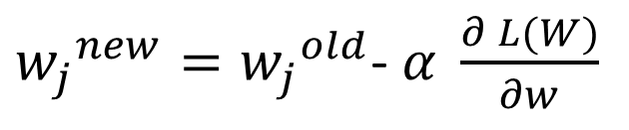


Gradient Descent Algorithm: Semantics of Learning Rate
${w_{j}}^{new}={w_{j}}^{old}$- $α \frac{∂ L(W)}{∂w}$
$$L{(w}_{j})$$
$$w_{j}$$
${w_{j}}^{new}={w_{j}}^{old}$- $α \frac{∂ L(W)}{∂w}$
$$L{(w}_{j})$$
$$w_{j}$$

Slide 37
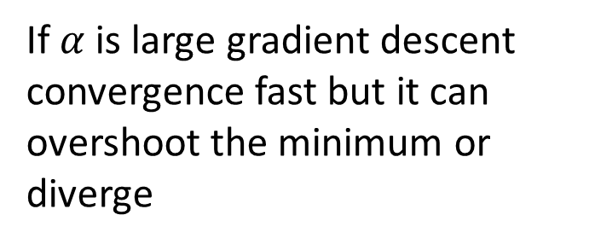
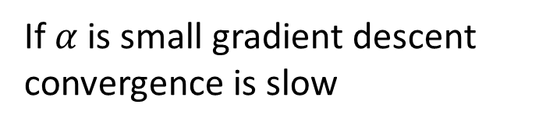
Gradient Descent Algorithm: Semantics of Learning Rate
${w_{j}}^{new}={w_{j}}^{old}$- $α \frac{∂ L(W)}{∂w}$
$$L{(w}_{j})$$
If $α$ is small gradient descent convergence is slow
$$w_{j}$$
${w_{j}}^{new}={w_{j}}^{old}$- $α \frac{∂ L(W)}{∂w}$
If $α$ is large gradient descent convergence fast but it can overshoot the minimum or diverge
$$L{(w}_{j})$$
$$w_{j}$$

Slide 38
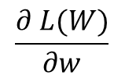

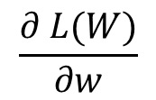

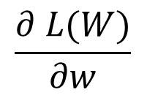
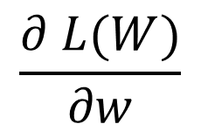
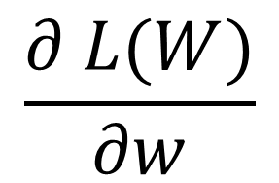

Convergence
$$\frac{∂ L(W)}{∂w}$$
$$\frac{∂ L(W)}{∂w}$$
$$L{(w}_{j})$$
$$\frac{∂ L(W)}{∂w}$$
$$w_{j}$$
$$\frac{∂ L(W)}{∂w}$$
$$\frac{∂ L(W)}{∂w}$$
$$\frac{∂ L(W)}{∂w}$$

Slide 39
Convergence
$$\frac{∂ L(W)}{∂w}$$
$$\frac{∂ L(W)}{∂w}$$
$$L{(w}_{j})$$
$$\frac{∂ L(W)}{∂w}$$
$$w_{j}$$
As it approaches to local minimum, gradient descent automatically takes smaller steps
$$\frac{∂ L(W)}{∂w}$$
$$\frac{∂ L(W)}{∂w}$$
$$\frac{∂ L(W)}{∂w}$$

Slide 40

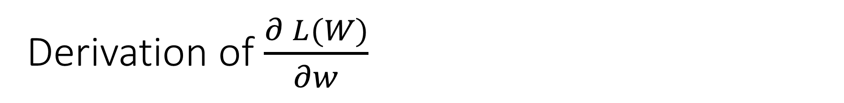
Derivation of $\frac{∂ L(W)}{∂w}$
Loss function:
$L\left(W\right)= \sum_{i=1}^{m}{{(y −\hat{y})}^{2}}$
$\frac{∂ L(W)}{∂w}$ = $\frac{∂\sum_{i=1}^{m}{{(y −\hat{y})}^{2}}}{∂w}$ = …

Slide 41
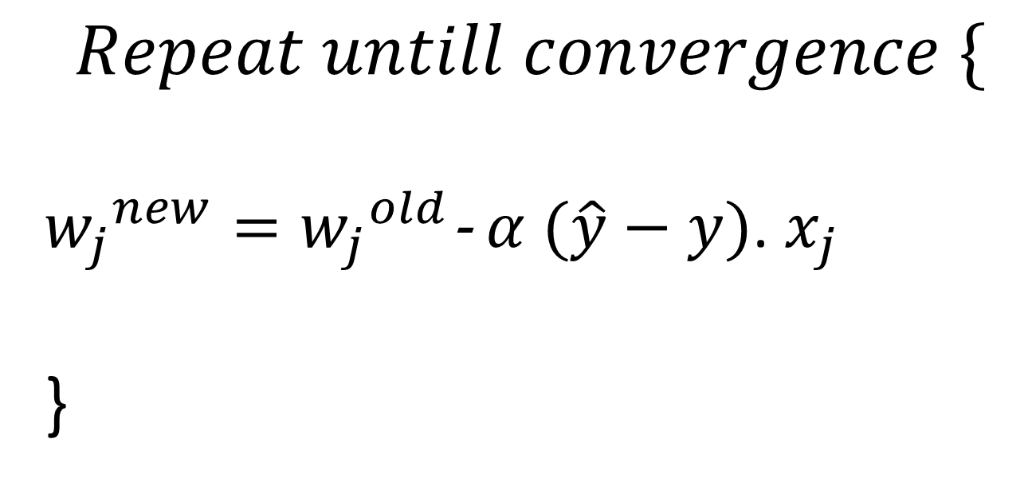
Gradient-Descent Algorithm
$$Repeat untill convergence \{$$
${w_{j}}^{new}={w_{j}}^{old}$- $α (\hat{y}−y)$. $x_{j}$
}

Slide 42
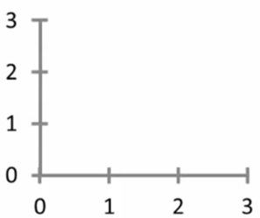


Perceptron Decision Boundary: Linear
Single input neuron
$$w_{1}$$
$$x_{1}$$
∑
$$\hat{y}$$
$$w_{1}=0.5$$
$$\hat{y}$$
$$x_{1}$$

Slide 43
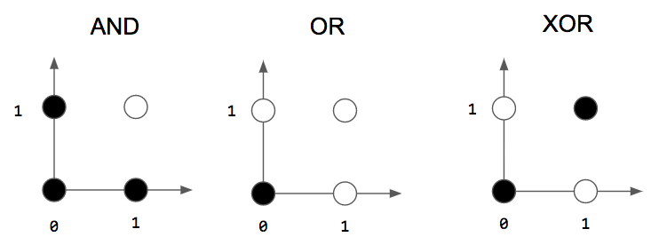
Linearly and Nonlinearly Separable Problem

Slide 44
Implementing AND with Perceptron
$${x }_{1}$$
$${w }_{1}=1$$
$$\hat{y }$$
$${∑= w }_{1}{x }_{1}+{w }_{2}{x }_{2}$$
$$=2$$
$${x }_{2}$$
${w }_{2}=$ 1
$≥2 then\hat{y }$ = 1
$else \hat{y }$ = 0

Slide 45
Implementing OR with Perceptron
$${x }_{1}$$
$${w }_{1}=1$$
$$\hat{y }$$
$${∑= w }_{1}{x }_{1}+{w }_{2}{x }_{2}$$
$$=1$$
$${x }_{2}$$
${w }_{2}=$ 1
$≥1 then\hat{y }$ = 1
$else \hat{y }$ = 0

Slide 46
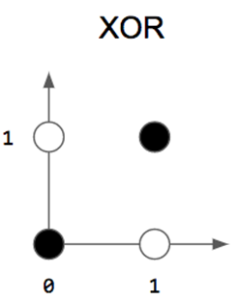
Implementing XOR with Perceptron

Slide 47
Implementing XOR with Perceptron

Slide 48
Implementing XOR with Perceptron
We cannot because XOR is nonlinearly separable

Slide 49
Implementing XOR with Multi-Perceptron
Perceptron # 2
Perceptron # 1

Slide 50
Nonlinearly Separable Problems and Multi-perceptron
Decision rule:
if ∑ of P1 < 0 -> black
elseif ∑ of P2 > 0 -> black
else white
Perceptron # 2
Perceptron # 1

Slide 51









Multi-perceptron Architecture
Perceptron # 1
$$w_{11}$$
$$x_{1}$$
∑
$$w_{11}$$
$$w_{12}$$
$$\hat{y}$$
∑
$$w_{21}$$
$$x_{2}$$
$$w_{22}$$
$$w_{21}$$
∑
Perceptron # 2
Perceptron # 3

Slide 52
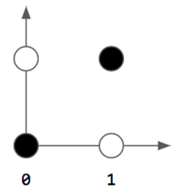
Multi-perceptron Architecture
Perceptron # 1
$$w_{11}$$
$$x_{1}$$
∑
$$w_{11}$$
$$w_{12}$$
$$\hat{y}$$
∑
$$w_{21}$$
$$x_{2}$$
$$w_{22}$$
$$w_{21}$$
∑
Perceptron # 2
Perceptron # 3

Slide 53

Nonlinearity is Important
Perceptron 1: ${w }_{11}{x }_{1}+{w }_{21}{x }_{2}$
Perceptron 2: ${w }_{12}{x }_{1}+{w }_{22}{x }_{2}$
Perceptron 3: ${w }_{11}({w }_{11}{x }_{1}+{w }_{21}{x }_{2})+{w }_{21}({w }_{12}{x }_{1}+{w }_{22}{x }_{2})$

Slide 54
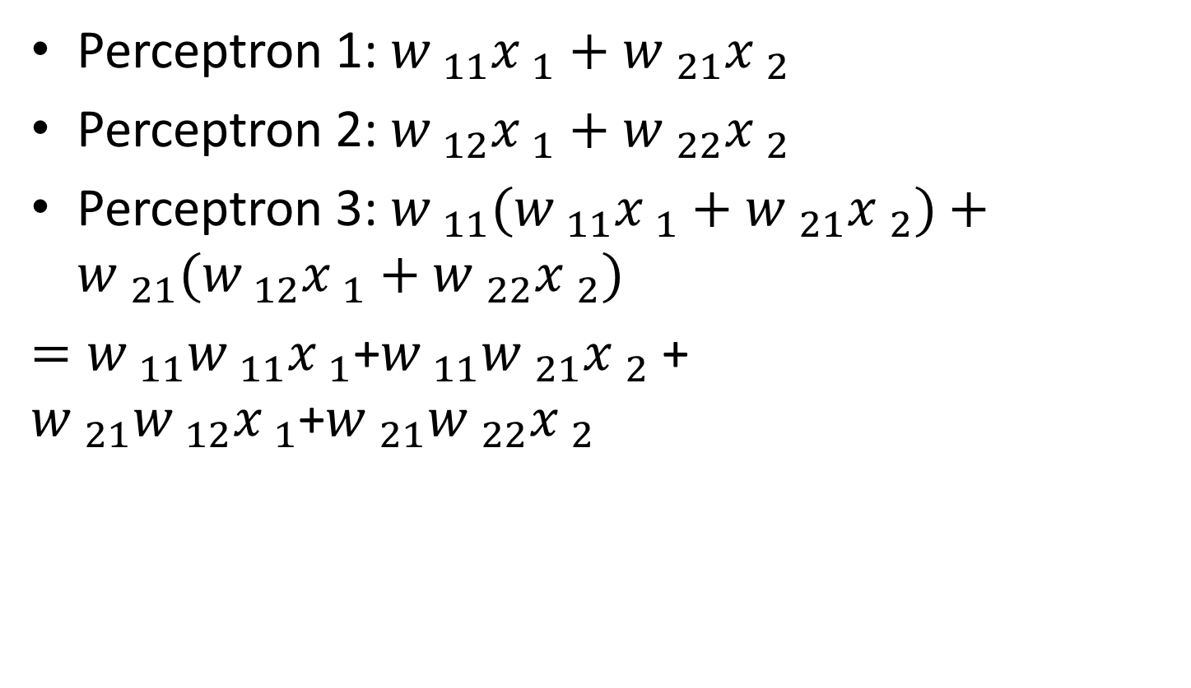
Nonlinearity is Important
Perceptron 1: ${w }_{11}{x }_{1}+{w }_{21}{x }_{2}$
Perceptron 2: ${w }_{12}{x }_{1}+{w }_{22}{x }_{2}$
Perceptron 3: ${w }_{11}({w }_{11}{x }_{1}+{w }_{21}{x }_{2})+{w }_{21}({w }_{12}{x }_{1}+{w }_{22}{x }_{2})$
$={w }_{11}{w }_{11}{x }_{1}$+${w }_{11}{w }_{21}{x }_{2}$ + ${w }_{21}{w }_{12}{x }_{1}$+${w }_{21}{w }_{22}{x }_{2}$

Slide 55
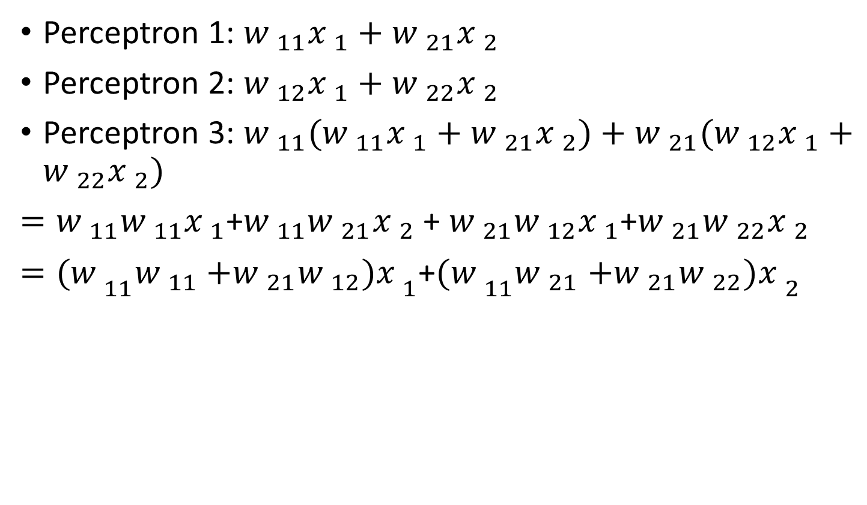
Nonlinearity is Important
Perceptron 1: ${w }_{11}{x }_{1}+{w }_{21}{x }_{2}$
Perceptron 2: ${w }_{12}{x }_{1}+{w }_{22}{x }_{2}$
Perceptron 3: ${w }_{11}({w }_{11}{x }_{1}+{w }_{21}{x }_{2})+{w }_{21}({w }_{12}{x }_{1}+{w }_{22}{x }_{2})$
$={w }_{11}{w }_{11}{x }_{1}$+${w }_{11}{w }_{21}{x }_{2}$ + ${w }_{21}{w }_{12}{x }_{1}$+${w }_{21}{w }_{22}{x }_{2}$
$={(w }_{11}{w }_{11}{+{w }_{21}{w }_{12})x }_{1}$+${(w }_{11}{w }_{21}{+{w }_{21}{w }_{22})x }_{2}$

Slide 56
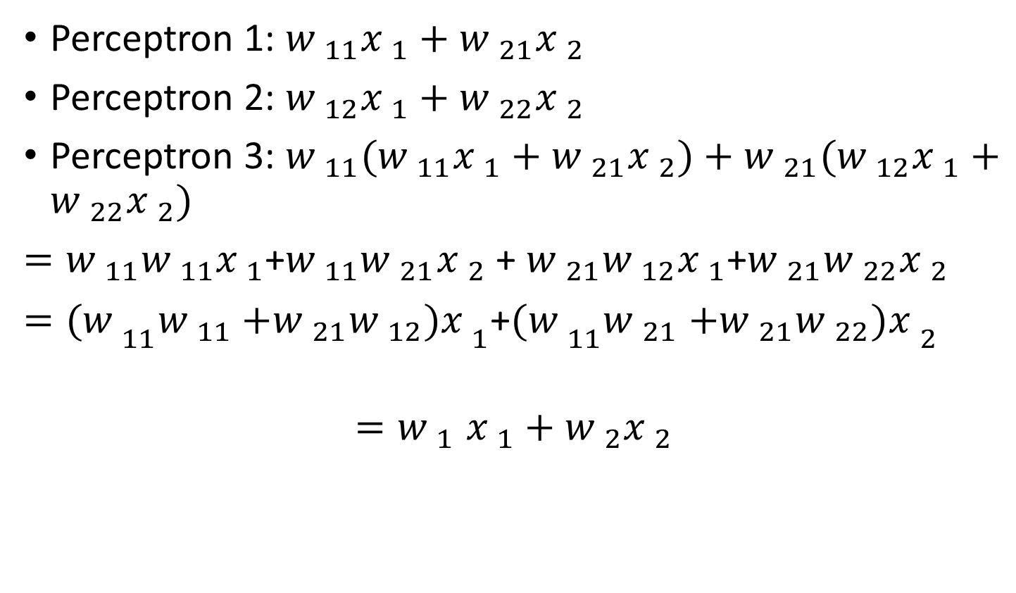
Nonlinearity is Important
Perceptron 1: ${w }_{11}{x }_{1}+{w }_{21}{x }_{2}$
Perceptron 2: ${w }_{12}{x }_{1}+{w }_{22}{x }_{2}$
Perceptron 3: ${w }_{11}({w }_{11}{x }_{1}+{w }_{21}{x }_{2})+{w }_{21}({w }_{12}{x }_{1}+{w }_{22}{x }_{2})$
$={w }_{11}{w }_{11}{x }_{1}$+${w }_{11}{w }_{21}{x }_{2}$ + ${w }_{21}{w }_{12}{x }_{1}$+${w }_{21}{w }_{22}{x }_{2}$
$={(w }_{11}{w }_{11}{+{w }_{21}{w }_{12})x }_{1}$+${(w }_{11}{w }_{21}{+{w }_{21}{w }_{22})x }_{2}$
$${=w }_{1}{x }_{1}+{w }_{2}{x }_{2}$$
Linear function

Slide 57

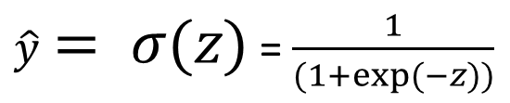
Computational Neuron
$${x }_{1}$$
$${w }_{1}$$
$$a=\hat{y }$$
$${z= w }_{1}{x }_{1}+{w }_{2}{x }_{2}$$
$$a= σ(z)$$
$${x }_{2}$$
$${w }_{2}$$
$\hat{y}= σ(z)$ = $\frac{1}{(1+exp⁡(−z))}$

Slide 58
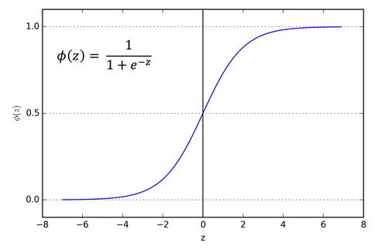
Computational Neuron
$a= σ(z)$ = $\frac{1}{(1+exp⁡(−z))}$

Slide 59
Interpretation
$$a= σ(z)$$
$$a=p\left(y=1\right| x, w)$$
Decision rule:
$$\hat{y}=1, ifa≥0.5$$
$$\hat{y}=0, ifa<0.5$$

Slide 60
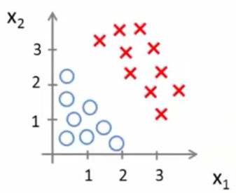
Decision Boundary
$${z={w }_{0}+w }_{1}{x }_{1}+{w }_{2}{x }_{2}$$
$a= σ(z)$ = $σ$(${{w }_{0}+w }_{1}{x }_{1}+{w }_{2}{x }_{2}$)
Suppose
${w }_{0}$ = -3
$${w }_{1}=1$$
$${w }_{2}=1$$
$predict y$= $1 if −3+{x }_{1}+$ ${x }_{2 }≥$ 0

Slide 61
Decision Boundary
$${z={w }_{0}+w }_{1}{x }_{1}+{w }_{2}{x }_{2}$$
$a= σ(z)$ = $σ$(${{w }_{0}+w }_{1}{x }_{1}+{w }_{2}{x }_{2}$)
Suppose
${w }_{0}$ = -3
$${w }_{1}=1$$
$${w }_{2}=1$$
$predict y$= $1 if −3+{x }_{1}+$ ${x }_{2 }≥$ 0

Slide 62
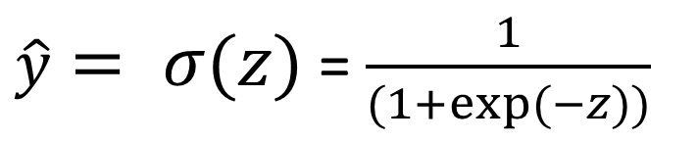

Learning Task
Dataset : $\{\left(x_{1},y_{1}\right),\left(x_{2},y_{2}\right), …(x_{m},y_{m})\}$
Input: $x={{(x}^{1},x^{2}, …,x^{n}) }^{T}$
Classifier
Where
How to choose parameters ?
$\hat{y}= σ(z)$ = $\frac{1}{(1+exp⁡(−z))}$
$${z= w }_{1}x^{1}+{w }_{2}x^{2}+…+{w }_{n}x^{n}$$

Slide 63

Cost Function
$$L\left(W\right)= \frac{1}{m}\sum_{i=1}^{m}{{ ({\hat{y}}_{i} −y_{i})}^{2}}$$

Slide 64




Cost Function
Mean square loss function
$$L\left(W\right)= \frac{1}{m}\sum_{i=1}^{m}{{ ({\hat{y}}_{i}−y_{i})}^{2}}$$
$\hat{y}= σ(z)$ = $\frac{1}{(1+exp⁡(−z))}$

Slide 65

Cost Function
Mean square loss function
$$L\left(W\right)= \frac{1}{m}\sum_{i=1}^{m}{{ ({\hat{y}}_{i}−y_{i})}^{2}}$$
$exp=quad ((exp)$)
$\hat{y}= σ(z)$ = $\frac{1}{(1+exp⁡(−z))}$

Slide 66

Cost Function
Mean square loss function
$$L\left(W\right)= \frac{1}{m}\sum_{i=1}^{m}{{ ({\hat{y}}_{i}−y_{i})}^{2}}$$

Slide 67

Cost Function
Mean square loss function
$$L\left(W\right)= \frac{1}{m}\sum_{i=1}^{m}{{ ({\hat{y}}_{i}−y_{i})}^{2}}$$
$$L\left(W\right)=Cost ({\hat{y}}_{i},y)\text{ =} { ({\hat{y}}_{i}−y_{i})}^{2}$$

Slide 68

Cost Function
Mean square loss function
$$L\left(W\right)= \frac{1}{m}\sum_{i=1}^{m}{{ ({\hat{y}}_{i}−y_{i})}^{2}}$$
$$L\left(W\right)=Cost ({\hat{y}}_{i},y)\text{ =} { ({\hat{y}}_{i}−y_{i})}^{2}$$
$$Cost \left({\hat{y}}_{i},y\right)= −\log\left(\hat{y}\right) if y=1$$
$−\log\left(1−\hat{y}\right) if y=0$

Slide 69


Cost Function
Mean square loss function
$$L\left(W\right)= \frac{1}{m}\sum_{i=1}^{m}{{ ({\hat{y}}_{i}−y_{i})}^{2}}$$
$$L\left(W\right)=Cost ({\hat{y}}_{i},y)\text{ =} { ({\hat{y}}_{i}−y_{i})}^{2}$$
$$Cost \left({\hat{y}}_{i},y\right)= −\log\left(\hat{y}\right) if y=1$$
$−\log\left(1−\hat{y}\right) if y=0$
Cost = 0 if y = 1, a = 1
But as $\hat{y}$ -> 0
Cost -> ∞

Slide 70


Cost Function
Mean square loss function
$$L\left(W\right)= \frac{1}{m}\sum_{i=1}^{m}{{ ({\hat{y}}_{i}−y_{i})}^{2}}$$
$$L\left(W\right)=Cost ({\hat{y}}_{i},y)\text{ =} { ({\hat{y}}_{i}−y_{i})}^{2}$$
$$Cost \left({\hat{y}}_{i},y\right)= −\log\left(\hat{y}\right) if y=1$$
$−\log\left(1−\hat{y}\right) if y=0$
Cost = 0 if y = 0, a = 0
But as $\hat{y}$ -> 1
Cost -> ∞

Slide 71


Cost Function
Mean square loss function
$$L\left(W\right)= \frac{1}{m}\sum_{i=1}^{m}{{ ({\hat{y}}_{i}−y_{i})}^{2}}$$
$$L\left(W\right)=Cost ({\hat{y}}_{i},y)\text{ =} { ({\hat{y}}_{i}−y_{i})}^{2}$$
$$Cost \left({\hat{y}}_{i},y\right)= −\log\left(\hat{y}\right) if y=1$$
$−\log\left(1−\hat{y}\right) if y=0$
$$J\left(W\right)=−\frac{1}{m}\sum_{i=1}^{m}{\operatorname{ylog}{(\hat{y})}}+\left(1−y\right)log\left(1−\hat{y}\right)$$

Slide 72

Cost Function
Mean square loss function
$$L\left(W\right)= \frac{1}{m}\sum_{i=1}^{m}{{ ({\hat{y}}_{i}−y_{i})}^{2}}$$
$$L\left(W\right)=Cost ({\hat{y}}_{i},y)\text{ =} { ({\hat{y}}_{i}−y_{i})}^{2}$$
$$Cost \left({\hat{y}}_{i},y\right)= −\log\left(\hat{y}\right) if y=1$$
$−\log\left(1−\hat{y}\right) if y=0$
$$J\left(W\right)=−\frac{1}{m}\sum_{i=1}^{m}{\operatorname{ylog}{(\hat{y})}}+\left(1−y\right)log\left(1−\hat{y}\right)$$
Cross-entropy loss function

Slide 73

Learning Parameters: Gradient Descent Algorithm
$$J\left(W\right)=−\frac{1}{m}\sum_{i=1}^{m}{\operatorname{ylog}{(\hat{y})}}+\left(1−y\right)log\left(1−\hat{y}\right)$$
$$Repeat \{$$
$$W_{i}←W_{i}+∆W_{i}$$
$∆W_{i}=α(\hat{y}−y)$ $x_{i}$
$$\}$$

Slide 74
Nonlinear Classification Example: XOR/XNOR

Slide 75
Nonlinear Classification Example: XOR/XNOR

Slide 76
Nonlinear Classification Example: XOR/XNOR

Slide 77
Simple Example: AND

Slide 78
Simple Example: AND
Notes:
-30,+20,+20

Slide 79
Simple Example: AND
Notes:
-30,+20,+20

Slide 80
Example: OR Function

Slide 81
Example: Negation Function
Notes:
General idea: put negative weight in front of variable to negate

Slide 82
Example: Negation Function
Design a Network to model:
Notes:
General idea: put negative weight in front of variable to negate

Slide 83
x1 XNOR x2

Slide 84
x1 XNOR x2

