Slide 1

QRah-e-Shifa (Route to Cure)
Ambulance deployment and Hospital allocation for rapid Emergency Response

Slide 2



SDGs Alignment
SDGs Alignment
SDG 03 – Good health and Well Being
SDG 11 – Sustainable Cities and Communities
SDG 16.6 – Strong Institutions
Notes:
SDG 11---- improves urban emergency mobility, making cities safer
SDG 16---
Target 16.6 (effective, accountable institutions)
QAOA: Quantum Approximation Optimization Algorithm

Slide 3
Objectives
Objectives
Minimize response time of Ambulance
Optimized Ambulances to cater all patient
Notes:
SDG 11---- improves urban emergency mobility, making cities safer
SDG 16---
Target 16.6 (effective, accountable institutions)
QAOA: Quantum Approximation Optimization Algorithm

Slide 4
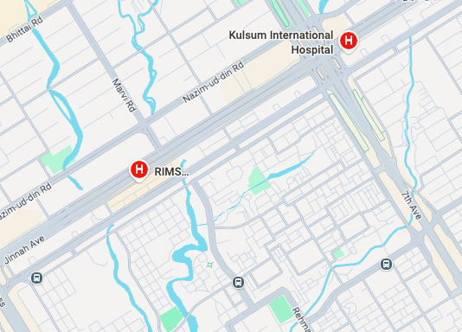
Best Route
Notes:
SDG 11---- improves urban emergency mobility, making cities safer
SDG 16---
Target 16.6 (effective, accountable institutions)
QAOA: Quantum Approximation Optimization Algorithm

Slide 5
Optimizing cases
Accident
Ambulance
Notes:
SDG 11---- improves urban emergency mobility, making cities safer
SDG 16---
Target 16.6 (effective, accountable institutions)
QAOA: Quantum Approximation Optimization Algorithm

Slide 6
Optimizing cases
Accident
Ambulance
L
A
K
B
Notes:
SDG 11---- improves urban emergency mobility, making cities safer
SDG 16---
Target 16.6 (effective, accountable institutions)
QAOA: Quantum Approximation Optimization Algorithm

Slide 7
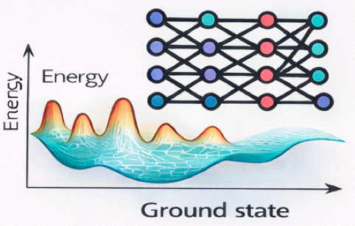
Physics Interpretation
Physics Interpretation
Optimization ↔ energy minimization
Ground state = Optimal solution
Notes:
SDG 11---- improves urban emergency mobility, making cities safer
SDG 16---
Target 16.6 (effective, accountable institutions)
QAOA: Quantum Approximation Optimization Algorithm

Slide 8



Problem Set
Variables:
Accidents: i ∈{1,…,N}
Ambulances: j ∈{1,…,M}
Hospitals: k ∈{1,…,K}
Notes:
SDG 11---- improves urban emergency mobility, making cities safer
SDG 16---
Target 16.6 (effective, accountable institutions)
QAOA: Quantum Approximation Optimization Algorithm

Slide 9
Constraints
1 ambulance = 1 accident
1 accident = 1 hospital
Hospital Specialty (ICU, CCU, burn, Maternity)
Hospital Capacity
Notes:
SDG 11---- improves urban emergency mobility, making cities safer
SDG 16---
Target 16.6 (effective, accountable institutions)
QAOA: Quantum Approximation Optimization Algorithm

Slide 10


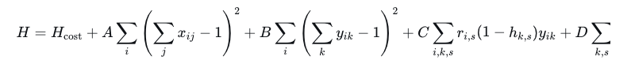

QUBO Formulation
Notes:
SDG 11---- improves urban emergency mobility, making cities safer
SDG 16---
Target 16.6 (effective, accountable institutions)
QAOA: Quantum Approximation Optimization Algorithm

