Slide 1
FMCG ERP
Analytics
Portfolio snapshot
£358.12M
Net Sales
SQL Server + Power BI portfolio project
£114.50M
End-to-end analysis of a synthetic FMCG ERP dataset covering sales, customers, service, inventory, manufacturing and suppliers.
Contribution
61.14%
LINE OTIF
SQL Server
Power BI
DAX
Power Query
£531.8K
2024–2025 reporting period • 7 ERP source tables • 597K raw rows
Unfulfilled Order Value
Synthetic data • Built for portfolio demonstration

Slide 2
Project scope & business questions
Built to show end-to-end analytics skills, not just dashboard design.
DATASET
597K
7
12
731
4
Raw source rows
ERP source tables
BI model tables
Calendar days
Factory / warehouse pairs
MANAGEMENT THEMES
Commercial
Service
Inventory
Operations
Sales growth
Margin pressure
Customer profitability
Promotion performance
LINE OTIF
Carrier lateness
Unfulfilled demand
Safety stock
Days of cover
Warehouse write-offs
Plan attainment
Downtime & rejects
Supplier timeliness & PPV
Key modelling rule: keep facts separate, use dimension-to-fact relationships, and apply the correct date role for each process.
Examples: DispatchDate for invoiced sales/COGS • ReturnDate for credits • SnapshotDate for inventory • ProductionDate for manufacturing • ActualReceiptDate for procurement

Slide 3
Data engineering & SQL workflow
Raw files were preserved, profiled, validated and converted into a reporting layer for Power BI.
01
02
03
04
05
06
Raw CSVs
SQL staging
Profiling
Cleaning
Validation
Reporting views
7 source files
Typed imports
Keys, NULLs, ranges
Standardised labels
Reconciled balances
Facts + dimensions
VALIDATION HIGHLIGHTS
145,527
168,005
175,440
Data quality handled explicitly
Sales order lines
Delivery allocations
Inventory snapshots
123 Channel labels standardised
106 missing sales reps reported as “Unassigned”
Split deliveries handled without double-counting demand
Inventory equation reconciled daily
Invoice and procurement arithmetic validated
58,480
17,544
20,188
Production batches
Procurement receipts
Return lines
SQL skills demonstrated
CTEs
joins at correct grain
conditional aggregation
window functions
date logic
reconciliation

Slide 4
Power BI model & analytical layer
A manually controlled star-style model with explicit measures and business-safe date roles.
DimCustomer
DimProduct
DimDate
DimLocation
DimSupplier
DimMaterial
FactSalesOrders
FactDeliveries
FactReturns
FactProduction
FactInventory
FactProcurement
Demand
Revenue / COGS
Credits
Manufacturing
Stock
Suppliers
Dimensions filter facts (1 → *) • single-direction • no fact-to-fact relationships
Measures built
Key Power BI skills
Net Sales • Gross Profit • Contribution • Gross / Contribution Margin • LINE OTIF • Unfulfilled Cases / Value • Plan Attainment • Rejection Rate • Downtime • Supplier On-Time % • PPV
DAX
Power Query
relationships
date table
conditional formatting
custom visuals

Slide 5
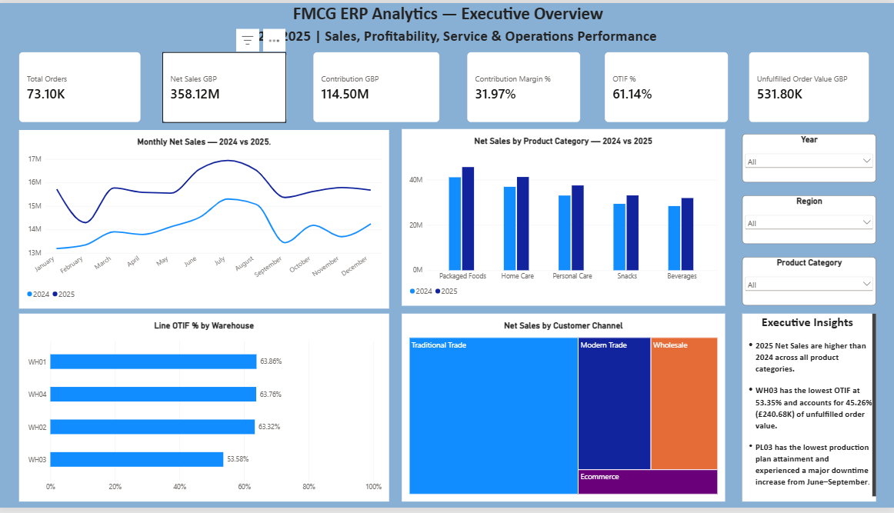
Executive Overview
A management-level summary of commercial performance, profitability and service risk.
HEADLINE KPIS
Net Sales
Contribution
£358.12M
£114.50M
Contribution Margin
LINE OTIF
31.97%
61.14%
EXECUTIVE TAKEAWAYS
2025 Net Sales exceeded 2024 across all product categories.
WH03 had the weakest LINE OTIF at 53.58%.
Unfulfilled order value reached £531.8K; WH03 accounted for ~45%.
Traditional Trade remained the largest customer channel.

Slide 6
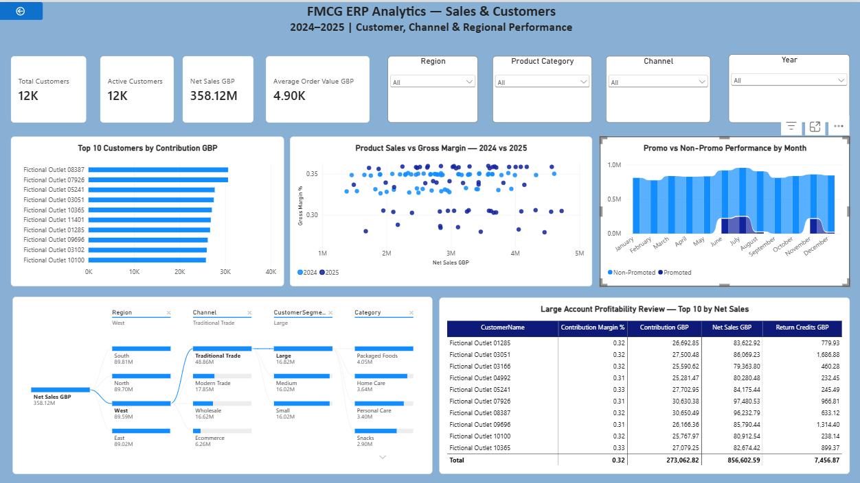
Sales & Customers
Customer profitability, margin pressure and interactive sales-driver analysis.
WHAT THIS PAGE DEMONSTRATES
Top customers ranked by contribution, not just revenue.
Large-account review combines Net Sales, Contribution Margin and Return Credits.
Product sales vs Gross Margin scatter highlights margin pressure.
Decomposition Tree supports drill-down by Region → Channel → Segment → Category.
Recruiter signal
Shows commercial thinking: profitability, margin, customer concentration and interactive root-cause exploration.

Slide 7
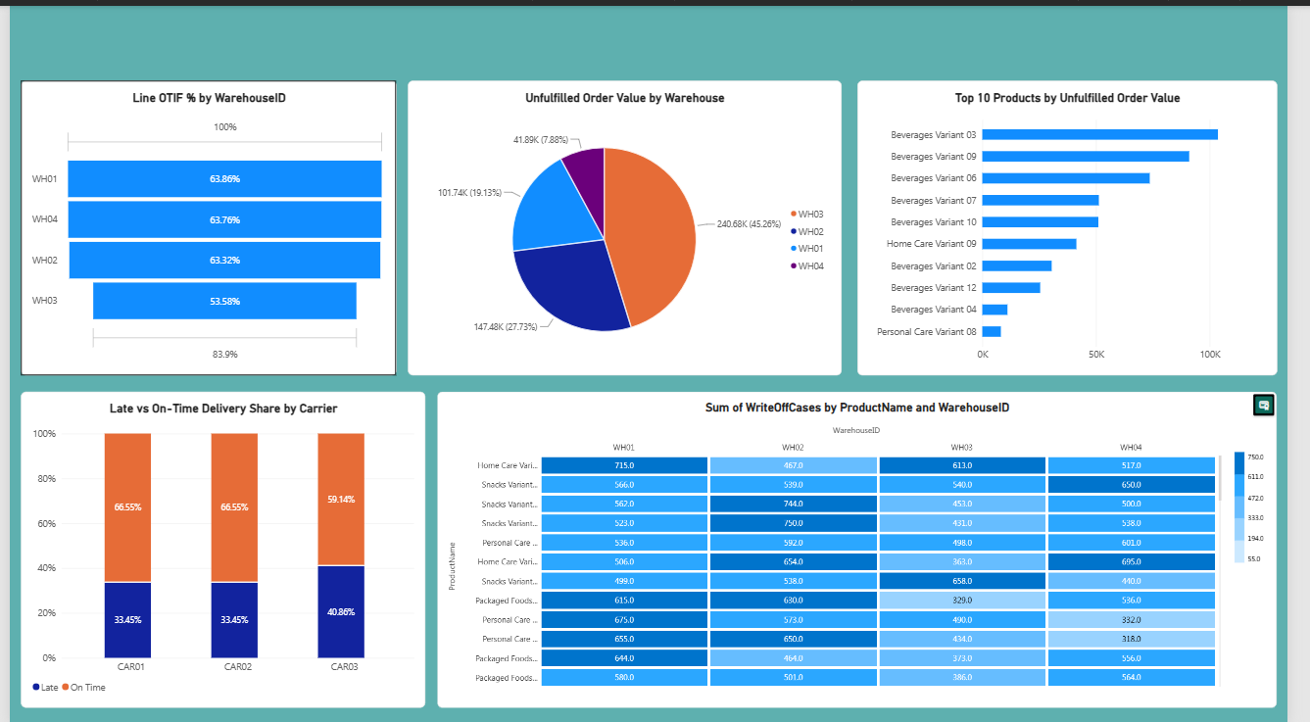
Supply & Service
Service performance, carrier reliability, shortages and warehouse loss signals.
OPERATIONAL FINDINGS
WH03 LINE OTIF: 53.58% — lowest of the four warehouses.
CAR03 late-delivery share: 40.86% vs 33.45% for CAR01/CAR02.
WH03 contributed 45.26% (£240.68K) of unfulfilled order value.
Beverages Variant 03 was the largest product-level shortage exposure.
Warehouse write-offs were profiled by product and location.
19K
£531.8K
Unfulfilled cases
Unfulfilled order value

Slide 8
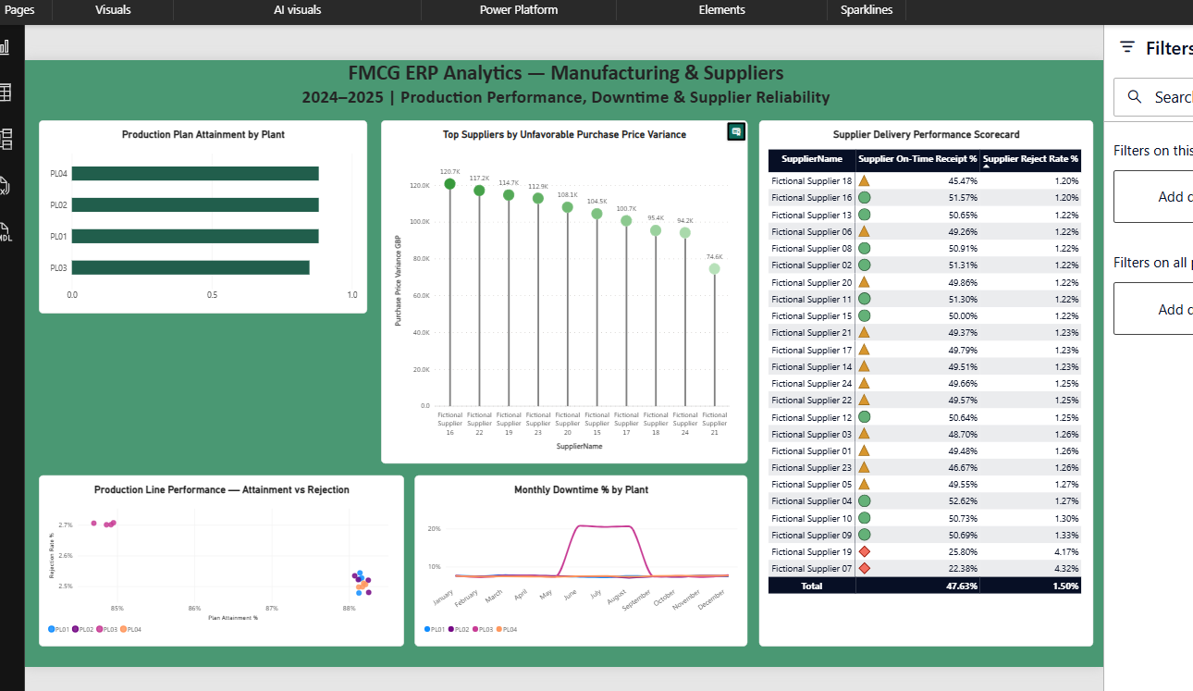
Manufacturing & Suppliers
Production efficiency, downtime deterioration and supplier reliability / price variance.
OPERATIONAL FINDINGS
PL03 had the lowest production-plan attainment.
PL03 also showed the highest rejection rate cluster.
Downtime on PL03 spiked to ~20% from June through September.
Supplier on-time performance averaged ~47.6% across received POs.
Supplier 07 and Supplier 19 were clear timeliness outliers.
Unfavourable PPV was concentrated among a small set of suppliers.
Storytelling choice
Used a lollipop visual for supplier PPV to avoid repeating standard bars and tables.

Slide 9
What this project demonstrates
A recruiter-ready summary of the skills evidenced by the work.
SQL & Data Quality
Data Modelling
DAX & Power Query
Business Storytelling
Database setup & imports
Profiling / validation
Clean reporting views
Correct grain & reconciliation
Star-style schema
Manual relationships
Date roles
No fact-to-fact joins
Profitability measures
LINE OTIF logic
Unfulfilled demand
Promo / delivery enrichment
4 management pages
Interactive drill-downs
Custom visuals
Evidence-based insights
Recruiter takeaway
I can take messy operational data from raw files to validated SQL, a controlled BI model, explicit DAX measures and management-ready insights.
Suggested GitHub contents: SQL scripts • project documentation • PBIX / report screenshots • this presentation • README with verified findings and limitations

