Slide 1
END-TO-END ANALYTICS PORTFOLIO
Software License
Sales Analytics
Python → PostgreSQL → dbt → Power BI
A business-facing analytics project that cleans raw license-sales data, tests data quality, builds a star schema, and answers revenue, subscription, pipeline, sales-rep and customer questions.
Python
PostgreSQL
dbt
Power BI
Portfolio presentation

Slide 2
Business problem & questions
Turn fragmented operational data into trusted, decision-ready reporting.
BUSINESS QUESTIONS
DELIVERABLE
1
How is net revenue trending, and which products or editions drive it?
Trusted analytics pipeline
2
Reusable Python ingestion into PostgreSQL raw tables
dbt staging models for cleaning and standardisation
Data tests that expose duplicates, invalid references and rule violations
Business-ready marts in a star schema
Two Power BI pages focused on revenue/subscriptions and sales/customers
Documented recommendations for management action
What is the health of the subscription base: active, expired, cancelled and trial?
3
Where is the sales pipeline concentrated, and which reps / accounts need attention?
4
Can management trust the data enough to act on it?

Slide 3
End-to-end architecture
Clear separation between ingestion, data quality, business modelling and reporting.
CSV files
Python
PostgreSQL
dbt staging
dbt tests
dbt marts
6 raw sources
ingest_data.py
raw schema
6 cleaned models
36 data tests
7 star-schema tables
Power BI semantic model & dashboards
Relationships + DAX measures + interactive business analysis
Key design choice: transformations live in dbt; Power BI is primarily the semantic + visual layer.

Slide 4
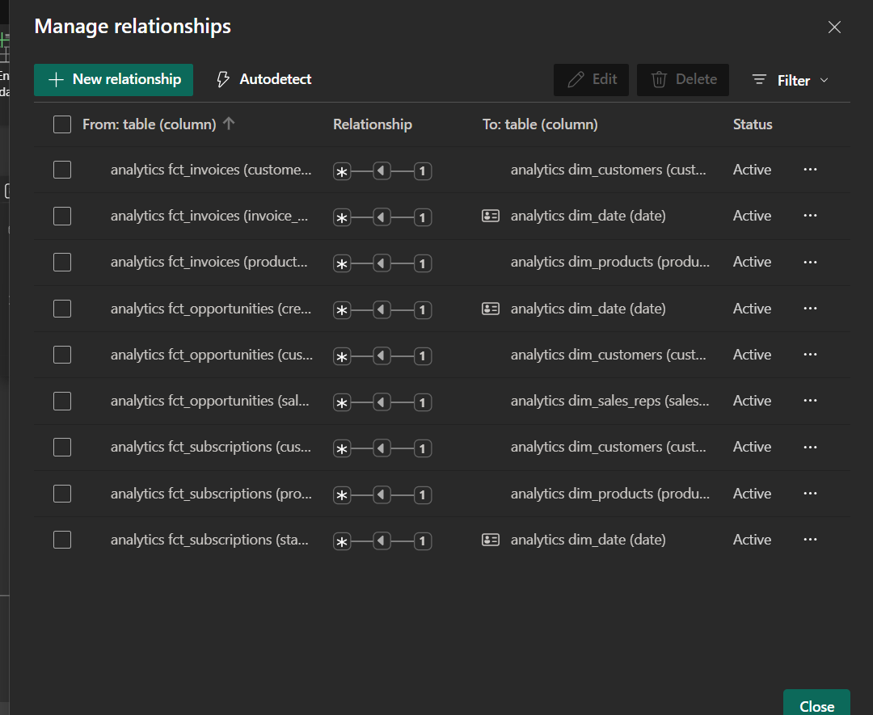
Business-ready star schema
Dimensions describe the business; fact tables store measurable events.
MODEL DESIGN
POWER BI RELATIONSHIPS
dim_customers
fct_invoices
dim_products
fct_subscriptions
dim_sales_reps
fct_opportunities
dim_date
1 → * single-direction filtering
Fact-to-fact relationship removed; dimensions filter facts to keep the model predictable and easy to analyse.

Slide 5
dbt testing turned data problems into explicit rules
The pipeline does not silently hide quality issues.
EXAMPLES OF TEST-DRIVEN CLEANING
FINAL BUILD RESULT
Duplicate customers
3 duplicate customer IDs
Deduplicated in staging; uniqueness test passed
dbt build
Found 13 models, 36 data tests, 6 sources
Done. PASS=45 WARN=4 ERROR=0 TOTAL=49
Known warnings:
• 11 orphan sales-rep references
• 7 missing seat counts
• 5 orphan invoice references
• 13 invalid subscription date ranges
Negative invoice amounts
27 negative values
Normalised with ABS(); custom test passed
Subscription date logic
13 end dates before start
Kept + flagged; custom test downgraded to warning
Missing / orphan references
11 sales reps, 5 invoices
Kept + flagged so BI can exclude or surface them
PASS
WARN
ERROR
45
4
0
Missing seats
7 subscriptions
Known source issue; warning rather than pipeline failure
Tests passed
Known issues
Pipeline healthy
Why warnings instead of forced fixes? The source data did not contain enough information to infer a correct value safely.

Slide 6
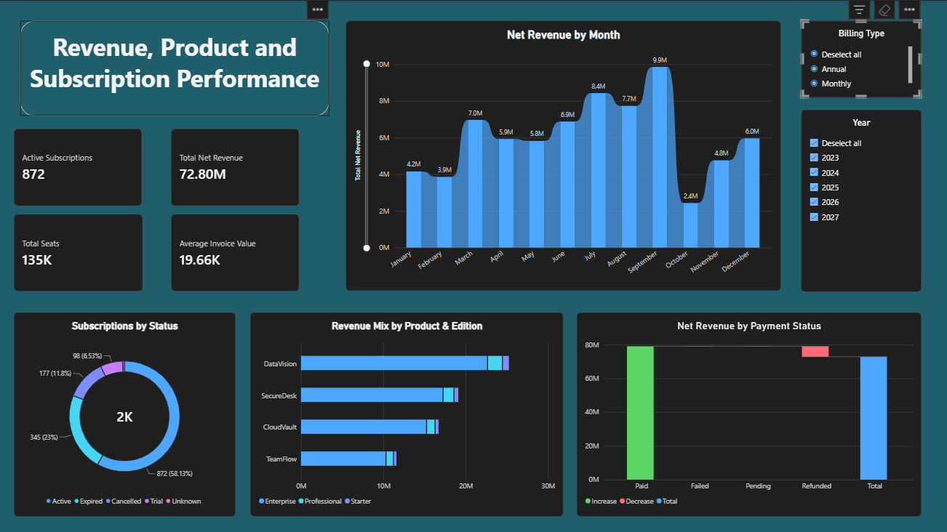
Dashboard 1 — Revenue & Subscriptions
Answers: revenue trend, product mix, subscription health and payment quality.
OBSERVED INSIGHTS
Net revenue across the full dataset
72.8M
September is the strongest revenue month
9.9M
Active subscriptions (872 of 1,500)
58.1%
DataVision is the largest product revenue contributor
~25M
Action: investigate September/October seasonality, protect the leading product line, and target expired/cancelled subscriptions for renewal or win-back.

Slide 7
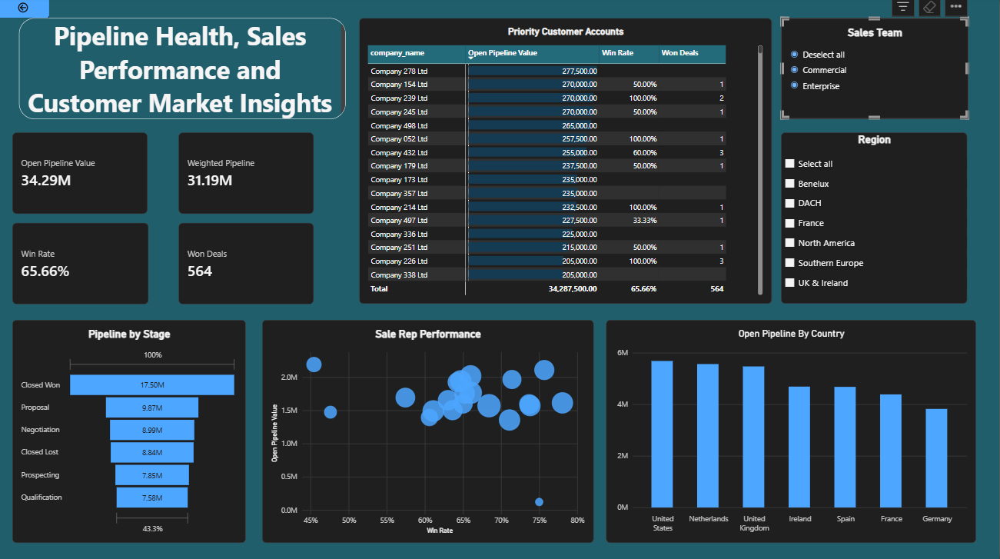
Dashboard 2 — Sales & Customers
Answers: pipeline health, rep performance, priority accounts and geographic opportunity.
OBSERVED INSIGHTS
Open pipeline value
34.29M
Weighted pipeline — ~91% of open pipeline
31.19M
Overall win rate with 564 won deals
65.66%
United States, Netherlands and United Kingdom lead open pipeline
Top 3
Action: coach high-pipeline/low-win reps, feed more leads to high-conversion reps, and focus account plans on the largest open opportunities.

Slide 8
Business answers → management actions
The value is not the chart; it is the decision the chart supports.
Business question
What the analysis shows
Recommended action
Where is revenue strongest?
September peaks at ~9.9M; DataVision leads product revenue.
Investigate timing drivers; protect the strongest product while diversifying mix.
Is the subscription base healthy?
872 active; 345 expired; 177 cancelled; 98 trial.
Prioritise renewal / reactivation campaigns and trial conversion.
How healthy is pipeline?
34.29M open, 31.19M weighted, 65.66% win rate.
Prioritise late-stage deals and protect forecast quality.
Where should sales focus?
US, Netherlands and UK lead open pipeline; rep performance varies widely.
Coach low-conversion reps and reallocate leads toward high-conversion capacity.
Can the data be trusted?
45 tests passed, 4 known warnings, 0 errors.
Keep warnings visible; fix source-system quality rather than guessing corrections.

Slide 9
GitHub-ready project structure & reproducibility
Make the portfolio easy to understand, rerun and review.
RECOMMENDED REPOSITORY
RUNBOOK
1. Create PostgreSQL database and credentials in local .env (never commit secrets).
2. Run Python ingestion to load CSVs into raw schema.
3. Run dbt build to create staging + marts and execute tests.
4. Open the PBIX and refresh the PostgreSQL connection.
5. Review the two dashboard pages and documented recommendations.
software-license-sales-analytics/
├── data/raw/
├── src/ingest_data.py
├── license_sales_dbt/
│ ├── models/staging/
│ ├── models/marts/
│ └── tests/
├── powerbi/
│ └── software_license_sales_dashboard.pbix
├── docs/images/
├── presentation/
│ └── software_license_sales_project_presentation.pptx
├── README.md
└── .gitignore
Portfolio signal
This project demonstrates SQL, Python, PostgreSQL, dbt testing, dimensional modelling, DAX, Power BI design and business storytelling in one reproducible workflow.

