Slide 1
IT TICKETS ANALYSIS
Analyzing Ticket Operations, Agent Performance & Investment Opportunities
Excel Data Analytics Project
Mehwish

Slide 2
The Business Challenge— Problem Statement
You are tasked with analyzing the IT support ticket management system to understand the performance of IT agents, the efficiency of ticket resolution, and the satisfaction levels of employees. The objective is to identify high and low performers among IT agents, assess the overall effectiveness of the team, and pinpoint areas for improvement in the ticket resolution process. The ultimate goal is to make informed staffing decisions, including hiring, firing, and training, to enhance overall service quality and team performance.

Slide 3

How can the organization manage rapidly growing IT support demand while maintaining fast resolution times and high employee satisfaction?
Goal: Identify operational bottlenecks and determine where process, technology and workforce improvements should be prioritized.

Slide 4
Project analysis slide 2
IT Support Analysis
Understand Ticket Demand
Evaluate Service Performance
What This Analysis Aims to Uncover?
Guide Investment Decisions
Evaluate Agent Performance
Goal: Transform raw IT ticket data into actionable management decisions.

Slide 5
Understanding the IT Support Data
Data Overview:
Tables: Tickets • IT Agents
IT Agents Table:
  Rows: 51 (including the header row)
  Data records: 50
  Columns: 6
Tickets Table:
  Rows: 97,499 (including the header row)
  Data records: 97,498
  Columns: 11
Data Dimensions
Ticket Information: Ticket ID • Date • Issue Type • Request Category
Service Metrics: Resolution Time • Satisfaction Rate
Ticket Criticality: Severity • Priority
Agent Information: Agent ID • Agent Name • Age • Email
The dataset allows performance to be evaluated across demand, efficiency, service quality, ticket complexity and agent performance.

Slide 6
Project analysis slide 3
From Raw Ticket Records to Decision-Ready Insights
STEP 1
Data Validation
STEP 2
Data Enrichment
STEP 3
Excel Analysis
STEP 4
Interactive Dashboard
Checked data types
Reviewed missing values
Checked duplicates
Validated numeric fields
Verified category consistency
Used:
Excel Tables
PivotTables
COUNTIF / SUMIF
INDEX-MATCH
Conditional aggregation
Date functions
Sorting & filtering
Created/derived fields such as:
Agent Name
Year
Month
Age Group
Email Domain
Built PivotCharts + slicers for management exploration.

Slide 7
KPI Overview
KPI | Value
Total Tickets | 97,498
Avg. Resolution Time | 4.55 Days
Avg. Satisfaction | 4.1 / 5
Total Agents | 50
Avg. Severity Score | 2.05
Avg. Priority Score | 1.59
Avg. Agent Age | 41.06
Daily Ticket Volume | 53.68
Insight: demand is substantial, while satisfaction remains strong.
Recommendation: use the KPIs as the monitoring layer, then drill into bottlenecks before making staffing or investment decisions.

Slide 8
IS PERFORMANCE HOLDING UP?

Slide 9
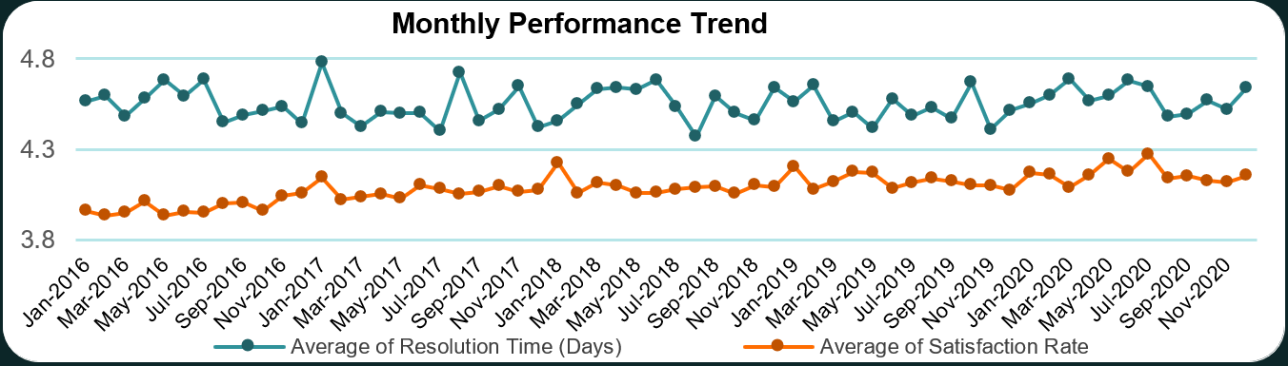
Monthly Performance Trend
WHAT IT SHOWS:
  Tracks average resolution time and satisfaction rate month-by-month from 2016–2020.
KEY INSIGHT
  Despite fluctuations, both metrics remain relatively stable, with satisfaction staying around 4/5 while resolution time remains around 4.5 days.
RECOMMENDATION
  Continue monitoring satisfaction and resolution time together so that future workload growth does not reduce service quality.

Slide 10
HOW FAST ARE TICKETS BEING RESOLVED?

Slide 11
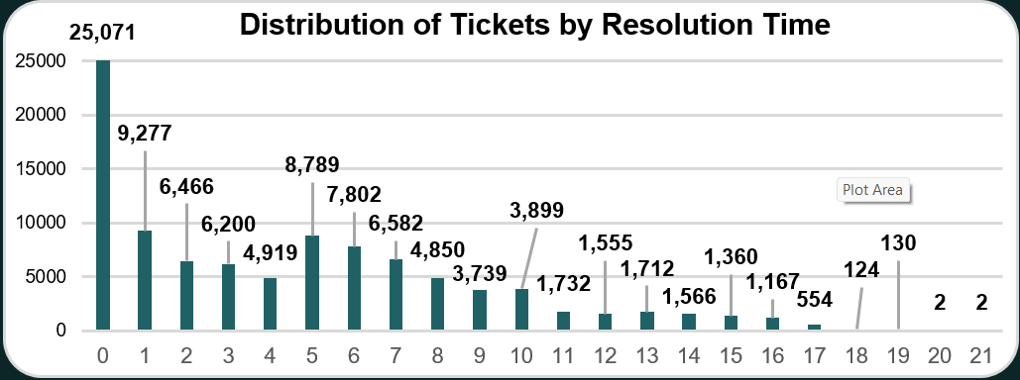
Distribution of Tickets by Resolution Time
WHAT IT SHOWS
  Shows the number of tickets resolved across different resolution durations.
KEY INSIGHT
  The largest group — 25,071 tickets — was resolved within 0 days, while progressively fewer tickets required very long resolution periods.
RECOMMENDATION
  Investigate tickets in the long-resolution tail to identify recurring causes of delays and opportunities for process improvement.

Slide 12
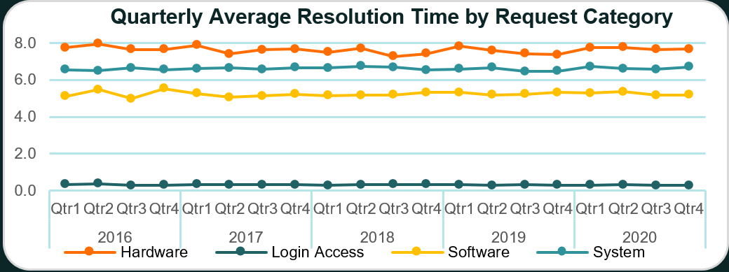
Quarterly Average Resolution Time by Request Category
WHAT IT SHOWS
  Compares average resolution time for Hardware, Login Access, Software and System requests quarter-by-quarter from 2016–2020.
KEY INSIGHT
  Hardware consistently records the highest resolution time across quarters, showing that the issue is a persistent operational bottleneck rather than a temporary spike.
RECOMMENDATION
  Investigate hardware availability, replacement procedures, vendor dependencies and escalation processes.

Slide 13
WHAT IS DRIVING SUPPORT DEMAND?

Slide 14
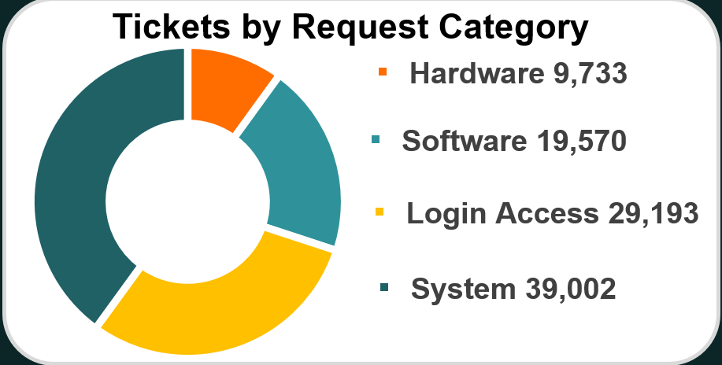
Tickets by Request Category
WHAT IT SHOWS
  Breaks the total ticket workload into four major request categories.
KEY INSIGHT
  System requests are the largest category with 39,002 tickets, followed by Login Access with 29,193.
RECOMMENDATION
  Prioritize automation, standardized workflows and self-service solutions for high-volume System and Login Access requests.

Slide 15
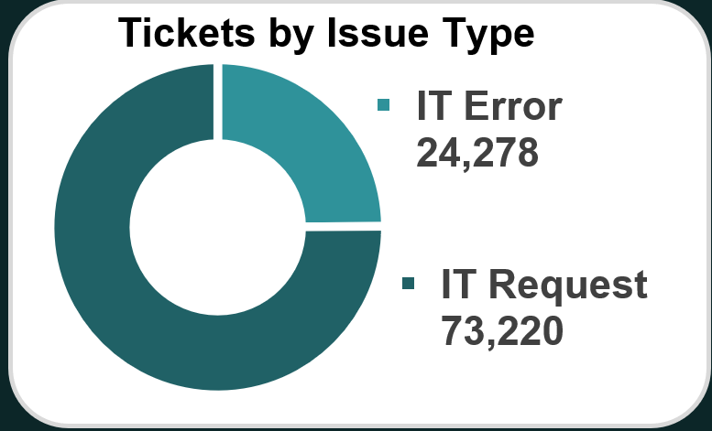
Tickets by Issue Type
WHAT IT SHOWS
  Compares the number of general IT Requests against IT Error tickets.
KEY INSIGHT
  IT Requests account for approximately 75% of all tickets, making them the dominant source of support workload.
RECOMMENDATION
  Identify frequently repeated IT Requests that could be moved to self-service portals, FAQs or automated workflows.

Slide 16
HOW COMPLEX/URGENT ARE THE TICKETS?

Slide 17
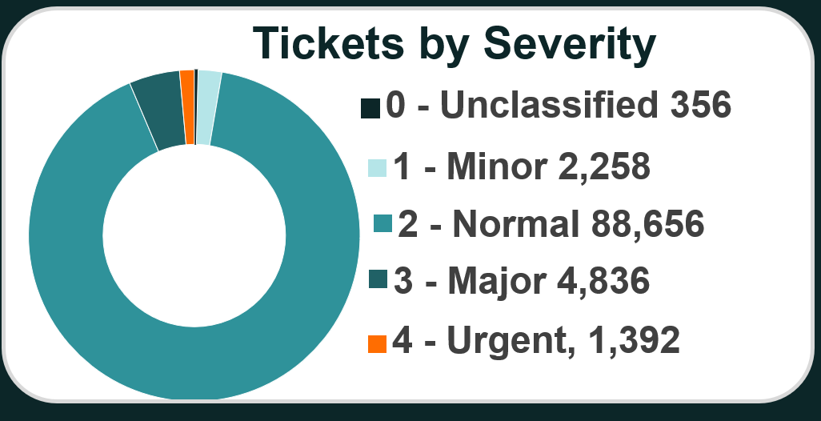
Tickets by Severity
WHAT IT SHOWS
  Shows how total tickets are distributed across severity levels.
KEY INSIGHT
  The overwhelming majority of tickets — 88,656 — are Normal severity, while Major and Urgent tickets represent a much smaller share.
RECOMMENDATION
  Standardize and automate workflows for high-volume Normal tickets, while maintaining clear escalation procedures for Major and Urgent issues.

Slide 18
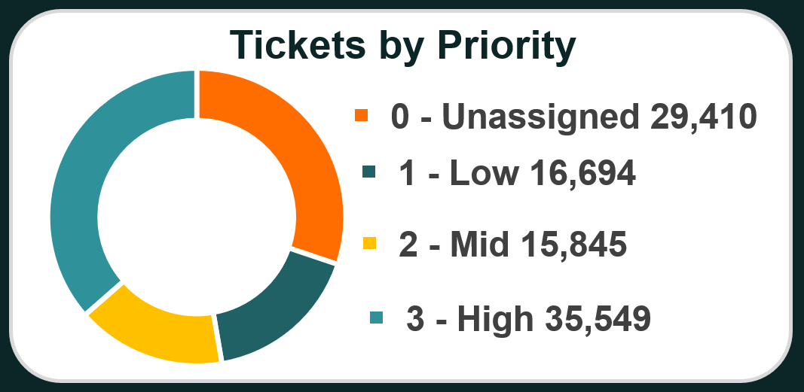
Tickets by Priority
WHAT IT SHOWS
  Shows how total tickets are distributed across assigned priority levels.
KEY INSIGHT
  High-priority tickets form the largest group at 35,549, while 29,410 tickets remain Unassigned, which is also a substantial proportion.
RECOMMENDATION
  Review priority classification and assignment rules, particularly for Unassigned tickets, to improve routing consistency and workload management.

Slide 19
HOW FAST IS DEMAND GROWING?

Slide 20
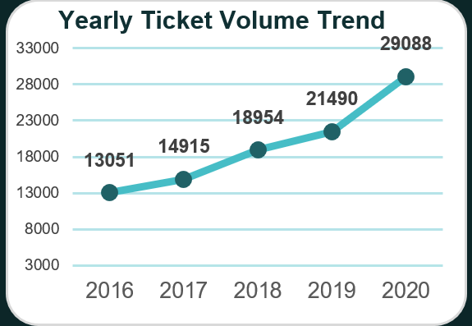
Yearly Ticket Volume Trend
What it shows
Tracks annual IT ticket volume from 2016–2020.
Insight
Ticket volume increased from 13,051 to 29,088, showing substantial growth in IT support demand.
Recommendation
Management should regularly evaluate support capacity, automation and staffing requirements as demand grows.
13,051 → 29,088 +123% approximately

Slide 21
WHAT DO EMPLOYEES THINK OF THE SERVICE?

Slide 22
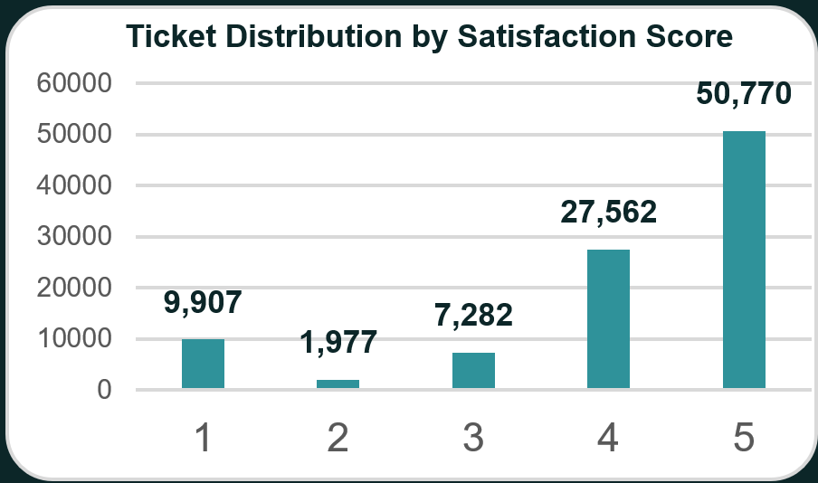
Ticket Distribution by Satisfaction Score
WHAT IT SHOWS
  Shows how tickets are distributed across satisfaction ratings from 1 to 5.
KEY INSIGHT
  Approximately 80.3% of tickets received ratings of 4 or 5, indicating strong overall satisfaction with IT support.
RECOMMENDATION
  Maintain the practices driving high satisfaction while analysing low-rated tickets to identify specific service failures.

Slide 23
DOES AGENT DEMOGRAPHY MATTER?

Slide 24
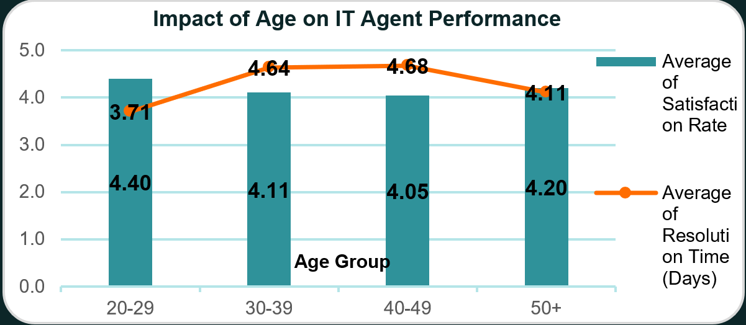
Impact of Age on IT Agent Performance
WHAT IT SHOWS
  Compares average satisfaction rate and average resolution time across agent age groups..
KEY INSIGHT
  Performance varies slightly between age groups, but the pattern does not show a simple relationship between agent age and overall performance.
RECOMMENDATION
  Workforce decisions should be based on actual agent performance, workload and ticket complexity rather than age alone.

Slide 25
WHICH AGENTS ARE PERFORMING WELL?

Slide 26
IT Agent Performance Metrics
WHAT IT SHOWS:
  Provides a multi-metric comparison of individual agents based on workload, resolution efficiency, satisfaction and ticket complexity.
KEY INSIGHT
  Individual agents show different performance patterns, indicating that performance cannot be evaluated using ticket volume alone.
RECOMMENDATION
  No immediate workforce reduction is supported by the analysis.

Slide 27
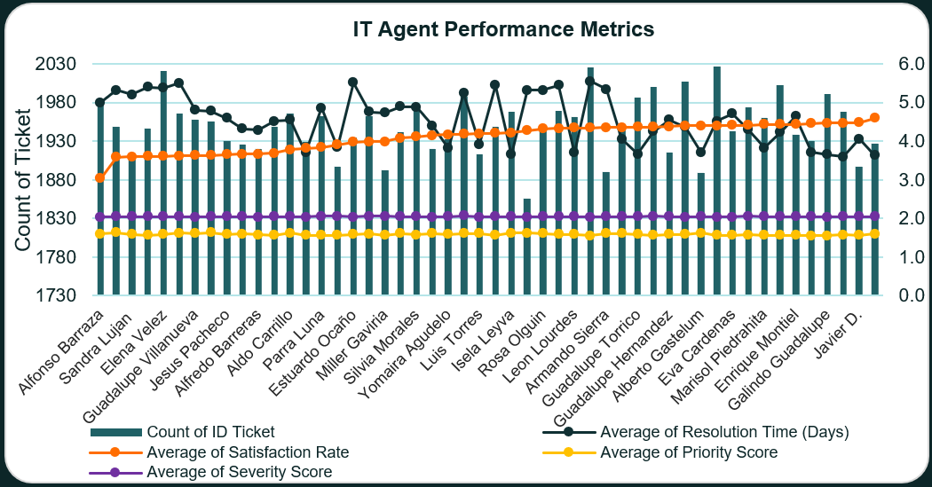

Slide 28
IT SUPPORT DASHBOARD
Interactive Excel dashboard integrating KPIs, operational trends, ticket characteristics, resolution performance and agent-level analysis through dynamic slicers.

Slide 29
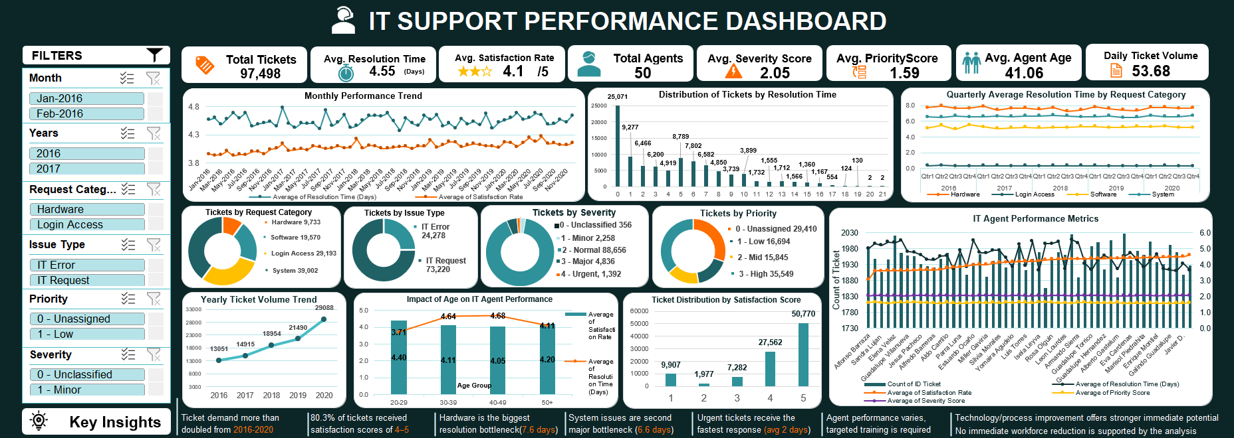

Slide 30
01 — Demand is accelerating
Ticket volume increased from 13,051 → 29,088 annually.
02 — Satisfaction remains strong
80.3% of tickets received satisfaction ratings of 4–5.
03 — Hardware is the key resolution bottleneck
Hardware consistently records the highest resolution time.
04 — Volume and difficulty are different problems
System generates the most tickets, while Hardware takes the longest to resolve.
05 — Workforce reduction is not the immediate solution
The data points toward process improvement, technology investment and targeted training.
Key Findings

Slide 31
Recommendations
⚙️ 01 — Process Improvement
Improve Hardware and System troubleshooting, escalation and resolution workflows.
💻 02 — Automation & Self-Service
Automate repetitive System, Login Access and routine IT Request activities.
👥 03 — Agent Development
Use multi-KPI agent performance data for targeted training, coaching and workload balancing.
📈 04 — Capacity Planning
Monitor growing ticket volumes against agent capacity and prepare for future staffing or automation needs.

Slide 32
CONCLUSION
📈
Growing Demand
IT support demand has more than doubled from 2016 to 2020, indicating increasing pressure on support operations.
⭐
Strong Service Quality
Despite increasing ticket volumes, overall satisfaction remains strong at 4.1/5, with 80.3% of tickets rated 4 or 5.
⏱
Key Bottleneck
Hardware remains the most persistent resolution bottleneck, while System and Login Access contribute significantly to overall ticket demand.
🎯
Investment Direction
The analysis supports prioritizing process improvement, automation and targeted agent development before considering major workforce changes.
Optimize processes → Automate repetitive work → Train strategically → Scale capacity as demand grows

Slide 33
Thank You
Tools Used: Microsoft Excel
Analysis: PivotTables, PivotCharts, Excel formulas, trend analysis & interactive dashboarding
Dataset: IT Support Ticket Project Dataset

