Slide 1


MORTGAGE CONSULTANT TRAINING

Slide 2
Our Agenda: 1. To train our team in terms of mortgage. 2. To know about the product we’re offering. 3. Building strong relationship with clients.

Slide 3
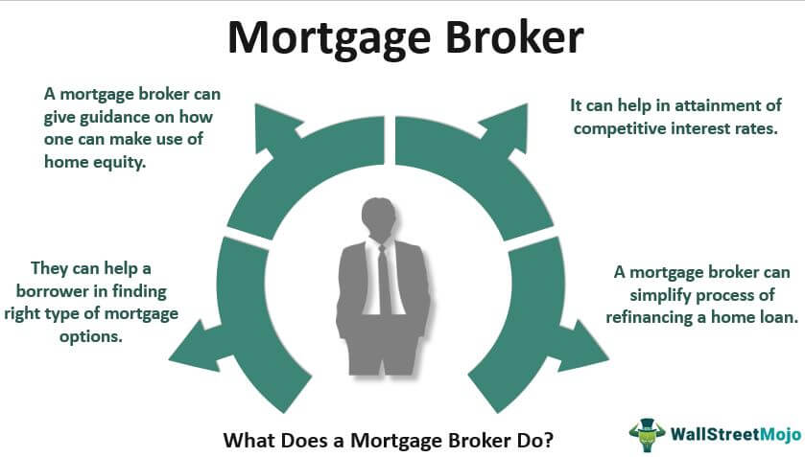
Key Responsibilities of a Mortgage Broker
Assess client financial situations.
Compare loan options from lenders.
Advise clients on mortgage solutions.
Handle loan applications and paperwork.
Ensure compliance with regulations.
Guide clients through the approval process.
Maintain relationships with lenders and clients.

Slide 4

BRIDGING THE GAP
Our sales team plays a crucial role in driving business growth. To succeed, it is essential to have a deep understanding of our products, their features, and their benefits. This guide will help bridge the gap in product knowledge, ensuring that every sales representative can confidently communicate value to customers.

Slide 5

In sales, success is not just about closing deals but also about ongoing training, knowledge acquisition, and skill enhancement.

Slide 6
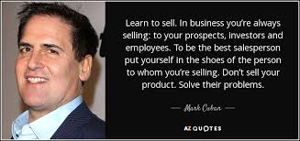

Slide 7



INTRODUCTION AND KNOWLEDGE ASSESSMENT
Product knowledge
Services
Questionnaire
Self evaluation

Slide 8

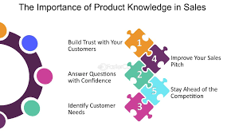

Slide 9
Key Aspects of Product Knowledge
Product Overview
What is the product?
? What problems does it solve?
What makes it unique?
Features & Benefits
List down key features
Focus on value
Cases & Applications
Real world scenarios
Customer case study
Competitive Advantage
Product Comparison
Unique Selling points
Object Handling
Common Concerns
Effective response

Slide 10
PRODUCT UNDERSTANDING AND COMMUNICATION
The key to success is understanding the service and how it helps real estate investors, buyers, and individual clients save on expenses and manage assets. The service is exclusive in the UAE, which makes it important to convey its benefits in a straightforward way. Consultants should highlight:
Key benefits of the service we provide:
Differences between what our service offers versus competitors
Focus on transparent communication—avoid overselling or creating insecurities in clients
By establishing a strong market image, you won’t need to hard-sell; clients will come to you for solutions. The focus should be on the long-term value clients receive, as satisfied clients will likely bring others.

Slide 11
INDIVIDUAL CHALLENGES
ORGANIZATIONAL CHALLENGES
IDENTIFYING CHALLENGES

Slide 12

1.
Maintain organized records and documents for each client using digital tools.
2.
Prioritize tasks and meetings based on urgency.
3.
Stay consistent and prepared for meetings and events.
Track daily progress and set goals for the next day.
4.

Slide 13
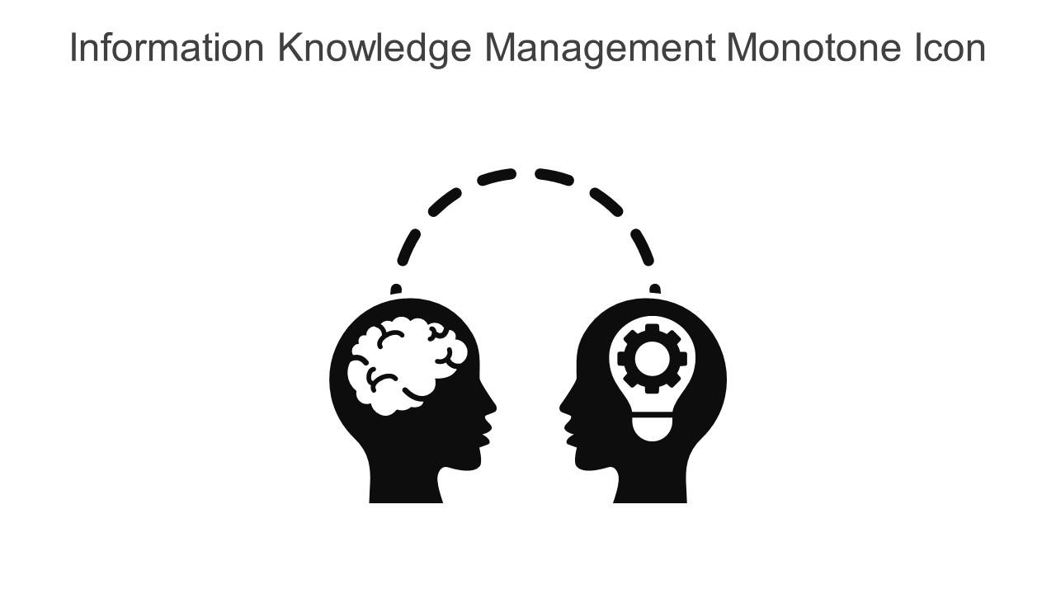
KNOWLEDGE BUILDING & UNDERSTANDING
A consultant should:
- Be well-informed about the various stages in the mortgage process.
- Understand different client needs based on their profiles—such as residents versus non-residents, and salaried versus self-employed individuals.
- Be able to identify the appropriate service for each client, based on their transaction type (e.g., developer payment, post-handover payments, refinancing).

Slide 14

Closing
Deals
Communication
Understanding Mortgage process

Slide 15
Resident
1.Salaried
2. Property owners
3. Self employed
4. Golden visa holders
Non-Resident
1. Salaried
2. Self employed

Slide 16



Documentation
Policies
Clarity
How to overcome obstacles

Slide 17

Leveraging Holiday Time for Growth
Study market trends.
Focus on inter personal and intra personal skills.
Assessing clients’ needs.
Stay updated on digital gadgets.

Slide 18

Thank you!

