Slide 1

Neural Network based Image Classification System on Heterogeneous Platforms
Linjuan Fan, Ibrahim Bouriga, Andres Stober, Bahaa Mahagne and Mehyar Cherni

Slide 2
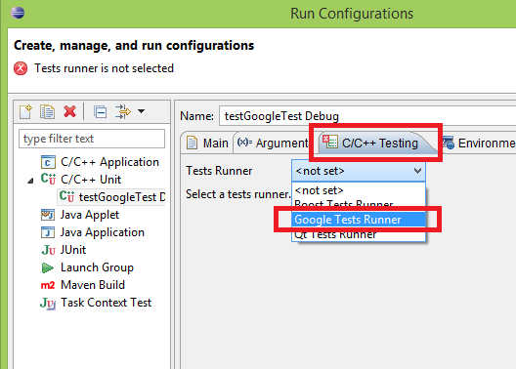
Google Tests
Google Test is a unit Testing library for the C++ programming language, based on the xUnit architecture
This Photo by Unknown Author is licensed under CC BY-SA

Slide 3
Why we decided to use this framework ?
Google Test is designed to be portable and it works around various bugs in various compilers and environments
Google's test framework has built-in assertions that are deployable in software where exception handling is disabled
Running the tests is simple and it’s easy to write assertions that generate informative messages
Google Test automatically detects your tests and doesn’t require you to enumerate them in order to run them

Slide 4
gcov – coverage testing tool
gcov is a test coverage program.
We used it in concert with GCC to analyze our programs to help,
create more efficient, faster running code
to discover untested parts of your program.
discover where our optimization efforts will best affect our code.
analyze our code's performance
Software Engineering Practice

Slide 5
Using GCOV
By using gcov we found some basic performance statistics, such as:
how often each line of code executes
what lines of code are actually executed
how much computing time each section of code uses

Slide 6
Convolution Layer Test
In order to avoid any unexpected behaviour of the convolutional layer we apply different filters with different strides on the input.
Differentes paddings were also used by the input.
However we model the image as a set of data and do not use real images in this approach, so that we can avoid interpreting graphical representation by the output.
The data are represented as vectors of float.
The expected output are calculated manually and compared to the one produced by the layer.

Slide 7
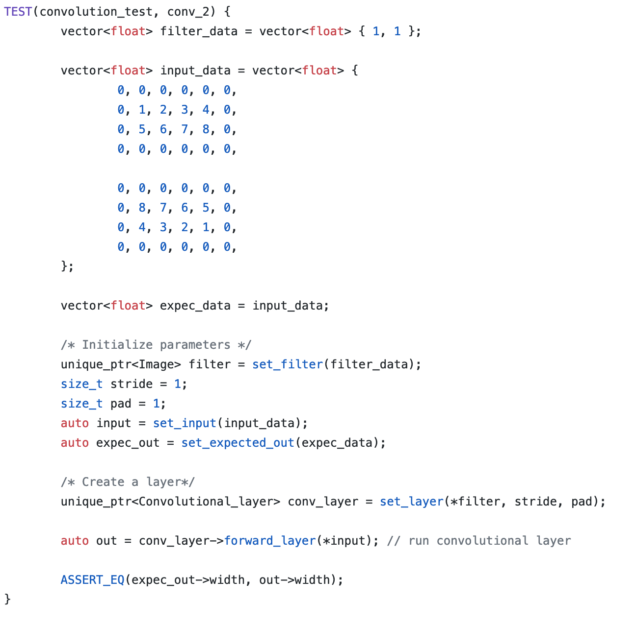

Slide 8
Fully Connected Layer Test
This layer basically takes an input volume (whatever the output is of the conv or ReLU or pool layer preceding it) and outputs an N dimensional vector where N is the number of classes that the program has to choose from.
for this test we have created this objects:
Weights: object of an Image
fully_connected_layer: object of Fully Connected Layer class
InputImage: input image
expectedOutput: expected output
outputFrom_Fully_connected_layer: output of the fully connected layer for the input image

Slide 9
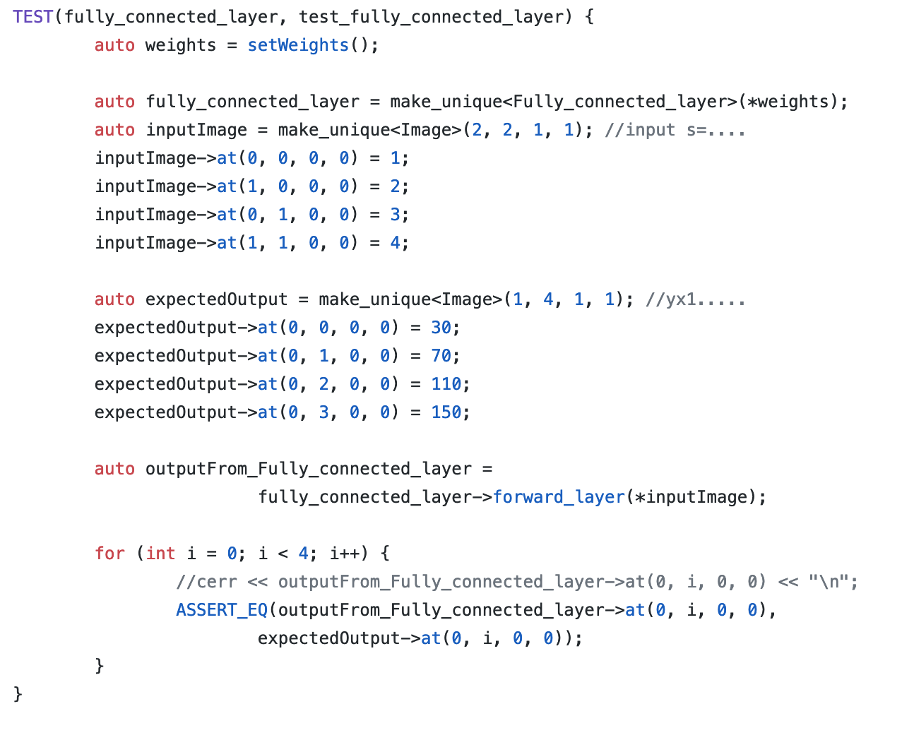

Slide 10
Max Pooling Layer Test
Its function is to progressively reduce the spatial size of the representation to reduce the amount of parameters and computation in the network, and hence to also control overfitting.
For this test have we created:
input image,
expected output
object of max pool layer
After adding the data for each object we tested with (ASSERT_EQ) if the output of the max pool layer as we expect it in the output that we created.

Slide 11
