Slide 1

Neural Network based Image Classification System on Heterogeneous Platforms
Linjuan Fan, Ibrahim Bouriga, Andres Stober, Bahaa Mahagne and Mehyar Cherni

Slide 2
What was implemented?

Slide 3
GUI
We tried to implement a user friendly GUI, which allows the user to easily understand the features of the software and access them.
The design has been maintained, indeed the GUI consists of a control section, an image section and a platform/mode section.

Slide 4
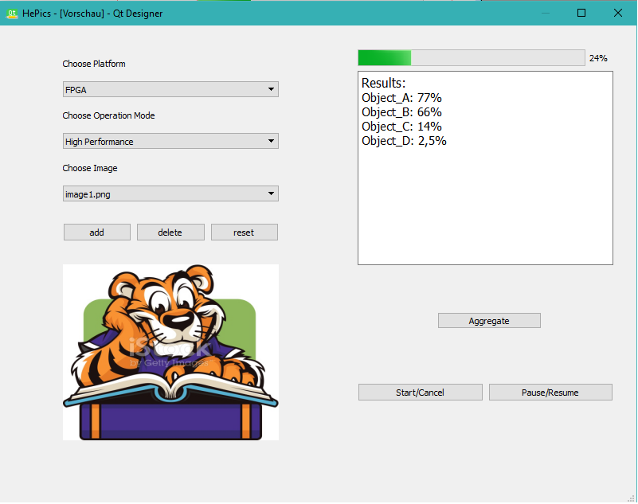
Software Engineering Practice

Slide 5
Neural Network Model
We previously designed the neural network as a number of layers on which the method forward_propagation(Image input) runs. This provided a solid ground for us to model the network and its layers.
However, we still opted for slight changes, as we moved forward and had a clearer idea of what the task consisted of.
For instance, the topology is now not an independent class, but a single image that can be displayed to the user.

Slide 6
Image Model
The Image class saw some modifications as well. As a matter of fact, it was built in a way that allows us to run multiple functions on an Image object in order to transform it, and provide it under the required format to the layer to process it. Example :
resize_image(int w, int h)
void set_pixel(int x, int y, int c, float val)
add_pixel(int x, int y, int c, float val)
It also contains static methods like load_image(char *filename, int w, int h, int c) that were supposed to run under the class ImageManager, which we decided to leave out, and merge in the Image class.

Slide 7
Image Model
Class “QImage” :
https://doc.qt.io/qt-5/qimage.html
We tried to use the “QImage” external library as it provides a rich and solid environment of Image representation, transformation and editing (particularly load methods). Due to technical difficulties and complications on Eclipse, we decided to avoid it.
As a substitute, we opted for stb\_image, which also provided us with a load image method that worked well with the rest of our program.
Other external libraries to note are GEMM, BLAS and IM2COL.

Slide 8
Scheduler and Operating Modes
Operating modes were declared as an enumeration type next to the platforms, inside the Scheduler class. With the help of two arrays of Boolean variables, we defined the selection of platforms to use corresponding the chosen mode, and the by-the-user-enabled platforms. Decisions were made upon articles, and with the assumption that most of the code contains vector operations.
Sources : https://semiengineering.com/cpu-gpu-or-fpga/
https://medium.com/altumea/gpu-vs-cpu-computing-what-to-choose-a9788a2370c4
The Scheduler also provides us with a vector of Workers, to which we can assign tasks to run on a certain platform, if it‘s available and set to use.

Slide 9
FPGA Connection
Running tasks on an FPGA turned out to be quite the tricky part of the implementation. The soc board provided us with another task as it supported an independent linux on its own.
In addition, we found ourselves in the position of needing to write a service to connect to the FPGA via ethernet.
Padding had to be addressed to reduce branching in the FPGA.

Slide 10
Changes and Positive Aspects
The class diagram can be a really solid tool to lean on during the implementation, nevertheless, it came to our understanding that we do not stand before the obligation of implementing the software exactly as we designed it, as certain flows only appear as we progress in the implementation.
This has made our software more flexible and expandable, because through parsing of the configuration files, we can deploy another neural network.

Slide 11
Plan and Distribution

Slide 12
Plan
week
tasks
1
Image, ImageManager, Convolutional Layer, GUI, Classifier
2
Changed distribution, Image, NeuralNetwork, Convolving, FPGA, GUI
3
Result, Aggregation, FPGA, Maxpool layer, Activation, GUI
4
Scheduler, FPGA, Parser, Classifier, weight data, connected layer

Slide 13
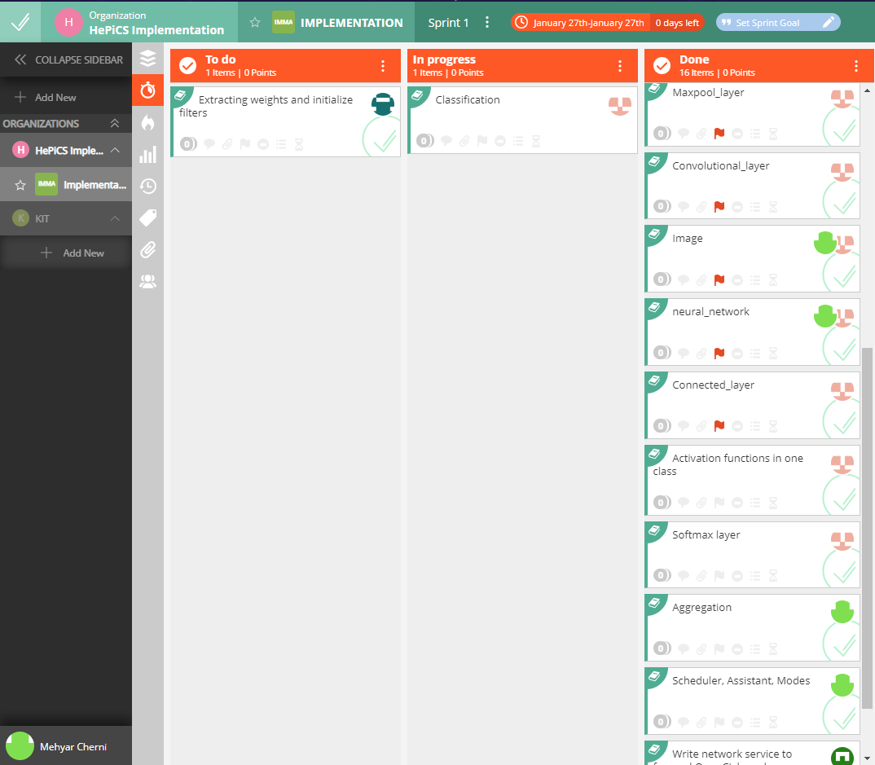
Distribution and Scrum

Slide 14
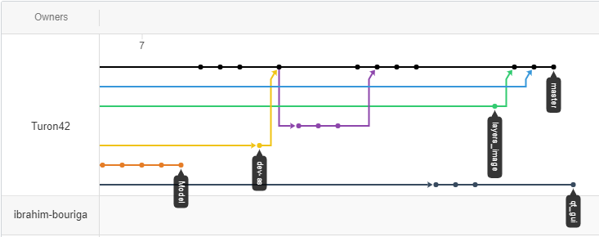
Links
We proceeded to work each on a branch. Whenever we had conflicts to solve, we tried to meet and clear them manually, which ended up by choosing one take at the problem over the other.
Merging was limited to the master branch.
https://github.com/Turon42/hepics
https://app.vivifyscrum.com
Software Engineering Practice

Slide 15
Issues and Problems faced
Software Engineering Practice

Slide 16
The software is indeed one tough problem to tackle, but its current state pushes us to rethink our decisions as a team, and review the technical difficulties we faced for the sake of learning something, and eventually get better at it.
We classified the problems we faced into two major categories :
Team work issues
Implementation issues
The following is only stating facts which apply to one or multiple members. We have to face these issues to succeed.
Software Engineering Practice

Slide 17
I. Teamwork
Lack of commitment
Working too slow
Giving work too late
Giving poor quality work
Lack of communication
Not answering direct messages or emails
Too few commits on GitHub, leading to more separated work.

Slide 18
II. Implementation challenges :
Difficulties adapting to a new programming language.
The implementation of functionalities took so much time, that we were unable to generate proper unit tests, apart from the FPGA part.
Amount of work needed for the fpga still surprising, leading to the convolution on the fpga being still not ready to run (padding issues)
Software Engineering Practice

Slide 19
Test Run

Slide 20
Ready for a test run ?
Although the program is still not running for the most part, there could be something interesting to show for the moment.
There’s most definitely space for improvement !
Software Engineering Practice

Slide 21
Thank you for your attention The End

