Slide 1
Neural Network based Image Classification System on Heterogeneous Platforms
Linjuan Fan- Ibrahim Bouriga- Andres Stober- Bahaa Mhajne- Mehyar Cherni

Slide 2
Architecture Description
In this diagram several design patterns were used. In order to decouple major components and allow parallel development we use the Model-View-Controller as a global architecture. The class diagram consists of several common patterns to reduce complexity and dependencies between classes. We use the template Method as pattern for sections to define the skeleton of the algorithm in an operation. However the results and states are updated using an observer which defines a one-to-many dependency between objects. Different Modes as well as Worker are represented by simple is-relationships. Another interesting pattern to be used by layers is the strategy-pattern. In this context we define a family of algorithm, encapsulate each one and make them interchangeable. This approach also lets the algorithm vary independently from the layer that uses it.

Slide 3
View

Slide 4
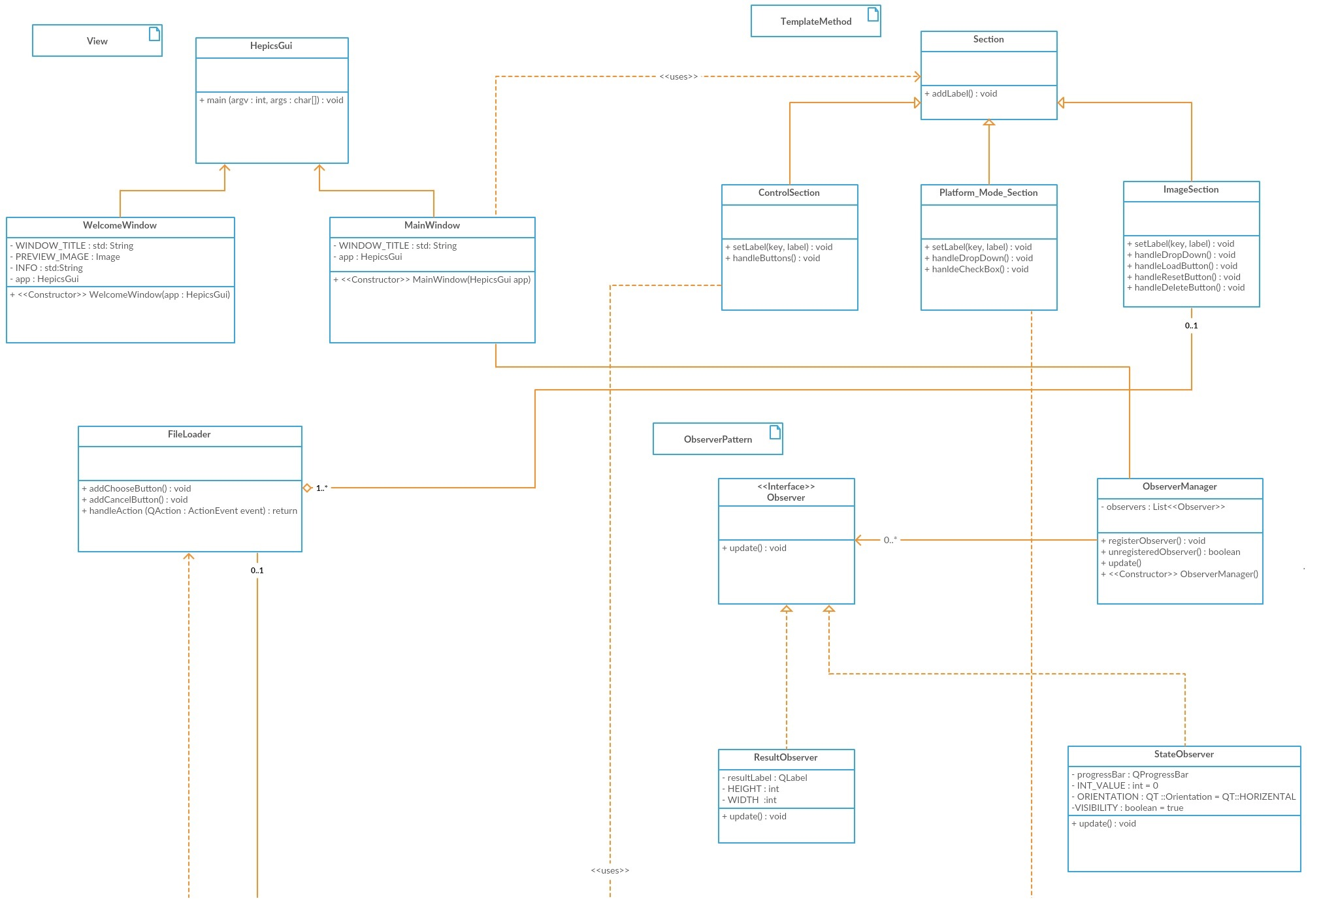

Slide 5
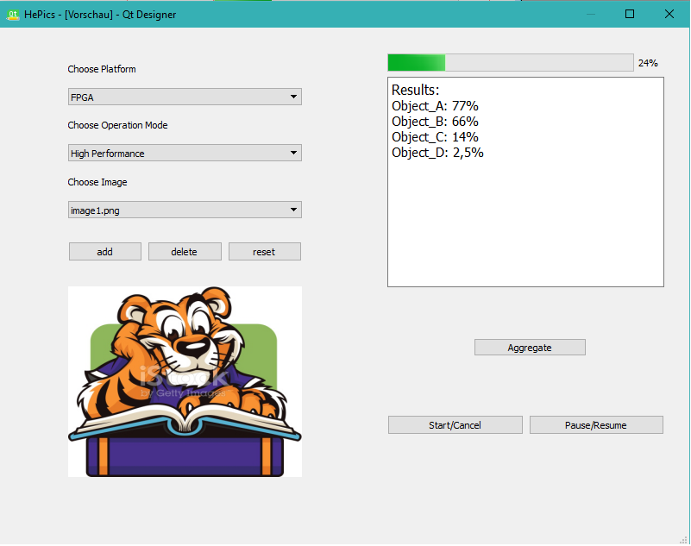
Classes on GUI
Platform-Mode
Section
Results observer
Image section
Control section

Slide 6
Model

Slide 7
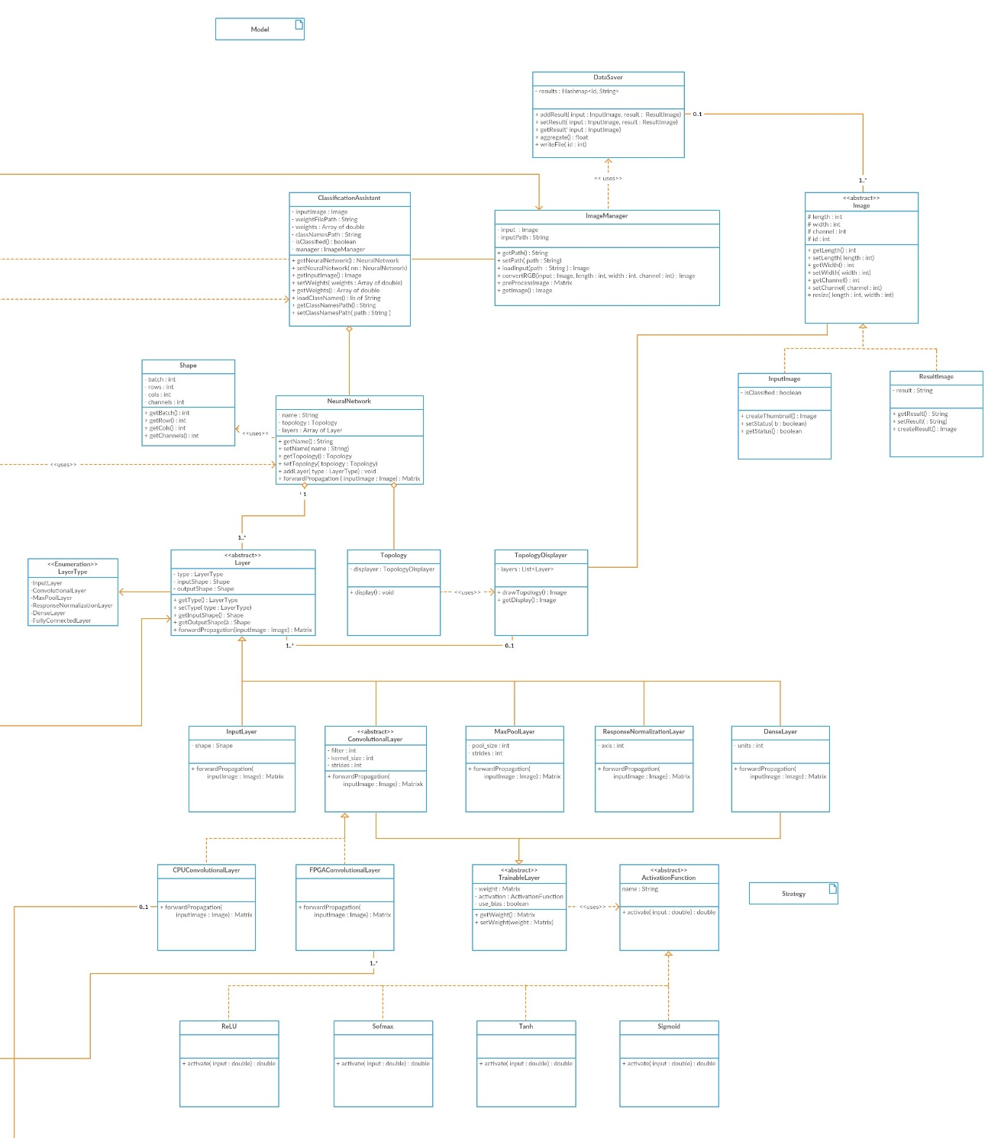

Slide 8
Controller

Slide 9
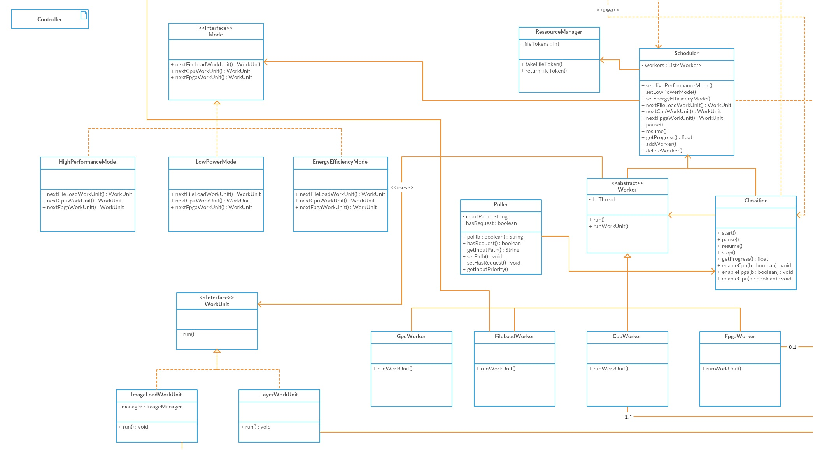

Slide 10
Functionality Description

Slide 11
Sequence Diagrams

Slide 12
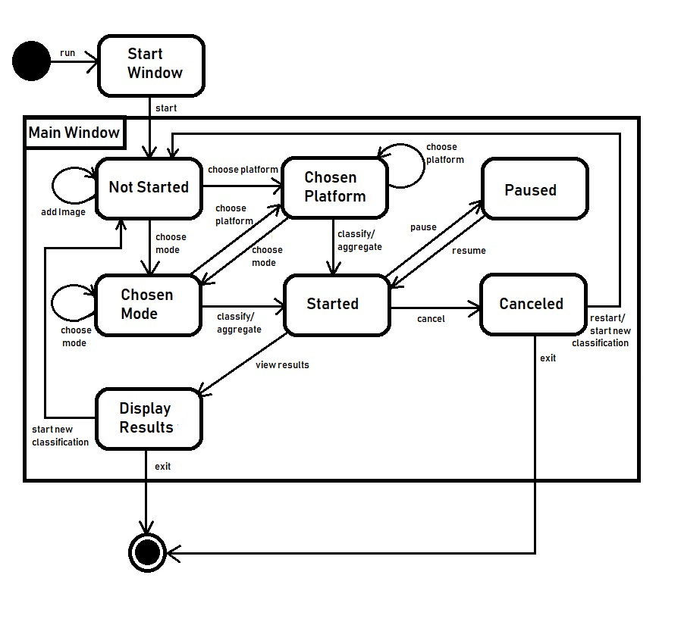
State Diagram

