Slide 1

Neural Network based Image Classification System on Heterogeneous Platforms
Linjuan Fan, Ibrahim Bouriga, Andres Stober, Bahaa Mahagne and Mehyar Cherni
Notes:
<number>

Slide 2
Introduction
For the purpose of testing sub-modules and base classes of our program, we configured Google Test on eclipse.
We oriented ourselves as much as possible to the design set during the design phase, and of course, with minor changes, our goal has been mostly achieved, since unit tests are all successful.
The effectiveness of these tests will be proven in the next phase, when the full integration is finished
Software Engineering Practice
1

Slide 3
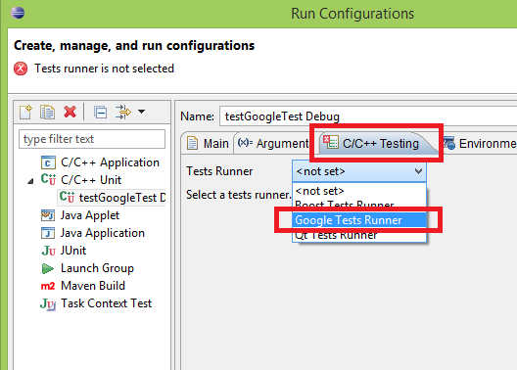
Google Tests
Google Test is a unit Testing library for the C++ programming language, based on the xUnit architecture
Software Engineering Practice
1
This Photo by Unknown Author is licensed under CC BY-SA

Slide 4
Why we decided to use this framework ?
Google Test is designed to be portable and it works around various bugs in various compilers and environments
Google's test framework has built-in assertions that are deployable in software where exception handling is disabled
Running the tests is simple and it’s easy to write assertions that generate informative messages
Google Test automatically detects your tests and doesn’t require you to enumerate them in order to run them
Software Engineering Practice
1

Slide 5
Test
Software Engineering Practice
<number>

Slide 6
Network
The constructor of Network loads the layers from a configuration file through Caffe parser. Therefore, tests were run to check if these layers are properly loaded in the class.
Software Engineering Practice
1

Slide 7
Insert picture here
Software Engineering Practice
1

Slide 8
Caffe
Caffe was used to access functions which made the network model easier to implement, since it offers parsing methods to fill each layer with its proper fields. It also provided as the weights.
Software Engineering Practice
1

Slide 9
Insert picture here
Software Engineering Practice
1

Slide 10
Convolution Layer Test
In order to avoid any unexpected behaviour of the convolutional layer we apply different filters with different strides on the input.
Differentes paddings were also used by the input.
However we model the image as a set of data and do not use real images in this approach, so that we can avoid interpreting graphical representation by the output.
The data are represented as vectors of float.
The expected output are calculated manually and compared to the one produced by the layer.
Software Engineering Practice
1

Slide 11
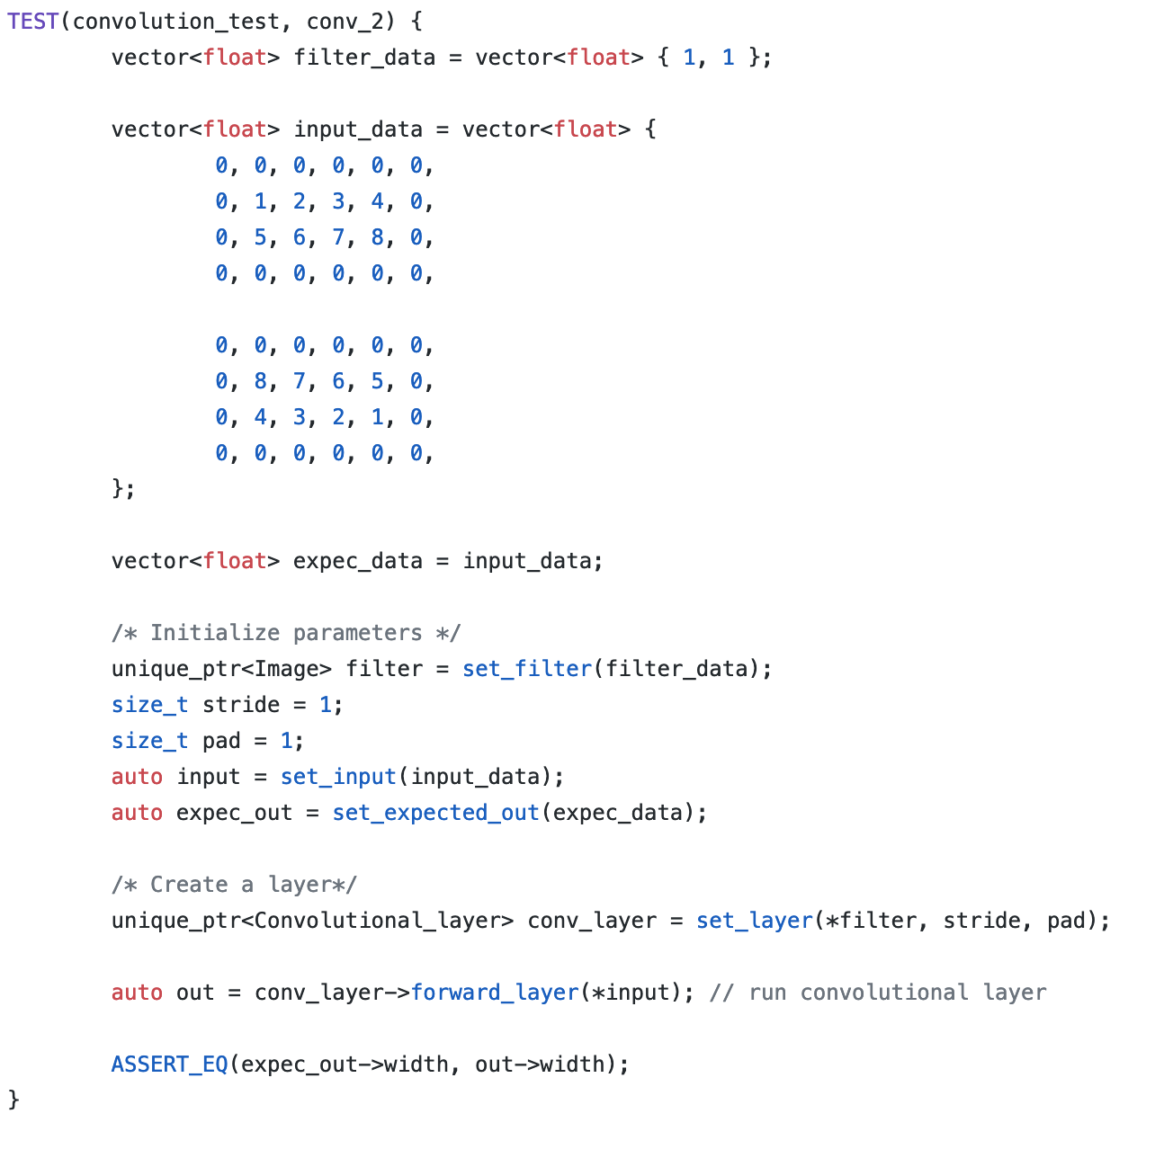
Software Engineering Practice
1

Slide 12
Fully Connected Layer Test
This layer basically takes an input volume (whatever the output is of the conv or ReLU or pool layer preceding it) and outputs an N dimensional vector where N is the number of classes that the program has to choose from.
for this test we have created this objects:
weights: object of an Image
fully_connected_layer: object of Fully Connected Layer class
InputImage: input image
expectedOutput: expected output
outputFrom_Fully_connected_layer: output of the fully connected layer for the input image
Software Engineering Practice
1

Slide 13
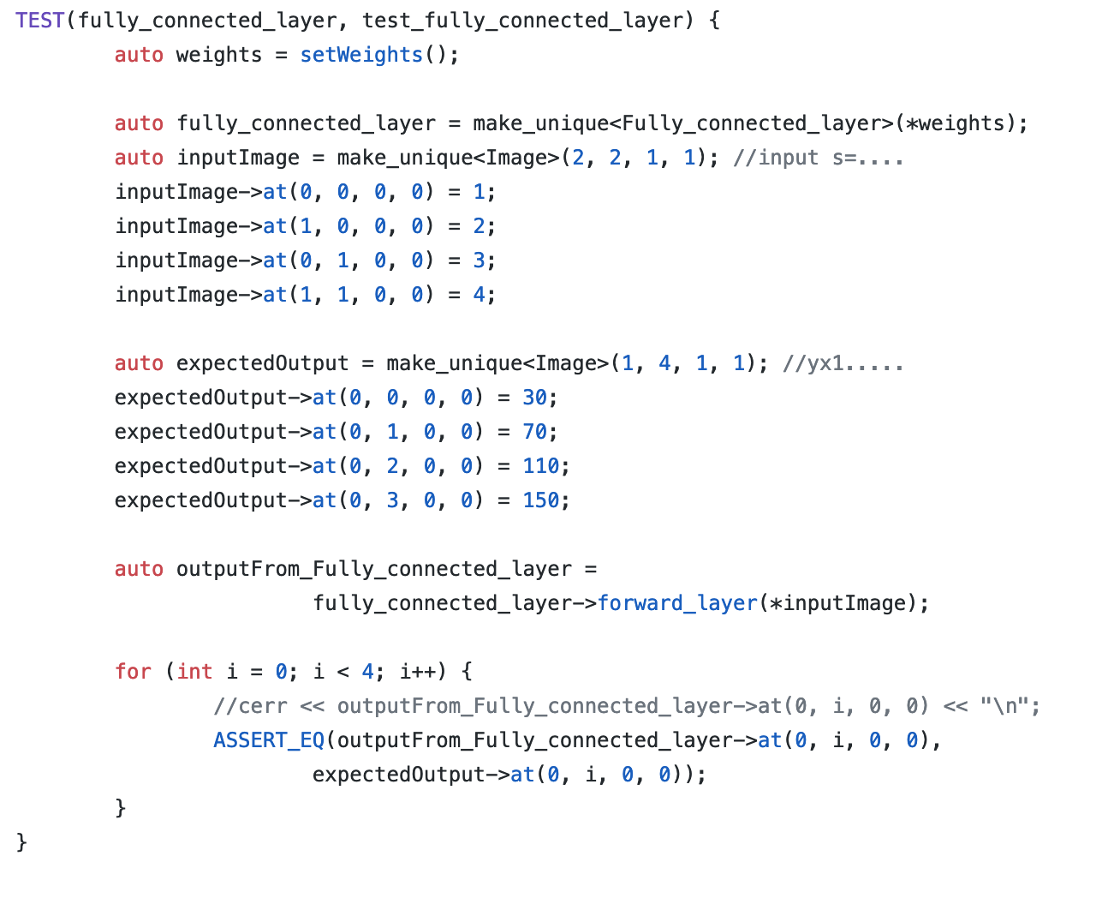
Software Engineering Practice
1

Slide 14
Max Pooling Layer Test
Its function is to progressively reduce the spatial size of the representation to reduce the amount of parameters and computation in the network, and hence to also control overfitting.
For this test have we created:
input image,
expected output
object of max pool layer
After adding the data for each object we tested with (ASSERT_EQ) if the output of the max pool layer as we expect it in the output that we created.
Software Engineering Practice
1

Slide 15
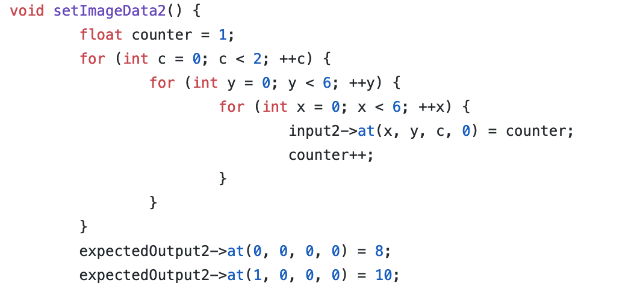
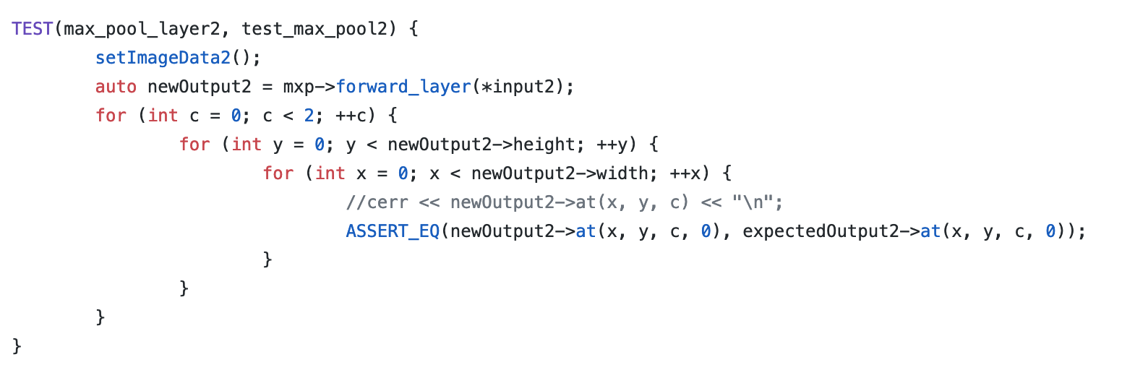
Software Engineering Practice
1

Slide 16
Local Response Normalization Layer
This layer performs a kind of “lateral inhibition” by normalizing over local input regions. In across_channels mode, the local regions extend across nearby channels, but have no spatial extent.
For this test we have created this object:
lrn: object of local response normalization layer
input: input image in size 2x2x2x1
expectedOutput：expected output
output: output after applying forward_layer method
Software Engineering Practice
1

Slide 17
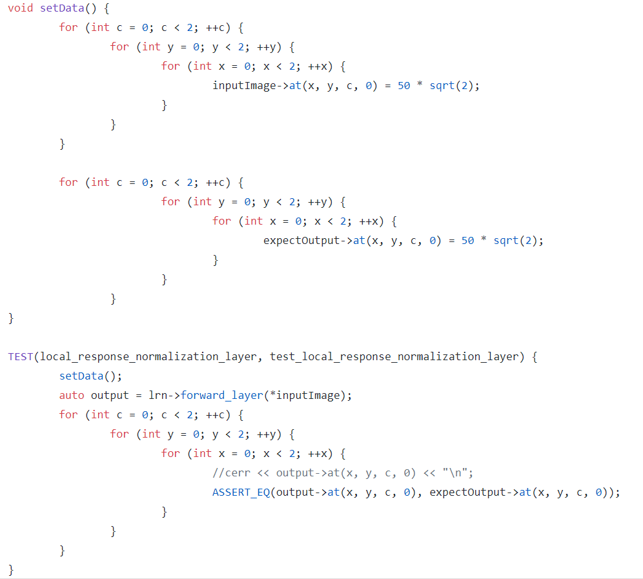
Software Engineering Practice
1

Slide 18
Input Output Management
These classes work directly with the user interface, and provide through it the input images and platforms, as well as the mode to the back end , and offer access to the results, whether seperately, or aggregated
Software Engineering Practice
1

Slide 19
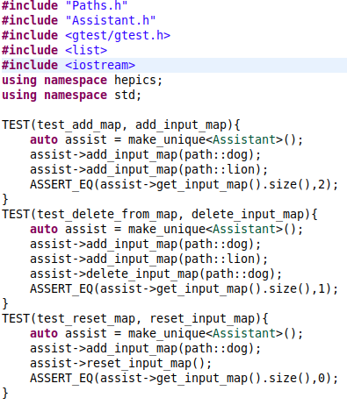
Assistant
The assistant has the input images
stored in a map, with their respective
paths
Software Engineering Practice
1

Slide 20
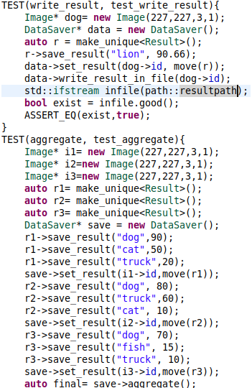
Result
This is a basic representation of the
results stored in a vector of pairs, sorted
descendently.
Software Engineering Practice
1

Slide 21
DataSaver
The datasaver saves outputs of the classification, converts them into result objects and saves them into a map, directly providing access to them. It also can aggregate the current stored results.
Software Engineering Practice
1

Slide 22
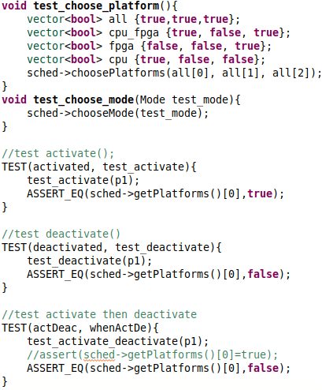
Scheduler
The scheduler is responsible of providing the system with information about platforms it can run on, depending on the user’s choise of platforms and operation mode.
Software Engineering Practice
1

Slide 23
Coverage
Software Engineering Practice
1

Slide 24
gcov – coverage testing tool
gcov is a test coverage program.
We used it in concert with GCC to analyze our programs to help,
create more efficient, faster running code
to discover untested parts of your program.
discover where our optimization efforts will best affect our code.
analyze our code's performance
Software Engineering Practice
1

Slide 25
Using GCOV
By using gcov we found some basic performance statistics, such as:
how often each line of code executes
what lines of code are actually executed
how much computing time each section of code uses
Software Engineering Practice
1

Slide 26
Current Overall State
Used two different ways of building and compiling GUI and back-end
Trying to make both of the GUI and classification run on eclipse
Have made a big step in this direction, since basic GUI’s are now running on eclipse, however we still have compiling errors when merging both of the main projects
Software Engineering Practice
<number>

