Slide 1

Neural Network based Image Classification System on Heterogeneous Platforms
Linjuan Fan, Ibrahim Bouriga, Andres Stober, Bahaa Mahagne and Mehyar Cherni

Slide 2
Architecture Description

Slide 3
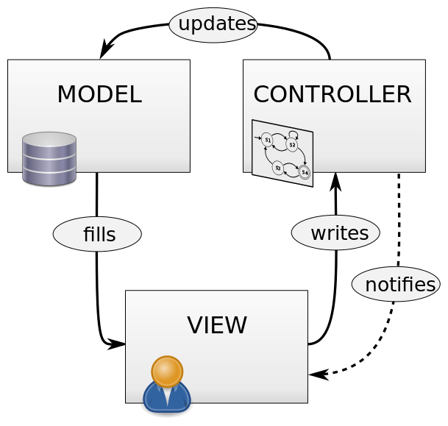
Architecture Description
In this diagram several design patterns were used. In order to decouple major components and allow parallel development we use the Model-View-Controller as a global architecture

Slide 4
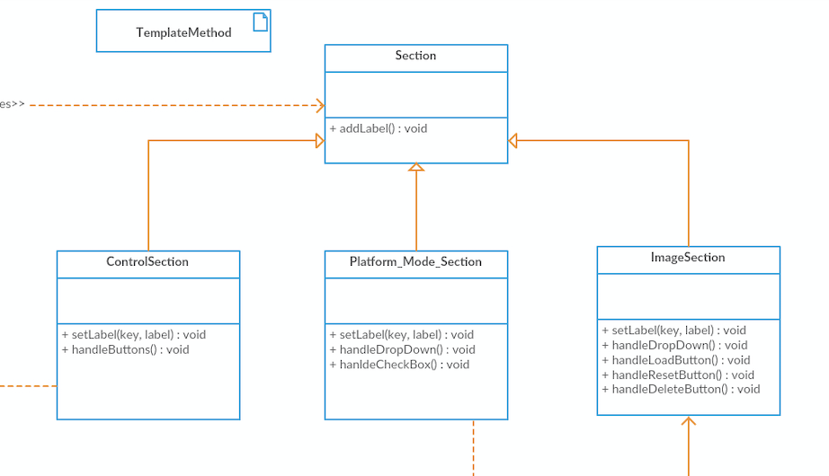
Architecture Description
The class diagram consists of several common patterns to reduce complexity and dependencies between classes. We use the template Method as pattern for sections to define the skeleton of the algorithm in an operation.

Slide 5
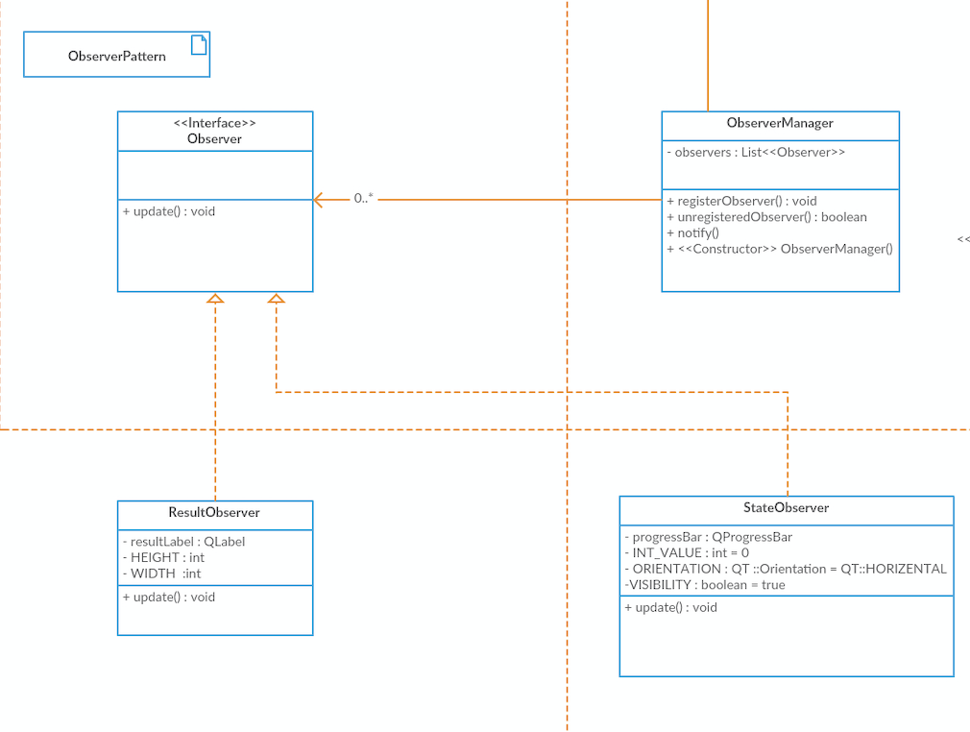
Architecture Description
However the results and states are updated using an observer which defines a one-to-many dependency between objects.

Slide 6
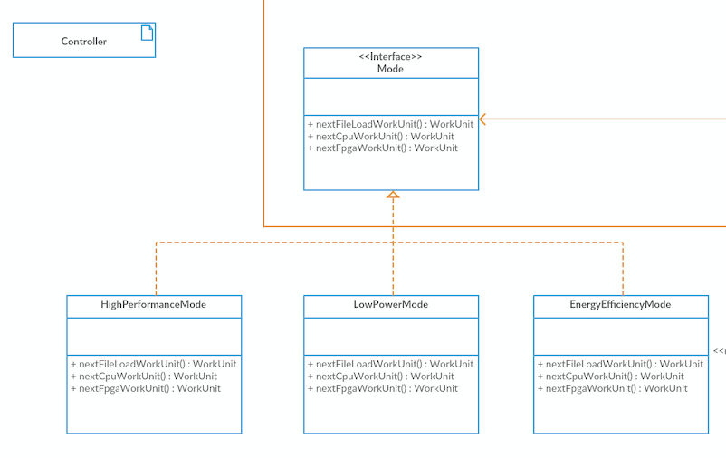
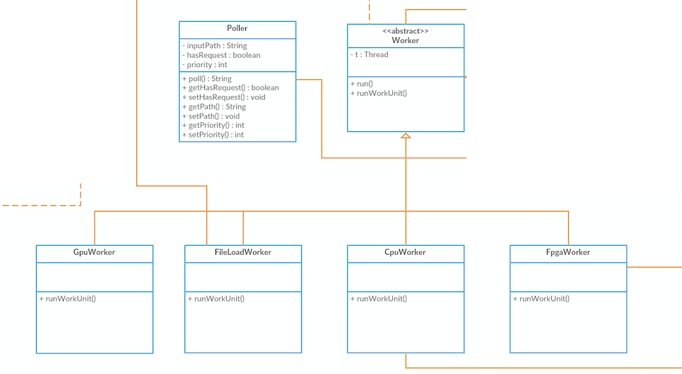
Architecture Description
Different Modes as well as Worker are represented by simple is-relationships.

Slide 7
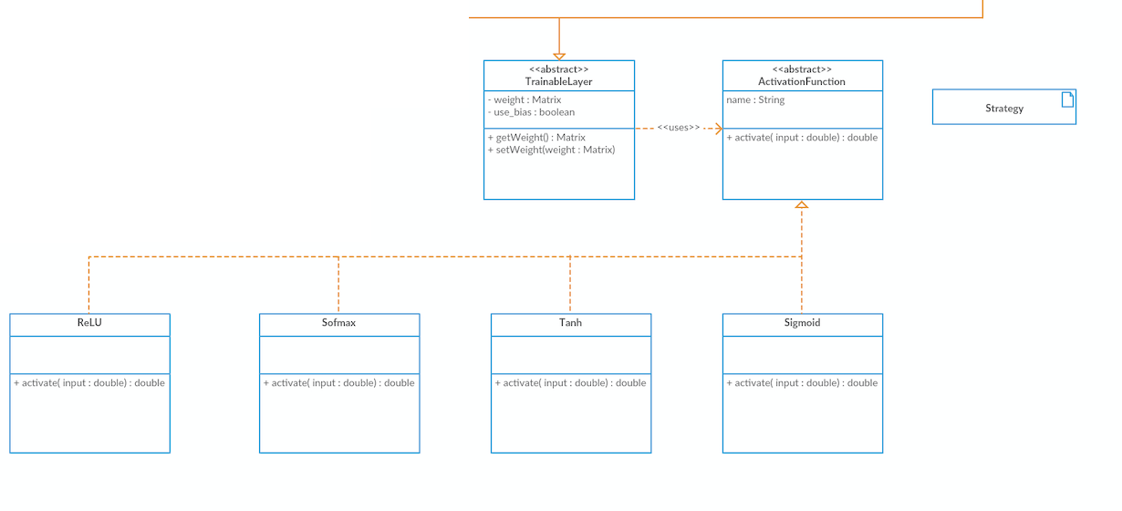
Architecture Description
Another interesting pattern to be used by layers is the strategy-pattern.

Slide 8
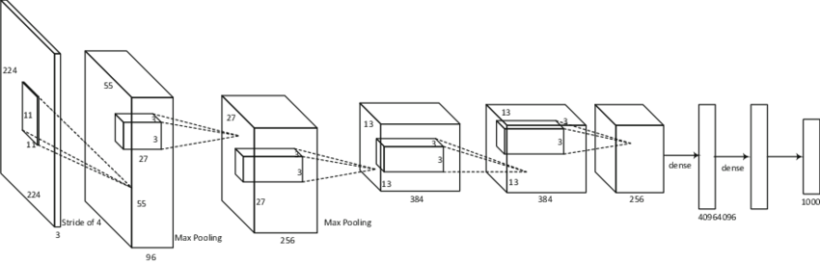
Architecture Description
In this context we define a family of algorithm, encapsulate each one and make them interchangeable. This approach also lets the algorithm vary independently from the layer that uses it.

Slide 9
UML Class Diagram

Slide 10
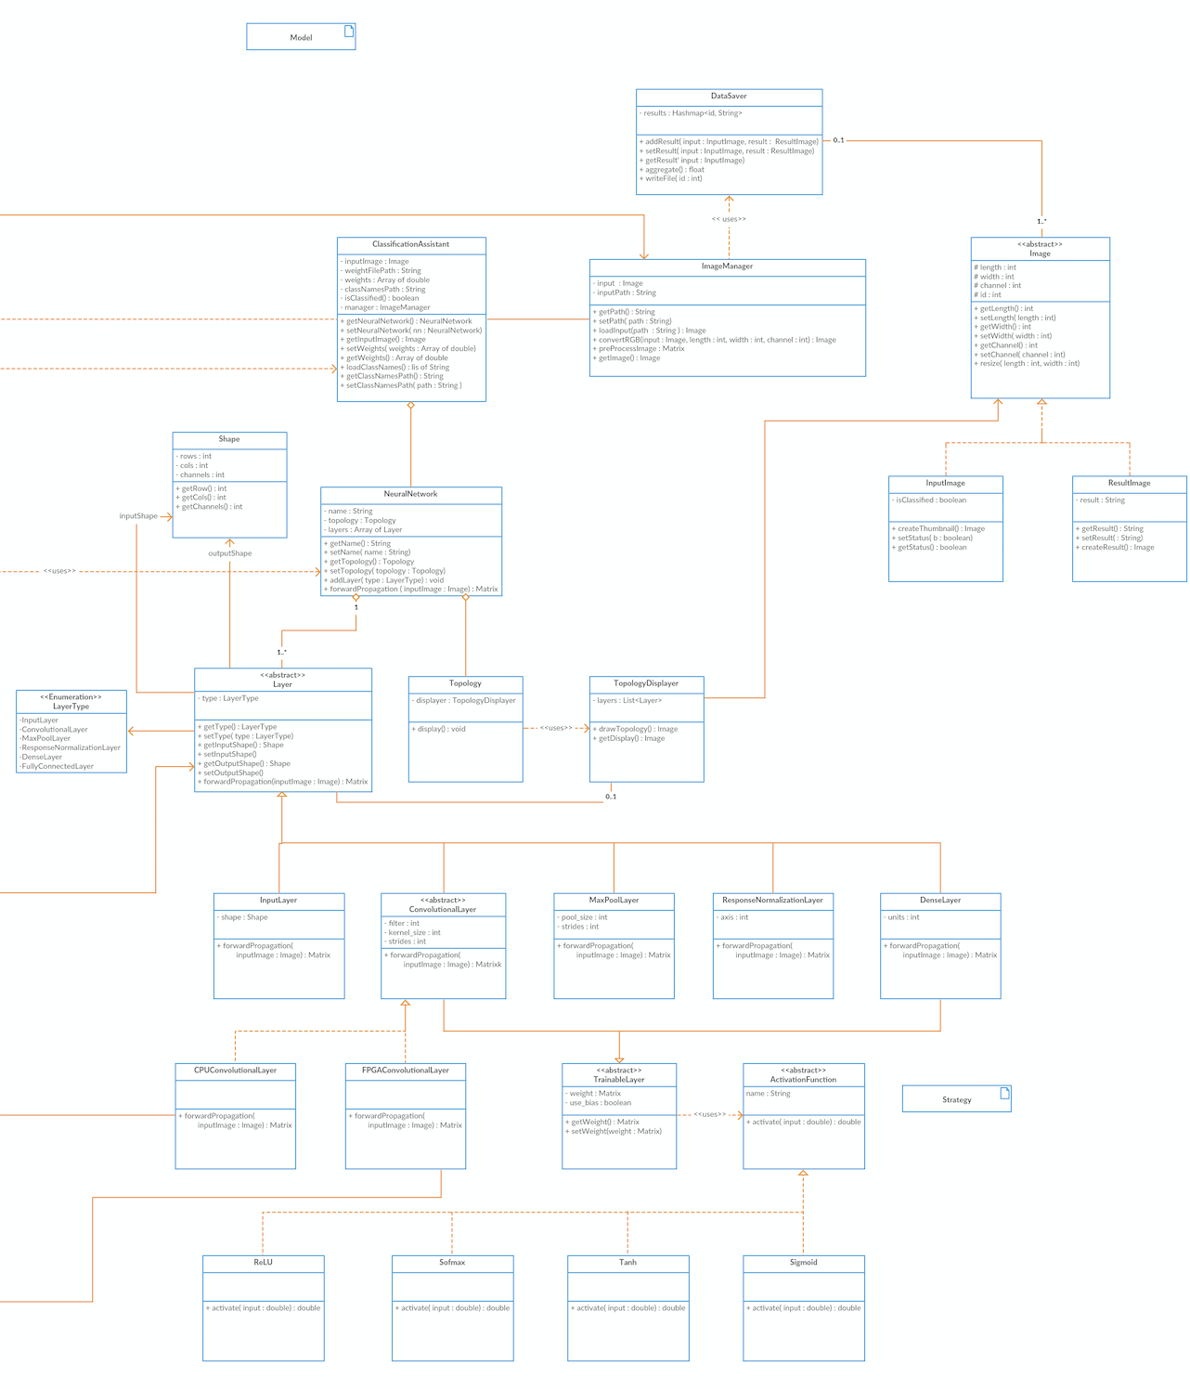
Model
UML Class Diagram

Slide 11
UML Class Diagram
Model Functionality Description
In model part, the classes realize the management of all the data and logic
They load the path of images and access their features.
The results of classification are stored in the type of string to be shown in various forms.
The logic of classification is determined by the neural network being used. Its topology defines how different layers interact with each other.
With the assistance of all the layers, the forward propagation functionality can be implemented, which is the core of algorithms for image classification with pre-trained model.

Slide 12
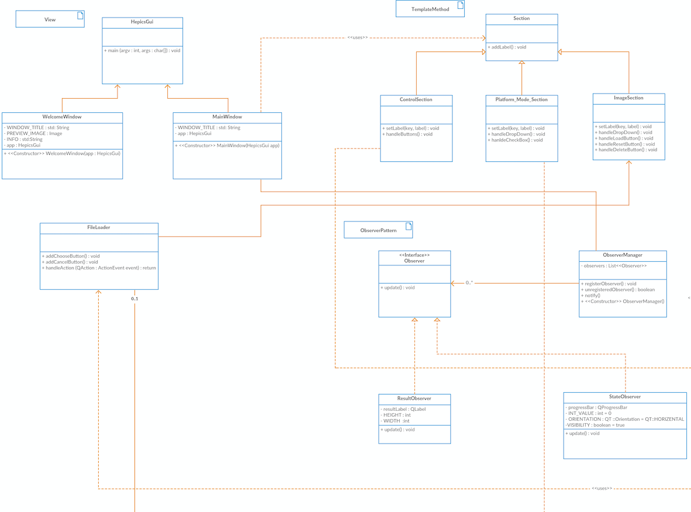
View
UML Class Diagram

Slide 13
UML Class Diagram
View Functionality Description
Realizes the user interfaces
The welcome window and the main window, which contains three different sections, guide the user to
upload their input images
select available platforms
choose operating mode
show the prediction results.

Slide 14
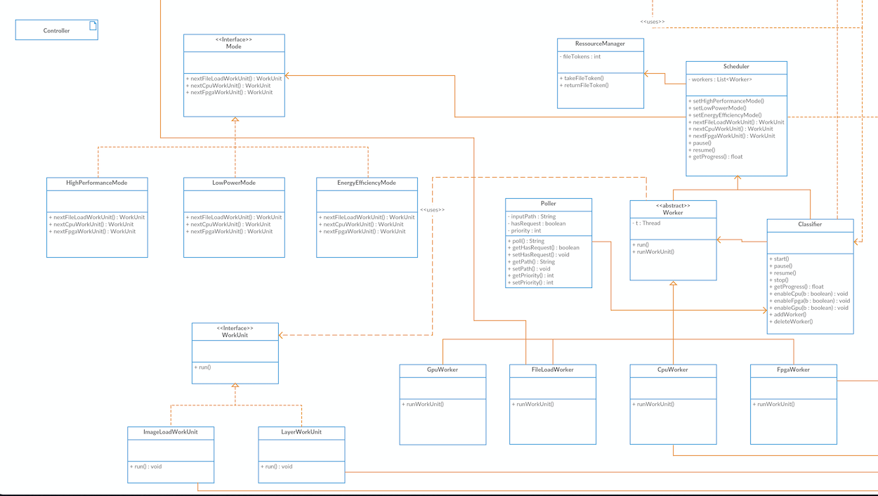
Controller
UML Class Diagram

Slide 15
UML Class Diagram
Controller Functionality Description
accepts user inputs handled by the components of the views and converts them to the commands.
The classifier controls the progress of processing and assigns the scheduler to dispatch work to workers in heterogeneous platforms.
In addition, the poller checks the requests from external systems regularly.
After receiving the correct request with the image path, the classifier starts the process of classification.

Slide 16
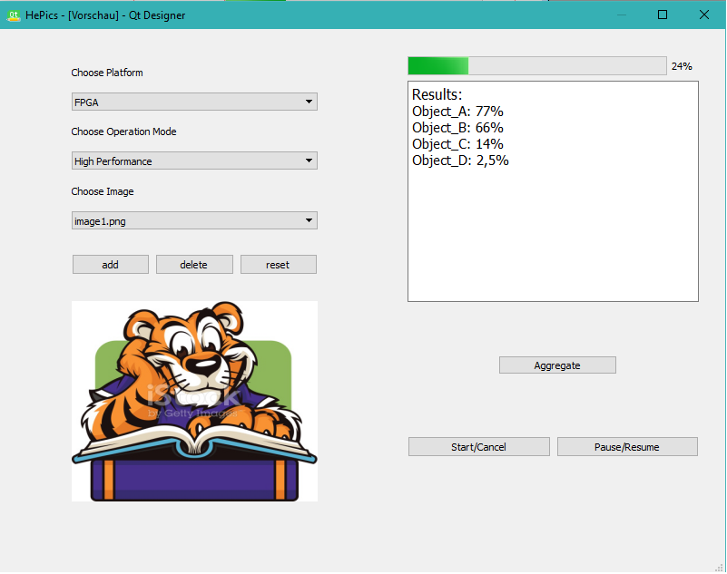
UML Class Diagram
Classes on GUI
Platform-Mode
Section
Results observer
Image section
Control section

Slide 17
Sequence Diagram

Slide 18
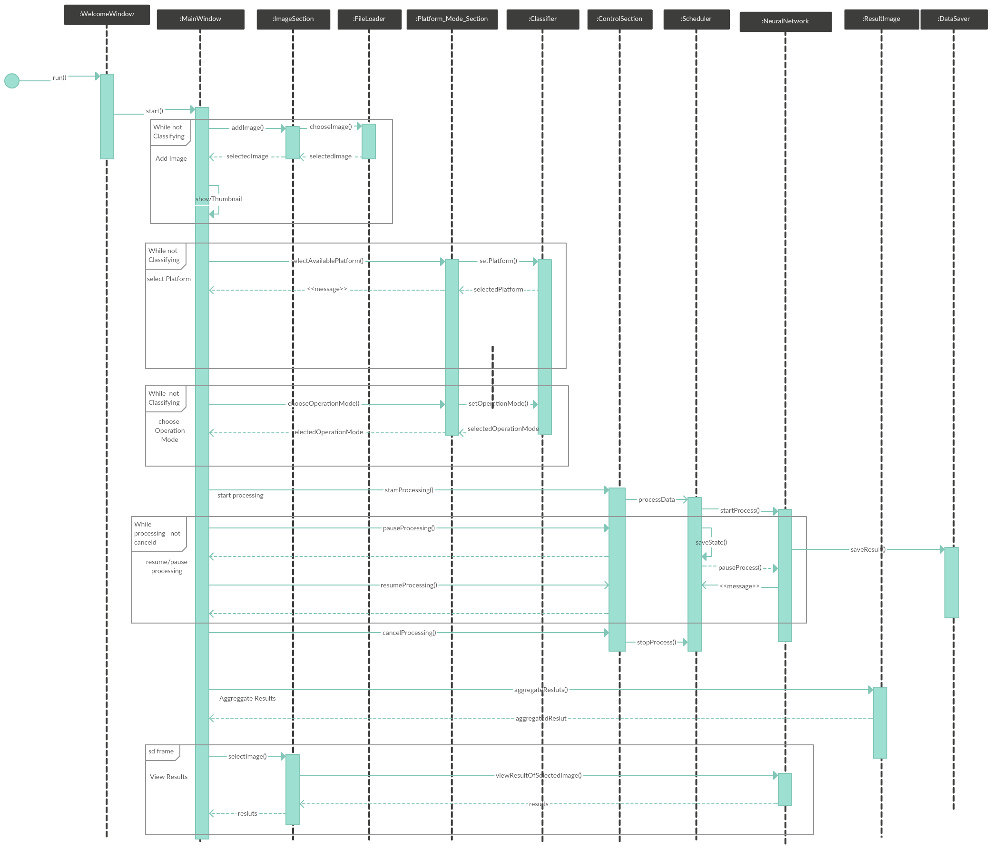
Sequence Diagram

Slide 19
State Diagram

Slide 20
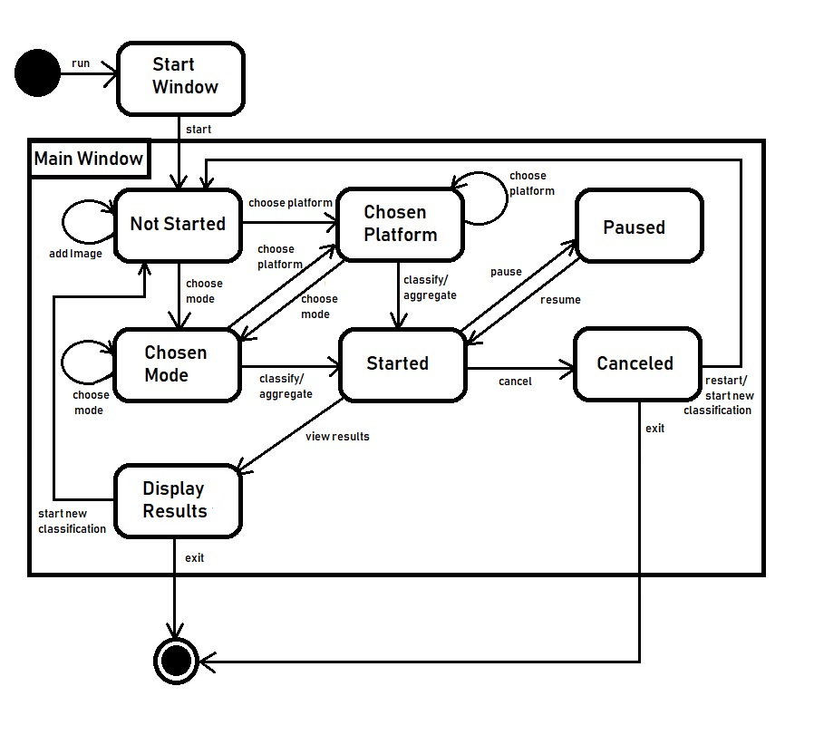
State Diagram

