Slide 1
Neural Network based Image Classification System on Heterogeneous Platforms
Linjuan Fan- Ibrahim Bouriga- Andres Stober- Bahaa Mhajne- Mehyar Cherni

Slide 2
Introduction
Image Classification System
Artificial Neural Network
Heterogeneous Platform

Slide 3
Target Specification
Must Requirements
Classify images.
Aggregate the results.
AlexNet as pre-trained deep ANN model.
Execute intense calculations through heterogeneous platforms.
Select the available platforms.
Three different operating modes.
Run GUI on Ubuntu system.
Interface for communication with external systems.

Slide 4
Target Specification
Can Requirements
GoogLeNet as another pre-trained model
Display topologies.
Choose other accelerators, such as GPU, ASICs or other FPGAs.
Deploy training of an arbitrary NN.
Carry out transfer learning of an already implemented NN.

Slide 5
Product Functions
Basic Functions
Choose input images.
Choose operation mode.
Choose available platforms.
Start/pause/resume/cancel the processing.
Show the results.
Check the request from external systems.
Send back results.

Slide 6
Product Functions
Optional Functions
Choose and show topologies.
Deploy training.
Transfer learning.
Show results in a clear form.
Write the output results into a new file.

Slide 7
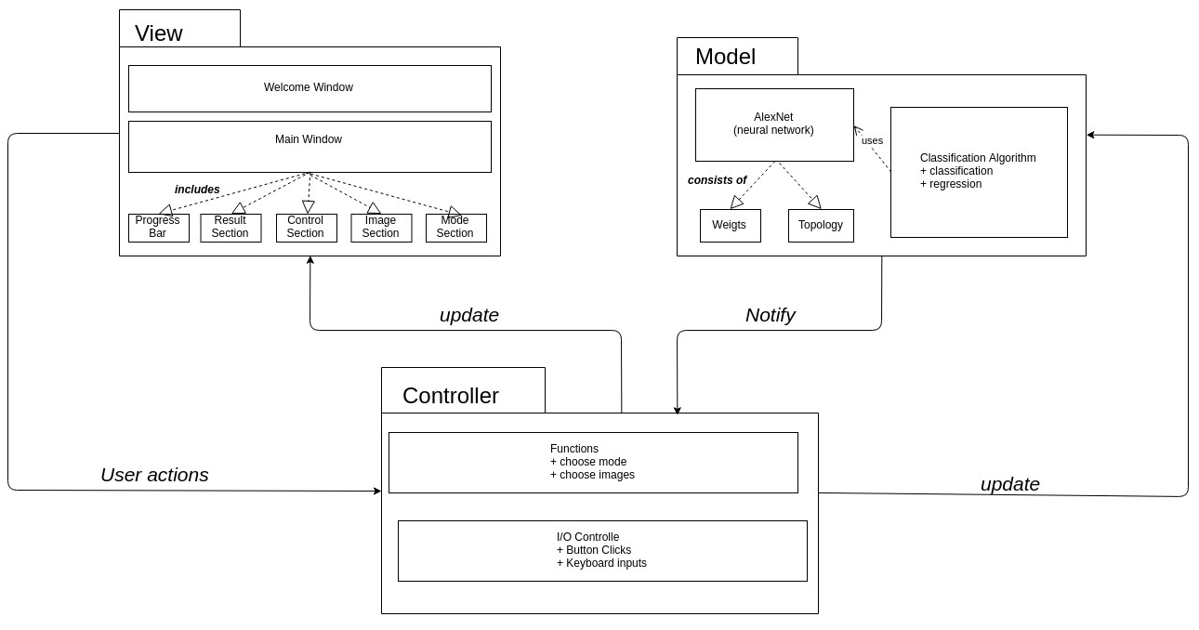
System Model: MVC Architecture Pattern

Slide 8
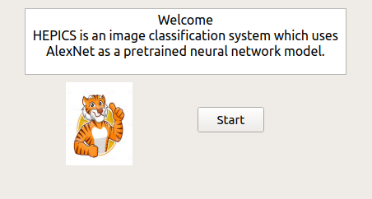
GUI

Slide 9
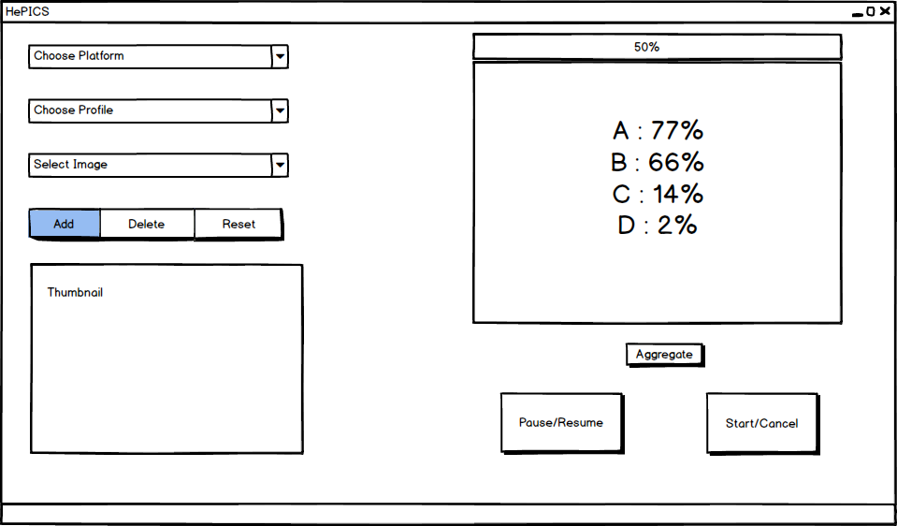
GUI

Slide 10
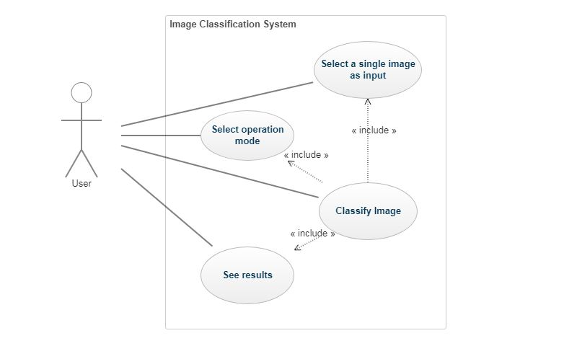
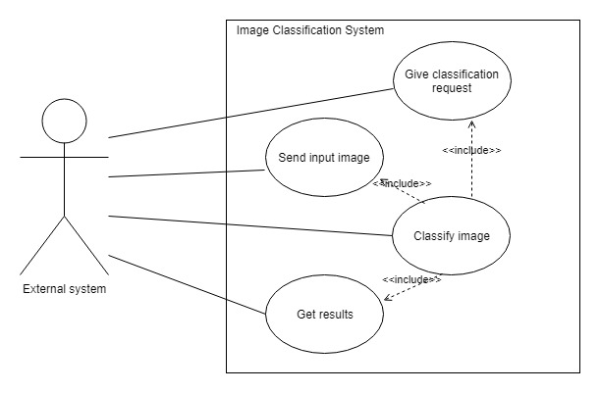
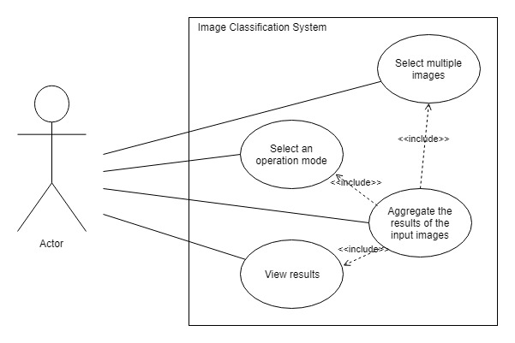
Use Case Diagram

Slide 11
Main Test Scenario
User starts the program
System displays Welcome screen
User clicks on the "start" button
System displays main window
User clicks on an "add image..." button
User selects input image(s)
System displays the thumbnail of the last selected image
User selects operating mode, available platform
System starts the processing
System displays results
User terminates the program

