Slide 1

ATML Project American Sign Language Recognition
Dominik Seliner
Mei ling Wong
Jiyoung Lee

Slide 2

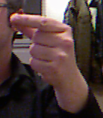
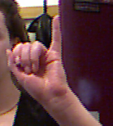


Our goal
∙ Alphabet Sign Language Detection
a
b
DenseNet
b
DenseNet
c
Learned weights
train
predict
∙ Achieve better result with different settings
Notes:
Our goal is to detect alphabets in American Sign Language.

Slide 3
Motivation
∙ Need for a sign language detection system
- functions as a universal language
- difficult to memorize all the hand poses and gestures

Slide 4
Challenges
Limited dataset
2) No depth Information
- no motion , could not train j and z
Notes:
Currently there are not many dataset that are available.

Slide 5
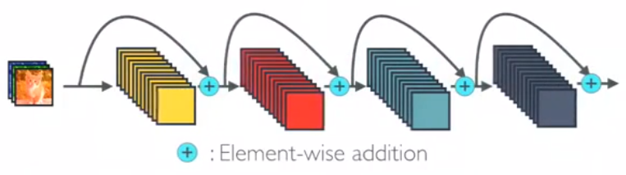
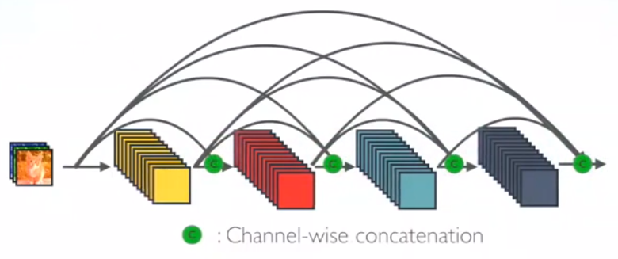
Network Architecture - DenseNet
logical extension of ResNet
concatenating outputs from previous layers instead of summation
Strong Gradient Flow
Encourage the feature reuse
Reducing the number of parameters
ResNet
DenseNet

Slide 6
Prior work

Slide 7
Dataset & Implementation
Dataset from “Spelling it out” paper > 50’000 static images of hand poses of letters without j and z, 5 different users
Dataset of 4 user for training, 1 user for test Adam optimizer with learning rate of 0.001 training for 300 epochs Mini-batch size of 32

Slide 8
Experiments
DenseNet with Data Augmentation
- Horizontal Flip
- Random Crop
- Resize
- Color Jittering ( brightness and contrast)
2) Two different datasets for the test
“Finger spelling” dataset
“Kaggle” dataset

Slide 9
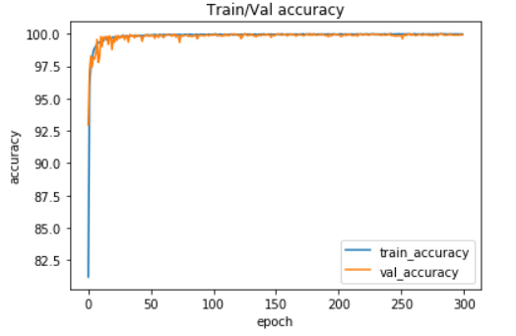
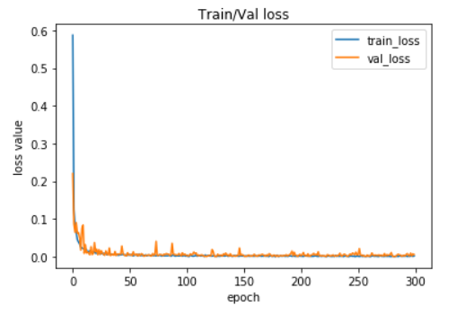
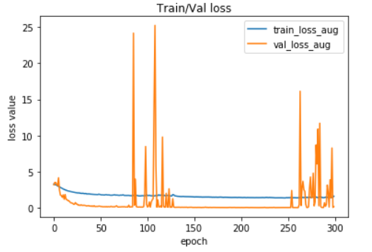
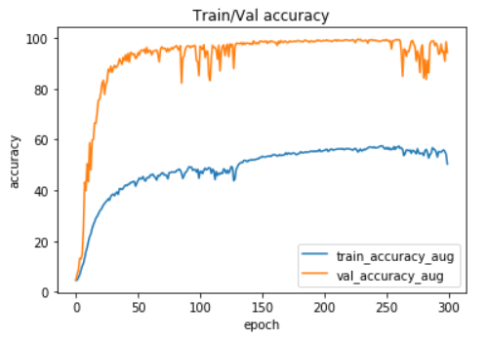
Results and analysis
DenseNet without Data Augmentation
Setting | Train accuracy | Validation accuracy
DenseNet | 99.9685 | 99.924
DenseNet with Augmentation | 50.3439 | 94.2264
DenseNet with Data Augmentation
Setting | “spelling” Test set | “Kaggle” Test set
DenseNet | 83.852 | 2.625
DenseNet with Augmentation | 65.138 | 4.739

Slide 10
Conclusions

Slide 11
References
Daroya at el. “Alphabet Sign Language Image Classification Using Deep Learning,” IEEE , 2018

