Slide 1
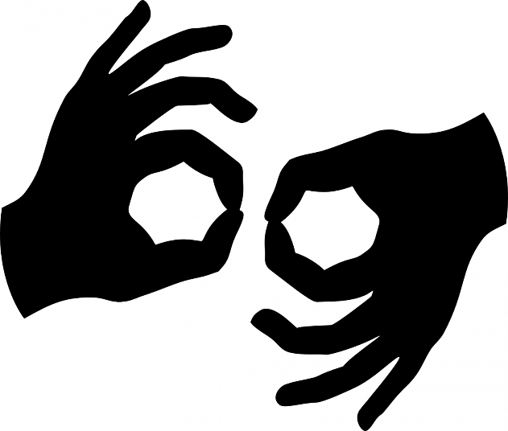
ATML Project American Sign Language Recognition
Dominik Seliner
Mei ling Wong
Jiyoung Lee

Slide 2

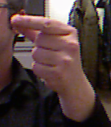
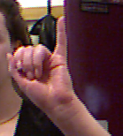


Our goal
∙ Alphabet Sign Language Detection
a
b
DenseNet
b
DenseNet
c
Learned weights
train
predict
∙ Achieve better result with different settings
Notes:
Our goal is to detect alphabets in American Sign Language.

Slide 3
Motivation
∙ Need for a sign language detection system
- functions as a universal language
- difficult to memorize all the hand poses and gestures

Slide 4
Challenges
Limited dataset
2) No depth Information
- no motion , could not train j and z
Notes:
Currently there are not many dataset that are available.

Slide 5
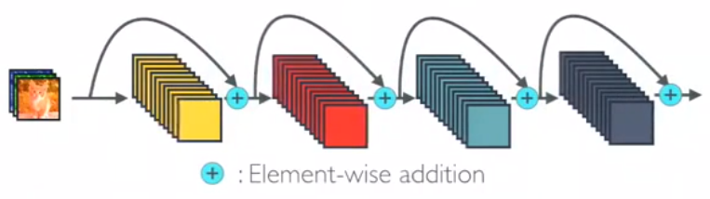
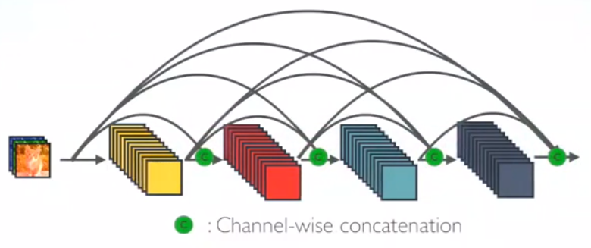
Network Architecture - DenseNet
Similar to ResNet: solve the vanishing-gradient problem
concatenating outputs from previous layers instead of summation
ResNet
DenseNet

Slide 6
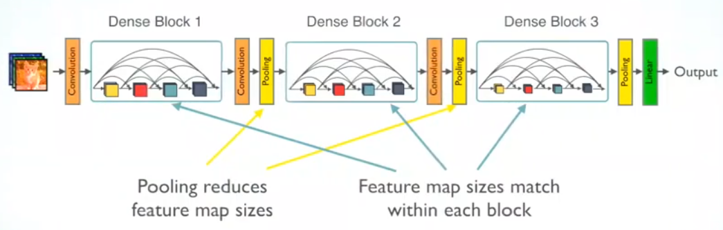
Network Architecture - DenseNet
Dense Block: multiple layers of batch normalization, relu activation and 3x3 convolutional layer
Transition layer: batch normalization, relu, a 1x1 convolutional layer and a 2x2 average pooling layer.

Slide 7
Network Architecture - DenseNet
Advantages:
Strong Gradient Flow
Encourage the feature reuse
Reducing the number of parameters

Slide 8
Dataset and general parameters
Dataset from “Spelling it out” paper > 50’000 static images of hand poses of letters without j and z, 5 different users
Dataset of 4 user for training, 1 user for test Adam optimizer with learning rate of 0.001 training for 300 epochs Mini-batch size of 32 ( DenseNet is Memory hungry)

Slide 9
Implementation & Experiments
DenseNet with and without Data Augmentation
- Random Horizontal Flip
- Random Crop
- Color Jittering (brightness and contrast)
2) Two different datasets for the test
“Finger spelling” dataset
“Kaggle” dataset

Slide 10
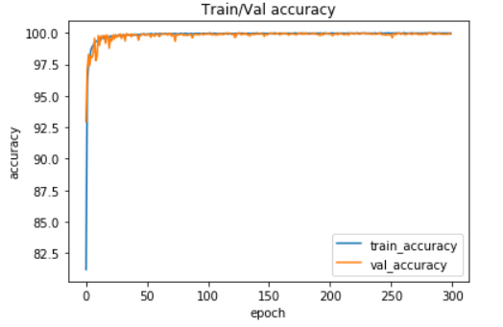
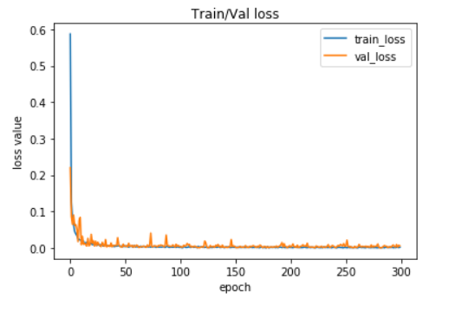
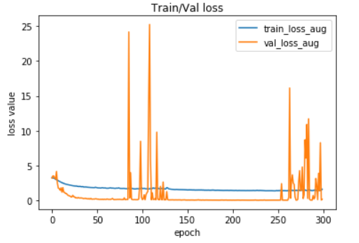
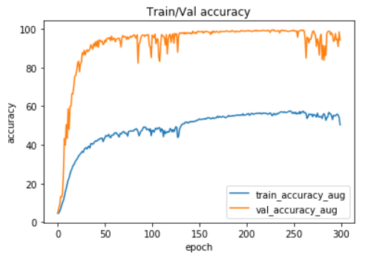
Results and analysis
DenseNet without Data Augmentation
Setting | Train accuracy | Validation accuracy
DenseNet | 99.9685 | 99.924
DenseNet with Augmentation | 50.3439 | 94.2264
DenseNet with Data Augmentation
Setting | “spelling” Test set | “Kaggle” Test set
DenseNet | 83.852 | 2.625
DenseNet with Augmentation | 65.138 | 4.739

Slide 11
Conclusions

Slide 12
References
Daroya at el. “Alphabet Sign Language Image Classification Using Deep Learning,” IEEE , 2018
G. Huang, Z. Liu, K. Q. Weinberger, and L. van der Maaten, “Densely connected convolutional networks,” in Proceedings of the IEEE conference on computer vision and pattern recognition
“finger spelling” dataset: http://empslocal.ex.ac.uk/people/staff/np331/index.php?section=FingerSpellingDataset
Kaggle dataset: https://www.kaggle.com/grassknoted/asl-alphabet
https://towardsdatascience.com/review-densenet-image-classification-b6631a8ef803

