Slide 1


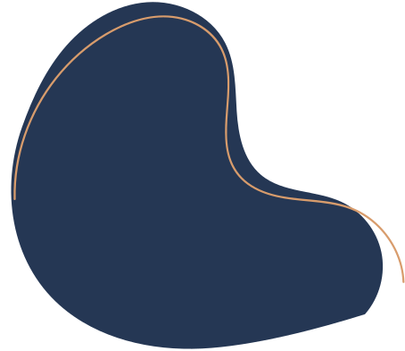
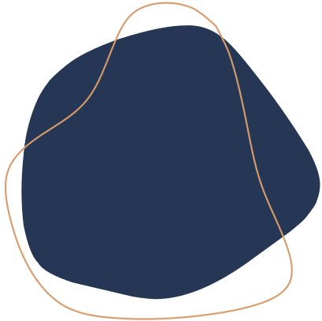
RAG SYSTEM FOR
Exchange PROGRAM Q&A
Meichen Dong

Slide 2
TABLE OF
CONTENT
01
02
03
04
05
06
07
Overview & Motivation
System Architecture
Experiments & Evaluation
Key Results at a Glance
Prompt Template Experiments
Gradio Interface
Conclusion

Slide 3

OVERVIEW & MOTIVATION
There are 8 official exchange program PDFs, Students must read everything manually.
Information scattered across files, Hard to compare universities
Time-consuming and error-prone
build a Retrieval-Augmented Generation (RAG) system
Users can ask questions in natural language and receive concise answers based on the official program materials.

Slide 4







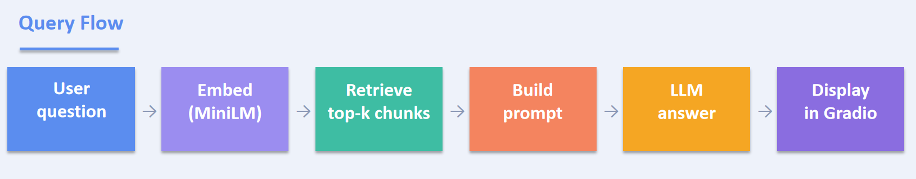
SYSTEM ARCHITECTURE
01
02
03
04
05
06
PDF
Loading
Chunking
Embedding
ChromaDB
LLM
Gradio UI

Slide 5
EXPERIMENTS & EVALUATION
6.1 RAG vs. No RAG
Without retrieval the LLM hallucinates. RAG is essential.
6.2 Embedding Models
all-MiniLM-L6-v2 outperforms paraphrase-MiniLM-L3-v2
6.3 Top-k Chunks
k = 4 gives the best balance; beyond 4 adds noise
6.4 Response Time
Average end-to-end latency ~2.3 s per query
6.5 LLM Comparison
Qwen2.5-72B gives more complete answers than zephyr-7b
6.6 Prompt Templates
Role-based > Structured > Basic
6.7 Accuracy
75% accuracy — 6 of 8 questions correct.

Slide 6
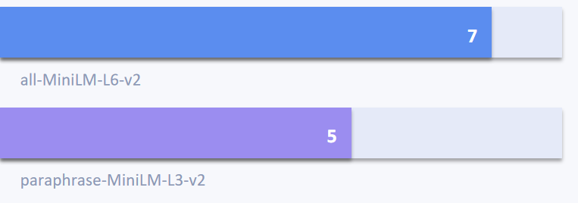
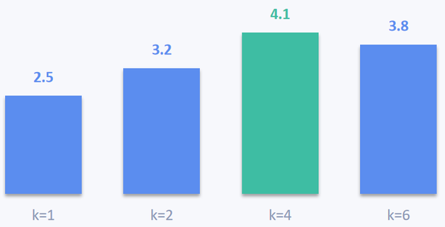
KEY RESULTS AT A GLANCE
Embedding comparison — retrieved hits (8 test queries)
Accuracy
Avg. response
75%
2.3s
Best chunk count
Correct
answers
Answer quality by top-k (1–5 scale, estimated)
k = 4
6 / 8

Slide 7

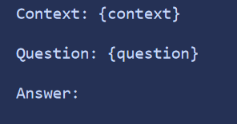

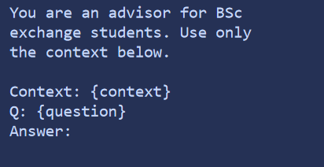
PROMPT TEMPLATE
EXPERIMENTS (6.6)
BASIC
STRUCTURED (XML)
ROLE-BASED
Simple but unreliable — LLM
sometimes ignores context.
XML tags help the model
distinguish context from query.
Best results — role framing
produces precise answers.
Baseline
Better
Best !!

Slide 8
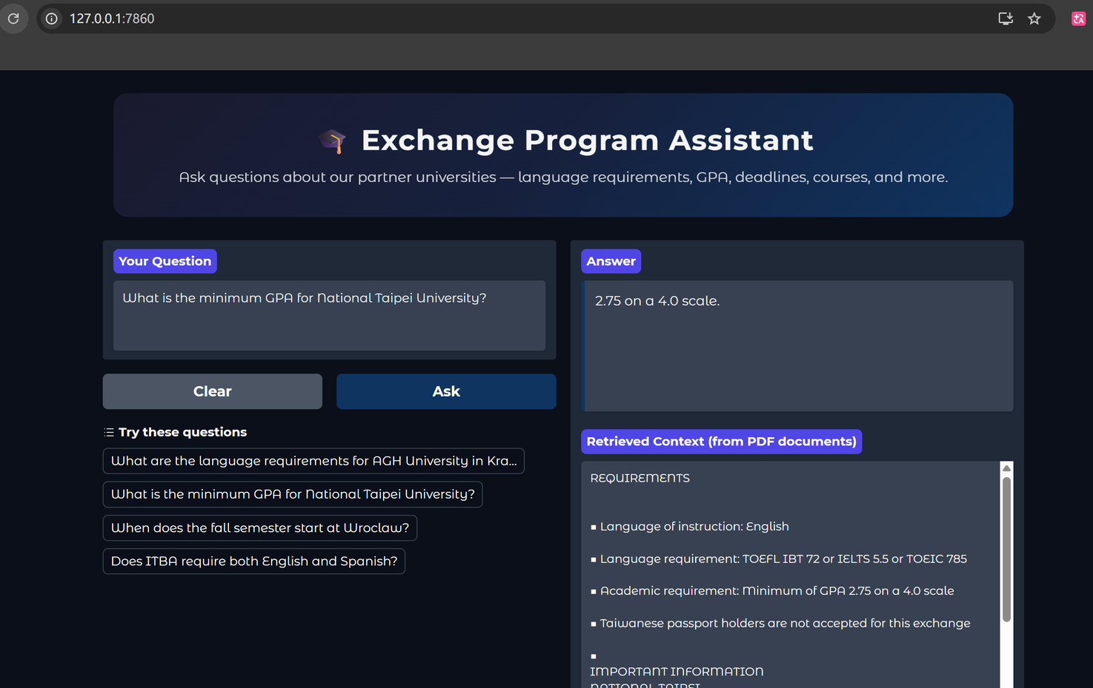
GRADIO INTERFACE

Slide 9
CONCLUSION
RAG pipeline successfully retrieves relevant information from 8 exchange PDFs
ChromaDB PersistentClient enables fast, persistent semantic search on disk
Role-based prompt template consistently produces the most accurate answers
75% accuracy — 6 of 8 manually labelled questions answered correctly
Gradio interface makes the system accessible without technical knowledge
Future work: fine-tuned embeddings, larger evaluation set, multilingual support

Slide 10
THANK YOU

