Slide 1
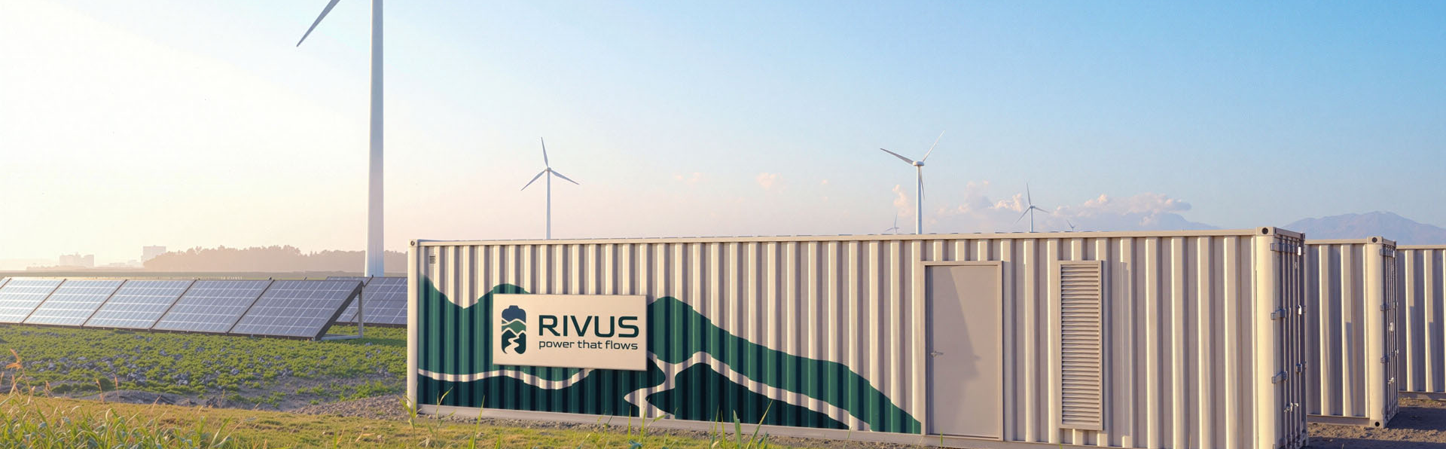

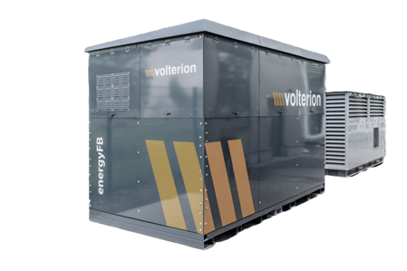
Familjebostäder
Familjebostäder
Simulation Findings Sheet
Siriusgatan 54-58
We simulated how a 150 kWh, 25 kW battery + PV affects your electricity cost and grid fees based on your 2025 data. Key outcomes:
6.5 – 10.0 years
16.6% – 100%
1.3x
Payback time of the battery
With Peak Shaving, Arbitrage, and Ancillary Market revenues
Electricity cost reduction
Compared to 2024-2025
Without PV & Battery: €0.034-€0.054
Increase in self-sufficiency
% of on-site electricity demand met by PV with “self-sufficiency” objective
Revenue Share by type*
Peak Shaving 20.5%
Arbitrage 29.0%
^{13-ft Organic flow battery}
Fire-proof, sustainable & low lifecycle cost
Ancillary Market Revenue 50.5%
Specifications and parameters
Battery type: Organic Flow Battery, 13-ft
Power rating: 25 kW
Capacity rating: 150 kWh
Investment cost: €60000 (€400/kWh | Includes: battery, PCS, BoP. Excludes: Installation cost)
Pilot lifetime guarantee: >5000 cycles or 7 years with >70% remaining capacity
Round-trip efficiency: 72.2% AC-AC
Operating SOC window: 100%
Electricity demand data: Jan 2025 - Nov 2025
Electricity cost & FCR data: Jan 2024 – Nov 2025
Additional Information
Hourly demand data was provided together with hourly PV production for part of 2024 and 2025. Although after inspection we found that small irregularities might have been present within the raw demand data, we discussed with Familjebostader and decided the irregularities were negligible.
info@rivus-batteries.com 0046 763 01 29 16 www.rivus-batteries.com

Slide 2
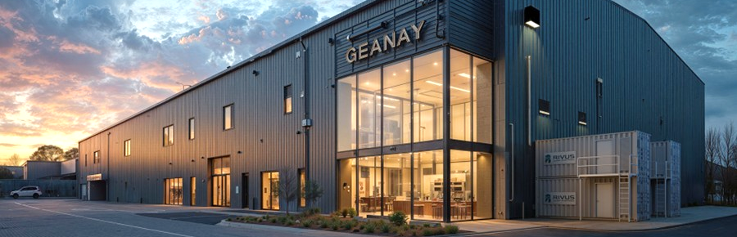

Findings – Siriusgatan Average annual demand: 73.0 MWh Total PV generation in period: 74.0 MWh
 | 2024 |  |  | 2025
Simulation / ​​Use-case | Baseline | Battery I (150 kWh, 25 kW) | Battery II (150 kWh, 25 kW) | Baseline | Battery I (150 kWh, 25 kW) | Battery II (150 kWh, 25 kW)
 | PV installed | Peak Shaving, Arbitrage, Ancillary Market revenues | Self-sufficiency objective and Peak Shaving, Arbitrage, Ancillary Market revenues | PV installed | Peak Shaving, Arbitrage, Ancillary Market revenues | Self-sufficiency objective and Peak Shaving, Arbitrage, Ancillary Market revenues
Total investments PV or Battery (B) | PV: €0 B: €0 | PV: €0 B: €60000 | PV: €0 B: €60000 | PV: €0 B: €0 | PV: €0 B: €60000 | PV: €0 B: €60000
Average electricity cost / year | €0.008/kWh | €0.0026/kWh | €0.0066/kWh | €0.013/kWh | €0/kWh | €0.0066/kWh
Total annual electricity cost | €638.0 | €214.0 | €533.0 | €1095.0 | €0* | €539.0
Annual ancillary market revenue | - | €7780.0 | €6703.0 | - | €4284.0 | €4418.0
Grid fees saved | - | €1012.0 | €1005.0 | - | €950.0 | €1023.0
Annual savings from the Battery (B) & PV | - PV: €2112.0 | B: €9216.0 PV: €2112.0 | B: €7814.0 PV: €2112.0 | - PV: €3300.0 | B: €7231.0 PV: €3300.0 | B: €5997.0 PV: €3300.0
Payback time Battery | - | 6.5 years | 7.7 years | - | 8.3 years | 10.0 years
Self-sufficiency % of on-site electricity demand met by PV | 59.2% | 59.5% | 75.7% | 59.3% | 63.8% | 77.1%
Equivalent Full Cycles per year | - | 60.6 cycles | 100.4 cycles | - | 161.3 cycles | 97.7 cycles
Time inside SoC 20%-80% | - | 75.9% | 79.0% | - | 60.9% | 77.4%
Total MWh charged /discharged | - | 9.1 MWh | 15.1 MWh | - | 24.2 MWh | 14.7 MWh
* An annual profit of €901.0 was made
info@rivus-batteries.com 0046 763 01 29 16 www.rivus-batteries.com

Slide 3
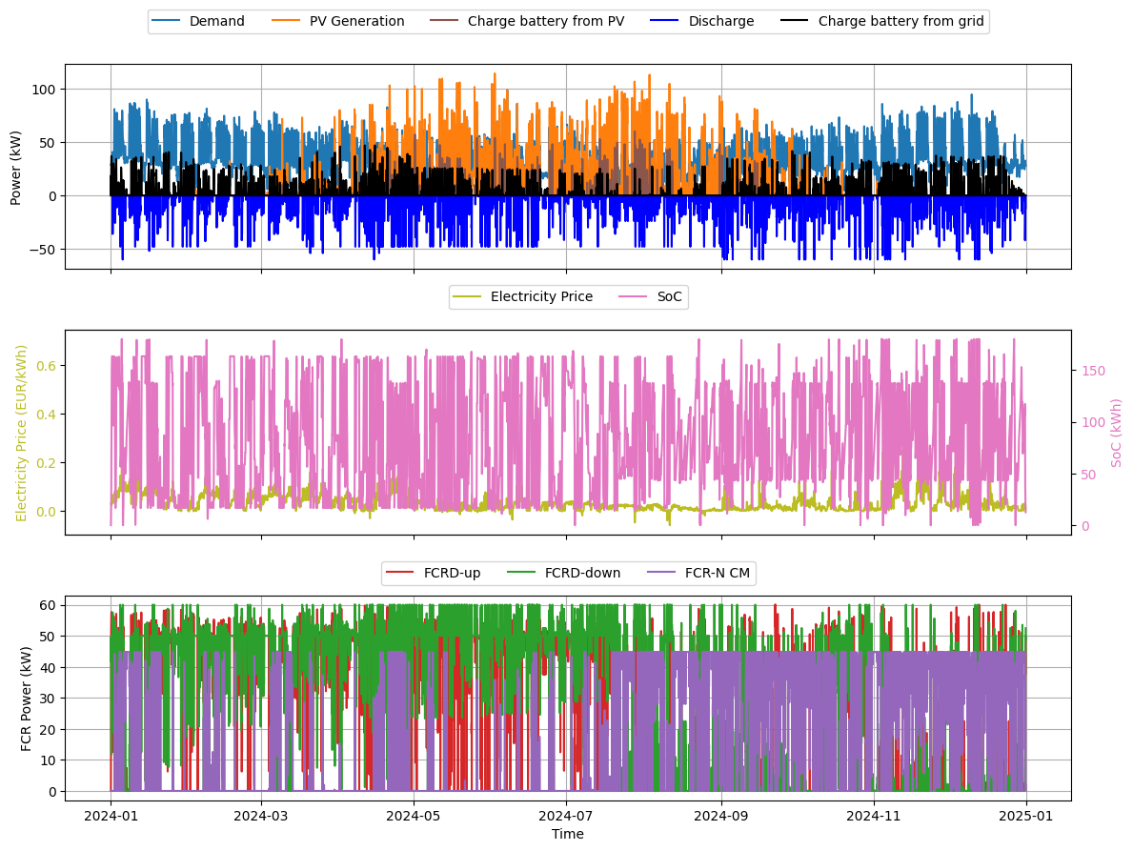
Simulation results in more detail
check
We invite those interested to explore the batteries’ behaviour. How? Click on this link here and use the controls to select the cases as seen in the findings sheet above to learn more!
The graphs below also gives an overview how the battery is used to maximize revenue and find the shortest payback time.
Amount of energy charged (black) and discharged (blue)
Electricity price (yellow) and the battery’s state of charge (pink)
Bid quantity of ancillary services for the various capacity markets
Key assumptions and parameters
Electricity cost Day-ahead prices SE3, repeated over lifetime
Ancillary market revenue Participation in FCR-N,FCR-D up/down, mimer.svk.se
Grid fees costs saved Effect of peak shaving on demand charges (4 €/kW)
Operating SOC window: 100%
IRR/NPV N/A – not used in the simulation
If you’d like to move forward, we’d be happy to outline the next steps! Just let us know if you have any questions. We are ready to deliver the 25 kW, 150-kWh battery in 2027.
info@rivus-batteries.com 0046 763 01 29 16 www.rivus-batteries.com

