Slide 1
JIVE On Single Cell RNA Sequencing Data
Meilei Jiang
Department of Statistics & Operations Research
University of North Carolina at Chapel Hill

Slide 2
Single Cell RNA Sequencing Data
Dataset: Chen and Zhou (2016)
251 samples of mouse embryonic stem cells
74 samples cultured in a two-inhibitor (2i) medium
45 samples cultured in a serum medium
56 samples with pooled RNA cultured in a 2i medium
76 samples with pooled RNA cultured in a serum medium
RNA sequencing
2795 genes as targets
17 ERCC spike-ins as controls

Slide 3
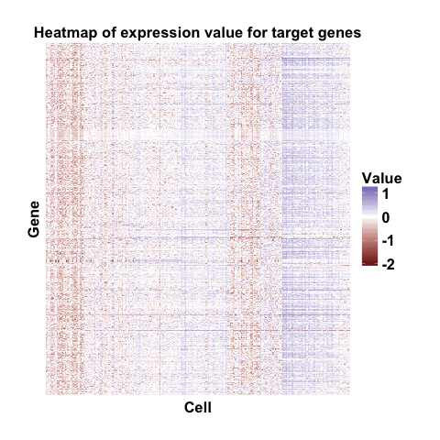
Target Genes

Slide 4

Control Gene: ERCC spike-ins

Slide 5
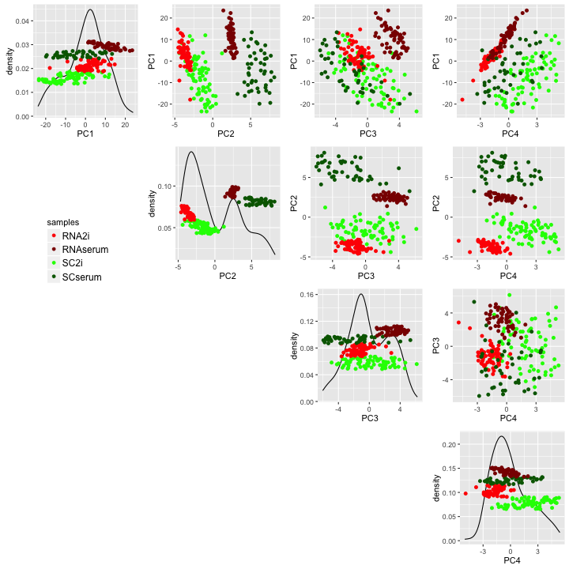
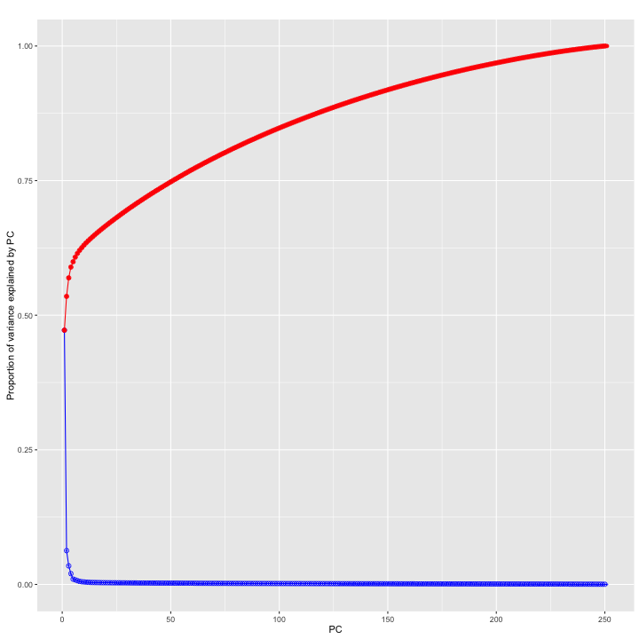
PCA On Expression Matrix Of Target Genes
PCA Scatter Plot
PCA Scree Plot

Slide 6
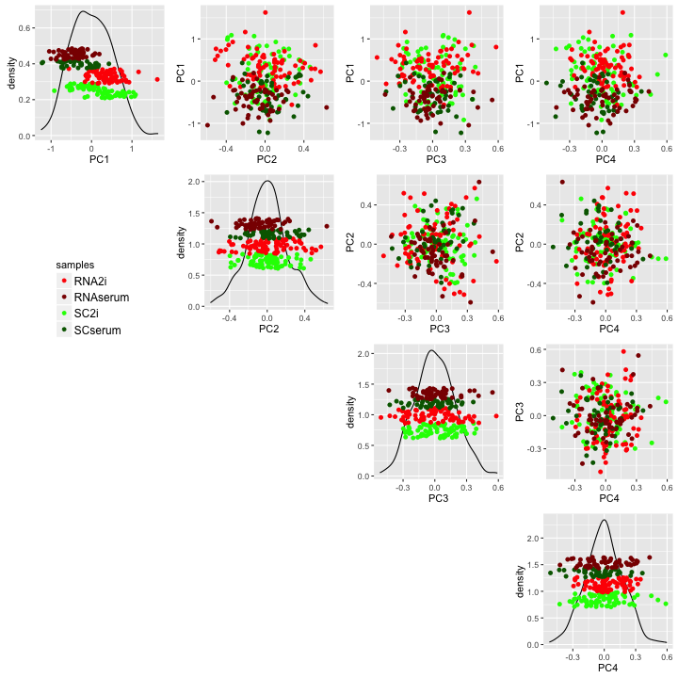
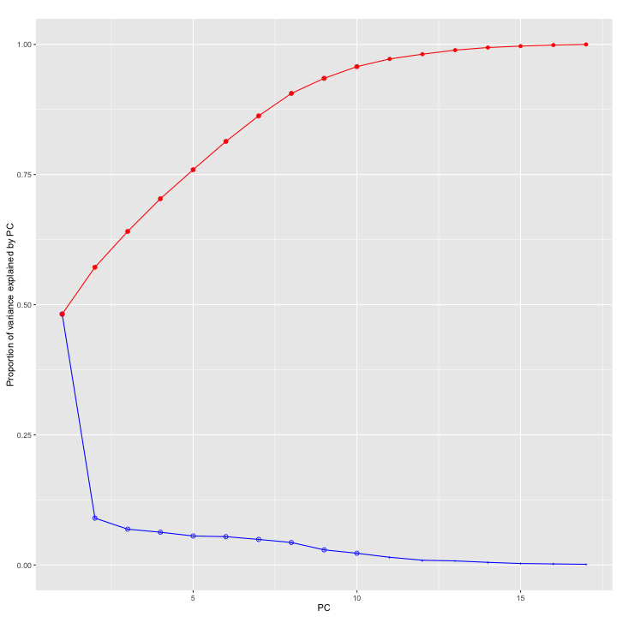
PCA On Expression Matrix Of Spike-ins
PCA Scatter Plot
PCA Scree Plot

Slide 7
JIVE Analysis On Both Targets and Controls
Apply JIVE on expression matrices from both target genes and spike-ins.
Use r package ‘r.jive’ (O'Connell and Lock 2016)
JIVE Estimation
Rank of joint subspace: 1
Rank of individual subspace:
Target genes: 7
Spike-ins: 1

Slide 8
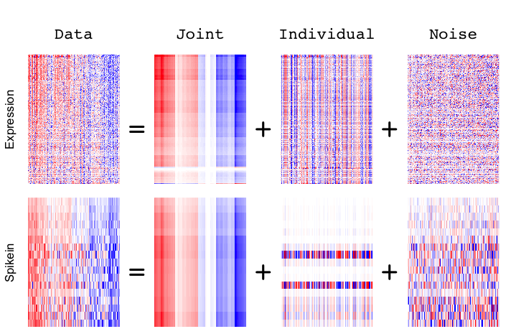
JIVE Decomposition On Expression Matrices From Targets and Controls

Slide 9
Variance Explained By JIVE

Slide 10
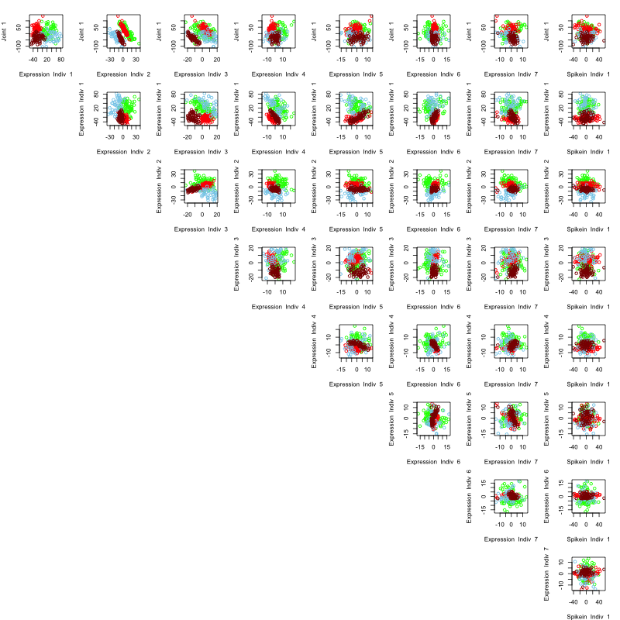
Biological Relevance

Slide 11
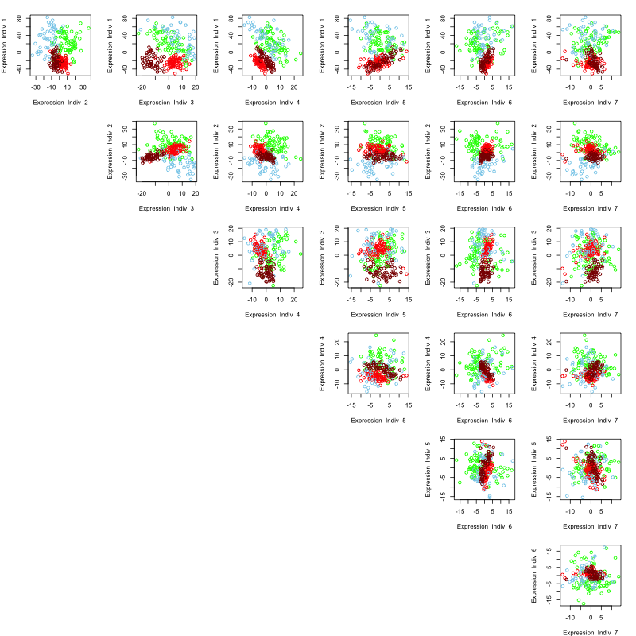
Biological Relevance In Individual Subspace Of Target Genes

Slide 12
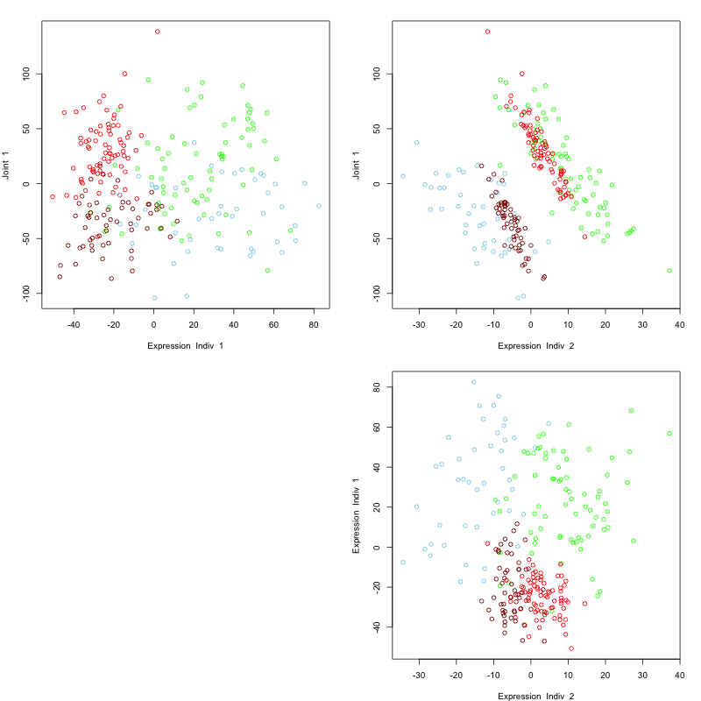
Biological Relevance In Joint Subspace And Individual Subspace Of Targets

Slide 13
Introduction to Joint and Individual Variation Explained
Slides modified from Qing Feng

Slide 14
Integrated Analysis
Lock et al (2013) : Joint and individual variation explained (JIVE)
Formulate it into a matrix decomposition problem
But no guarantee of satisfying the definitions
Slow iterative computation
A need for arbitrary normalization
Feng et al (2016) : Non-iterative Joint and Individual Variation Explained
An insightful interpretation of extracted variation
Fast non-iterative calculation
Improve identifiability
Normalization-free heterogeneity addressment
Notes:
Literature review

Slide 15
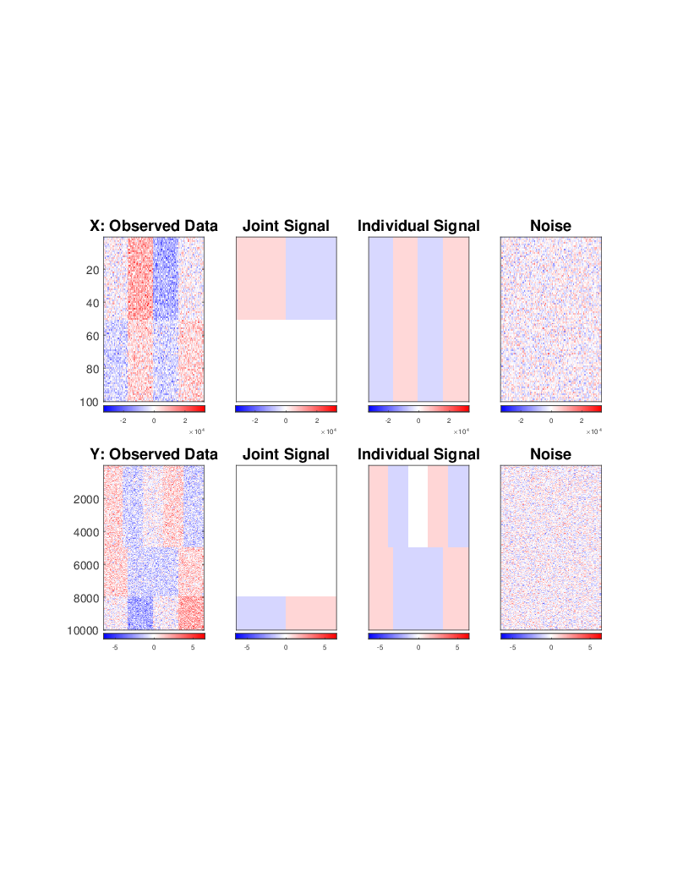


Toy Example
Analyze a two-block data set
Example:
X = Gene expression (GE)
Y = Copy number (CN)
$$100×100$$
$$10000×100$$

Slide 16
Toy Example
Sum of two types of signals and noise
Example:
X = Gene expression (GE)
Y = Copy number (CN)

Slide 17
Toy Example
Matrices containing joint variation
Example:
X = Gene expression (GE)
Y = Copy number (CN)
one variation component
a contrast between the left and right halves

Slide 18
Toy Example
Matrices containing individual variation
Example:
X = Gene expression (GE)
Y = Copy number (CN)
one contrast in X and two contrasts in Y

Slide 19
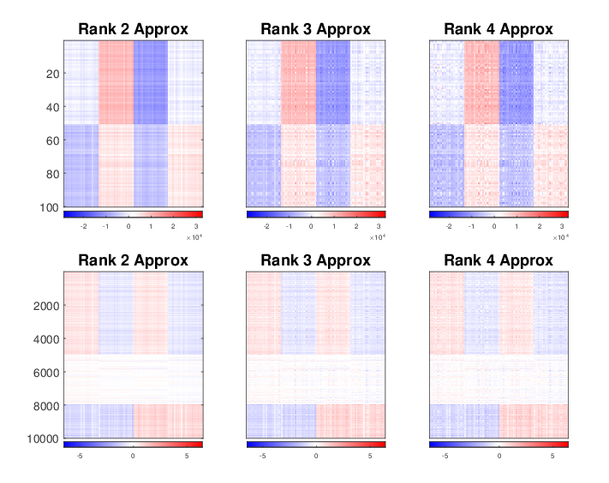
Toy Example
SVD on concatenation of the two matrices
Only capture signals in X
Lose individual signals in Y

Slide 20
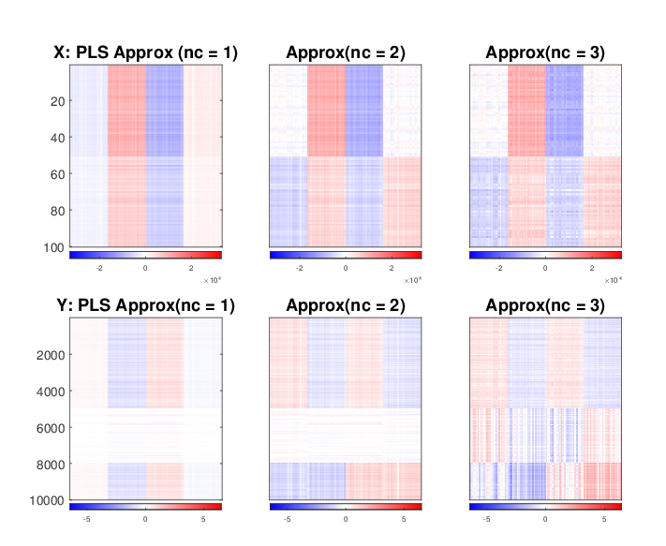
Toy Example
PLS analysis
Provide mixtures of the joint and some individual
Fail to distinguish the two types of variation

Slide 21
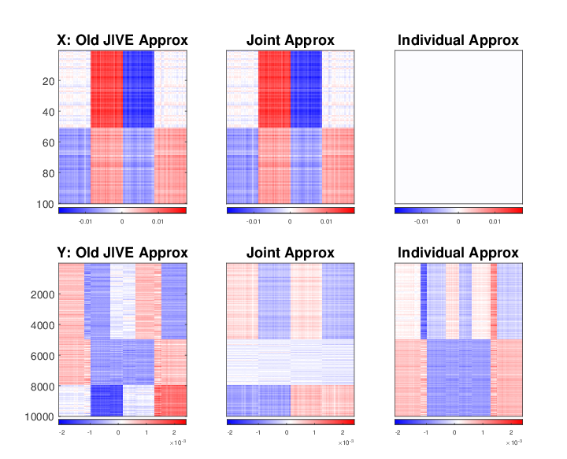
Toy Example
Old JIVE
Incorrectly contain the individual X in the joint
A Frobenius normalization

Slide 22
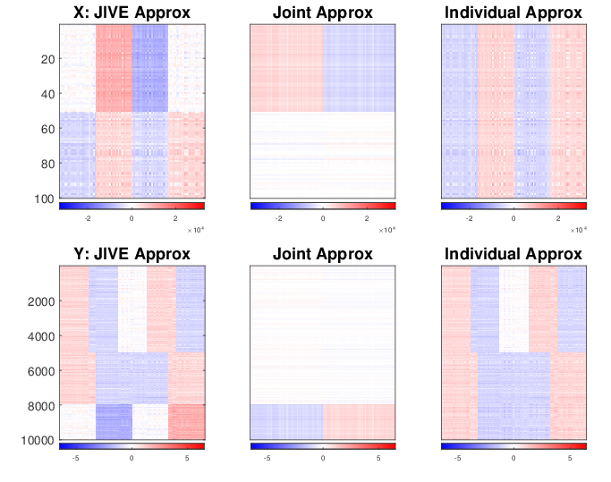
Toy Example
Non-iterative JIVE
Well capture the two types of signal

Slide 23













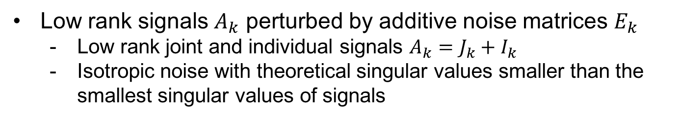




Population Model
Identifiable JIVE decomposition for data blocks $X_{k}, k=1, ⋯, K$
$$d_{1}×n$$
$$X_{1}$$
=
$$J_{1}$$
+
$$I_{1}$$
+
$$E_{1}$$
$$X_{2}$$
=
$$J_{2}$$
+
$$I_{2}$$
+
$$E_{2}$$
$$d_{2}×n$$
$$⋮$$
$$⋮$$
$$⋮$$
$$⋮$$
$$X_{K}$$
=
$$J_{K}$$
+
$$I_{K}$$
+
$$E_{K}$$
$$d_{K}×n$$
Low rank signals $A_{k}$ perturbed by additive noise matrices $E_{k}$
Low rank joint and individual signals $A_{k}=J_{k}+I_{k}$
Isotropic noise with theoretical singular values smaller than the smallest singular values of signals

Slide 24

Population Model
Identifiable JIVE decomposition for data blocks $X_{k}, k=1, ⋯, K$
$$d_{1}×n$$
$$X_{1}$$
=
$$J_{1}$$
+
$$I_{1}$$
+
$$E_{1}$$
$$X_{2}$$
=
$$J_{2}$$
+
$$I_{2}$$
+
$$E_{2}$$
$$d_{2}×n$$
$$⋮$$
$$⋮$$
$$⋮$$
$$⋮$$
$$X_{K}$$
=
$$J_{K}$$
+
$$I_{K}$$
+
$$E_{K}$$
$$d_{K}×n$$
Matrices containing joint variation
Same row spaces model common latent variation
$Row\left(J_{k}\right)≜Row(J)⊆{ℝ }^{n}$, $k=1, ⋯, K$

Slide 25











Population Model
Matrices containing joint variation
$Row\left(J_{k}\right)≜Row(J)⊆{ℝ }^{n}$, $k=1, ⋯, K$
Joint score subspace
$$U$$
$$Σ$$
$$V^{T}$$
Might be different sets of basis
But span the exact same row space
$$J_{1}$$
=
$$J_{2}$$
=
In the toy example
$$V^{T}$$
$$⋮$$
$$⋮$$
$$J_{K}$$
=
$$V^{T}$$

Slide 26

Population Model
Matrices containing joint variation
$Row\left(J_{k}\right)≜Row(J)⊆{ℝ }^{n}$, $k=1, ⋯, K$
Joint score subspace
$$U$$
$$Σ$$
$$V^{T}$$
Can be very different for each block
$$J_{1}$$
=
$$J_{2}$$
=
In the toy example
$$⋮$$
$$⋮$$
$$J_{K}$$
=

Slide 27
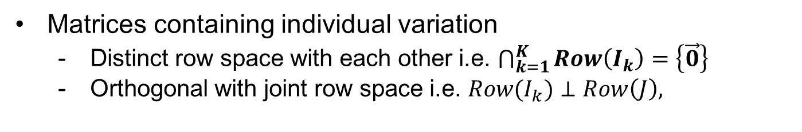
Population Model
Identifiable JIVE decomposition for data blocks $X, Y$
$$d_{1}×n$$
$$X_{1}$$
=
$$J_{1}$$
+
$$I_{1}$$
+
$$E_{1}$$
$$X_{2}$$
=
$$J_{2}$$
+
$$I_{2}$$
+
$$E_{2}$$
$$d_{2}×n$$
$$⋮$$
$$⋮$$
$$⋮$$
$$⋮$$
$$X_{K}$$
=
$$J_{K}$$
+
$$I_{K}$$
+
$$E_{K}$$
$$d_{K}×n$$
Matrices containing individual variation
Distinct row space with each other i.e. $\bigcap_{k=1}^{K}{Row\left(I_{k}\right)}=\left\{\vec{0}\right\}$
Orthogonal with joint row space i.e. ${Row(I}_{k})⊥Row\left(J\right),$

Slide 28
Estimation Approach
A three-step algorithm
Step 1: Initial signal extraction by low rank SVD approximation
Step 2: Extract the joint score space based on perturbation theory
Step 3: Reconstruct based on projection onto each estimated row spaces

Slide 29
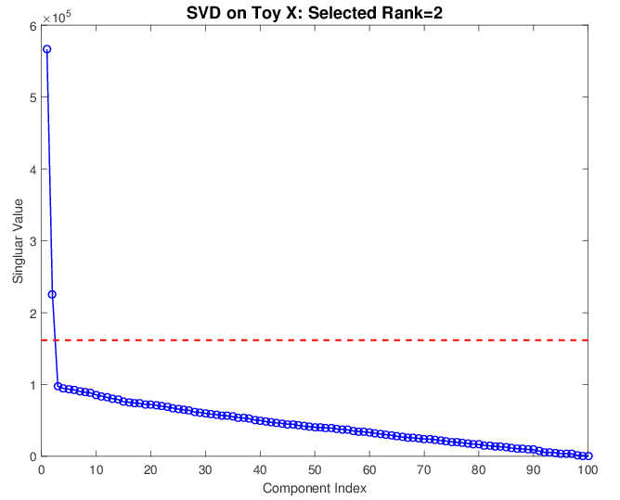
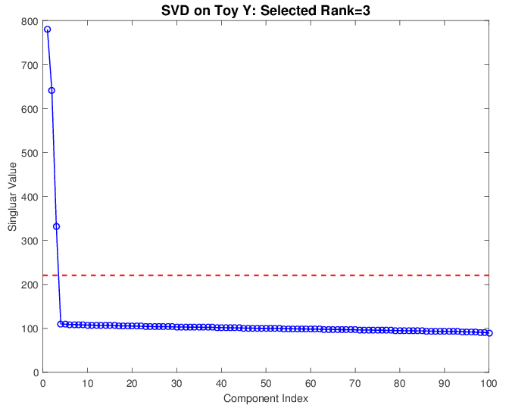
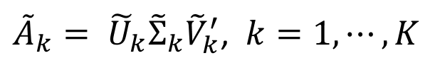
Estimation – Step 1
Extract signal based on singular values
Perform for each block separately
${\tilde{A}}_{k}= {\tilde{U}}_{k}{\tilde{Σ}}_{k}{\tilde{V}}_{k}^{′}$, $k=1, ⋯, K$
# 1 thresholds for each data block

Slide 30







Estimation – Step 2
Extract joint signals based on perturbation theory
Same row spaces
across $k$ data blocks
Theoretical signal score spaces
$$Row\left(A_{k}\right)=Row\left(J\right)+Row(I_{k})$$
Perturbed
Different but are
expected to be close
Extracted signal score spaces
$${\tilde{v}}_{i}$$
$$v$$
$$Row\left({\tilde{A}}_{k}\right)=Row\left({\tilde{J}}_{k}\right)+Row\left({\tilde{I}}_{k}\right)$$
$$θ_{}$$
$${\tilde{v}}_{j}$$

Slide 31
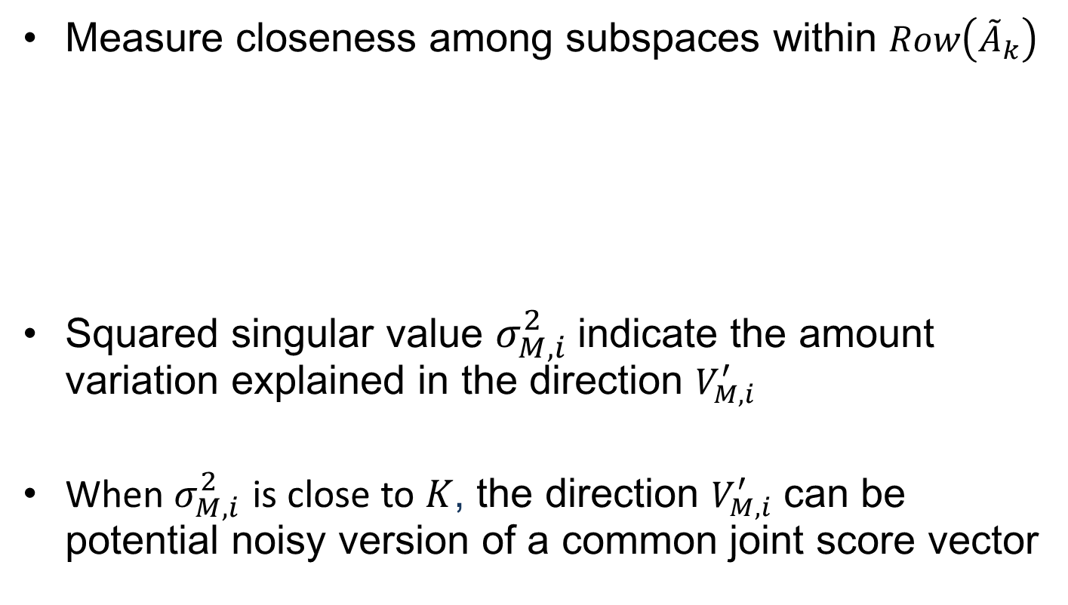

Estimation – Step 2
Measure closeness among subspaces within
Squared singular value indicate the amount variation explained in the direction
When is close to , the direction can be potential noisy version of a common joint score vector
$$M≜\left[\begin{aligned}\begin{matrix}{\tilde{V}}_{1}^{′} \\ {\tilde{V}}_{2}^{′} \\ ⋮\end{matrix} \\ {\tilde{V}}_{K}^{′}\end{aligned}\right]=U_{M}Σ_{M}V_{M}^{′}$$

Slide 32
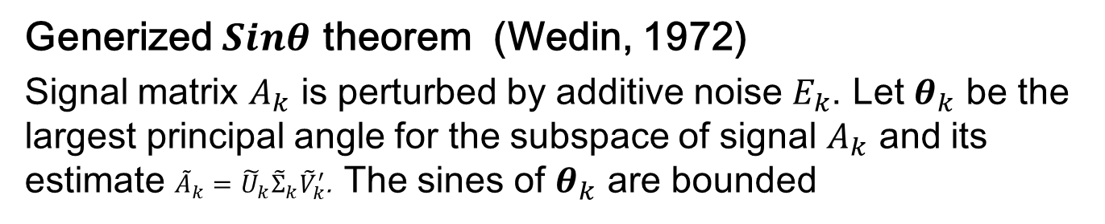
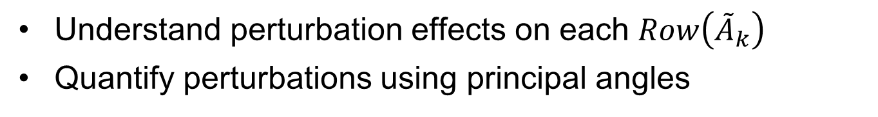
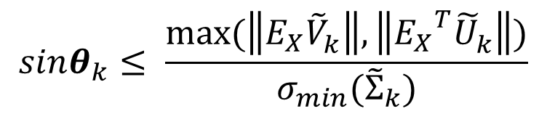
Estimation – Step 2
Understand perturbation effects on each $Row\left({\tilde{A}}_{k}\right)$
Quantify perturbations using principal angles
Generized theorem (Wedin, 1972)
Signal matrix is perturbed by additive noise . Let be the largest principal angle for the subspace of signal and its estimate . The sines of are bounded
$$sinθ_{k}≤ \frac{max⁡(\left\|E_{X}{\tilde{V}}_{k}^{}\right\|,\left\|{E_{X}}_{}^{T}{\tilde{U}}_{k}^{}\right\|)}{σ_{min}({\tilde{Σ}}_{k})}$$

Slide 33
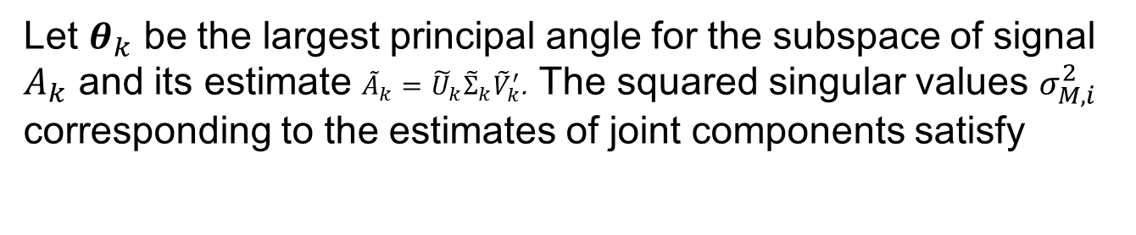
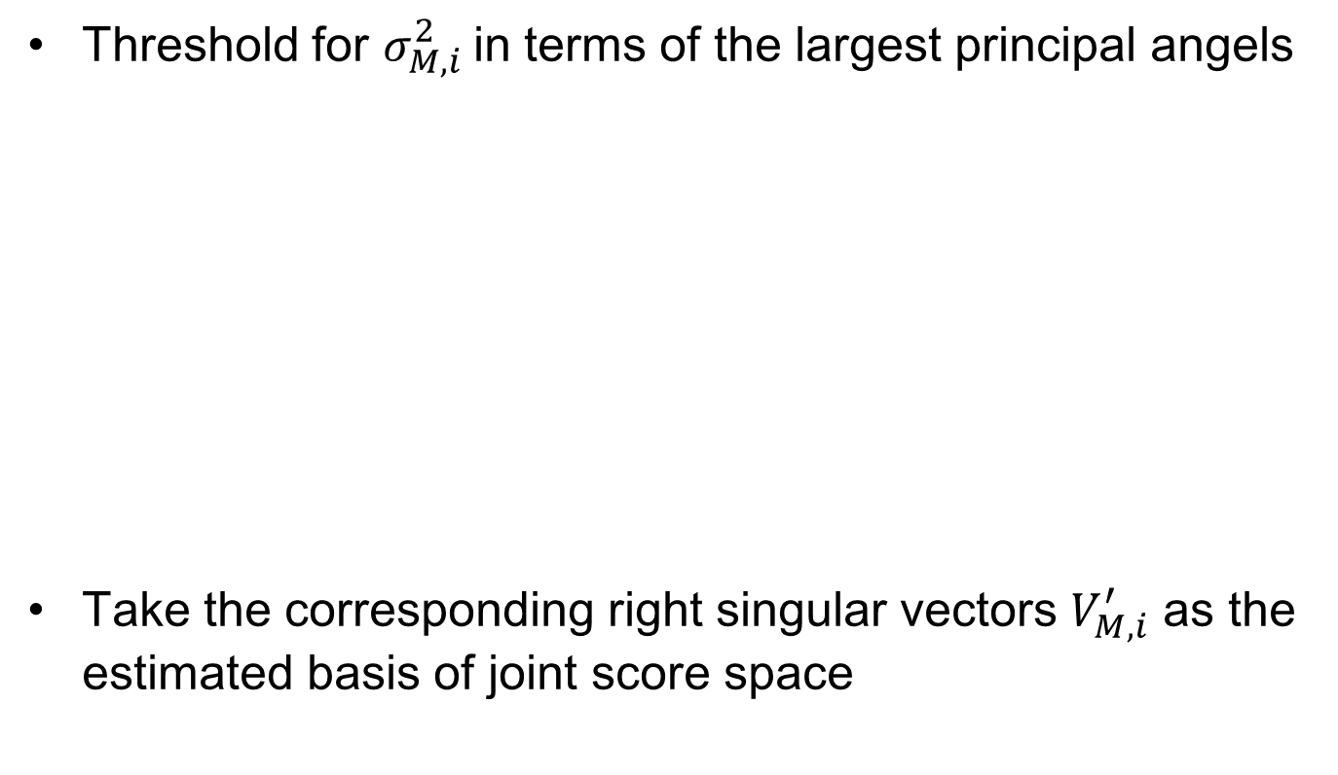
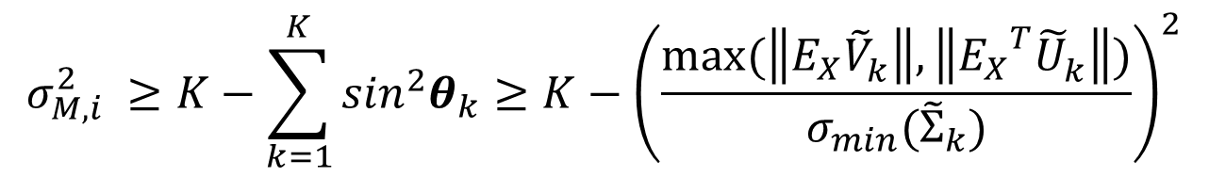
Estimation – Step 2
Threshold for in terms of the largest principal angels
Take the corresponding right singular vectors as the estimated basis of joint score space
Let be the largest principal angle for the subspace of signal and its estimate . The squared singular values corresponding to the estimates of joint components satisfy
$$σ_{M,i}^{2} ≥K−\sum_{k=1}^{K}{{\sin_{}^{2}θ}_{k}}≥K−{\left(\frac{max⁡(\left\|E_{X}{\tilde{V}}_{k}^{}\right\|,\left\|{E_{X}}_{}^{T}{\tilde{U}}_{k}^{}\right\|)}{σ_{min}({\tilde{Σ}}_{k})}\right)}^{2}$$

Slide 34

Estimation – Step 3
Project data blocks to each row spaces
Obtain estimations of each structure matrices
Times loading, singular value and basis in row together to recover each component
$$×$$
Row space
Data Block
Get Loading and singular value matrices

Slide 35
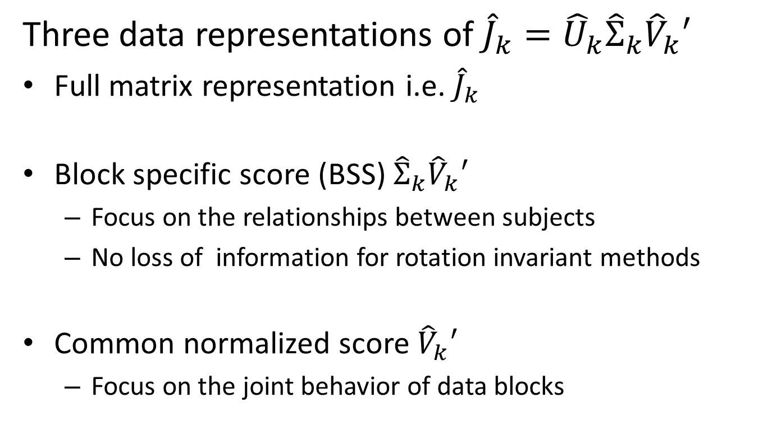
Post JIVE analysis
Three data representations of
Full matrix representation i.e.
Block specific score (BSS)
Focus on the relationships between subjects
No loss of information for rotation invariant methods
Common normalized score
Focus on the joint behavior of data blocks

