Slide 1
Non-iterative JIVE for Data Integration
Qing Feng
Joint Work with Jan Hannig, J.S. Marron
Mar. 24th , 2016

Slide 2
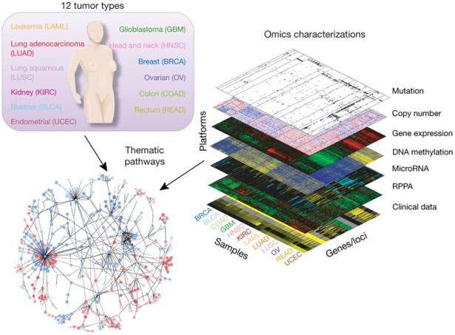
Modern Data Challenge
Subject
Feature
Figure : The Cancer Genome Atlas Research Network, Weinstein, J.N., Collisson, E.A., Mills, G.B., Shaw, K.M., Ozenberger, B.A., Ellrott, K., Shmulevich, I., Sander, C., and Stuart, J.M. (2013)
The Cancer Genome Atlas Pan-Cancer analysis project.
Integrate diverse information from disparate data sets
Gain unified and insightful understanding by simultaneously exploring the joint variation and the individual variation

Slide 3
Modern Data Challenge
Subject
Feature
Figure : The Cancer Genome Atlas Research Network, Weinstein, J.N., Collisson, E.A., Mills, G.B., Shaw, K.M., Ozenberger, B.A., Ellrott, K., Shmulevich, I., Sander, C., and Stuart, J.M. (2013)
The Cancer Genome Atlas Pan-Cancer analysis project.
Well defined intrinsic joint and individual variation to generate an identifiable decomposition
Heterogeneous high dimensional data sets

Slide 4
Integrated Analysis
Lock et al (2013) : Joint and individual variation explained (JIVE)
Formulate it into a matrix decomposition problem
But no guarantee of satisfying the definitions
Slow iterative computation
A need for arbitrary normalization
Our improvements
An insightful interpretation of extracted variation
Fast non-iterative calculation
Improve identifiability
Normalization-free heterogeneity addressment
Notes:
Literature review

Slide 5
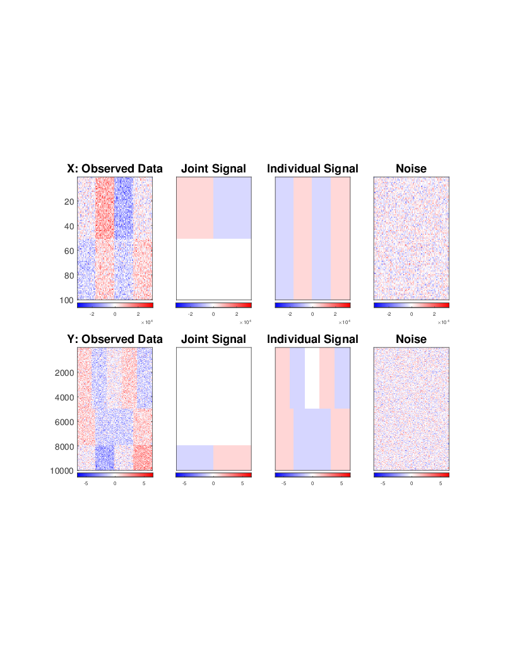


Toy Example
Analyze a two-block data set
Example:
X = Gene expression (GE)
Y = Copy number (CN)
$$100×100$$
$$10000×100$$

Slide 6
Toy Example
Sum of two types of signals and noise
Example:
X = Gene expression (GE)
Y = Copy number (CN)

Slide 7
Toy Example
Matrices containing joint variation
Example:
X = Gene expression (GE)
Y = Copy number (CN)
one variation component
a contrast between the left and right halves

Slide 8
Toy Example
Matrices containing individual variation
Example:
X = Gene expression (GE)
Y = Copy number (CN)
one contrast in X and two contrasts in Y

Slide 9
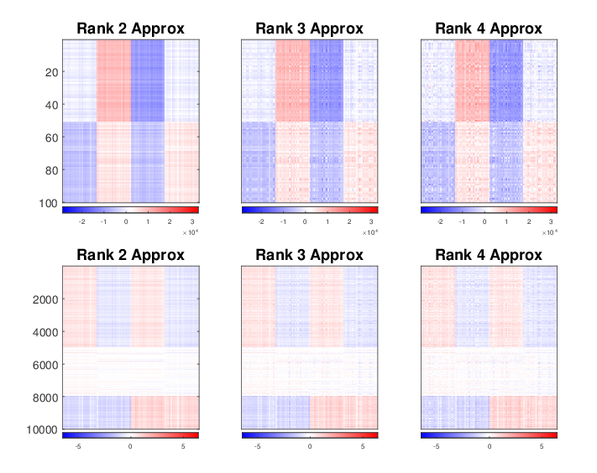
Toy Example
SVD on concatenation of the two matrices
Only capture signals in X
Lose individual signals in Y

Slide 10
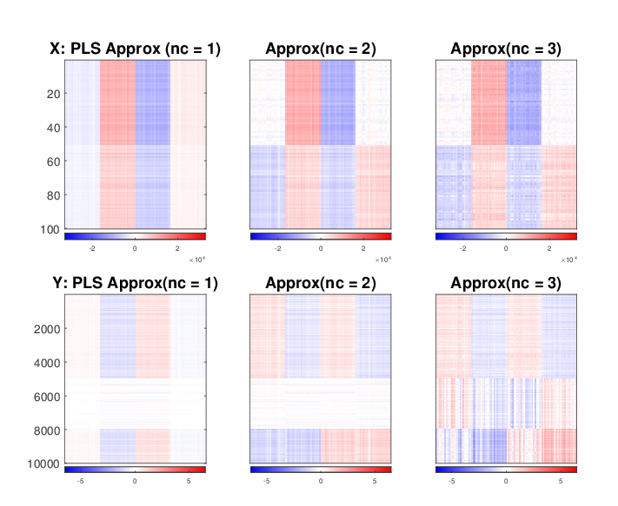
Toy Example
PLS analysis
Provide mixtures of the joint and some individual
Fail to distinguish the two types of variation

Slide 11
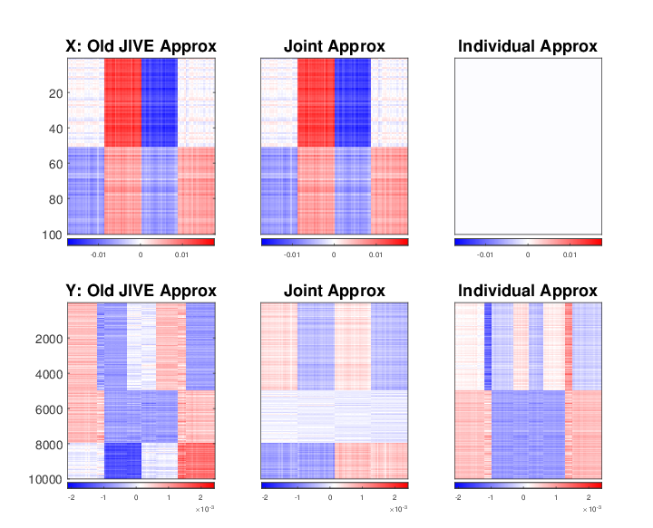
Toy Example
Old JIVE
Incorrectly contain the individual X in the joint
A Frobenius normalization

Slide 12
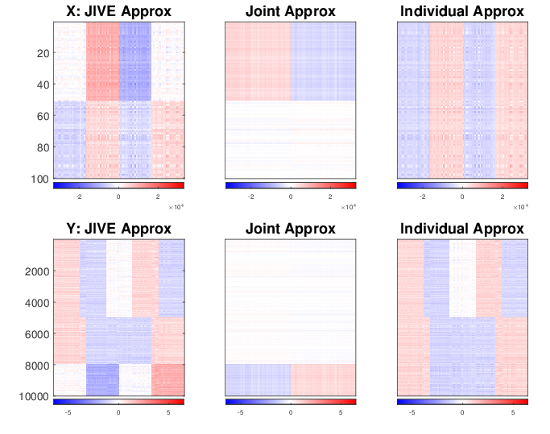
Toy Example
Our Non-iterative JIVE
Well capture the two types of signal

Slide 13















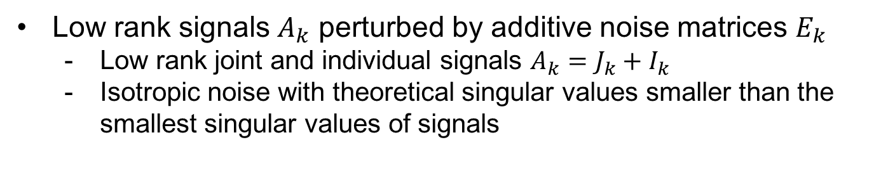


Population Model
Identifiable JIVE decomposition for data blocks $X_{k}, k=1, ⋯, K$
$$d_{1}×n$$
$$X_{1}$$
=
$$J_{1}$$
+
$$I_{1}$$
+
$$E_{1}$$
$$X_{2}$$
=
$$J_{2}$$
+
$$I_{2}$$
+
$$E_{2}$$
$$d_{2}×n$$
$$⋮$$
$$⋮$$
$$⋮$$
$$⋮$$
$$X_{K}$$
=
$$J_{K}$$
+
$$I_{K}$$
+
$$E_{K}$$
$$d_{K}×n$$
Low rank signals $A_{k}$ perturbed by additive noise matrices $E_{k}$
Low rank joint and individual signals $A_{k}=J_{k}+I_{k}$
Isotropic noise with theoretical singular values smaller than the smallest singular values of signals

Slide 14
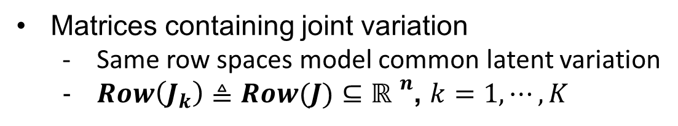
Population Model
Identifiable JIVE decomposition for data blocks $X_{k}, k=1, ⋯, K$
$$d_{1}×n$$
$$X_{1}$$
=
$$J_{1}$$
+
$$I_{1}$$
+
$$E_{1}$$
$$X_{2}$$
=
$$J_{2}$$
+
$$I_{2}$$
+
$$E_{2}$$
$$d_{2}×n$$
$$⋮$$
$$⋮$$
$$⋮$$
$$⋮$$
$$X_{K}$$
=
$$J_{K}$$
+
$$I_{K}$$
+
$$E_{K}$$
$$d_{K}×n$$
Matrices containing joint variation
Same row spaces model common latent variation
$Row\left(J_{k}\right)≜Row(J)⊆{ℝ }^{n}$, $k=1, ⋯, K$

Slide 15











Population Model
Matrices containing joint variation
$Row\left(J_{k}\right)≜Row(J)⊆{ℝ }^{n}$, $k=1, ⋯, K$
Joint score subspace
$$U$$
$$Σ$$
$$V^{T}$$
Might be different sets of basis
But span the exact same row space
$$J_{1}$$
=
$$J_{2}$$
=
In the toy example
$$V^{T}$$
$$⋮$$
$$⋮$$
$$J_{K}$$
=
$$V^{T}$$

Slide 16

Population Model
Matrices containing joint variation
$Row\left(J_{k}\right)≜Row(J)⊆{ℝ }^{n}$, $k=1, ⋯, K$
Joint score subspace
$$U$$
$$Σ$$
$$V^{T}$$
Can be very different for each block
$$J_{1}$$
=
$$J_{2}$$
=
In the toy example
$$⋮$$
$$⋮$$
$$J_{K}$$
=

Slide 17
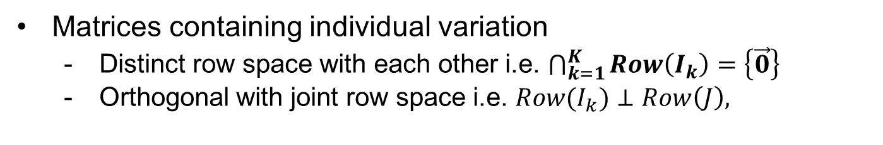
Population Model
Identifiable JIVE decomposition for data blocks $X, Y$
$$d_{1}×n$$
$$X_{1}$$
=
$$J_{1}$$
+
$$I_{1}$$
+
$$E_{1}$$
$$X_{2}$$
=
$$J_{2}$$
+
$$I_{2}$$
+
$$E_{2}$$
$$d_{2}×n$$
$$⋮$$
$$⋮$$
$$⋮$$
$$⋮$$
$$X_{K}$$
=
$$J_{K}$$
+
$$I_{K}$$
+
$$E_{K}$$
$$d_{K}×n$$
Matrices containing individual variation
Distinct row space with each other i.e. $\bigcap_{k=1}^{K}{Row\left(I_{k}\right)}=\left\{\vec{0}\right\}$
Orthogonal with joint row space i.e. ${Row(I}_{k})⊥Row\left(J\right),$

Slide 18
Estimation Approach
A three-step algorithm
Step 1: Initial signal extraction by low rank SVD approximation
Step 2: Extract the joint score space based on perturbation theory
Step 3: Reconstruct based on projection onto each estimated row spaces

Slide 19
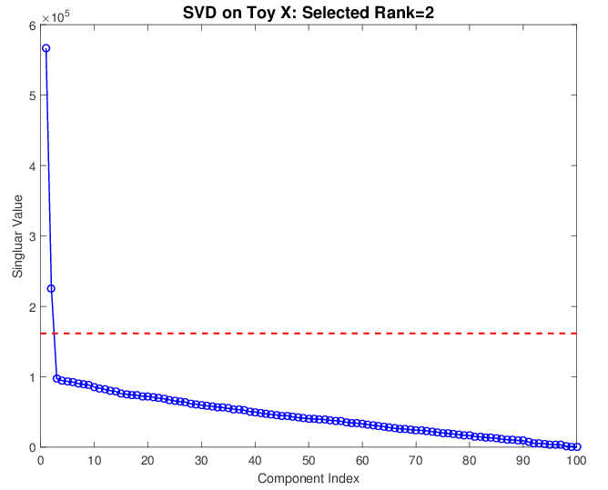
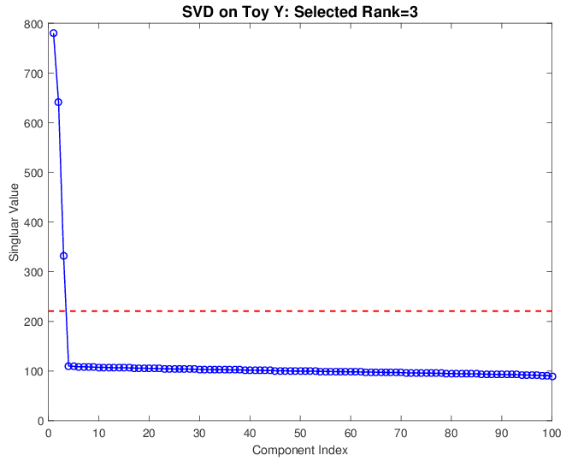
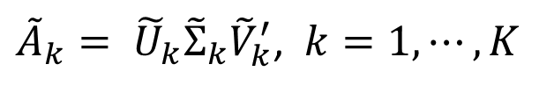
Estimation – Step 1
Extract signal based on singular values
Perform for each block separately
${\tilde{A}}_{k}= {\tilde{U}}_{k}{\tilde{Σ}}_{k}{\tilde{V}}_{k}^{′}$, $k=1, ⋯, K$
# 1 thresholds for each data block

Slide 20







Estimation – Step 2
Extract joint signals based on perturbation theory
Same row spaces
across $k$ data blocks
Theoretical signal score spaces
$$Row\left(A_{k}\right)=Row\left(J\right)+Row(I_{k})$$
Perturbed
Different but are
expected to be close
Extracted signal score spaces
$${\tilde{v}}_{i}$$
$$v$$
$$Row\left({\tilde{A}}_{k}\right)=Row\left({\tilde{J}}_{k}\right)+Row\left({\tilde{I}}_{k}\right)$$
$$θ_{}$$
$${\tilde{v}}_{j}$$

Slide 21
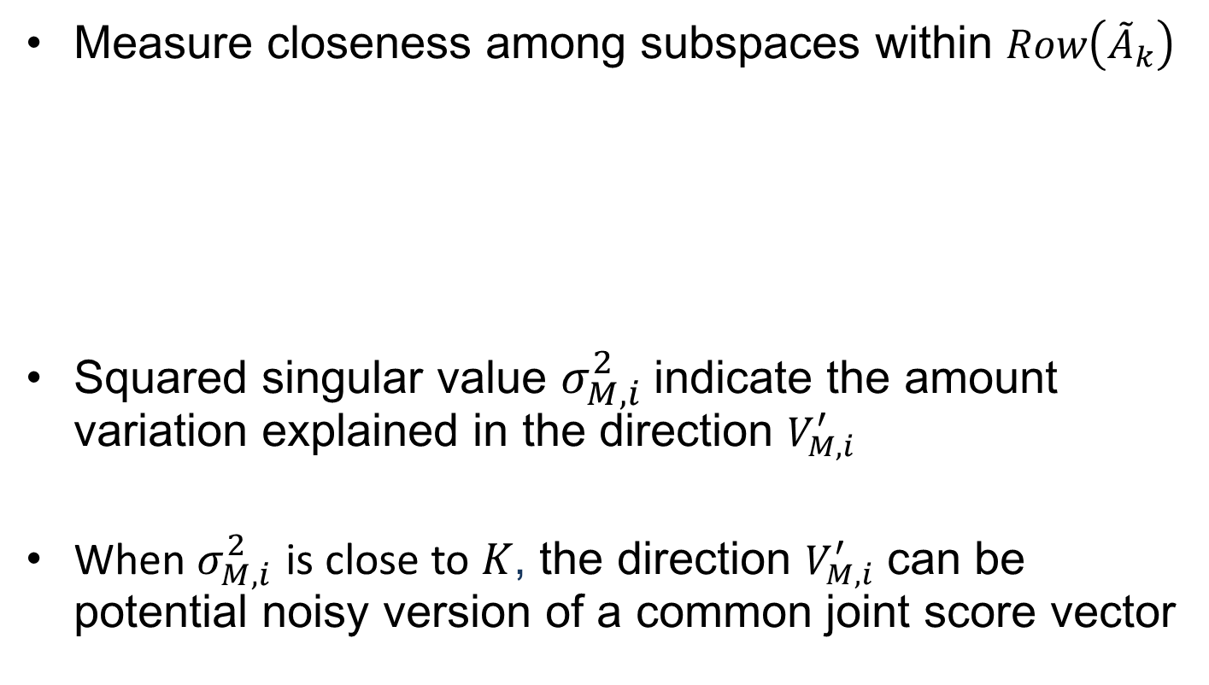

Estimation – Step 2
Measure closeness among subspaces within $Row\left({\tilde{A}}_{k}\right)$
Squared singular value $σ_{M,i}^{2}$indicate the amount variation explained in the direction $V_{M,i}^{′}$
When $σ_{M,i}^{2}$ is close to $K$, the direction $V_{M,i}^{′}$ can be potential noisy version of a common joint score vector
$$M≜\left[\begin{aligned}\begin{matrix}{\tilde{V}}_{1}^{′} \\ {\tilde{V}}_{2}^{′} \\ ⋮\end{matrix} \\ {\tilde{V}}_{K}^{′}\end{aligned}\right]=U_{M}Σ_{M}V_{M}^{′}$$

Slide 22
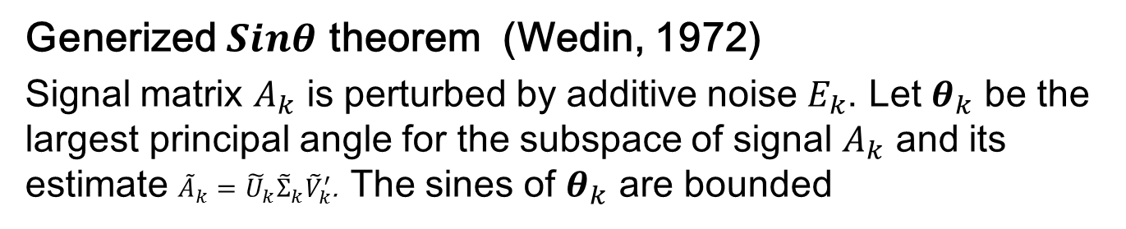
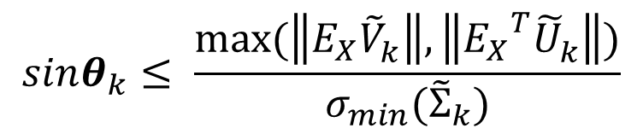
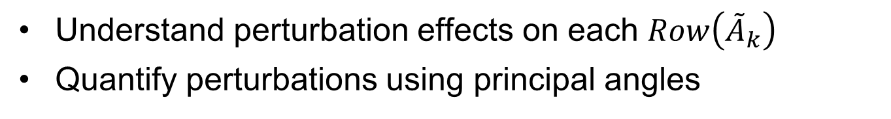
Estimation – Step 2
Understand perturbation effects on each $Row\left({\tilde{A}}_{k}\right)$
Quantify perturbations using principal angles
Generized $Sinθ$ theorem (Wedin, 1972)
Signal matrix $A_{k}$ is perturbed by additive noise $E_{k}$. Let $θ_{k}$ be the largest principal angle for the subspace of signal $A_{k}$ and its estimate ${\tilde{A}}_{k}={\tilde{U}}_{k}{\tilde{Σ}}_{k}{\tilde{V}}_{k}^{′}$. The sines of $θ_{k}$ are bounded
$$sinθ_{k}≤ \frac{max⁡(\left\|E_{X}{\tilde{V}}_{k}^{}\right\|,\left\|{E_{X}}_{}^{T}{\tilde{U}}_{k}^{}\right\|)}{σ_{min}({\tilde{Σ}}_{k})}$$

Slide 23
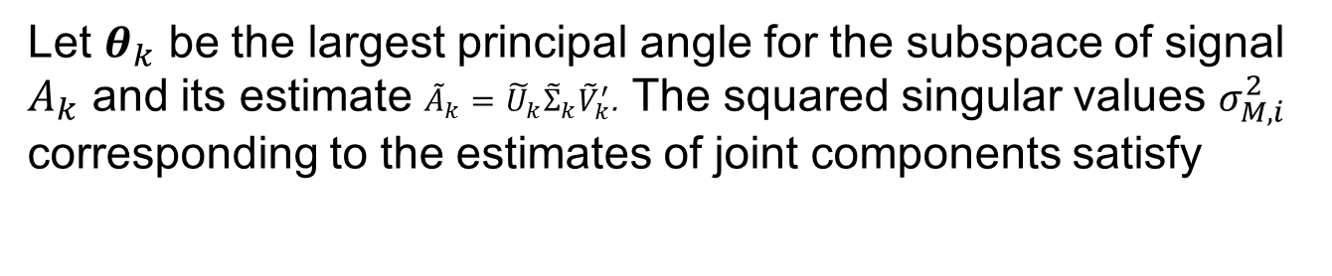
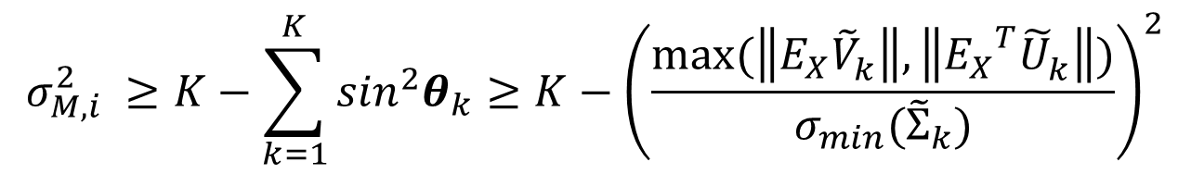

Estimation – Step 2
Threshold for $σ_{M,i}^{2}$in terms of the largest principal angels
Take the corresponding right singular vectors $V_{M,i}^{′}$ as the estimated basis of joint score space
Let $θ_{k}$ be the largest principal angle for the subspace of signal $A_{k}$ and its estimate ${\tilde{A}}_{k}={\tilde{U}}_{k}{\tilde{Σ}}_{k}{\tilde{V}}_{k}^{′}$. The squared singular values $σ_{M,i}^{2}$ corresponding to the estimates of joint components satisfy
$$σ_{M,i}^{2} ≥K−\sum_{k=1}^{K}{{\sin_{}^{2}θ}_{k}}≥K−{\left(\frac{max⁡(\left\|E_{X}{\tilde{V}}_{k}^{}\right\|,\left\|{E_{X}}_{}^{T}{\tilde{U}}_{k}^{}\right\|)}{σ_{min}({\tilde{Σ}}_{k})}\right)}^{2}$$

Slide 24

Estimation – Step 3
Project data blocks to each row spaces
Obtain estimations of each structure matrices
Times loading, singular value and basis in row together to recover each component
$$×$$
Row space
Data Block
Get Loading and singular value matrices

Slide 25
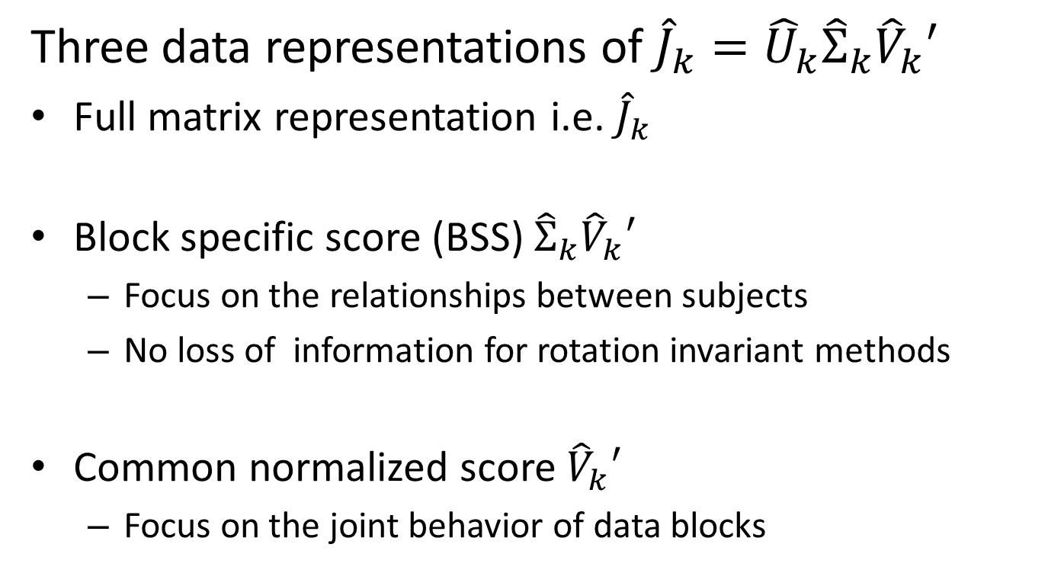
Post JIVE analysis
Three data representations of ${\hat{J}}_{k}={\hat{U}}_{k}{\hat{Σ}}_{k}{\hat{V}}_{k}′$
Full matrix representation i.e. ${\hat{J}}_{k}$
Block specific score (BSS) ${\hat{Σ}}_{k}{\hat{V}}_{k}′$
Focus on the relationships between subjects
No loss of information for rotation invariant methods
Common normalized score ${\hat{V}}_{k}′$
Focus on the joint behavior of data blocks

Slide 26
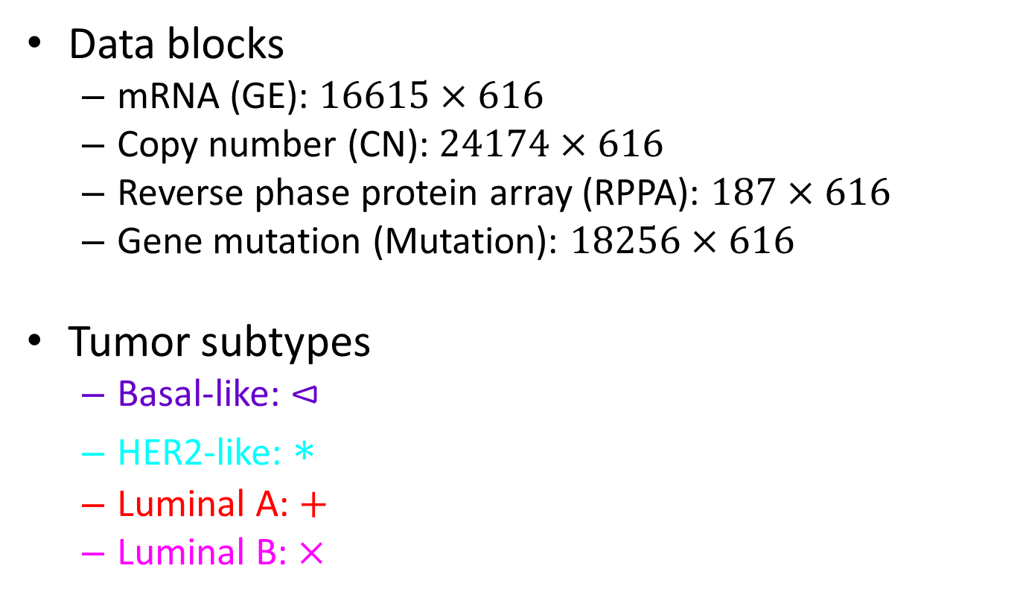
Application – TCGA Breast Cancer Data
Data blocks
mRNA (GE): $16615×616$
Copy number (CN): $24174×616$
Reverse phase protein array (RPPA): $187×616$
Gene mutation (Mutation): $18256×616$
Tumor subtypes
Basal-like: $⊲$
HER2-like: $∗$
Luminal A: $+$
Luminal B: $×$

Slide 27
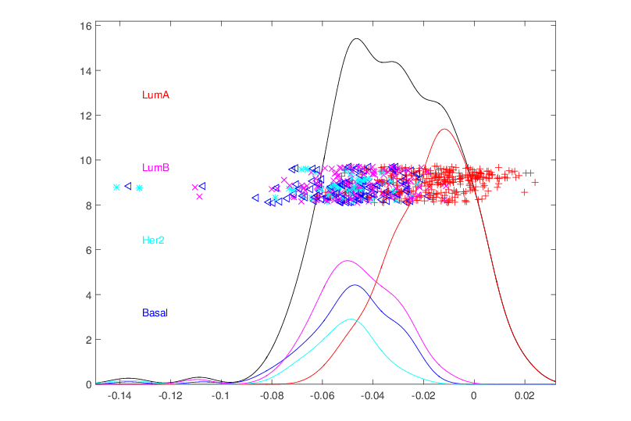
Application – TCGA Breast Cancer Data
Joint between GE – CN – RPPA – Mutation
CNS 1

Slide 28
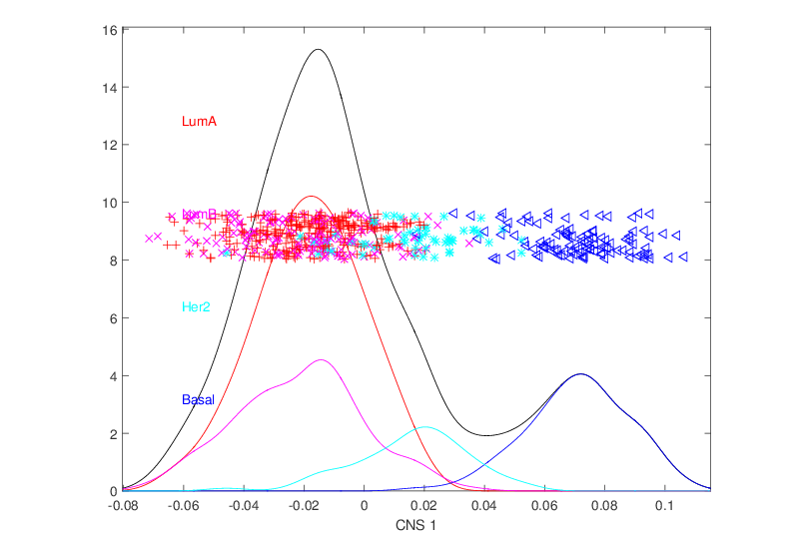
Application – TCGA Breast Cancer Data
Joint among the remaining individual GE – CN – RPPA

Slide 29
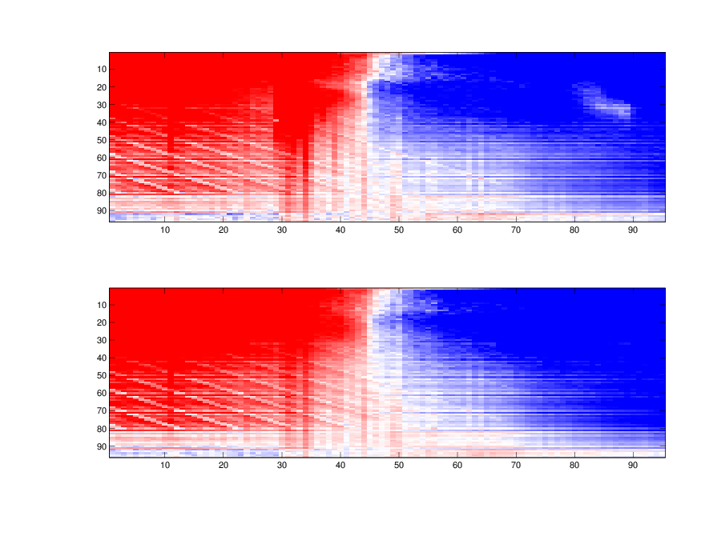
Application – Mortality Data
Male block Versus Female block
+
-
Spanish Male
Age as features
(0 – 95)
Years as Subjects (1918 - 2002)
Spanish Female
Age as features

Slide 30
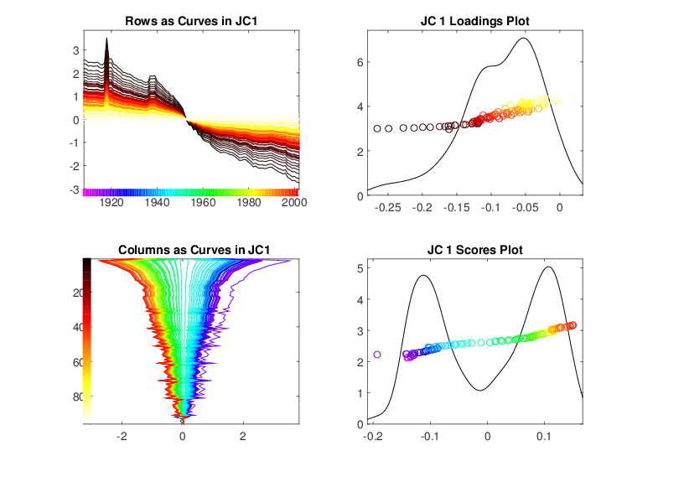
First Joint Component - Male
Notes:
Change to BSS

Slide 31
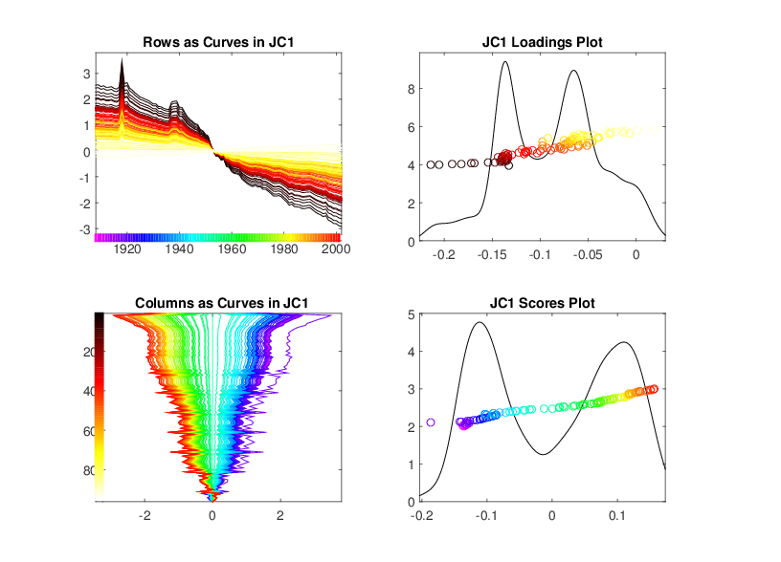
First Joint Component - Female

Slide 32
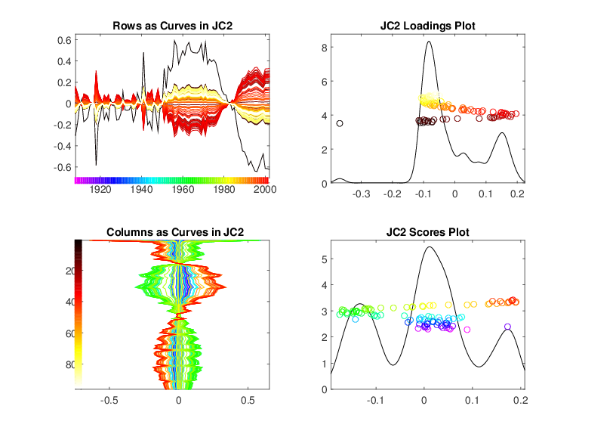
Second Joint Component - Male

Slide 33
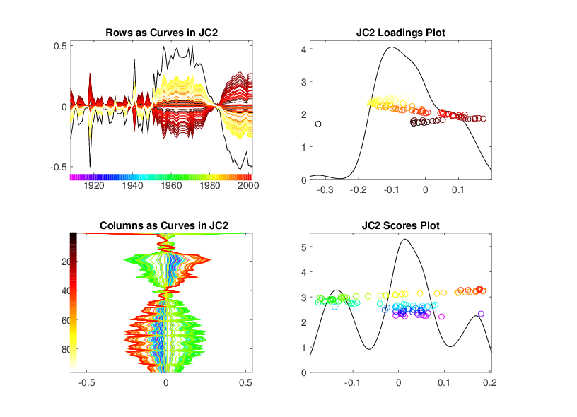
Second Joint Component - Female

Slide 34
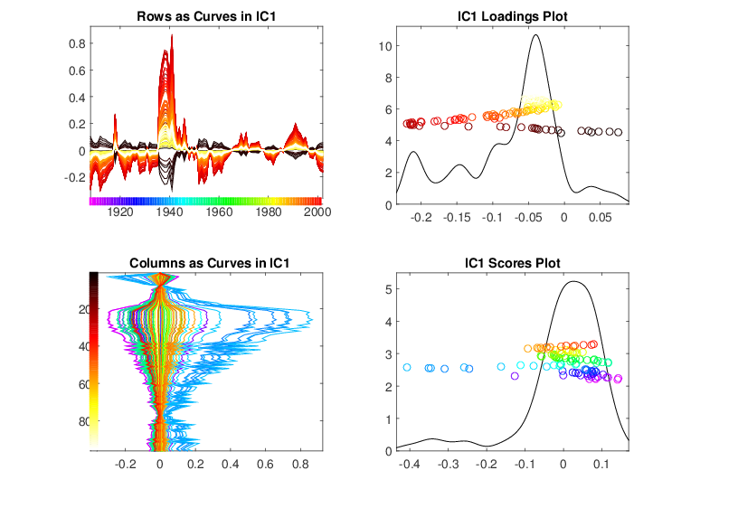
Individual Component - Male

Slide 35
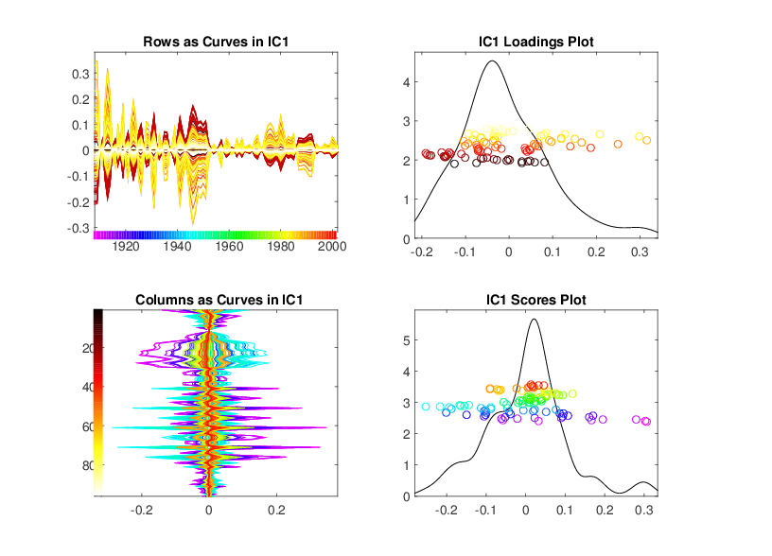
Individual Component - Female

Slide 36
Future Work
Hierarchical JIVE decomposition
Supervised learning
Additional applications

Slide 37
Thank you!

Slide 38
Appendix

Slide 39
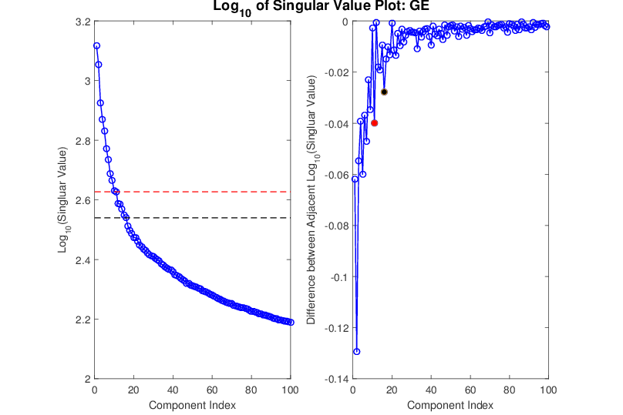
Suggested Rank： 11 / 16

Slide 40
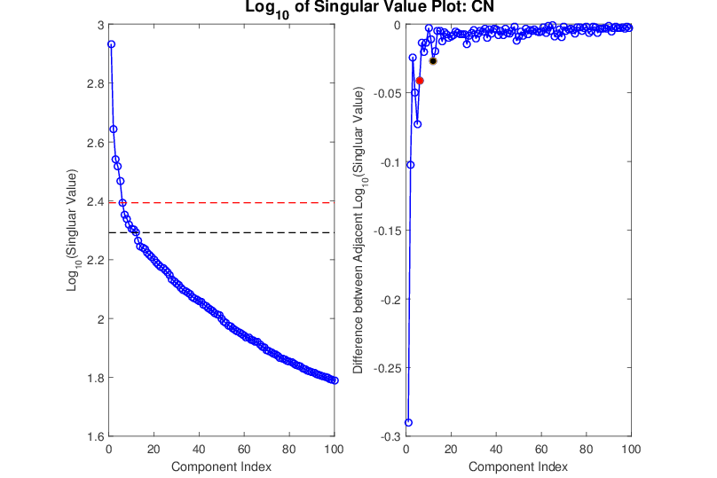
Suggested Rank： 6 / 12

Slide 41
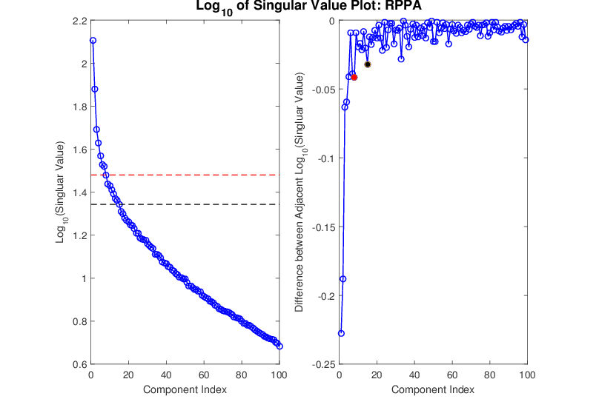
Suggested Rank： 8 / 15

Slide 42
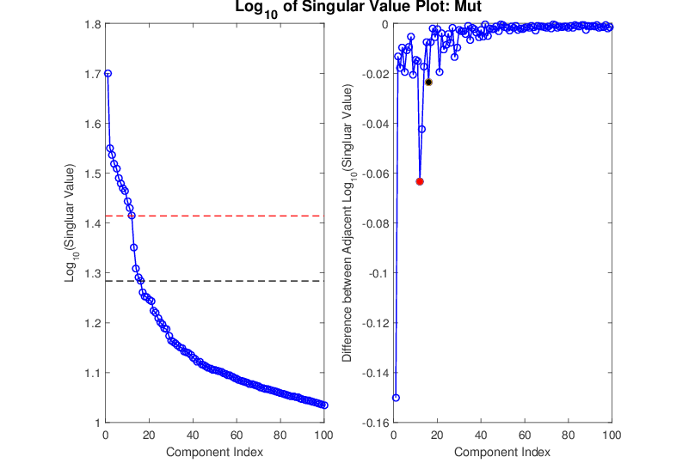
Suggested Rank： 12 / 16

Slide 43
