Slide 1
Conclusion
Some Concerns for this Paper 徐增

Slide 2
Main Contributions
Fused Feature Gaussian Process Regression (FEGOR) Model
Transform absolute GPS locations into relative distances to “Avoiding compromising user privacy”
Real-world experiments on Twitter dataset

Slide 3
Mobility Influence Content Similarity Social Relationship
Is that Innovative?

Slide 4
[5] DU et al. “Predicting activity attendance in event-based social networks: Content, context and social influence.
Content
Spatial and Temporal
Social Influence
Content Similarity
Mobility Influence
Social Relationship
2014
International Joint Conference on Pervasive and Ubiquitous Computing

Slide 5
Similar Related Works
[5] Du et al., “Predicting activity attendance in event-based social networks: Content, context and social influence”, 2014
[11] Cheng et al., “You are where you tweet: A content-based approach to geo-locating twitter users”, 2010
[12] Ryoo et al., “Inferring twitter user locations with 10 km accuracy”, 2014
[13] Yamaguchi et al., “Online user location inference exploting spatiotemporal correlations in social streams”, 2014
[14] Sadilek et al., “Finding your friends and following them to where you are”, 2012
[18] Tarasov et al., “Prediction of user location using the radiation model and social check ins”, 2013
[25] Backstrom et al., “Find me if you can: Improving geographical prediction with social and spatial proximity”, 2010

Slide 6
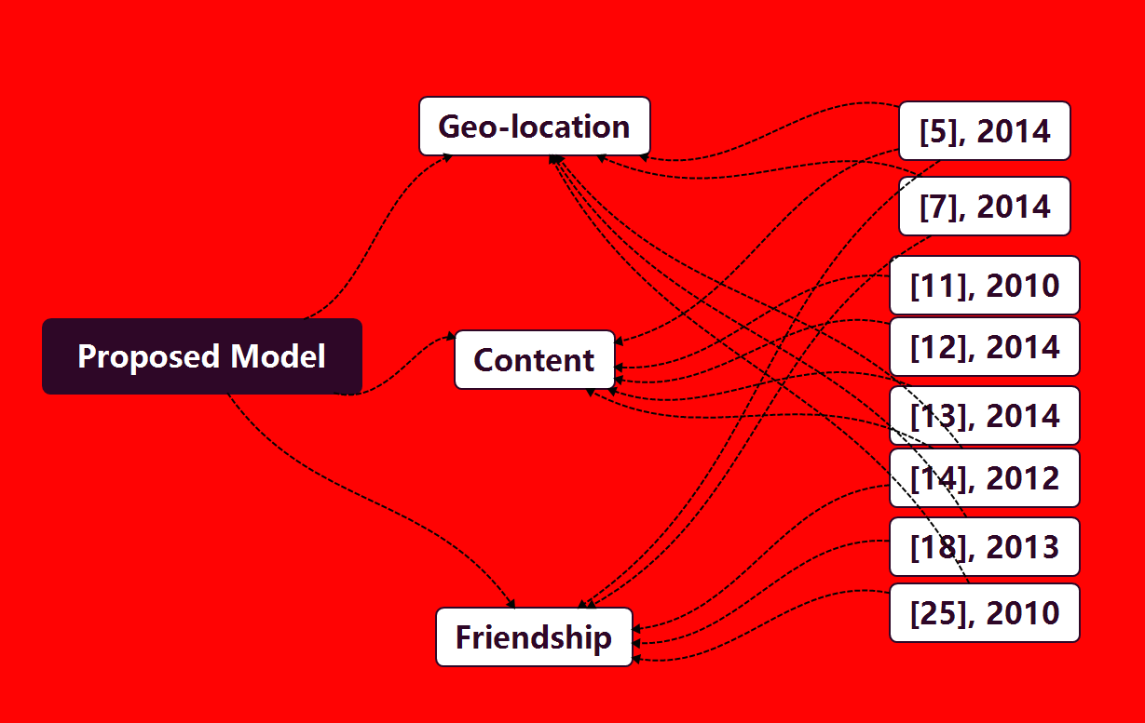

Slide 7
Vague and Hyperbolic Statement
How these three factors influence the model performance?
Can this model generalize to other types of data, topic, platform?
Without such restrictions, i.e, inefficient data source, API limitation, etc., does the model still make meaningful estimations?

Slide 8
“By integrating these factors, we are able to estimate the distance between a user and a social event even when the user’s location profile is unknown, thus identify on-site users.”
Lack of adequate data
Experiments are based on specific data types
Only Twitter platform and two specific topics are evaluated
Not Sufficient, and Not Convincing
Is this claim practicable?

Slide 9
Reproducibility
The code are unavailable to readers
Lack of Confidence

Slide 10
Future Improvements
Do more experiments about
these three factors (or more features), illustrate their particular effects
Different event types
Generalize to more heterogeneous resources

Slide 11
Thank you for listening!
王天亮、杨庆、张晟铭、徐增

