Slide 1

CSX4104 / ITX4104 · SOFTWARE TESTING
Campus Lost & Found
Management System
Software Testing Term Project Report
Jatupon Itsara (6610073)
Gulizara Benjapalaporn (6612233)
Chanyanut Pumasri (6620025)
Phanthira Kositjaroenkul (6630003)
Assumption University — Vincent Mary School of Engineering, Science and Technology

Slide 2
OVERVIEW
What We'll Cover
1
Project Overview
2
Functional Scope
The system, its purpose, and tech stack
What's in scope and what's explicitly not
3
Testing Strategy
4
Unit & Control Flow Testing
Six testing techniques applied end-to-end
91 tests, 38 independent paths, full branch coverage
5
Domain & Integration Testing
6
Access Control & Results
Boundary values and live end-to-end scenarios
Role-based security, defects found, final results
Campus Lost & Found Management System | CSX4104/ITX4104 Software Testing
1

Slide 3



INTRODUCTION
What the System Does
A web application that helps students and staff report lost and found items, automatically compares reports using a rule-based matching algorithm, and supports staff in verifying ownership before an item is handed over.
TECH STACK
React 19 + TypeScript
Item reporting with rule-based match scoring (name, description, color, brand, location, date)
Ownership verification via claim evidence and staff decisions
Handover confirmation requiring in-person identity checks
In-app notifications and full audit logging
Role-based access across Student, Staff, and Admin
Vite, React Router v7
Node.js + Express
Zod validation, Multer uploads
PostgreSQL + Prisma
Custom TS/ESM client via tsx
Campus Lost & Found Management System | CSX4104/ITX4104 Software Testing
2

Slide 4


REQUIREMENTS
Functional Scope
In Scope
Out of Scope
Item reporting for lost & found (optional photos)
Rule-based matching & score calculation
Confirm / dismiss suggested matches
Ownership verification via evidence
Claim management + handover confirmation
In-app notifications & audit logging
Role-based access (Student / Staff / Admin)
Real Microsoft/AU authentication
User account management
Email or SMS notifications
Mobile application
AI-based image recognition
Database performance optimization
Campus Lost & Found Management System | CSX4104/ITX4104 Software Testing
3

Slide 5






METHODOLOGY
Six Testing Techniques Applied
Unit Testing
Control Flow
Data Flow
91 tests across 4 files, pure-function isolation via Jest
9 functions · 38 independent CFG paths
def / c-use / p-use analysis on every CFG
Domain Testing
Integration
Access Control
13 boundary cases on the live application
7 automated end-to-end API scenarios
Role-based 403/200 checks, Bruno + automated
Campus Lost & Found Management System | CSX4104/ITX4104 Software Testing
4

Slide 6
1 / 6 — UNIT TESTING
Verifying Functions in Isolation
Jest 30.4.2 on Node.js v22.12.0. matchingService, claimService, and notificationService are pure functions with no database dependency — the full suite runs in well under a second.
91
Test File | Coverage | Tests
matchingService.test.js | 7 scorers + calculateMatchScore | 50
claimService.test.js | decideClaim, canConfirmHandover | 17
validation.test.js | Zod schema equivalence partitioning | 17
notificationService.test.js | buildNotificationMessage (5 types) | 7
UNIT TESTS — ALL PASSING
Equivalence Partitioning — validation.test.js
Boundary Value Analysis — classifyScore, scoreDate
Decision Table Testing — decideClaim (6 rules)
Edge cases: null/array input, empty descriptions, out-of-domain scores
Campus Lost & Found Management System | CSX4104/ITX4104 Software Testing
5

Slide 7
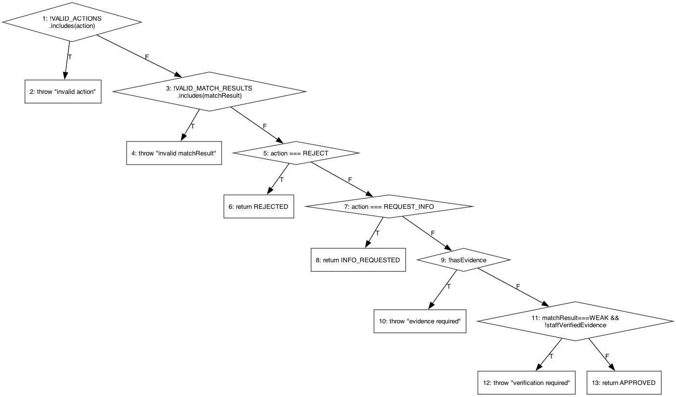
2 / 6 — CONTROL FLOW TESTING
Every Branch, Mapped and Covered
9
functions analyzed
38
independent branch-coverage paths
V(G)=8
highest complexity — decideClaim()
Notation: “1-2(T)-3” means from node 1, go to node 2, take the True branch to node 3. One discovery: a defensive branch in scoreDescription() is provably unreachable — flagged as an observation, not a defect.
decideClaim() — the claim-approval decision table, as a CFG
Campus Lost & Found Management System | CSX4104/ITX4104 Software Testing
6

Slide 8
3 / 6 — DATA FLOW TESTING
Tracking Variables Through Every Path
Data flow testing analyzes how each variable is defined (def) and used (c-use / p-use) across the same control flow graphs — finding definition-use pairs that unit tests must exercise.
Edges (i,j) | predicate(i,j) | p-use(i,j)
(9,10) | matchResult===WEAK && !staffVerifiedEvidence | {matchResult, staffVerifiedEvidence}
(9,11) | ~(matchResult===WEAK && !staffVerifiedEvidence) | {matchResult, staffVerifiedEvidence}
Excerpt from decideClaim() — full def/c-use/p-use tables for all 9 functions are in the written report.
9
functions with full DU analysis
100%
DU-pairs covered by existing unit tests
0
additional tests needed
Campus Lost & Found Management System | CSX4104/ITX4104 Software Testing
7

Slide 9
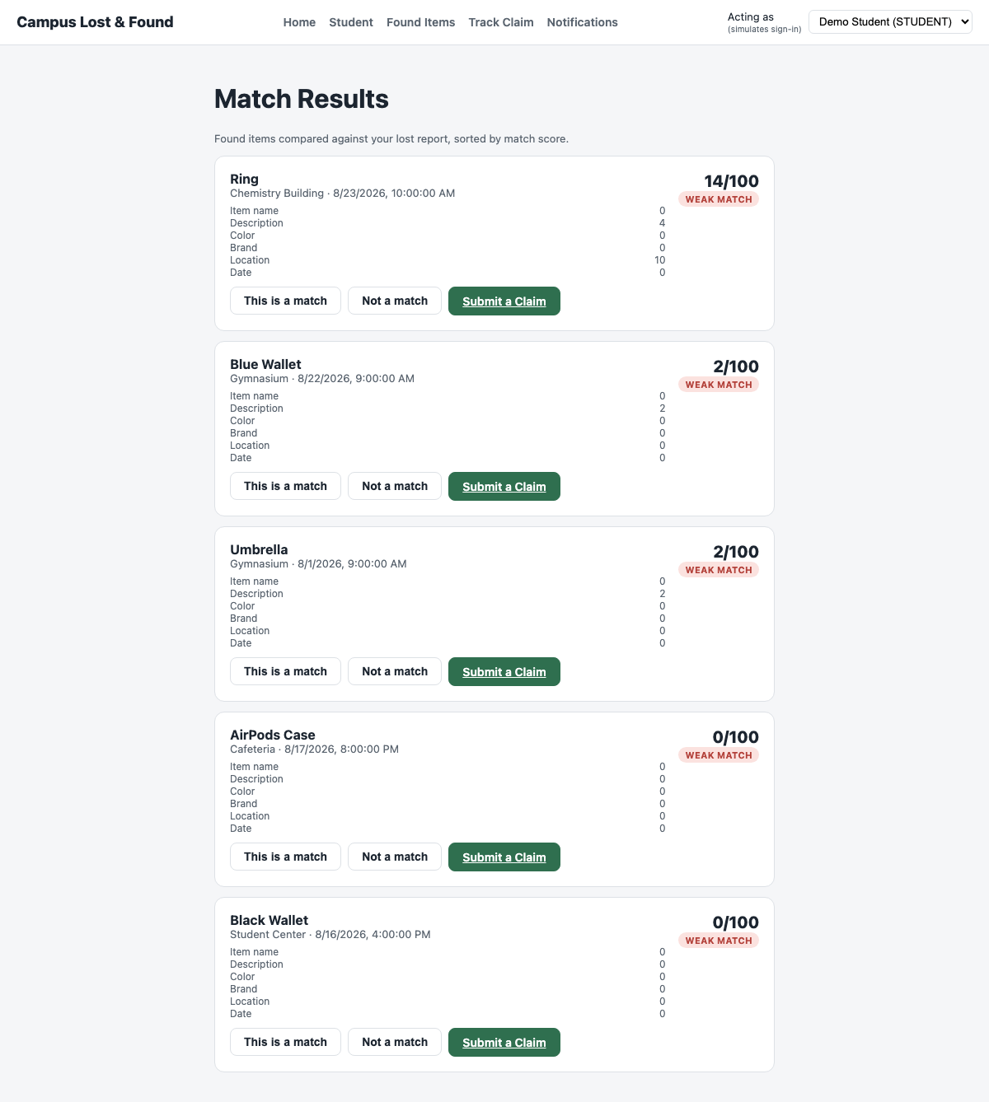
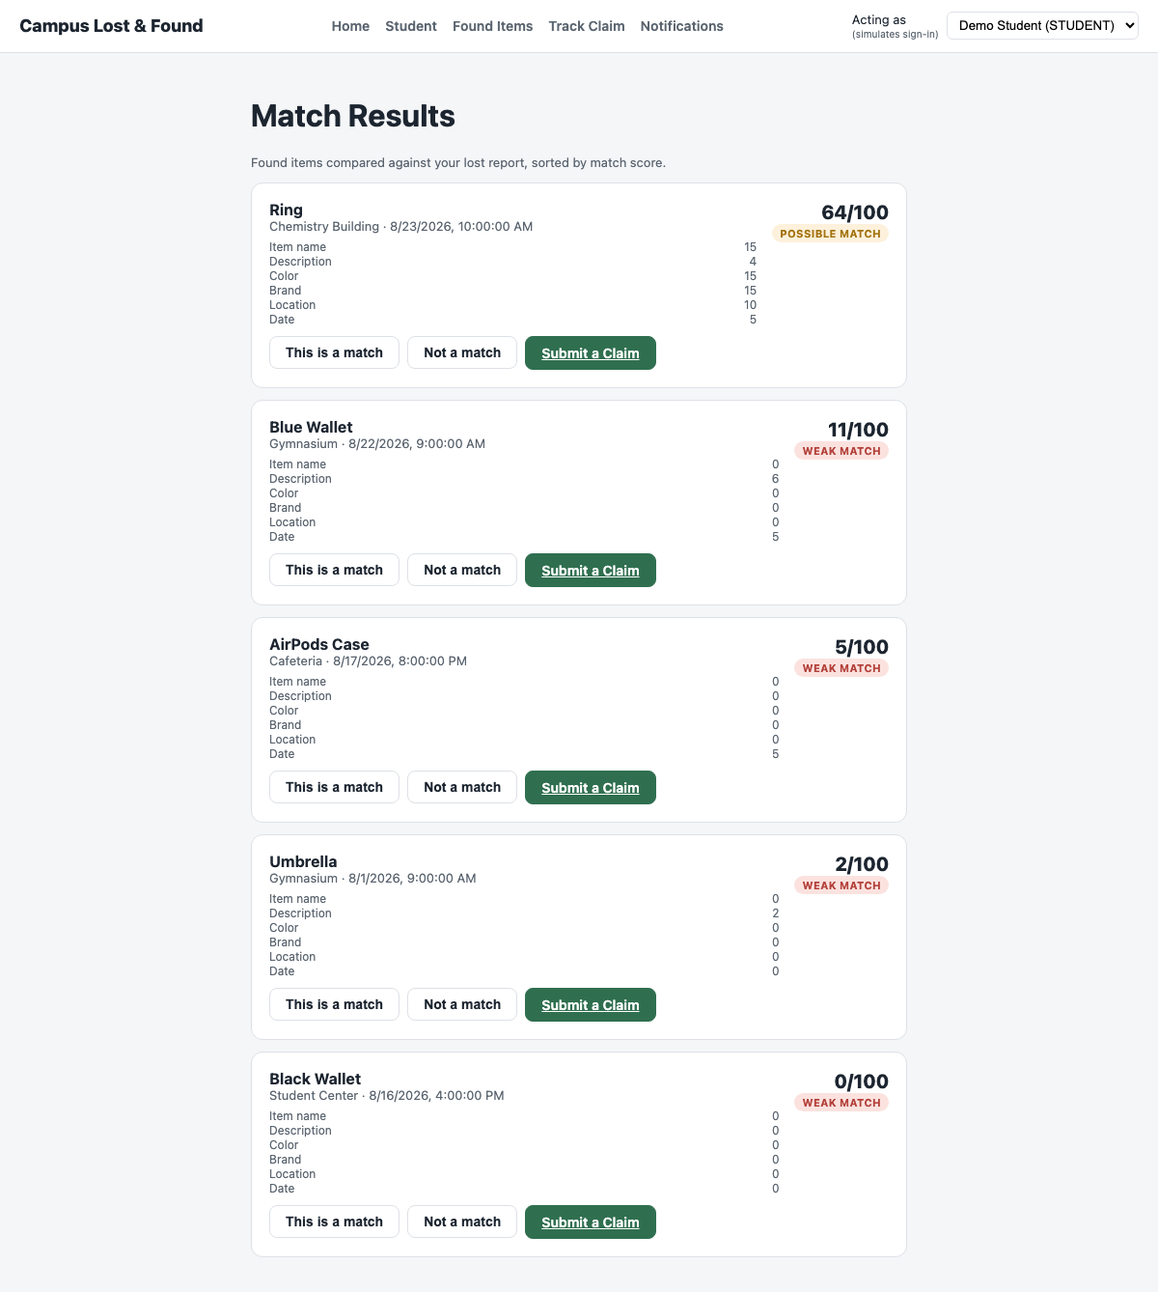
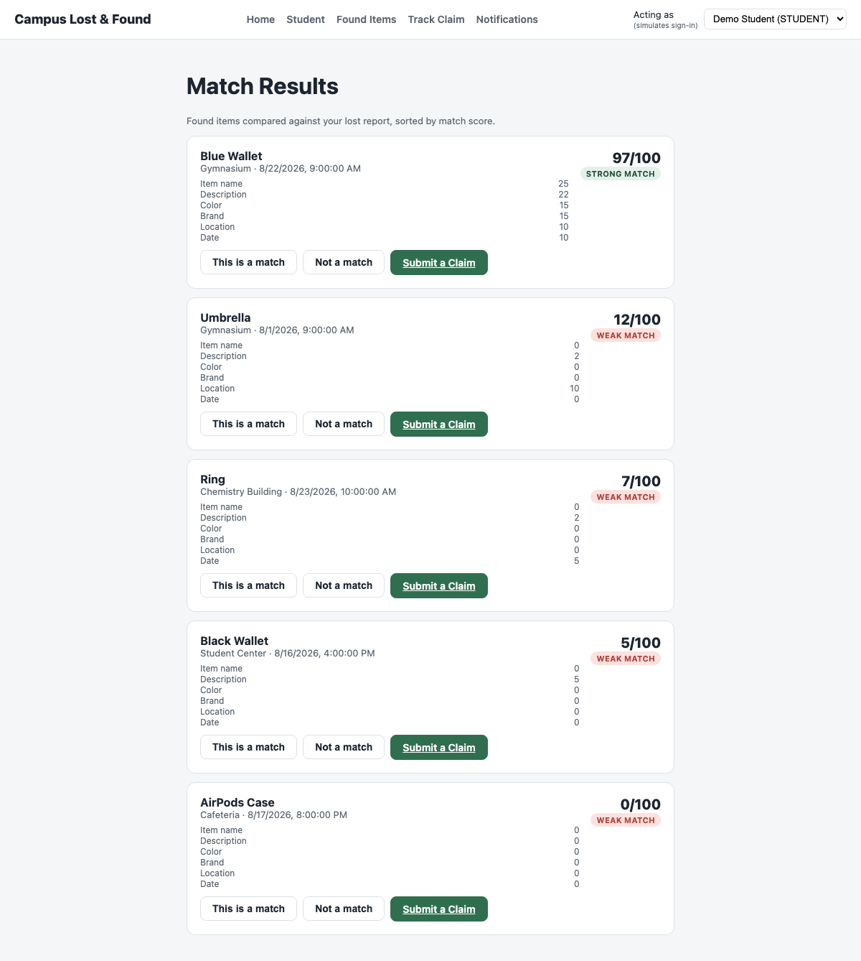
4 / 6 — DOMAIN TESTING
Exercising the Match-Score Boundaries
Every threshold in the rule-based matching engine was tested at its boundary using the live application — 13 cases in total, covering item reporting, matching, claims, handover, and role access.
WEAK MATCH
POSSIBLE MATCH
STRONG MATCH
0 – 49 pts
50 – 74 pts
75 – 100 pts
Campus Lost & Found Management System | CSX4104/ITX4104 Software Testing
8

Slide 10

5 / 6 — INTEGRATION TESTING
The Full Pipeline, End to End
Report
Match
Confirm
Claim
Decide
Handover
Automated end-to-end via tests/integration/apiIntegration.test.js (node:test under tsx) against the real Express API and PostgreSQL database — not mocks.
ID | Modules | Actual Result | Status
TC-IT-001 | Report ↔ Matching | matchScore=100, STRONG_MATCH | Pass
TC-IT-003 | Matching ↔ Claim | Claim created, status PENDING | Pass
TC-IT-005 | Claim ↔ Report Status | Both reports → RESOLVED | Pass
TC-IT-006 | Claim ↔ AuditLog | 3 audit entries recorded | Pass
TC-IT-007 | Role ↔ Route Access | 403 / 403 / 200 as expected | Pass
Campus Lost & Found Management System | CSX4104/ITX4104 Software Testing
9

Slide 11
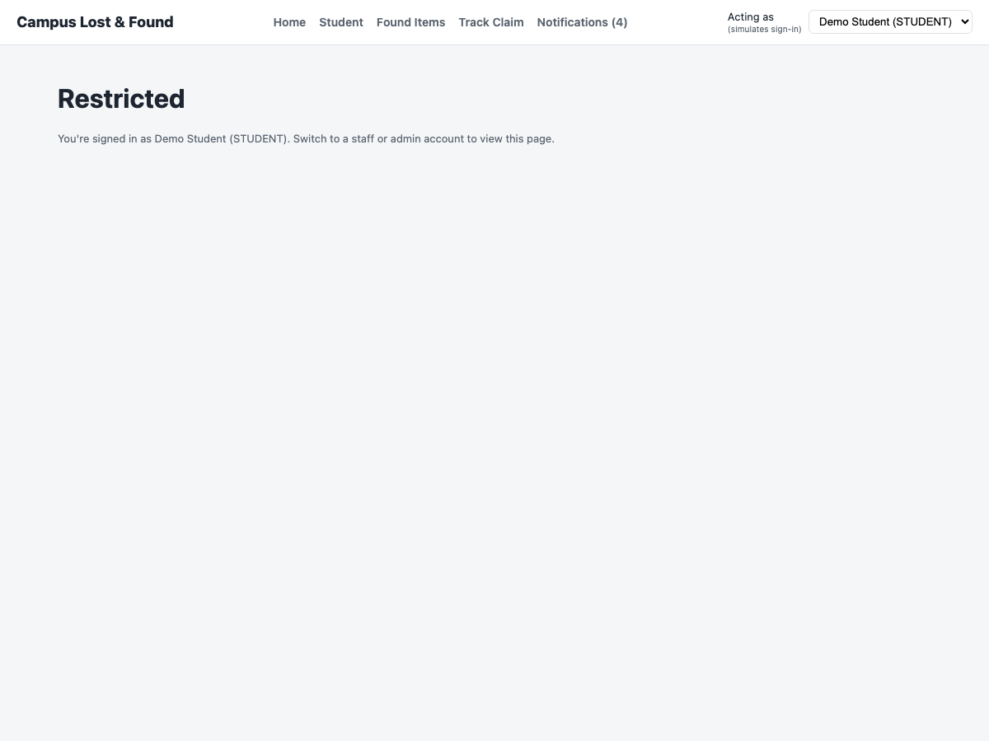



6 / 6 — ACCESS CONTROL TESTING
Role-Based Security, Verified Twice
Access control is enforced server-side by a requireRole middleware and exercised two independent ways: the automated integration suite, and a reproducible Bruno API collection anyone on the team can re-run.
Student
Report items, submit claims, view own notifications
Staff
Review & decide claims, confirm handover
Admin
View audit log (only role permitted)
A Student redirected away from the Staff dashboard — UI-level role gating in action
Campus Lost & Found Management System | CSX4104/ITX4104 Software Testing
10

Slide 12
DEFECT FOUND & RESOLVED
A Real Bug, Caught Before Users Saw It
BEFORE
AFTER
GET /api/claims/by-code/ (empty code) and a malformed claim ID both returned an uncaught 500 Internal Server Error.
Fixed in src/middleware/errorHandler.js: Prisma codes P2007 and P2023 now map to a clean 404 Not Found.
Root cause: Express routed the bad segment to GET /:id, which passed it straight to Prisma. Postgres rejected it as invalid UUID syntax (error P2007) — a code errorHandler.js didn't recognize.
Verified via curl and the Bruno “Get Claim by Code” request. Full regression re-run afterward: 91/91 unit tests and 9/9 integration checks still passing.
Campus Lost & Found Management System | CSX4104/ITX4104 Software Testing
11

Slide 13

RESULTS
Final Test Execution Summary
91
38
13
7
6
Unit Tests
Control-Flow Paths
Domain Cases
Integration Scenarios
Access Control Checks
155 total test cases executed across all six techniques — 100% Pass, zero open defects.
$ npm test Tests: 91 passed, 91 total
$ npm run test:integration # pass 9 # fail 0
$ npx @usebruno/cli run --env Local -r Requests 22 (22 Passed) · Tests 18/18
Campus Lost & Found Management System | CSX4104/ITX4104 Software Testing
12

Slide 14


CONCLUSION
Key Takeaways
High-risk logic, fully covered
The rule-based matching engine, claim decisions, and handover eligibility — flagged as highest-risk for their branching complexity — are covered by CFG/DFG analysis, not just spot checks.
Static analysis found a real defect
Building the CFGs surfaced an unreachable branch and, separately, the by-code 500-error bug — both fixed before this report was finalized.
Every result is reproducible
Automated integration tests and a Bruno collection mean any teammate can re-run and independently verify every “Pass” claim in this report.
Campus Lost & Found Management System | CSX4104/ITX4104 Software Testing
13

Slide 15
Thank You
Questions & Discussion
Campus Lost & Found Management System · CSX4104/ITX4104 Software Testing

