Slide 1
Stability Analysis of Foot Placement Methods for
Model Predictive Control-based Quadrupedal Trotting
Liwei Mei, Qi Guo

Slide 2
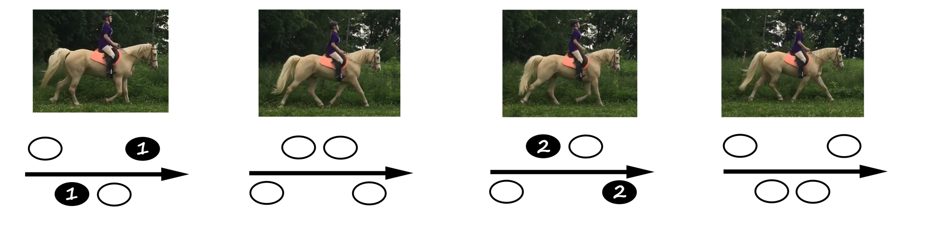
Research Question:
How Does Swing-Leg Foot Placement Affect Trotting Stability?
Trotting (alternating diagonal-leg contacts)
Our focus is how selecting future touchdown locations for swing legs influences stride-to-stride stability.
^{[4]}

Slide 3
Phase in Trot
The figure uses an idealized 50% duty cycle and omits the double-support and free-flight phases.
front-left + rear-right
front-left + rear-right
Pair A
front-right + rear-left
front-right + rear-left
Pair B
0
0.5T
T
1.5T
2T

Slide 4
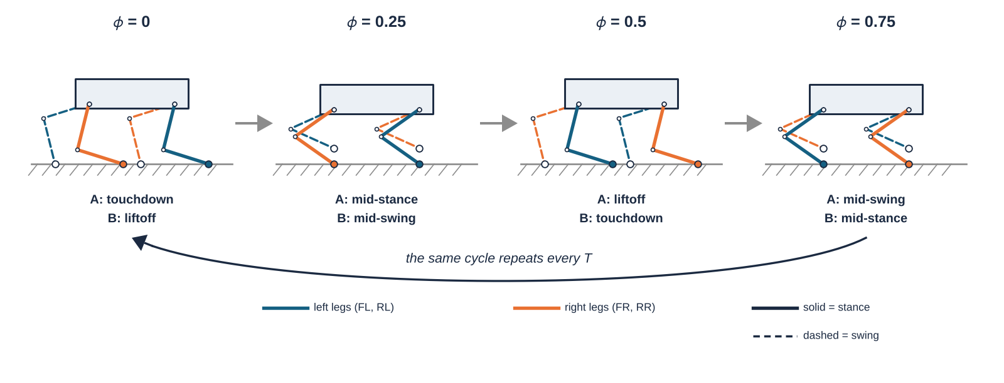
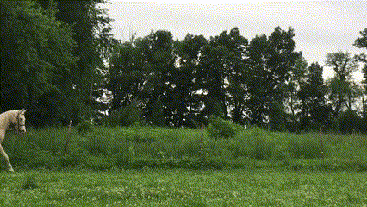
^{[4]}

Slide 5
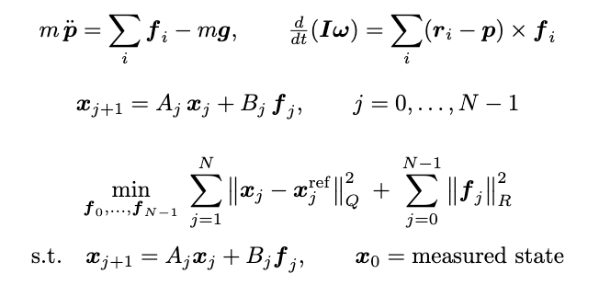
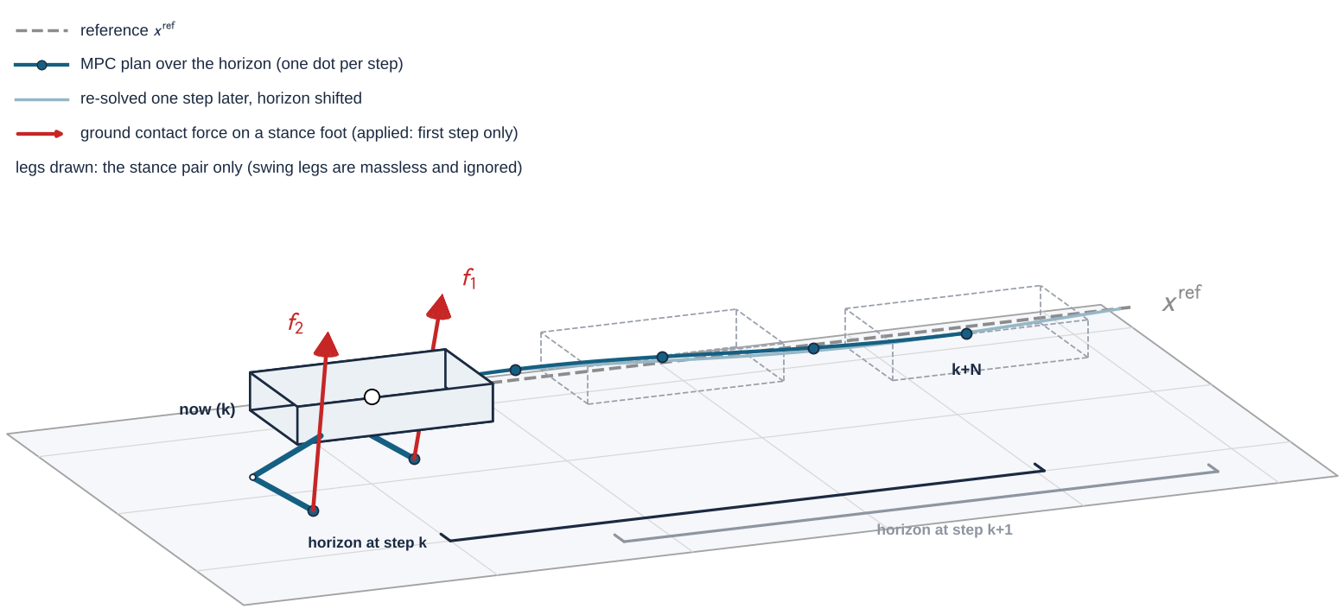
Model Predictive Control (MPC) ^{[1]}

Slide 6
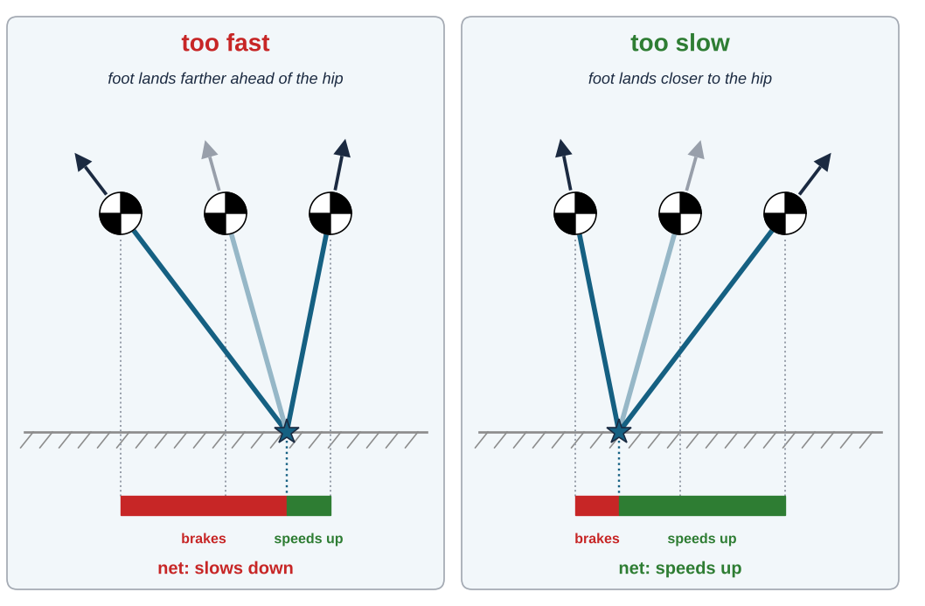
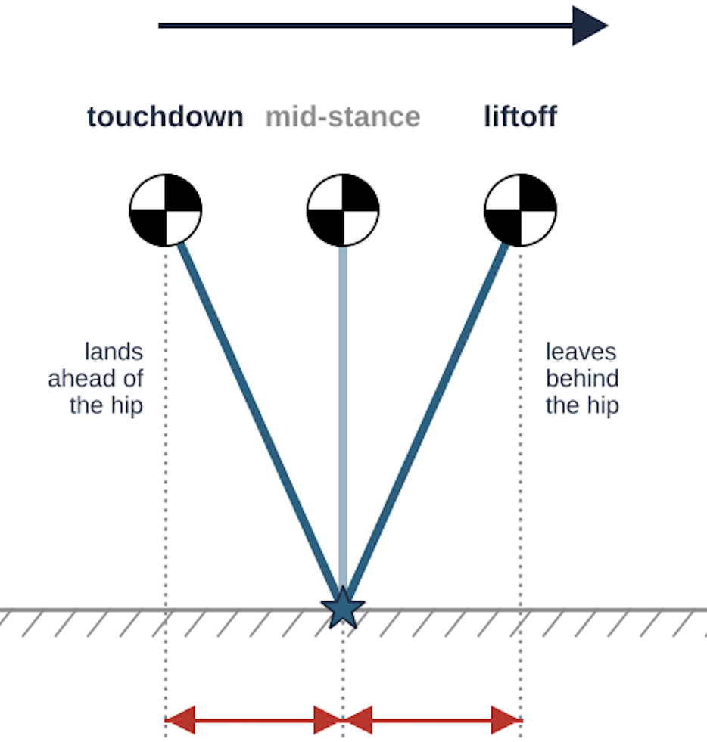





Foot placement ^{[2]}
$$p=\frac{vT}{2}$$
$$\frac{vT}{4}$$
$$\frac{vT}{4}$$
$v$: measured velocity
$$p=\frac{vT}{2}+K_{p}(v−v^{ref})$$

Slide 7
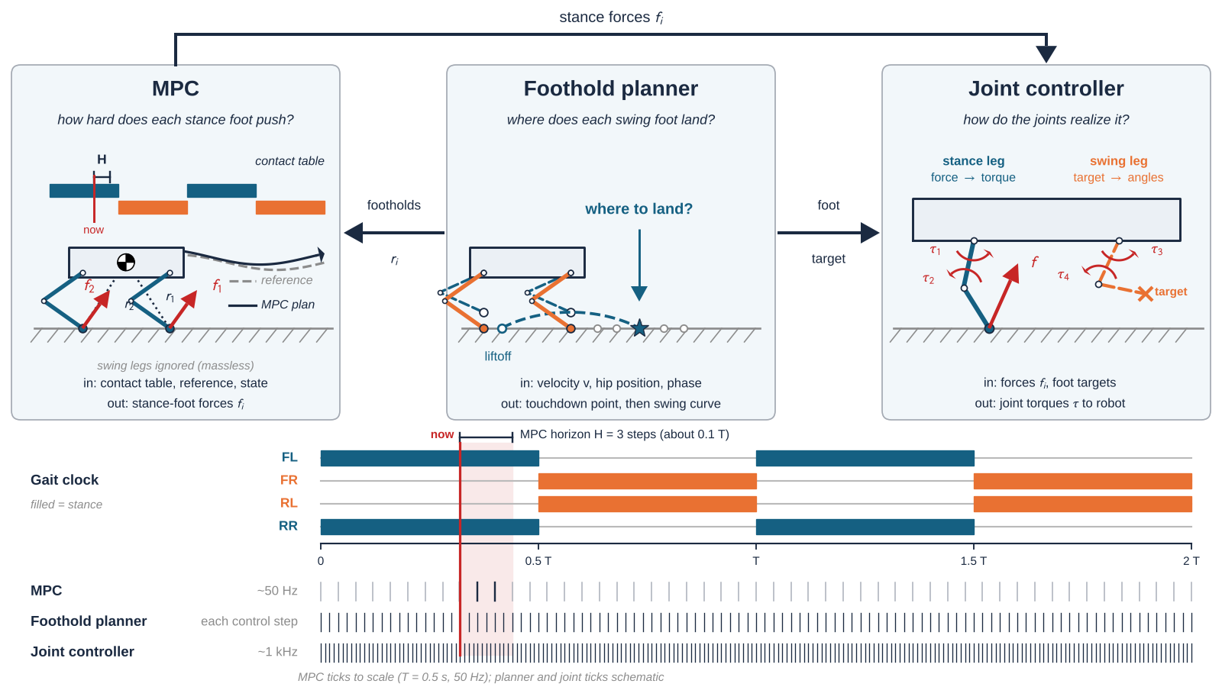
Control architecture and information flow
^{[3]}
Foot placement
Foot placement.

Slide 8
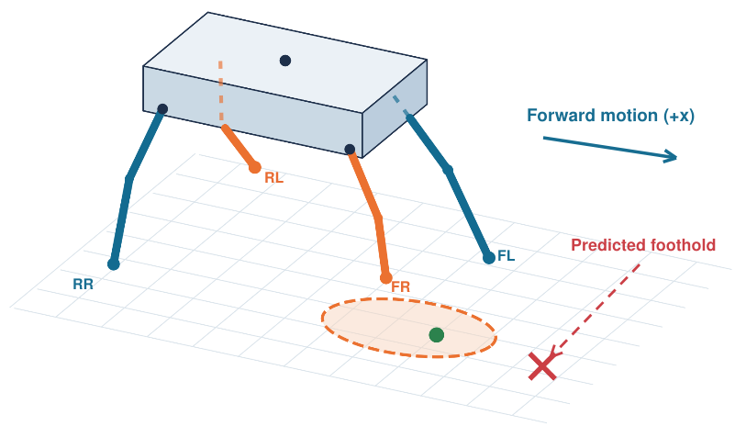
MOTIVATION / FAILURE MODE 1
Unreachable swing-foot touchdown
Orange: swing legs and candidate region
Red: requested touchdown point

Slide 9
MOTIVATION / FAILURE MODE 2
Touchdown delay creates a contact mismatch
If a swing foot fails to reach the ground at its scheduled touchdown time,
the MPC contact assumptions may no longer match the robot's actual support condition.
Swing-Foot Height
Planned touchdown
Actual touchdown
height
No ground contact force is available
from an airborne foot.
ground
t
Desired Contact
swing
stance
Actual Contact
swing (late)
stance
Contact mismatch interval

Slide 10
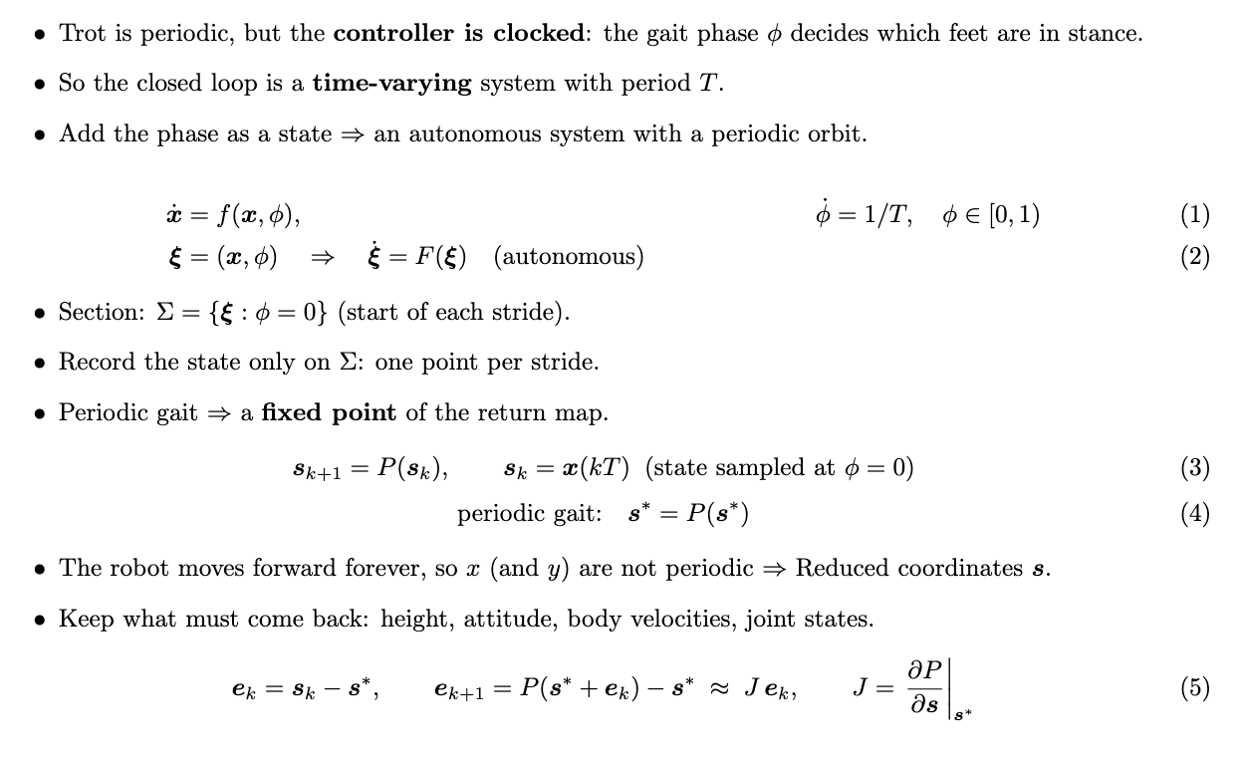
Periodic Stability Analysis

Slide 11
Other Candidate Metrics
Reference
[1] Jared Di Carlo, Patrick M Wensing, Benjamin Katz, Gerardo Bledt, and
Sangbae Kim. Dynamic locomotion in the mit cheetah 3 through convex
model-predictive control. In 2018 IEEE/RSJ international conference on
intelligent robots and systems (IROS), pages 1–9. IEEE, 2018
[2] Marc H Raibert, H Benjamin Brown Jr, and Michael Chepponis. Ex-
periments in balance with a 3d one-legged hopping machine. The
International Journal of Robotics Research, 3(2):75–92, 1984.
[3] Joseph Norby, Yanhao Yang, Ardalan Tajbakhsh, Jiming Ren, Justin K
Yim, Alexandra Stutt, Qishun Yu, Nikolai Flowers, and Aaron M John-
son. Quad-sdk: Full stack software framework for agile quadrupedal
locomotion. In ICRA Workshop on Legged Robots, pages 1–5, 2022.
[4] https://www.animatornotebook.com/learn/quadrupeds-gaits
Trajectory tracking error
Region of Attraction
Disclosure of GenAI Usage:
Images redrawn from hand-drawn sketches via GenAI

