Slide 1
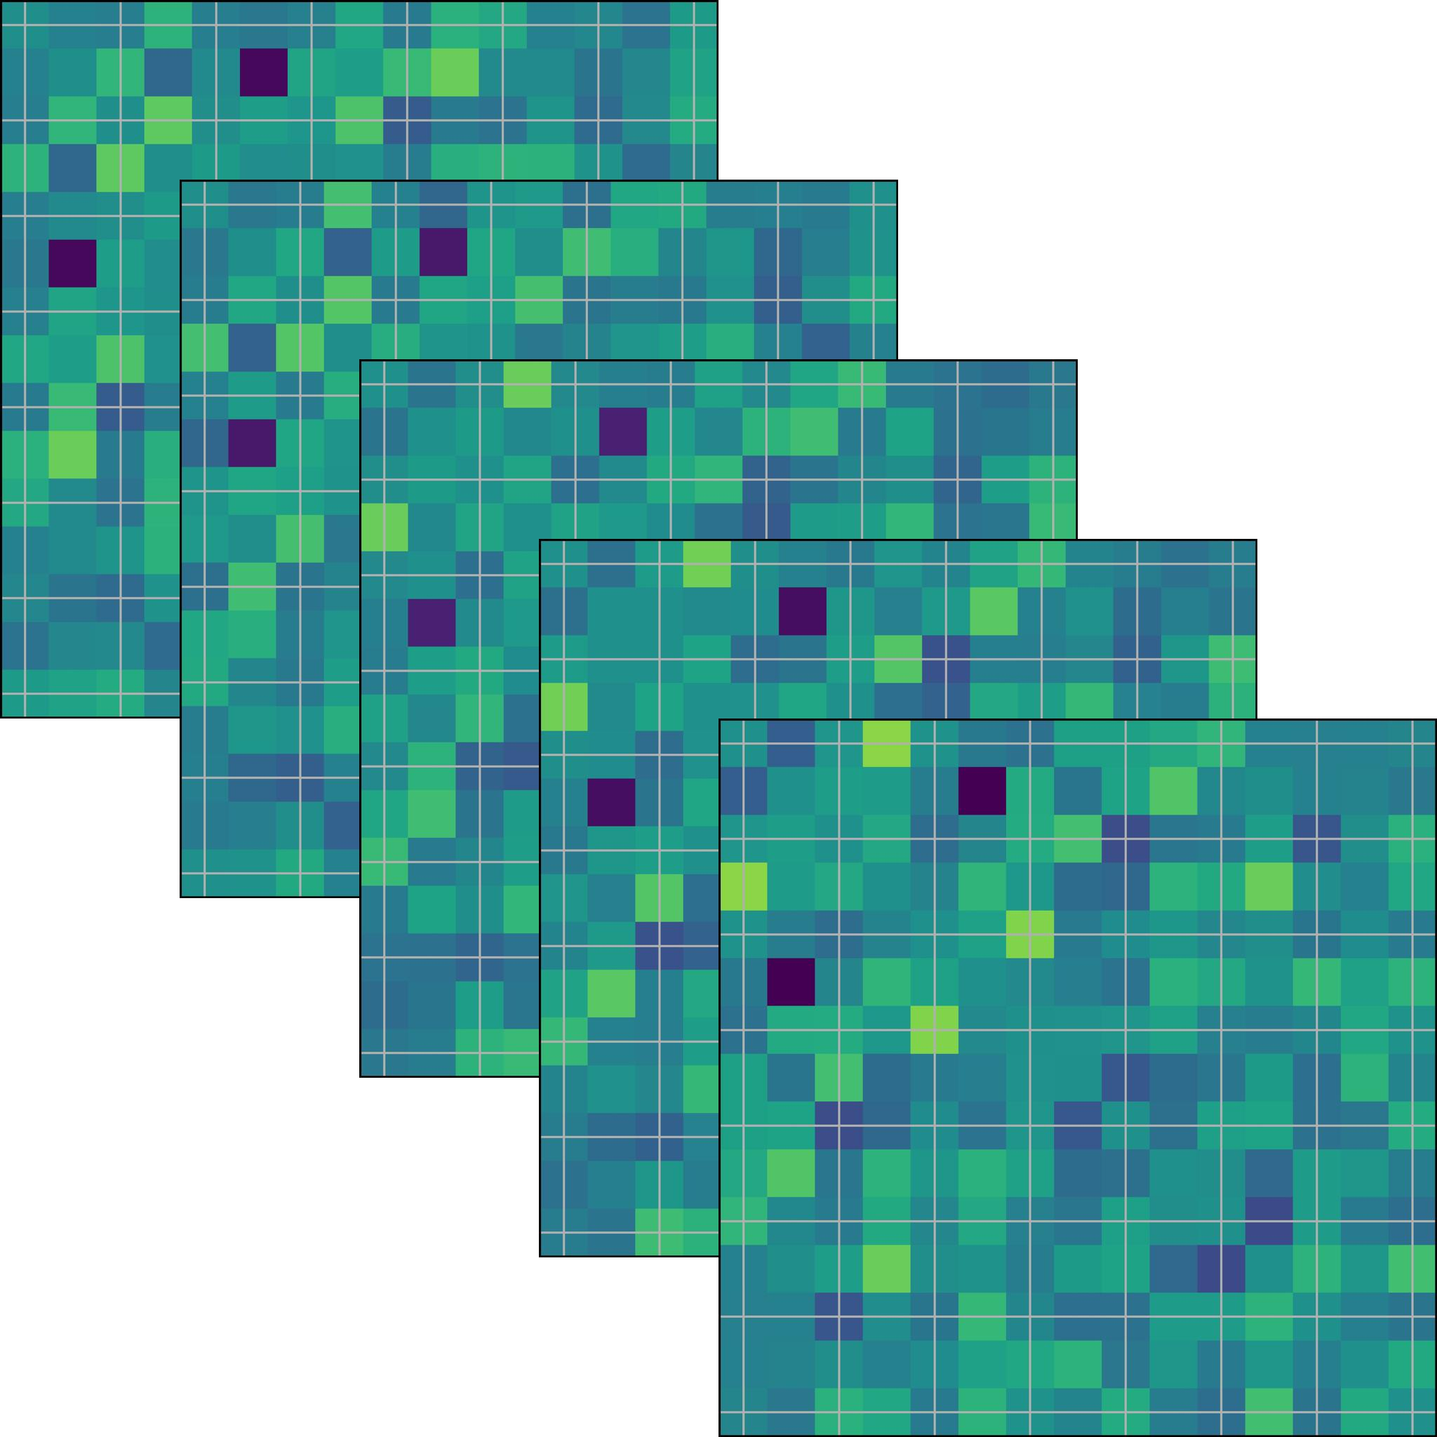

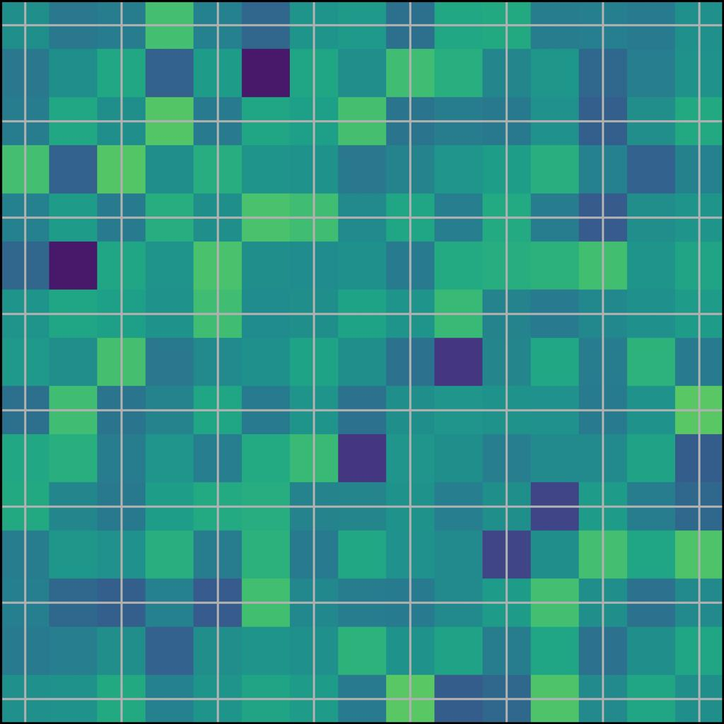
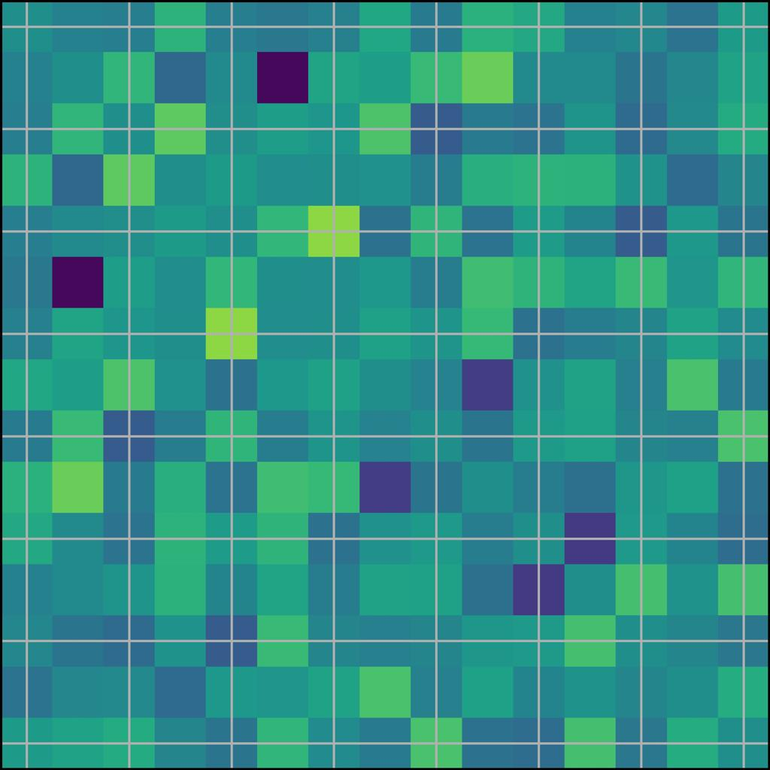
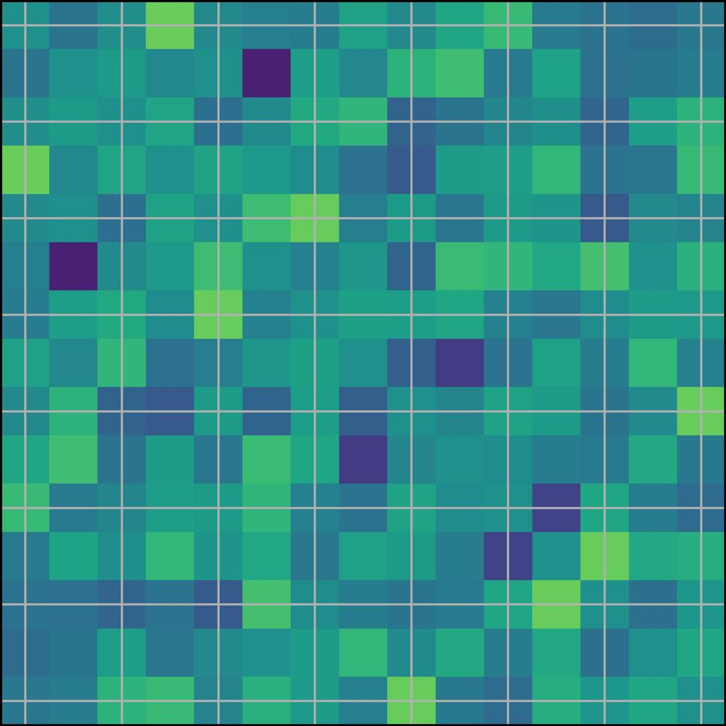


…
Processing time series with sliding windows
Dynamic functional connectivity
$$(x_{1},x_{2},…, x_{m})$$
$$\{Female, Male\}$$
CNN
MLP
Features
Results

