Slide 1








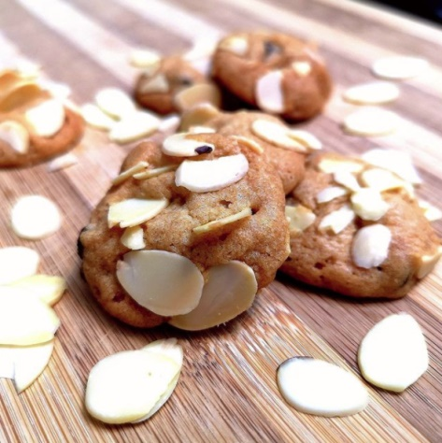
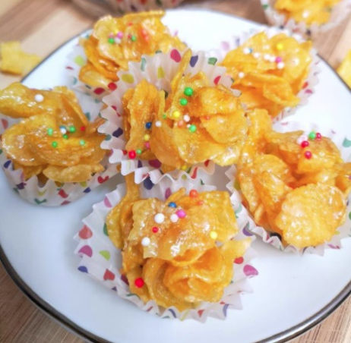

Allergens please note that all our products may contain traces of nuts, eggs, dairy products. Please inform if buyer is allergic to any, special request can be made. Orders are subject to availability.
Standard
Monster Cookie $5 per 100gm
Standard Natural Dark Cocoa
Basic
Colourful life $5 per 100gm
Rainbow Sprinkles with Natural Dark Cocoa
Snowflakes $5 per 100gm
Grated Coconut with Cocoa
Crunchy Treasure $5 per 100gm
Cereal Cornflakes with Dark Cacao
Premium Nuts
Baked Almond $6 per 100gm
Natural Baked Almond with Dark Cacao
Baked Cashew with Sesame $8 per 100gm
Natural Baked Premium Cashew
Nutty Nuts $8 per 100gm
Peanut Butter coated with Baked Diced Almonds
Baked Almond
Special Orders
Crunchy Treasure with Hidden Gem $6 per 100gm
Cornflakes added Natural Raisins
Oatmeal Butterscotch $8 per 100gm
Oatmeal Butterscotch
Cranberry White Chocolate $8 per 100gm
Cranberry White Chocolate
Special Orders
Honeybee Crunchy Treasure $8 per tub
Honey Cornflakes Cup
Honeybee Crunchy Treasure
----- Best Seller
----- Kid’s Friendly
Follow us on @meispecialty

