Slide 1
UVM Verification Final Project
Chip Design & Verification Course
Author: Meitar Shimoni
This project demonstrated a full UVM Environment build for a CPM dut.
Using RAL, Coverage, Assertions, Reference Model, Scoreboard etc.

Slide 2
Verification Requirements & Deliverables
1. Complete System Flow Orchestration
Reset -> Configure -> Traffic -> reconfigure -> Stress -> Drop -> Readback -> End
2. Functional Coverage
Coverpoint: MODE
Coverpoint: OPCODE
Cross: MODE x OPCODE
Drop Event Coverage
Stall/Backpressure
3. SVA
Input stability under stall
Bounded liveness
Output stability under stall

Slide 3
Requirements Extraction & RTM
Req ID | Description | Verification method | Planned Artifact
R1 | Synchronous Reset: Upon rst, registers return to reset values, pipeline flushes, and counters clear. | Simulation / RAL | ResetSequence
R2 | In-Order Processing: The CPM must preserve strict packet ordering under all conditions | Scoreboard | CpmScoreboard
R3 | Handshake Stability (In): If in_valid is high and in_ready is low, data signals must remain stable | SVA | SVA inside StreamInInterface
R4 | Handshake Stability (Out): If out_valid is high and out_ready is low, data signals must remain stable | SVA | SVA inside StreamOutInterface
R5 | Processing Mode 0 (PASS): payload_out = payload_in with 0 cycles latency | Scoreboard / Test | SmokeTest
R6 | Processing Mode 1 (XOR): payload_out = payload_in ^ MASK with 1 cycle latency. | Scoreboard / Test | SmokeTest
R7 | Processing Mode 2 (ADD): payload_out = payload_in + ADD_CONST with 2 cycles latency | Scoreboard / Test | SmokeTest
R8 | Processing Mode 3 (ROT): payload_out = rotate_left(payload_in, ROT_AMT) with 1 cycle latency. | Scoreboard / Test | SmokeTest
R9 | Configuration Sampling: Mode and parameters are sampled at in_fire. | Scoreboard / Test | SmokeTest
R10 | Packet Drop: Packets matching DROP_OPCODE when DROP_EN=1 are not produced at output. | Scoreboard | SmokeTest
R11 | Counter Invariant: COUNT_OUT + DROPPED_COUNT == COUNT_IN. | Scoreboard | CpmScoreboard
R12 | Backpressure: CPM must handle downstream stalls by deasserting in_ready. | Stress Test | Stress Test
R13 | Bounded Liveness: Accepted non-dropped packets must exit within spec-defined latency. | SVA | SVA inside StreamInInterface
R14 | Register Handshake: gnt is asserted whenever req is asserted (zero wait states). | SVA | SVA inside RegCtrlInterface

Slide 4
The Design Spec
The CPM is a block that processes packages received on a streaming input interface and produces a modified packages on the output interface.
Mode | Operation | Latency
PASS | payload_out = payload_in | 0 cycles
XOR | payload_in ^ MASK | 1 cycles
ADD | payload_in + ADD_CONST | 2 cycles
ROT | rotate_left(payload_in, ROT_AMT) | 1 cycles
The CPM is a block that processes packages received on a streaming input interface and produces a modified packages on the output interface.

Slide 5
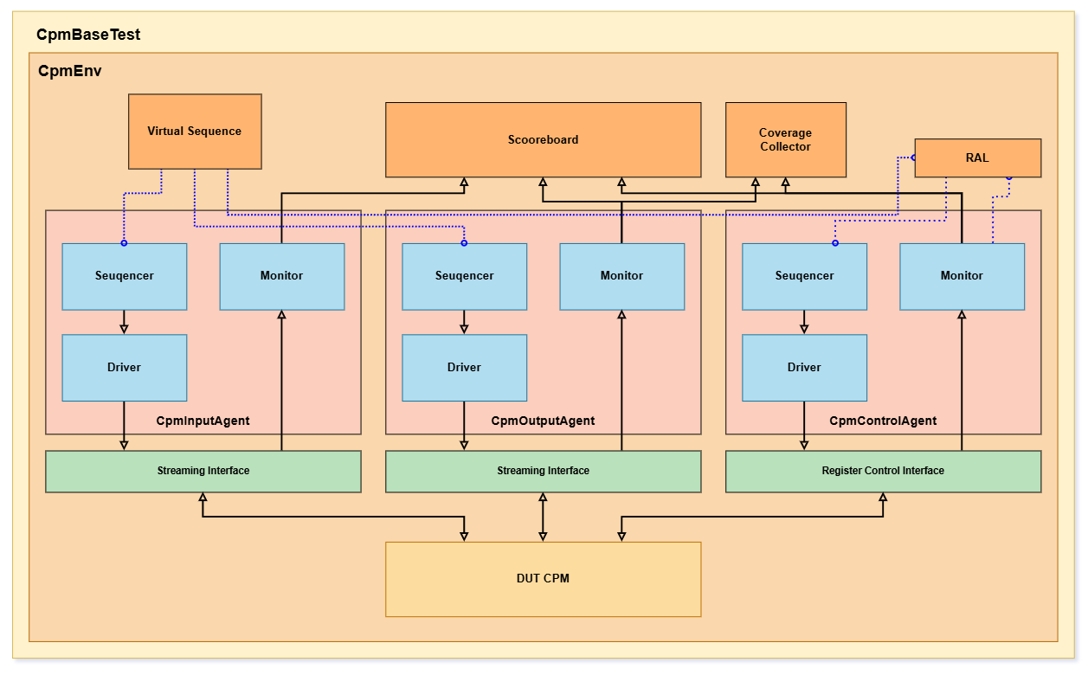
Verification Environment
The Environment includes 3 active agents, one for each interface.
CpmInputAgent: Run the Streaming Interface.
CpmOutputAgent: Act as an output master
CpmRegCtrlAgent: Master Registers via RAL.
Virtual Sequence: Connects between all the sequences.
RAL (Register Access Layer) : Holds the register map.
Scoreboard/Reference Model: Collects transactions and compare them with a reference model.
Coverage Collector: Collects The Modes and packages properties into covergroups.

Slide 6
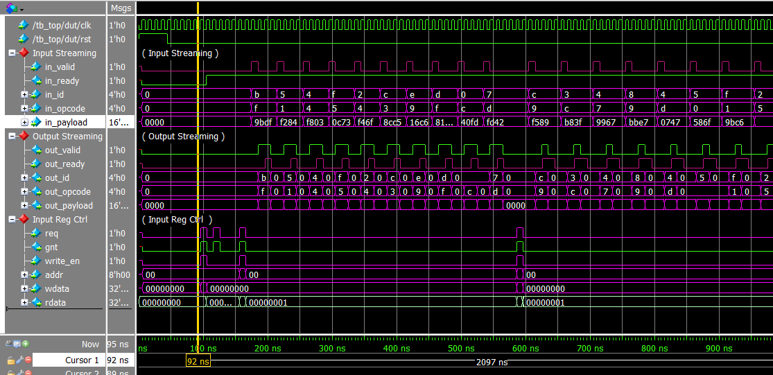
SmokeTest:
The Goal
Runs simple traffics over a
couple of modes for sanity check.
PASS mode, XOR mode, ADD mode, ROT mode.
Checks the RAL’s Counter for validation.
This is the most critical part of the workshop.

Slide 7
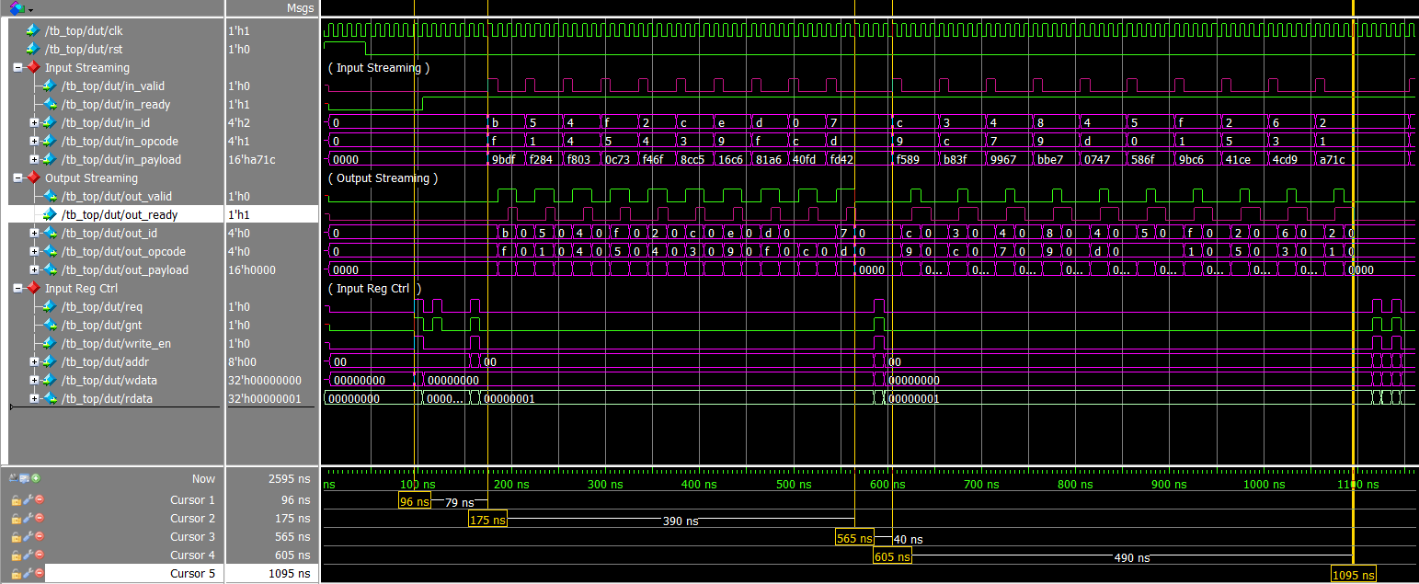

Slide 8
StressTest:
The Goal
Run different modes with backpressure.

Slide 9

Part C: Inspect the Generated RAL Model
The Goal
Understand what RAL gives you for free — and what it does not.
C1. Generated Code
Open:
You are not expected to understand every line.
Verification/ral/stu_ral.sv
You are expected to understand:
Locate:
How registers map to addresses
How fields map to bits
Where reset values are defined
The stu_ral_model class (uvm_reg_block)
At least one uvm_reg
At least one uvm_reg_field

Slide 10
D2. File to Edit
Open:
You must implement:
Verification/ral/stu_reg_adapter.sv
reg2bus
bus2reg
Do not guess. Think carefully about who calls these functions and why.
D3. Concept Check (Before Coding)
You should be able to reason about:
Who calls reg2bus()?
Who calls bus2reg()?
Why does RAL care about write data?
Why does prediction exist at all?
If these are unclear — that is expected at this stage.

Slide 11
Part E: Integrate RAL into the Environment
The Goal
Wire the RAL model into the UVM environment so it stays synchronized with hardware.
E1. File to Edit
Open:
You will:
Verification/env/stu_env.sv
Instantiate the RAL model
Instantiate the adapter
Instantiate the predictor
Connect predictor to the monitor
Bind the register map to the sequencer and adapter
E2. Integration Checklist
Before compiling, confirm:
The register model is built (build())
The adapter is assigned to the map
The predictor listens to the monitor
The predictor knows which adapter to use
Missing any one of these leads to silent errors.

Slide 12
Part F: Compile and Reason
The Goal
Observe behavior and reason about architecture — not write tests yet.
Think Like a Verification Engineer
Ask yourself:
If hardware updates a status register internally, who updates the model?
If mirrored values are wrong, where would you debug?
What breaks if the adapter is incorrect but simulation still runs?
These questions matter more than finishing code.

