Slide 1
ECG Arrhythmia Detection and Classification
Presenter: Mahdi Khalilzadeh, 9932213
Course: Fundamentals of Intelligent Systems
Lecturer: Dr. Mahdi Aliyari

Slide 2
TABLE OF CONTENTS
1
2
3
4
5
6
What is ECG?
The Importance of Arrhythmias
Dataset Introduction
Preprocessing
Deployed Models
Results & Further Work
1/14

Slide 3
1
What is ECG?

Slide 4
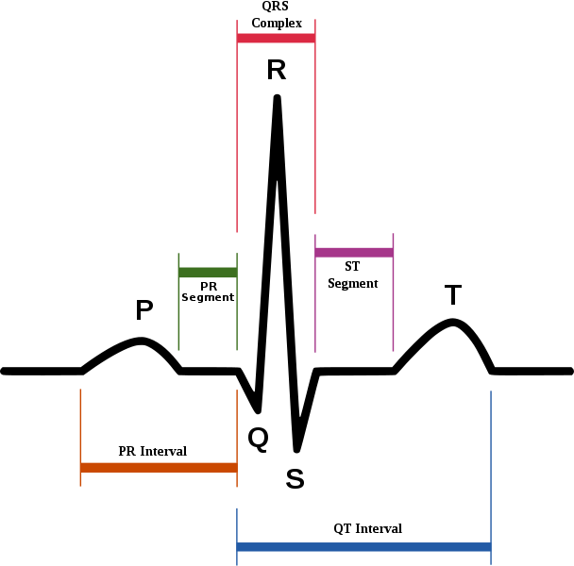

What is ECG?
A bioelectrical signal that records the heart’s electrical activity
Useful for assessing heart rhythm and functionality & detecting heart diseases like arrhythmias
2/14

Slide 5
2
The Importance of Arrhythmias

Slide 6
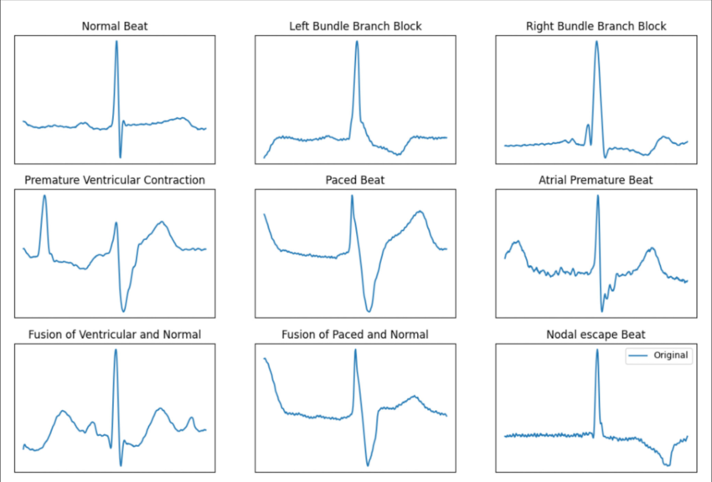
The Importance of Arrhythmias
A condition where the heart beats irregularly, which can lead to serious complications.
Mild or Severe Arrhythmias
Neglection= cardiac arrest = death
3/14

Slide 7
3
Dataset Introduction

Slide 8
Dataset Introduction
One of the most widely used and trusted ECG datasets
48 ECG recordings from 47 patients at 360 Hz
Annotated by experts for high accuracy
Six Considered Classes for this project:
N (Normal beat)
A (Atrial Premature Beat)
V (Premature Ventricular Cont.)
L (Left Bundle Branch Block)
R (Right Bundle Branch Block)
F (Fusion Beat)
4/14

Slide 9
4
Preprocessing Steps

Slide 10
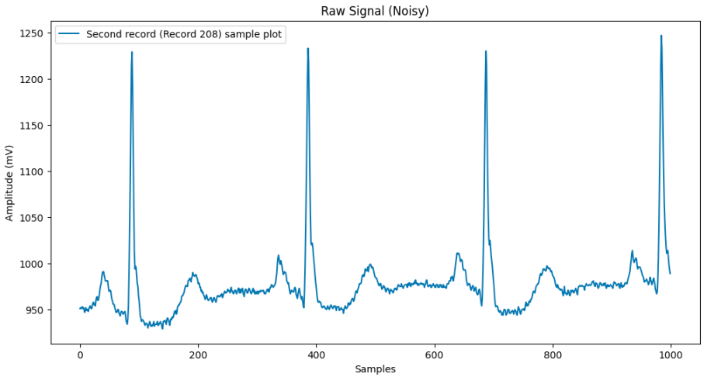
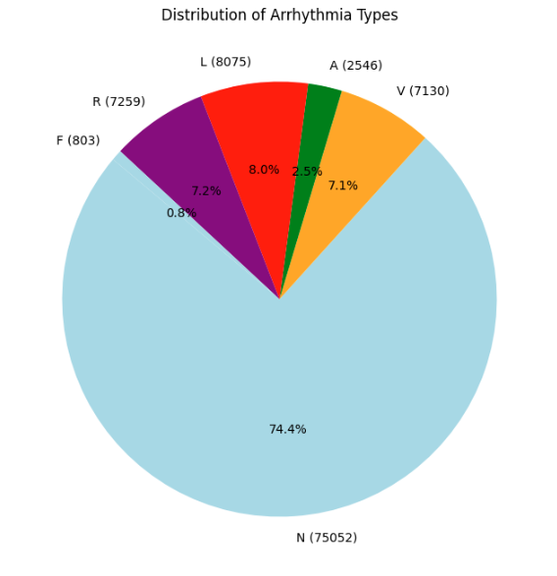
Preprocessing Steps
Why? Improve signal quality for better classification accuracy
Noise Removal
Notch filters (30Hz & 60Hz) to eliminate electrical interference & Moving Average
Normalization
Using Z-score normalization to standardize signal amplitudes
Heartbeat Segmentation
Isolating individual heartbeats
Class Balancing
Oversampling and undersampling to prevent bias in the model
5/14

Slide 11
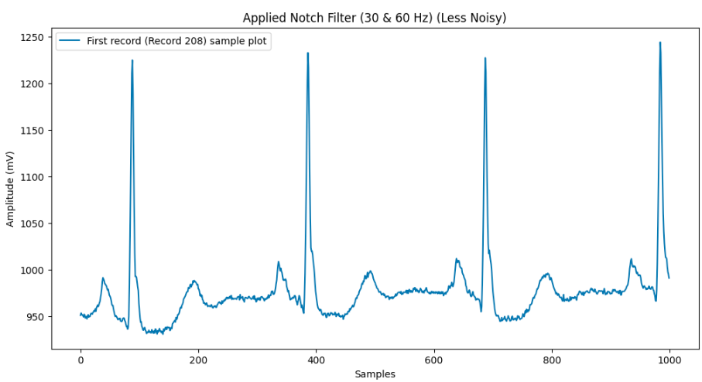
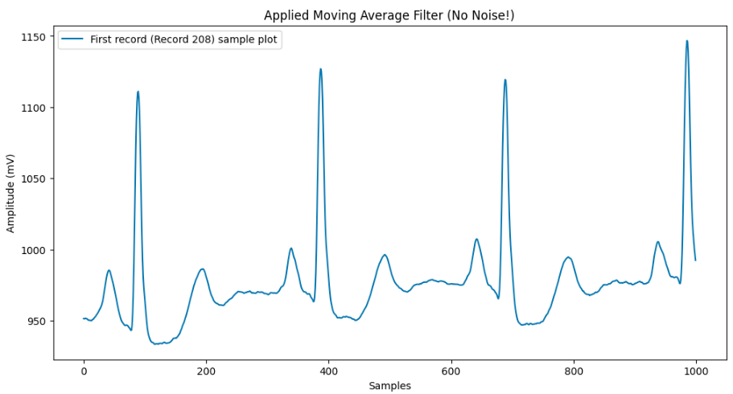
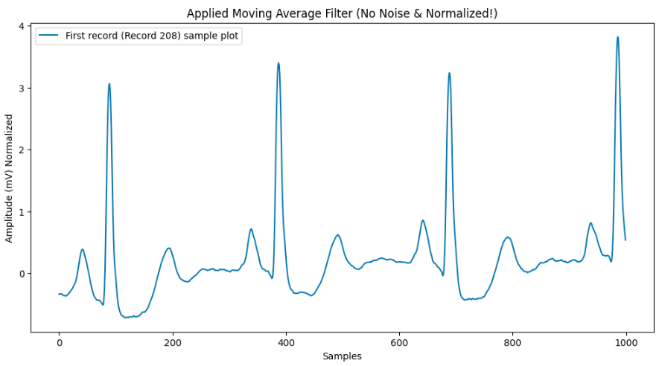
Preprocessing Steps
6/14

Slide 12
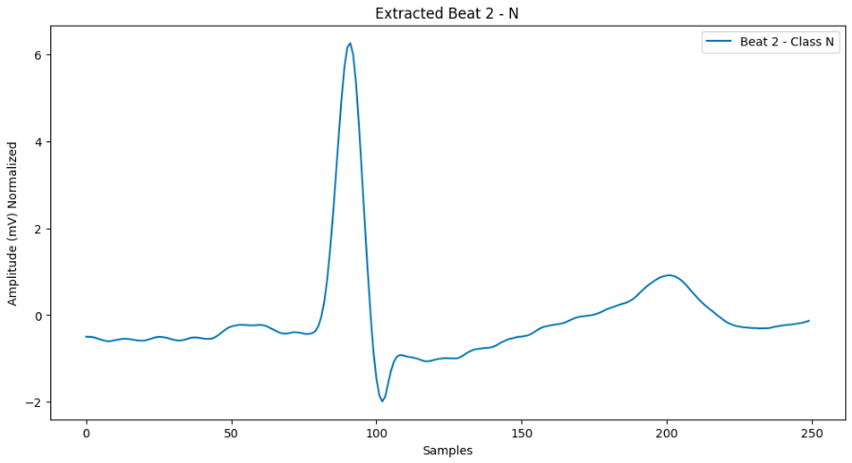
Preprocessing Steps
Segmented and Ready!
[2]
7/14

Slide 13
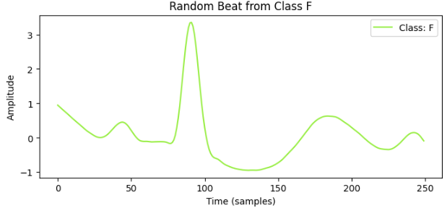
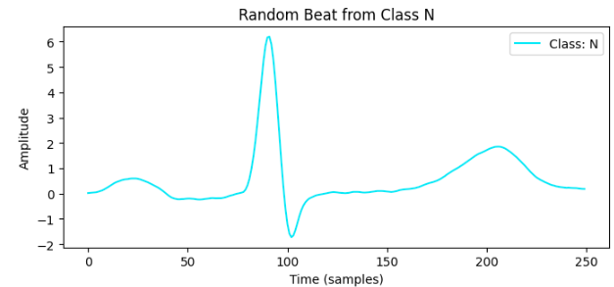
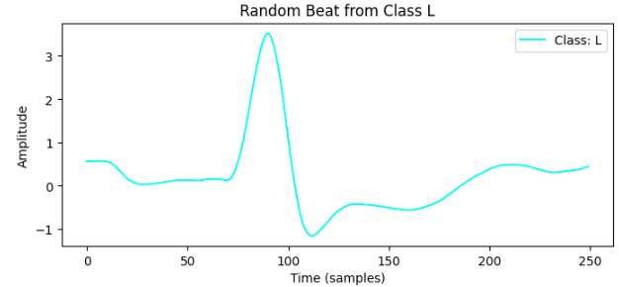
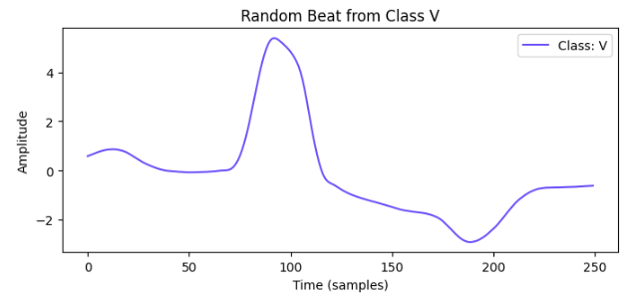
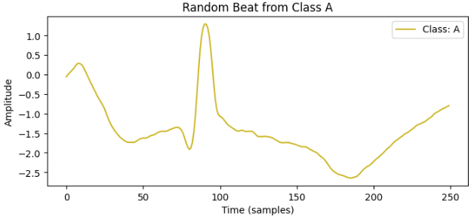
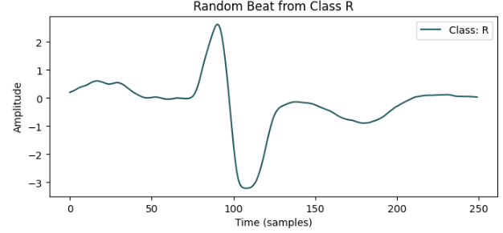
Preprocessing Steps
Sample of Classes
8/20

Slide 14
5
Deployed Models

Slide 15
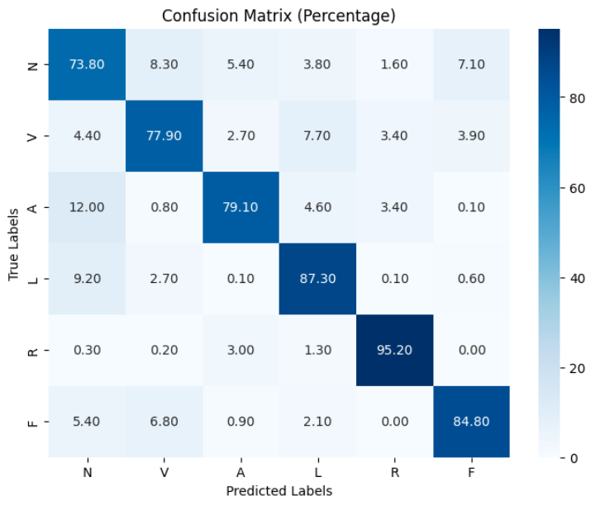
Deployed Models
Logistic Regression
Simple model serving as a baseline model
Achieved an accuracy of ~83%
Performance was limited due to ECG's time-series nature, as logistic regression does not capture temporal dependencies
9/14

Slide 16
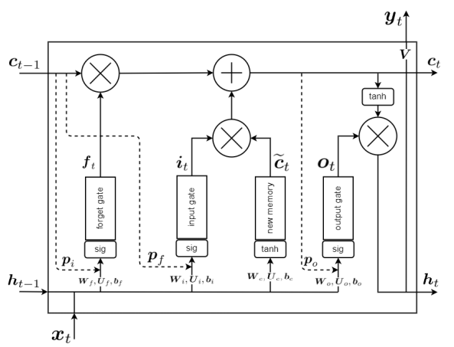
Deployed Models
Long Short-Term Memory (LSTM)
LSTM is a type of Recurrent Neural Network (RNN) designed to handle time-series and sequential data effectively.
Each LSTM cell has three main gates:
Forget Gate: Decides what information to discard.
Input Gate: Determines what new information to store.
Output Gate: Controls what information is passed to the next state.
10/14

Slide 17
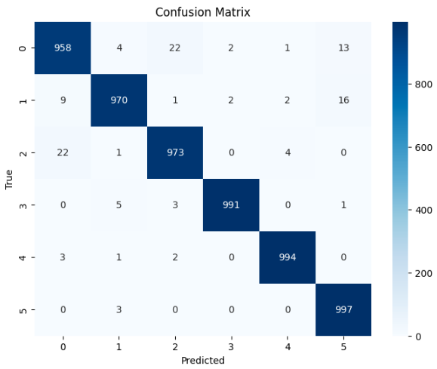
Deployed Models
Why LSTM for ECG?
ECG signals are time-dependent, meaning the previous states of the heart influence the current state.
Accuracy: ~98%
Significantly improved classification of abnormal heartbeats compared to Logistic Regression.
Training is computationally expensive.
11/20

Slide 18
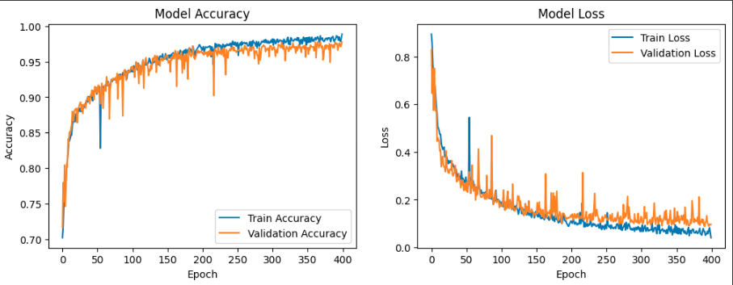
Deployed Models
Accuracy and Loss
12/14

Slide 19
6
Conclusion

Slide 20
Conclusion
Machine Learning is effective in automating arrhythmia detection.
LSTMs outperform traditional models due to their capability to capture sequential dependencies.
Models should be tested on other datasets!
13/14

Slide 21
References
[1] G. Moody, R. Mark, "The Impact of the MIT-BIH Arrhythmia Database," IEEE Engineering in Medicine and Biology Magazine, vol. 20, no. 3, pp. 45-50, 2001.
[2] B. Ghojogh, A. Ghodsi, "Recurrent Neural Networks and Long Short-Term Memory Networks: Tutorial and Survey," arXiv preprint arXiv:2304.11461, Apr. 2023.
14/14

Slide 22
THANKS
Do you have any questions?

Slide 23
LSTM Architecture
Model Input:
ECG signals are received as a sequence of sampled data points.
Input size: (num_samples, sequence_length, num_features).
LSTM Layers:
A 64-unit LSTM layer extracts time-dependent patterns from ECG data.
Return sequences being True ensures outputs are passed forward to deeper layers.
A final LSTM layer with 32 units learns higher-level temporal dependencies.
Fully Connected (Dense) Layers:
A Dense layer with 64 neurons processes extracted features.
A Softmax output layer with 6 neurons calculates the probability for each arrhythmia class.
Model Optimization:
Loss Function: Categorical Crossentropy for multi-class classification.
Optimizer: Adam optimizer for accuracy improvement and error reduction.
Training: The model is trained for 400 epochs, with performance evaluated on validation data at each step.
Bonus!/14

