Slide 1
CS6650 Assignment 4
Team: Grace Zhou, Huiru Wang, Qing Chen, Chicago

Slide 2
Self introduction

Slide 3
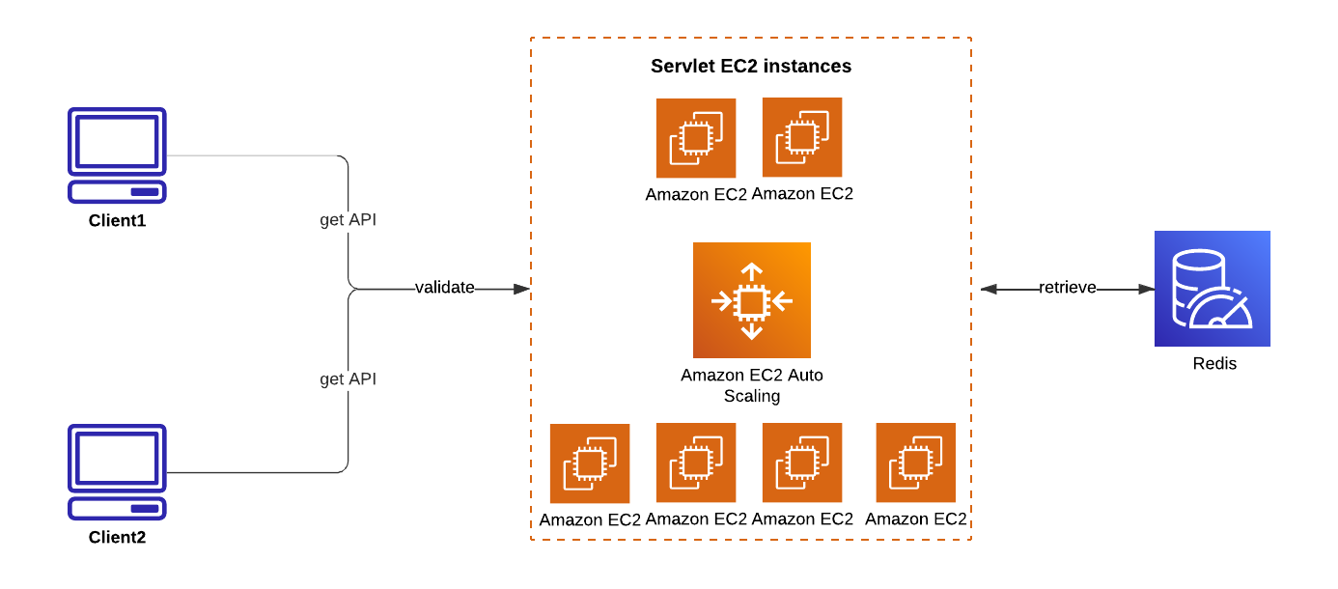
Architecture

Slide 4
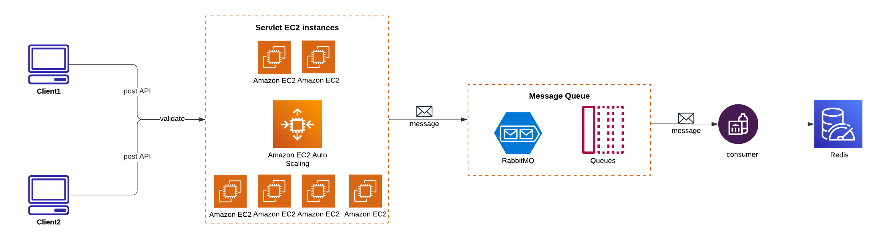
Architecture

Slide 5
Database Design
GET method: read-heavy, requires speed and low latency
Redis: in-memory storage, low latency, cache-first
DynamoDB & MySQL: disk-based

Slide 6
API design
1. GET/resorts/{resortID}/seasons/{seasonID}/day/{dayID}/skiers
Example
•Key: resort:12:season:2024:day:1:skiers
•Value: {12345, 67890, 11122} (a set of skier IDs)

Slide 7
API design
2.GET/skiers/{resortID}/seasons/{seasonID}/days/{dayID}/skiers/{skierID}
Example
•Key: resort:12:season:2024:day:1:skier:67890
•Fields:
•vertical: 4500 (total vertical distance covered on this day)

Slide 8
API design
3. GET/skiers/{skierID}/vertical
Example
•Key: resort:12:skier:67890:vertical
•Fields:
•2024: 8000 (total vertical distance for season 2024)
•2023: 7000 (total vertical distance for season 2023)
•all: 15000 (cumulative vertical distance across all seasons)

Slide 9
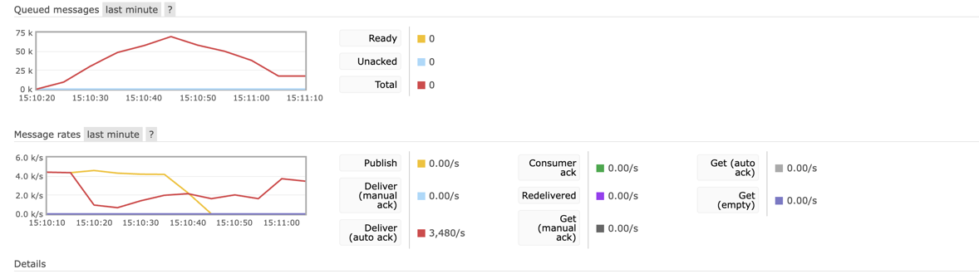
Failures
1. failed requests
2. accumulated messages in the queue - bottleneck

Slide 10
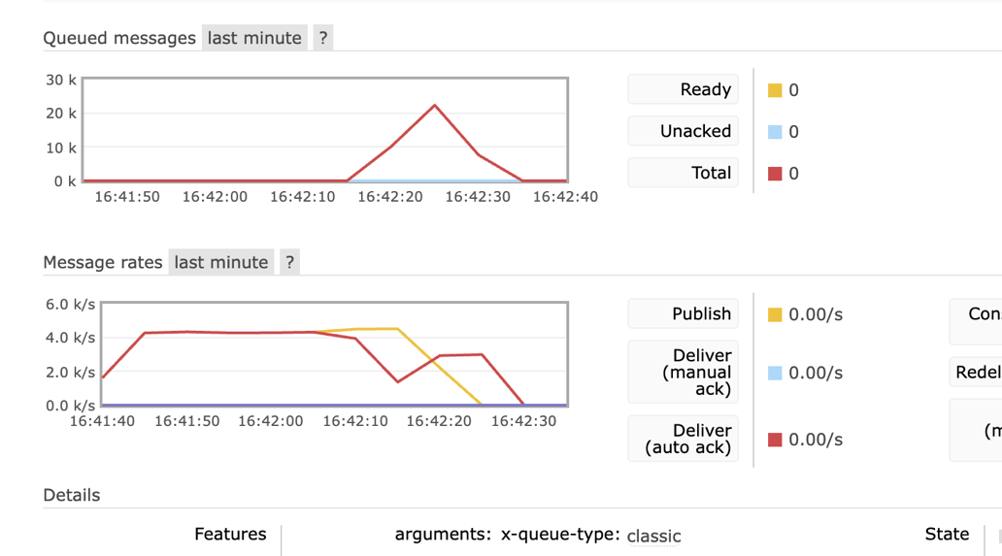
Solution
1: upgrade the instance to t3 medium
2: implemente a pipeline for writing data to Redis

Slide 11
Test results - JMeter

Slide 12
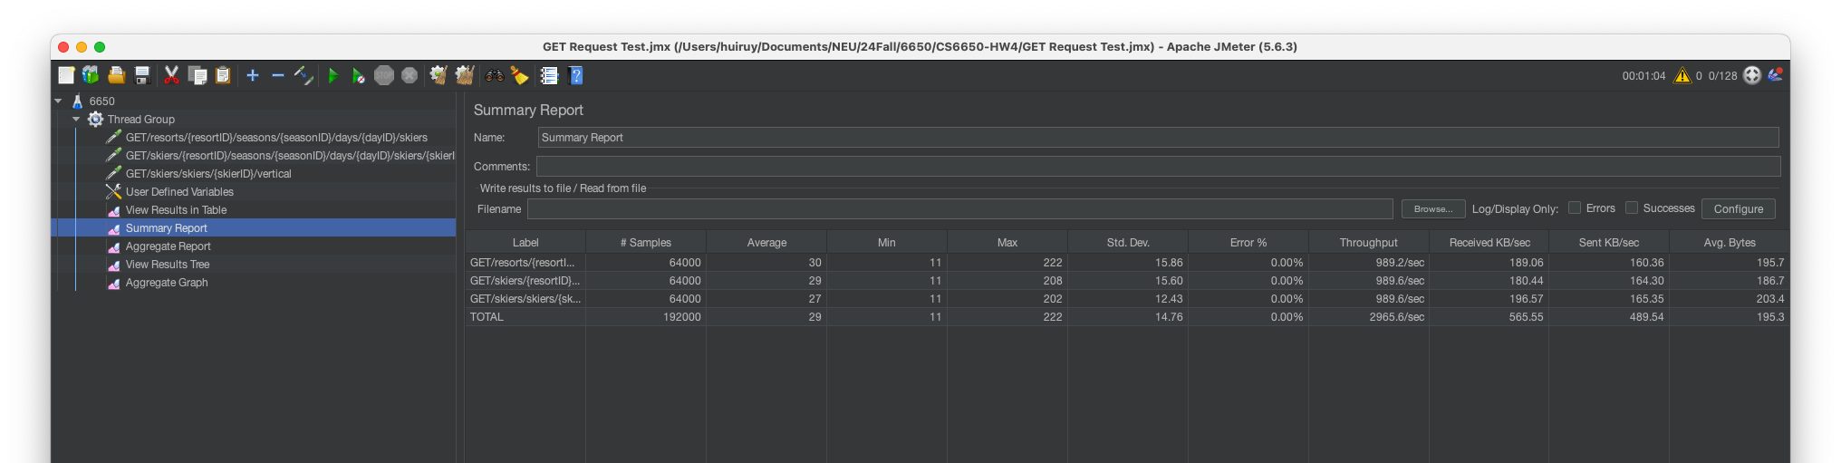

Slide 13
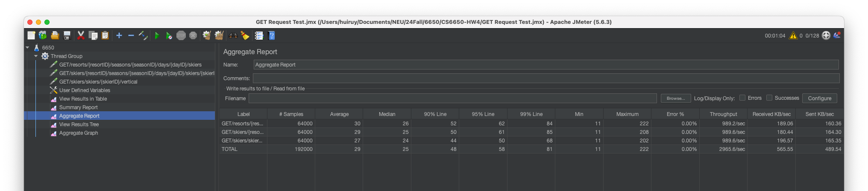

Slide 14
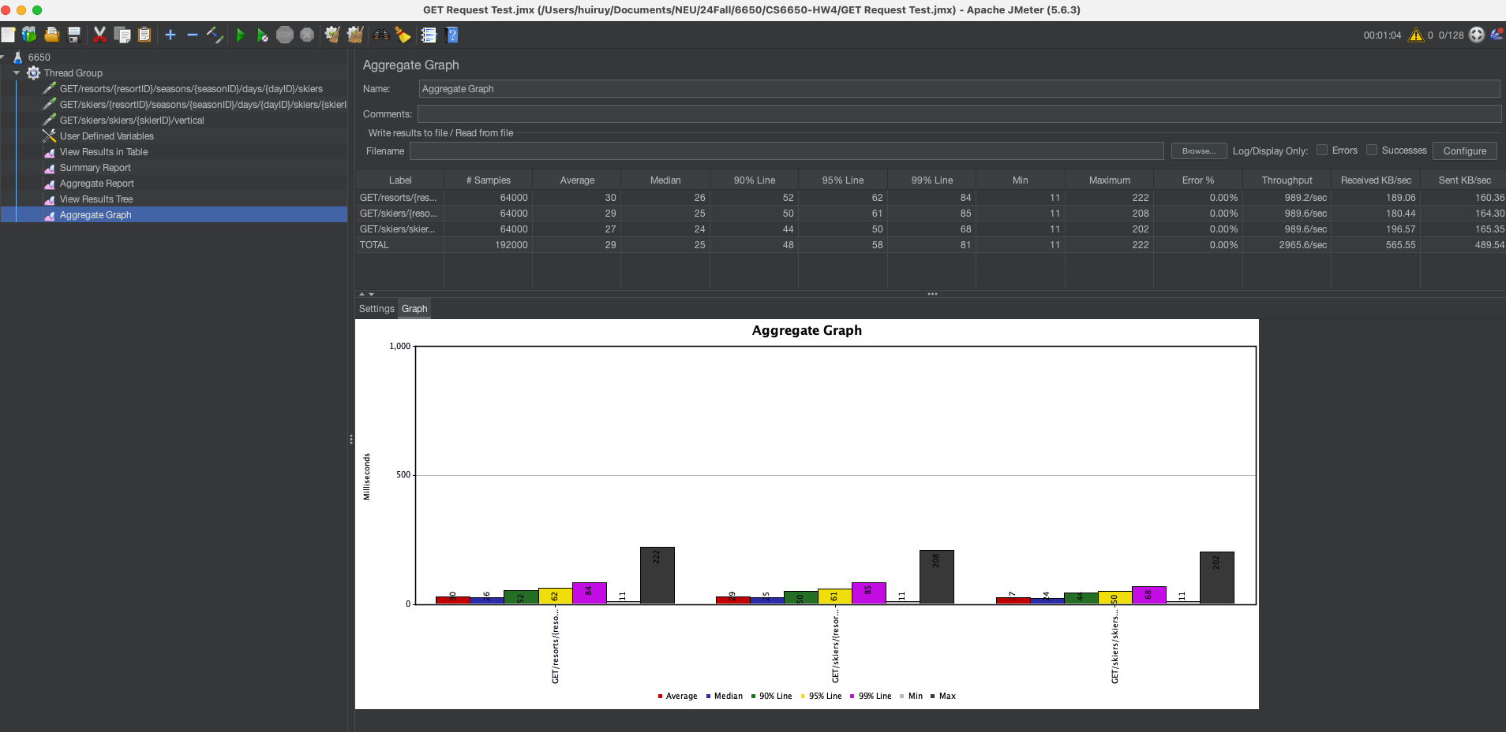

Slide 15
Q&A
Thanks for listening

