Slide 1
De novo genome assembly
Peter Stockwell & Gregory Gimenez

Slide 2
De novo genome assembly
How to plan a de novo genome sequencing project
General principles
Caveats
How to do it
QC and read trimming
Assembly
Assessment of assembly quality

Slide 3
Definition … the reads are:
Reads: Short sub sequence of the genome
Don’t know where on the genome or the strand
Reads are overlapping
Assuming we cover the whole genome
Reads contain errors (e.g. 0.2% to 12.5%)
Represent the genome but not uniformly

Slide 4
De novo assembly from the book
Reads
Contigs
Scaffolds
NNN

Slide 5
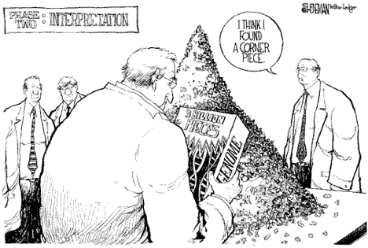
De novo assembly in reality
Source: http://dna.cs.byu.edu/

Slide 6
General principles
Before starting:
Think about what level of coverage is required for your project
Understand the computing and bioinformatics requirements (high memory machines needed)
Use good DNA!

Slide 7
Caveats
Difficulty depending on the genome.
Important parameters:
Size
Ploidy status (for example, Durum wheat = 6n)
Does your organism go through a haploid stage?
Presence of repeat regions
GC content

Slide 8
Caveats
Assembly of the genome is a computationally intensive step:
Requires high-memory computers; CPU is not the limiting resource
Bacterial genomes: Standard desktops/laptops are fine
Fungal / very small eukaryote: requires a small cluster e.g. a 40 MB fungal genome required ~30 GB of RAM
Human-size genome: ~100 GB
More sequencing for greater depth = more memory
Adjustment of critical assembly parameters = more or less memory
Newer assembly programs = less memory
Annotation(e.g. BLAST) is also computationally intensive
Limited by CPU speed and disk access rather than memory
BioIT

Slide 9
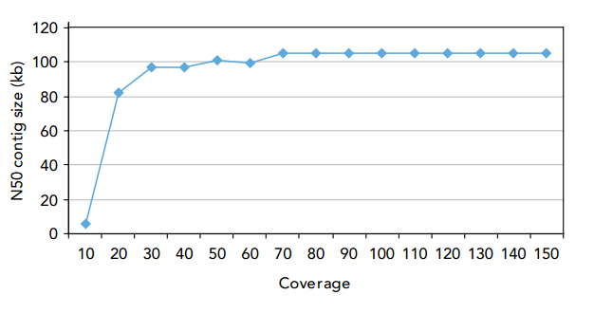
How much coverage do I need ?
http://res.illumina.com/documents/products/technotes/technote_denovo_assembly_ecoli.pdf
Human genome: 3 Gb
90 Gb (2 HiSeq V4 lanes)

Slide 10
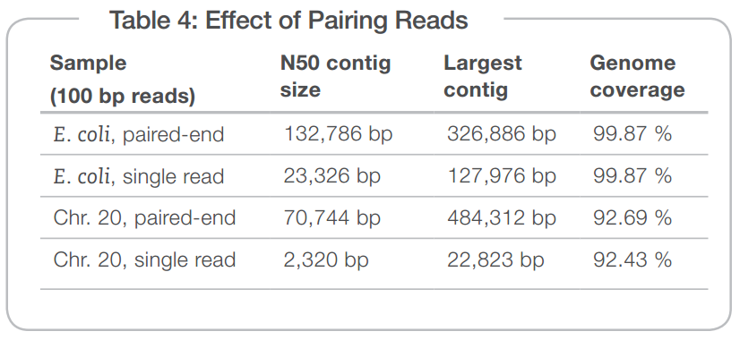
Do I need Paired end reads?

Slide 11
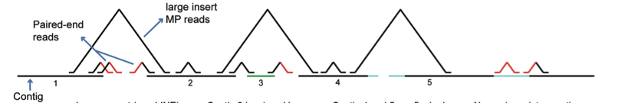
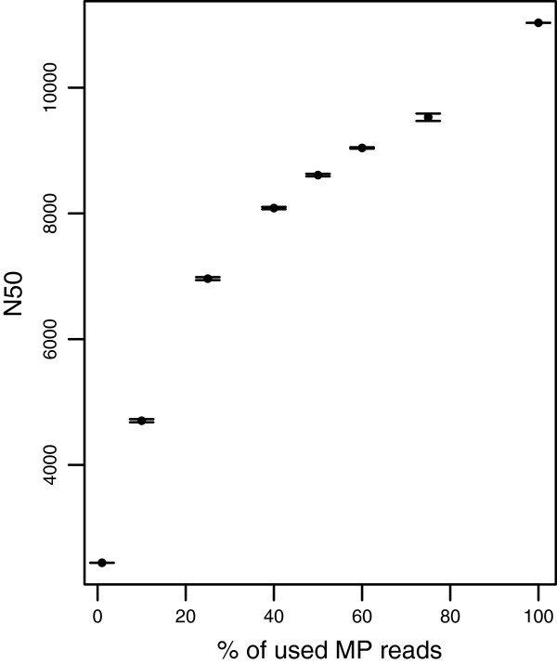
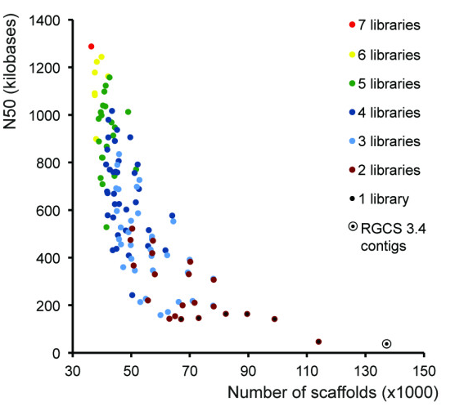
What about insert sizes
NNNNN
Belova et al. BMC Genomics 2013 14:222
Van Heesh et al. BMC Genomics 2013, 14:257

Slide 12
How to do it
Assemble genome
Many assembly programs
Assess quality
N50, Contig size
Newer methods of assessment (CGAL)
QC and read trimming
Assess the quality to your NGS run
Throw out the bad reads
Rapidly evolving area

Slide 13
QC and read trimming
Assess the quality of your NGS run
FastQC
SolexaQA
Read trimming: look what it is left!
Based on PHRED scores in a FASTQ file

Slide 14
Fastq files:
@HWI-ST871:65:B02N5ACXX:6:2106:20366:172524 1:N:0:ACTTGA
TTGCTGACTGCCCGTCACAGCCAGCAACGCCTTGTAGCGATAGCGGGTGACCAGTGTGGGCGCCAAACCGTAAACGGACGCTGCCGGGACGACAGCAGTGC
+
@@@ADBD:F>DDDAFHIIEH?HIIIIIGIIIIIEGGDCFHHIIIIII=B=BBAAECA>?6=???BDABB@8<>1>?8?BB@DDDB<090<BBDDBB?ACD>
@HWI-ST871:65:B02N5ACXX:6:2204:2585:26162 1:N:0:ACTTGA
CGAAGCCGATTGCCTGCGCCTCAATCAATGGGTAGAAAGGGCTATCACTGAATGCCCGGAACAATATCTNTGGGCCCATCGACGTTTCAAAAGTCGCCCGG
+
@@?D?:BDD6ABH?GE<GE)111?DGH<FHHG9DEGF9D>FDHGIHEIGHIGHG@)78EBD<@CC@;@@#,,58@?B<5<BCB<<BCCCCCACCC######
@HWI-ST871:65:B02N5ACXX:6:2204:18502:198713 1:N:0:ACTTGA
CAACATGATTCAGGTTGATCTGAACGGCACTACATTGCAGTACGCAATGAAGTCTGCTCATGGCGCCTCNAAGGTGTACATGCAGCCTGCTTCTGAAGGTA
+
@@@DBDFDDHAFFEEHCGHCJIIII@G<FHGC@AFCGHHJGBFEGII>BACF8BGIICHEGCDE8E?<B#,5===;AC@CDDD@CABDBBACDDCDC:>C@
@HWI-ST871:65:B02N5ACXX:6:1302:14336:185913 1:N:0:ACTTGA
TCAGATCCGTTGTTGACACGCGACACTGCGCCCATTAAAGTGCGCCCCGTTCCCAAGGGAAACAGTCGAAATGACTGTAAGGCGGTTGTAGAGAGGCGTTA
+
CCCFFFFFHHHGHJGIIIGIJJJJIIJJJJIJJIJIIIJJGGIJJHHFCDDECDDBDDDDBBCCDCDB<?BDDD>:>CCDDDDD><>BBCCDDCBD<>@DB
@HWI-ST871:65:B02N5ACXX:6:1204:8075:125363 1:Y:0:ACTTGA
CATGTCGCCTGCGCCGACCTTGTCCAGGTCGCGGCGCCCGGCCCGGCTGGAGCACGCCNCCGCGGCGCTGGCGGGAGGCTGGGTTGACGGGGTCGTGGCCG
+
;;?DDDD>DDDD1)2C?:D?D@DDB**0?BDD#####################################################################
@HWI-ST871:65:B02N5ACXX:6:2303:11664:74505 1:N:0:ACTTGA
GGAACGCTAGGCGGGTTGGCGACAAACAGTGTCTGGCCGTCACGGTTCTCGATGGTCTGGATCAGGTAAGGGCTGACCTTGTAACCGCCATTTTCAAAAGT
+
@@@FDFDFFHFDHGDFGGI?FFHE8GHEH7A;@DDFBA9=>?==;@B?CC@CCDDCCC?CACC?C>34@CC8@?@89ACDC3:@@CB@@############
# = Q2 I = Q40

Slide 15
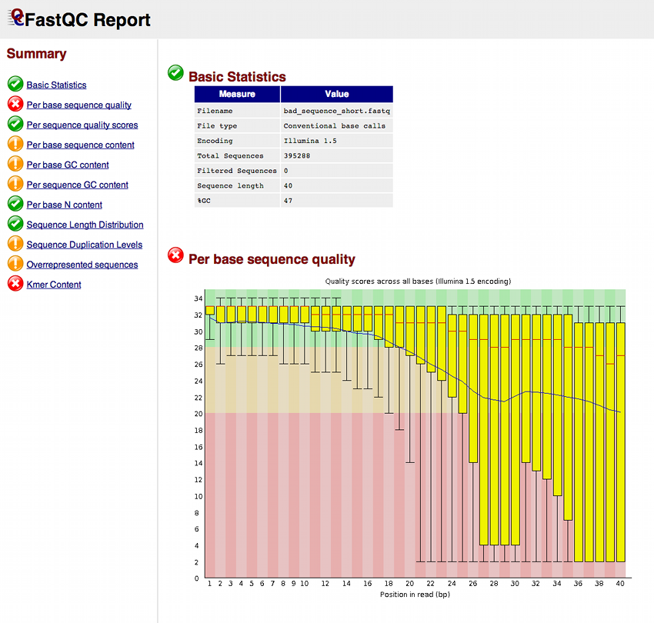
PHRED score
Q30 : 1 error/1,000 nts (99.9%)
Q20 : 1error / 100 nts (99%)

Slide 16
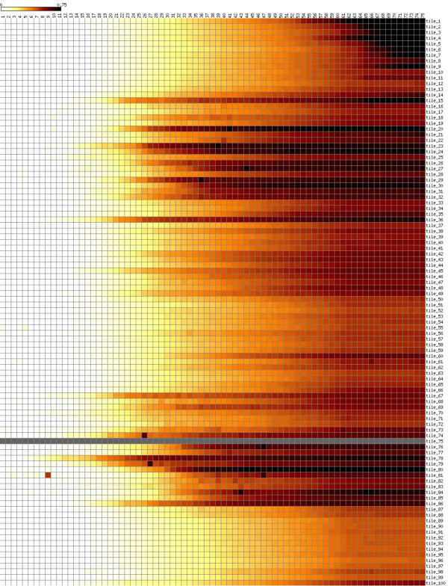
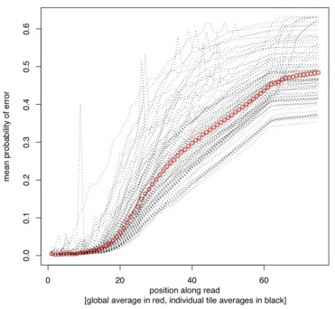
QC and read trimming
SolexaQA: BMC Bioinformatics 11:485

Slide 17
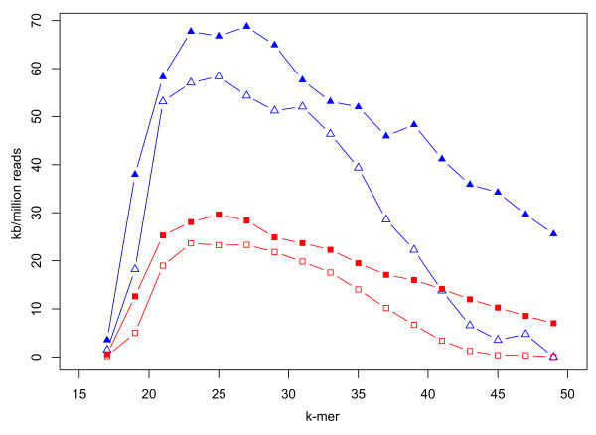
QC and read trimming
Does read trimming make a difference?
N50 (trimmed and untrimmed
Largest contig (trimmed and untrimmed)
Cox et al. BMC Bioinformatics 2010 11:485

Slide 18
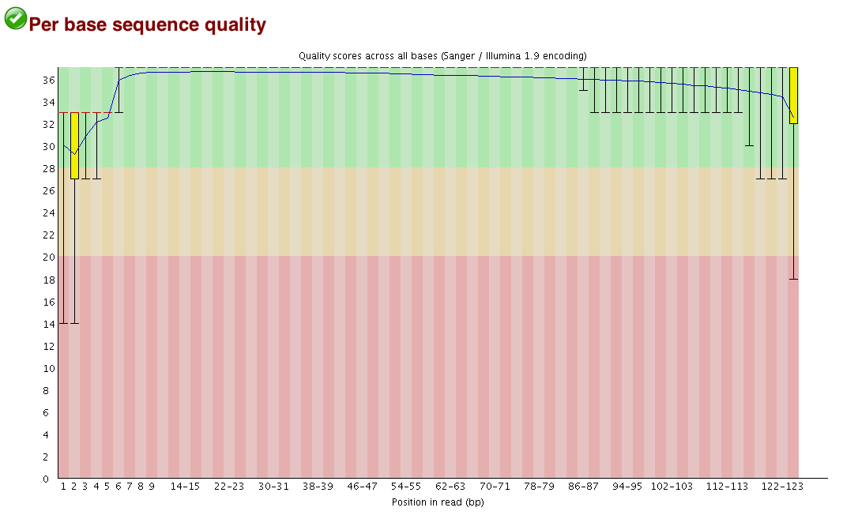
But: more recent Illumina chemistry makes quality trimming less necessary

Slide 19
Adaptor trimming:
See:
http://grahametherington.blogspot.co.uk/2014/09/why-you-should-qc-your-reads-and-your.html
- Some assemblers (e.g. mira) do this themselves
- If not, adaptor trimming should be done
- Some assemblers expect all reads to be the same length
and won't work with trimmed data

Slide 20
Assembly strategy
Overlap Layout Consensus method (OLC)
Designed for a small number of reads
Works for long reads (Sanger, PacBio or contigs)

Slide 21
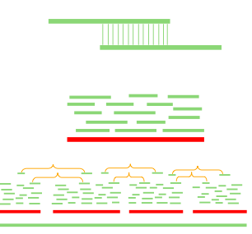
Overlap-Layout-Consensus
Overlap: find potentially overlapping reads (all vs all)
Layout: merge reads into contigs (contigs into supercontigs)
Consensus: derive sequence (correct read errors)

Slide 22
Assembly strategy
De Bruijn graph method
Designed to handle the problem of aligning millions or billions of reads in a computationally sane manner
Reads are broken down into k-mers of a particular size (a critical parameter) and a De Bruijn graph assembled

Slide 23
De Bruijn graph
Reads
CCG
TCC
AAGA
GACT
ACTC
ACTG
AGAG
CCGA
CGAC
CTCC
CTGG
CTTT
…
kmer:3
CGA
CTC
AAG
AGA
GAC
ACT
CTT
TTT
Node: unique kmer
Edge: overlap of kmer (k-1)
GGA
CTG
GGG
TGG
CTCCGA
CCGA
CTCC
AAGA
GACT
CTTT
AAGA
GACT
CTTT
GGGA
CTGG
CTGGGA
AAGACTCCGACTGGGACTTT
Contigs
AAGACTGGGACTCCGACTTT

Slide 24
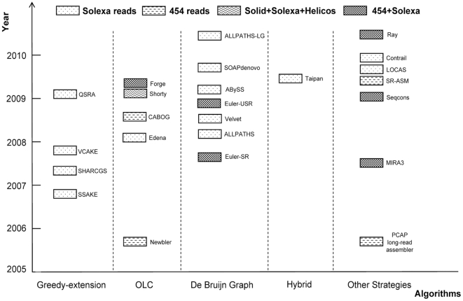
Short read assemblers
PLoS One. 2011; 6(3): e17915.

Slide 25
Assemblers: edena
* http://www.genomic.ch/edena
* free academic license
* short read assembler (128bp max), all must be same length
* overlap assembler
* two steps: 1. build overlap file (.ovl)
2. create contigs from it
* small RAM requirement

Slide 26
Assemblers: velvet
Zerbino DR1, Birney E. (2008) Velvet: algorithms for de novo short read assembly using de Bruijn graphs. Genome Res. 2008 18(5):821-9. doi: 10.1101/gr.074492.107.
* Open source license (Gnu Public License)
* two step process 1. velveth to generate hash (kmer) lists
2. velvetg for de Bruijn graph step
* usually run on range of kmer lengths to find optimal
* modest RAM requirements
* can be used for larger genomes
* can use mix of read lengths and PE + SE, etc.

Slide 27
Assemblers: abyss
Simpson JT, Wong K, Jackman SD, Schein JE, Jones SJ, Birol I. (2009) ABySS: A parallel assembler for short read sequence data. Genome Research, 19:1117-1123
* licensed for academic and non-profit use
* de Bruijn assembler, single kmer length must be specified
* can assemble a mixture of different read lengths/types
* multi-processor option via MPI library
* modest RAM for small assemblies

Slide 28
Assemblers: mira
http://sourceforge.net/projects/mira-assembler/
* free license – prebuilt executables for Linux & MacOS
* small genome assembler, hybrid operation
* extensive account taken of error types in sequencing technologies
* large RAM
* capable of incorporating long read data (max 29kb)
* does quality & adaptor trimming itself

Slide 29
Assemblers: SOAPdenovo2
http://soap.genomics.org.cn/soapdenovo.html
* Gnu Public License
* de Bruijn graph assembler
* suitable for small and large genomes
* latest versions intended to be memory-efficient
* moderate RAM for small genomes
* uses a config file to specify run parameters

Slide 30
Assemblers: spades
http://bioinf.spbau.ru/spades
* Gnu Public License – prebuilt executables available for Linux & MacOS
* small to medium size genomes
* accepts range of read types, including longread
* set of kmer lengths specified in command
* moderate RAM requirements (~9Gb for E. coli)
* produces both contigs and scaffolds

Slide 31
Assemblers: transcriptomic (RNAseq) vs. genomic
* transcriptomics assemblers are more ORF & exon/intron aware
* tend to produce more splice/assembly variants in output
* Trinity - http://trinityrnaseq.github.io
- slow & resource hungry
* Bridger - http://sourceforge.net/projects/rnaseqassembly/
- faster & less RAM
* can use interchangeably with genomics assemblers but results may
be inferior

Slide 32
Which assembler??
* different genomes behave differently
Junemann, et al. (2014) GABenchToB: A Genome Assembly Benchmark Tuned on Bacteria and Benchtop Sequencers, PLOS ONE 9:e107014
* try different assemblers and assess which did the best job

Slide 33
Longer reads:
* MiSeq reads now up to 300bp paired end
* ~500bp inserts overlap by ~100bp
* combine overlapping reads with flash (Fast Length Adjustment of
SHort reads) http://ccb.jhu.edu/software/FLASH/
* produces fastq files of combined reads and paired non-joined reads
* assemble with programs that accept mix of input data
* e.g. mira, SOAPdenovo, velvet

Slide 34
Running assemblers:
* small assemblies possible on laptops & desktops
* larger need servers with more RAM
* Galaxy provides web interface to some assemblers
* BioIT provides a supported environment with option of large
RAM
* most assemblers are best command-line driven
* proprietary assemblers (CLC, Geneious, Newbler) tend to lag behind
others

Slide 35
Assessing assembly quality
Standard metrics of assembly quality:
N50
Mean scaffold size
largest scaffold

Slide 36
Assessing assembly quality
N50: 50% of the genome is in contigs larger than half size of the genome
How: Organize your contigs from largest to smallest
The N50 is the length of the contig that is in the middle
Example: 1 Mbp genome
Contigs: 300k, 100k, 50k, 45k, 30k, 20k, 15k, 15k, 10k, ....
N50 size = 30 kbp (300k+100k+50k+45k+30k = 525k >= 500kbp)
Note: Only valuable when comparing genome of same size

Slide 37
Assessing assembly quality
Standard metrics of assembly quality:
N50, Mean scaffold size, largest scaffold
These often do not tell the full story!
Newer metrics of assembly quality (CGAL)
In the final analysis, the best metric is:
“Check if known sequences are there!”

Slide 38
Comparing assemblies: quast
http://bioinf.spbau.ru/quast
* free academic and non-profit license
* takes list of contig fasta files and generates comparative statistics
and graphs
* can incorporate gene positions or can predict genes
(genemark, glimmer and mummer included in package)
* can compare assembly with a reference genome
* output is html, viewed with web browser

Slide 39
Comparing assemblies: mummer
http://mummer.sourceforge.net
* set of sequence comparison tools
* capable of comparing assembly with assembly or with reference
* sequences compared (nucmer)
* alignments can be shown graphically

Slide 40
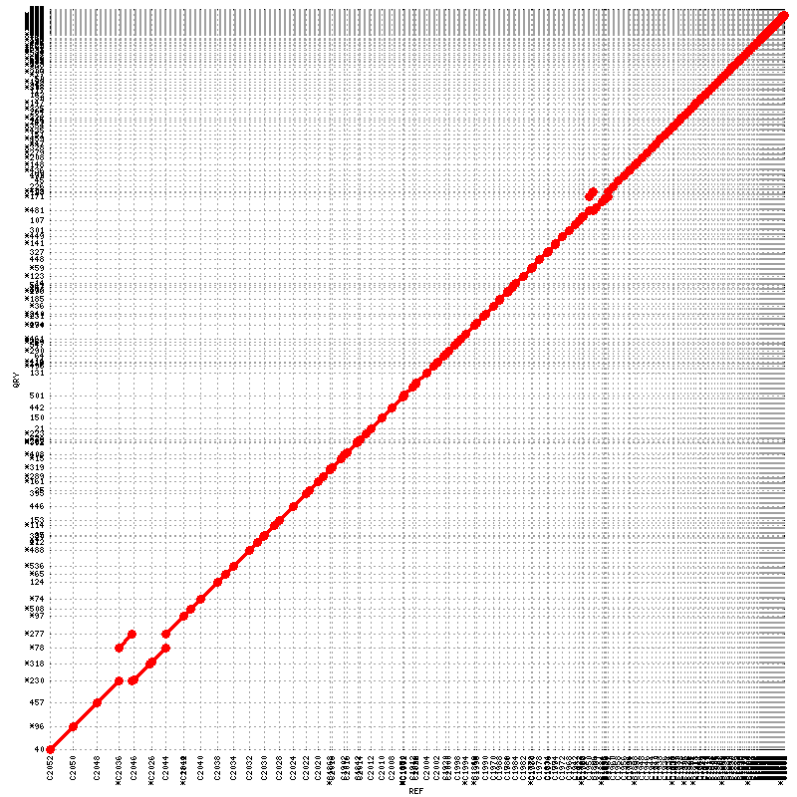
Comparing assemblies: mummer – assembly vs. assembly
Ref = Soapdenovo K25
Query = abyss K25

Slide 41
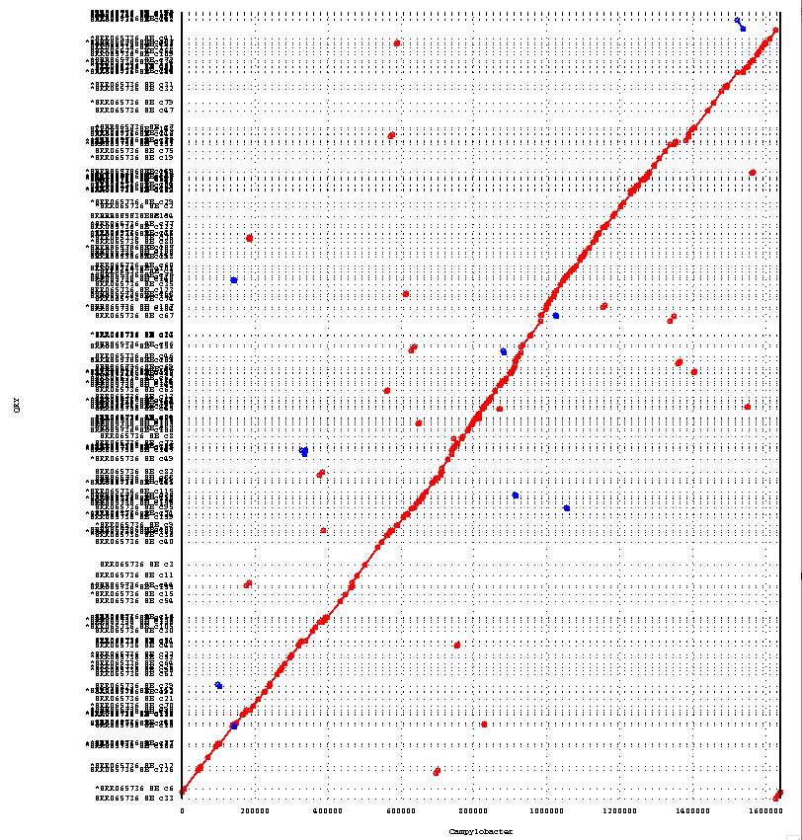
Comparing assemblies: mummer – assembly vs reference
Ref = Campylobacter jejuni NTCT11168
Query = mira assembly

Slide 42
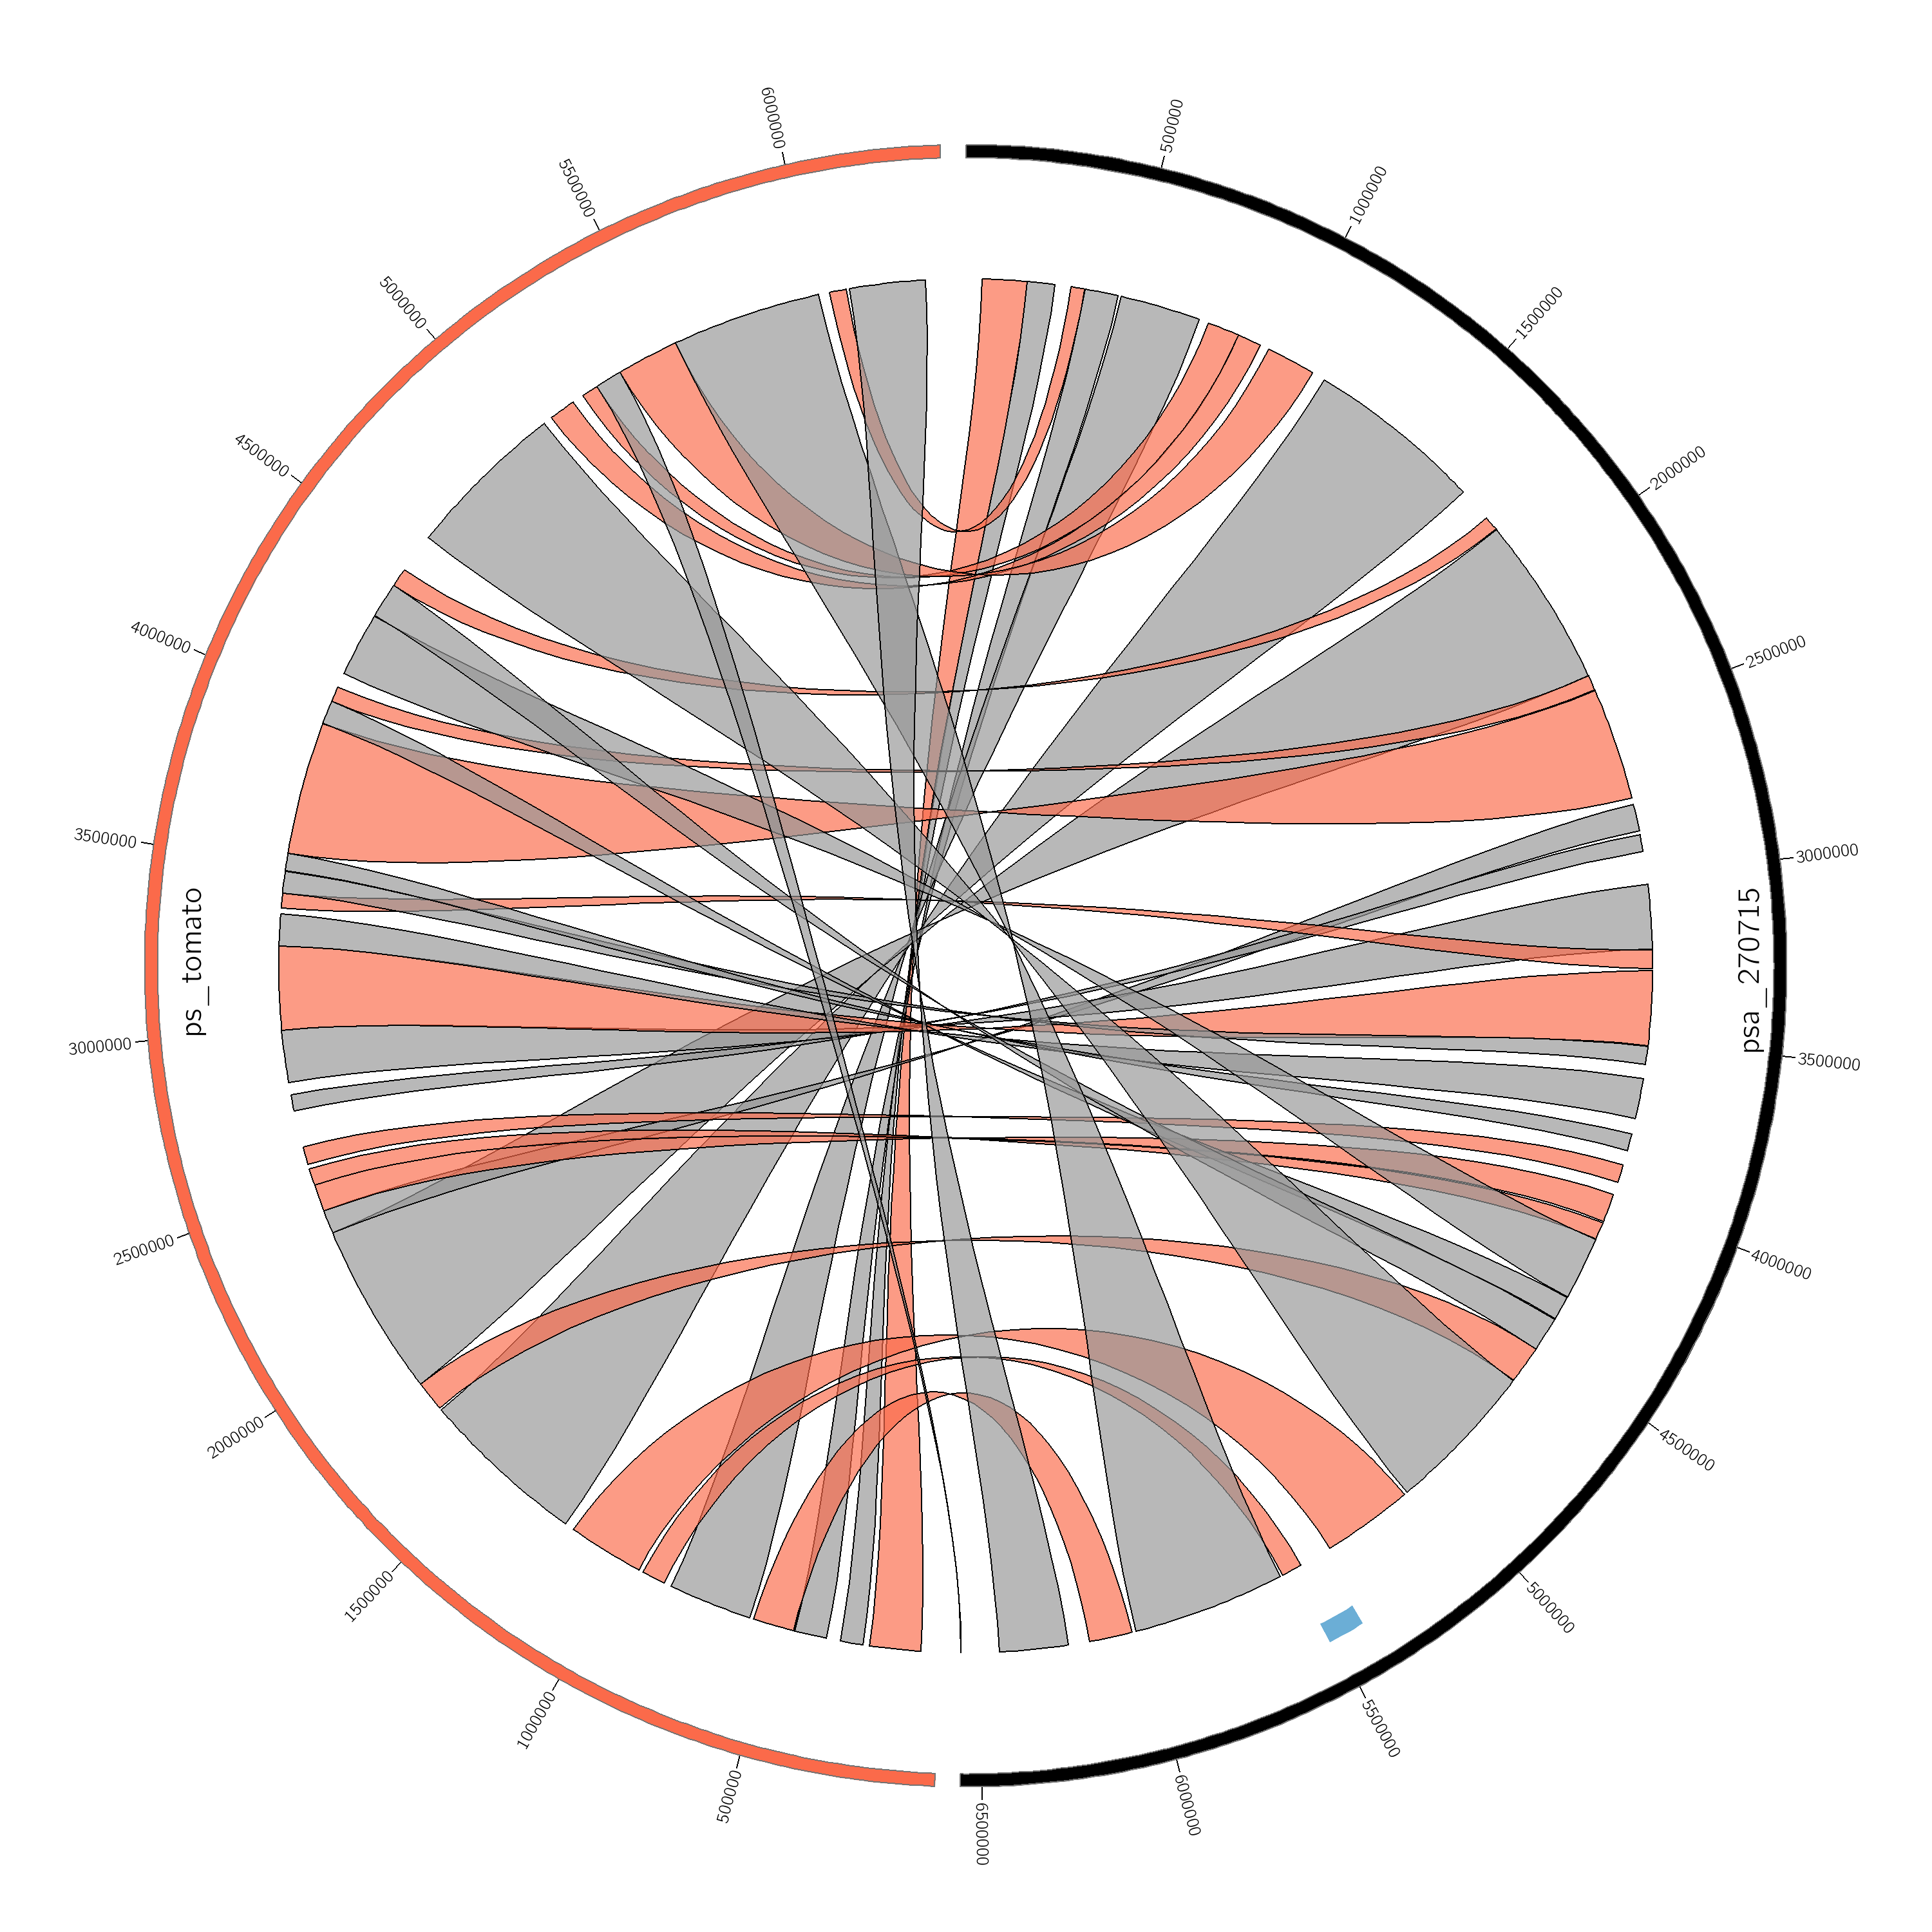
Comparing assembly with reference: reference must be close
circos ribbon comparison
mauve comparison of ICE element

Slide 43
Comparing assemblies: CGAL
Rahman & Pachter (2013) CGAL: computing genome assembly likelihoods, Genome Biology, 14:R8 doi:10.1186/gb-2013-14-1-r8
* make bowtie2 index of contig assembly
* map reads with bowtie2
* convert sam mapping with bowtie2convert
* align with 'align' – very time consuming
* generate assembly likelihoods with cgal

Slide 44
Hybrid assemblies
* longread technologies (PacBio, Nanopore) can generate >20Kb reads
* high error rate: ~15% for PacBio
* length can work through repeat regions
* SSPACE-LongRead can construct scaffolds from short-read contigs
* short reads can be used to error-correct longreads (e.g. LSC)
* PacBio's HGAP package can assemble mix of long & short reads
* completing bacterial-sized genomes requires significant manual work

Slide 45
Things to consider
Fully reconstructing a genome remains challenging (e.g. remember the human genome…)
The complexity of a genome isn’t easily solvable by any computational software
Bias in GC content, repeat regions…
Gap closure steps are often required to complete a genome (Time and money consuming…)
More data per se may not mean a better assembly
More data with different insert sizes probably does

