Slide 1
Research Updates
Jan.5 Meiye Wang

Slide 2
Progress:
Import, Export, Hydro, validation
Design different sensitivity to run (4*)
Battery cost (8,12,15,20 $/kWh)
EV number (1.5m by 2025 (1m, ), 5m by 2030, Executive Order B-48-18）
Renewable capacity percentage (CA goal: 44% retail sales by 2025, 60% retail sales by 2030)
Finish Validation
UC, 2019 without data, and get hourly price, annual generation on fuel type(done), annual total revenue for generators (load*price)
Next step
NGCC always set the marginal cost, 100*500=
scale up renewables (*1.5, can calculate), see it, add what point does renewable hit problems (with V2Gsim)
 | EV number | Renewable Capacity | Battery Cost
Base case 2025 | 1.5m | 44% | 8
 | 1m |  | 12
 |  |  | 15
 |  |  | 20
 | EV number | Renewable Capacity | Battery Cost
Base case 2030 | 5m | 60%

Slide 3
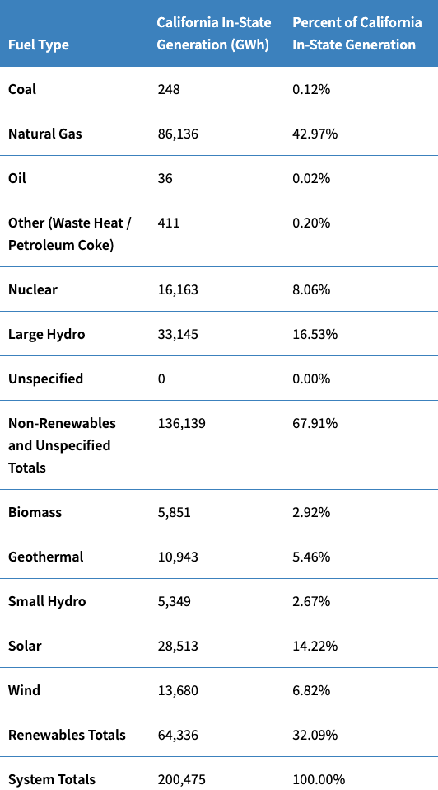
Validation
Simulation Generation | Simulation Percent
151 | 0.07%
96596 | 43.57%
0 | 0
5089 | 2.30%
19531 | 8.81%
38809 | 17.51%
0 | 0
 | 72.26%
5200 | 2.35%
16231 | 7.32%
0 | 0
25785 | 11.63%
14304 | 6.45%
 | 27.74%
221,695 | 100%
Small hydro + large hydro
38,494 19.2%

Slide 4
Research Plan
Dec.9 –Dec.16: finish validation, think about sensitivity implementation
Dec.16-Dec.23: sensitivity design and implementation, methods write up
Dec.23-Jan.6: running sensitivity
Jan.6-Jan.13: sensitivity result, results write up
Total .Hydro power, it’s okay
Do annual generation check, after the validation, and run the sensitivity:
More renewables, and
Friday, we give validation result, 3pm, how to set up. Super Computer arch guide, might not make sense, send you directions.

