Slide 1
Research Updates
Jan.26 Meiye Wang

Slide 2

Journal to consider:
Public perceptions of electric vehicles and vehicle-to-grid (V2G): Insights from a Nordic focus group study
Demand drivers for charging infrastructure-charging behavior of plug-in electric vehicle commuters
Assessing the financial value of real-time energy trading services for privately owned non-commercial electric vehicles

Slide 3

Journal to consider:
The load shift potential of plug-in electric vehicles with different amounts of charging infrastructure
Vehicle-to-grid power implementation: From stabilizing the grid to supporting large-scale renewable energy
The economics of using plug-in hybrid electric vehicle battery packs for grid storage
Impact analysis of vehicle-to-grid technology and charging strategies of electric vehicles on distribution networks - A review
Quantifying electric vehicle battery degradation from driving vs. vehicle-to-grid services
Encouraging vehicle-to-grid (V2G) participation through premium tariff rates

Slide 4
Journal to consider:
Applied Energy

Slide 5

Journal to consider:
A cost-benefit analysis of alternatively fueled buses with special considerations for V2G technology
The impact of PVs and EVs on domestic electricity network charges: A case study from Great Britain
Can parked cars and carbon taxes create a profit? The economics of vehicle-to-grid energy storage for peak reduction

Slide 6
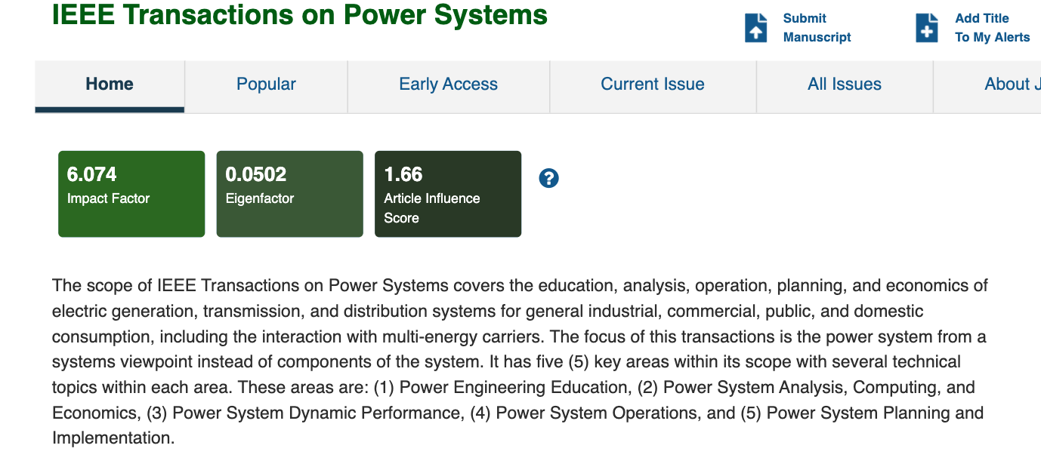
Journal to consider:
Optimized bidding of an EV aggregation agent in the electricity market
Electric vehicle aggregator/system operator coordination for charging scheduling and services procurement
Charging strategies for battery electric vehicles: Economic benchmark and V2G potential

Slide 7
Sensitivity design
 | PEV number | Renewable Capacity | Battery Cost | Battery Pack
Conservative 2025 | 1.3m | 39% | 14
Base case 2025 | 1.5m | 44% | 12(100$) | 100
Aggressive 2025 |  | 49% | 10
Conservative 2030 |  | 55% | 10 | 100
Base case 2030 | 5m | 60% | 8 | 61
Aggressive 2030 |  | 65% | 6

Slide 8
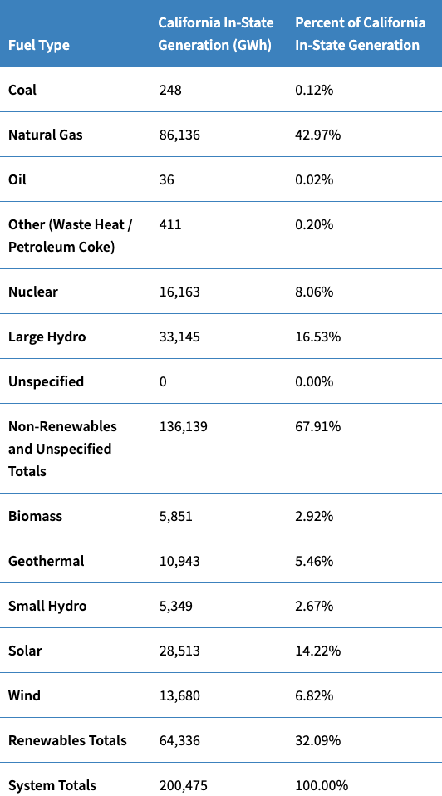
Validation
Simulation Generation | Simulation Percent
151 | 0.07%
96596 | 43.57%
0 | 0
5089 | 2.30%
19531 | 8.81%
38809 | 17.51%
0 | 0
 | 72.26%
5200 | 2.35%
16231 | 7.32%
0 | 0
25785 | 11.63%
14304 | 6.45%
 | 27.74%
221,695 | 100%
Small hydro + large hydro
38,494 19.2%

Slide 9
Research Plan
Dec.9 –Dec.16: finish validation, think about sensitivity implementation
Dec.16-Dec.23: sensitivity design and implementation, methods write up
Dec.23-Jan.6: running sensitivity
Jan.6-Jan.13: sensitivity result, results write up
Total .Hydro power, it’s okay
Do annual generation check, after the validation, and run the sensitivity:
More renewables, and
Friday, we give validation result, 3pm, how to set up. Super Computer arch guide, might not make sense, send you directions.

