Slide 1
Research Updates
Dec.16 Meiye Wang

Slide 2
Progress:
Import, Export, Hydro, validation
Design different sensitivity to run
Battery cost
EV number (1.5m by 2025, 5m by 2030, Executive Order B-48-18）
Renewable capacity percentage (CA goal: 44% retail sales by 2025, 60% retail sales by 2030)
Finish Validation
UC, 2019 without data, and get hourly price, annual generation on fuel type(done), annual total revenue for generators (load*price)
Next step
NGCC always set the marginal cost, 100*500=
scale up renewables (*1.5), see it, add what point does renewable hit problems (with V2Gsim)

Slide 3
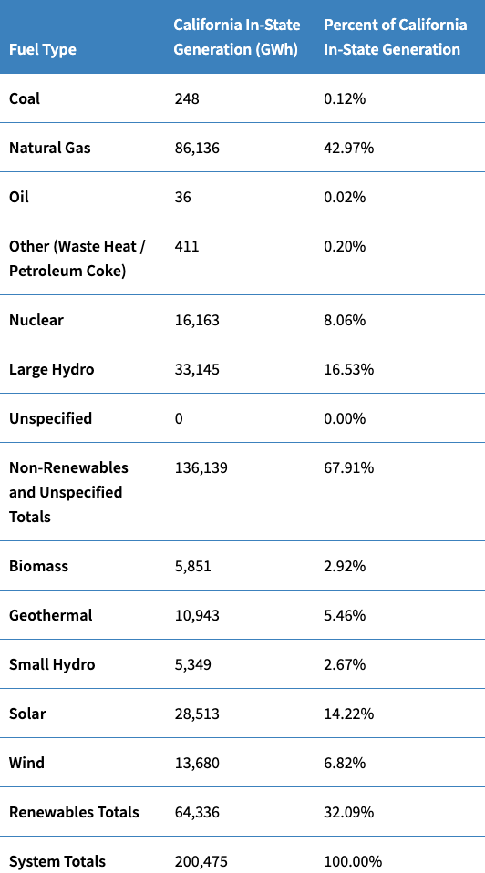
Validation
Simulation Generation | Simulation Percent
149 | 0.073%
70,216 | 34.54%
0 | 0
4,609 | 2.27%
20,216 | 9.94%
33,659 | 16.8%
0 | 0
 | 63.62%
5,973 | 2.9%
16,763 | 8.25%
0 | 0
32,881 | 17.9%
15,098 | 7.0%
 | 36.38%
Small hydro + large hydro
38,494 19.2%

Slide 4
Research Plan
Dec.9 –Dec.16: finish validation, think about sensitivity implementation
Dec.16-Dec.23: sensitivity design and implementation, methods write up
Dec.23-Jan.6: running sensitivity
Jan.6-Jan.13: sensitivity result, results write up
Total .Hydro power, it’s okay
Do annual generation check, after the validation, and run the sensitivity:
More renewables, and
Friday, we give validation result, 3pm, how to set up. Super Computer arch guide, might not make sense, send you directions.

