Slide 1
Research Updates
Nov.11 Meiye Wang

Slide 2
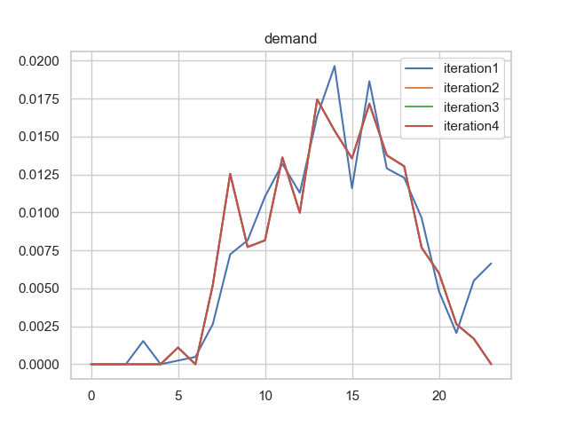
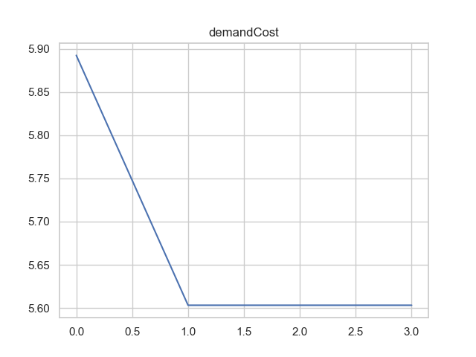
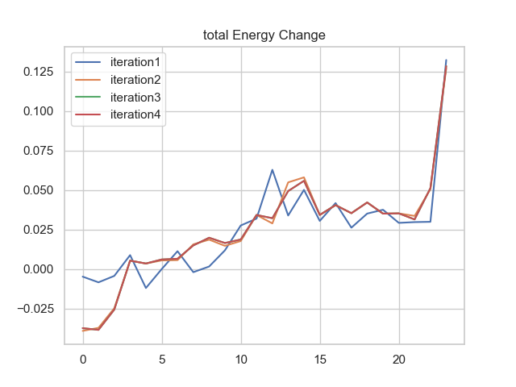
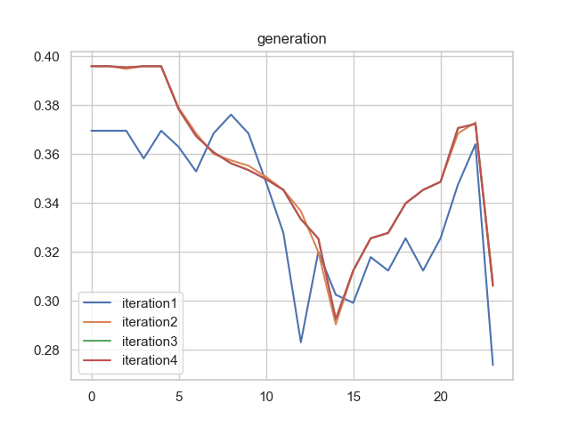
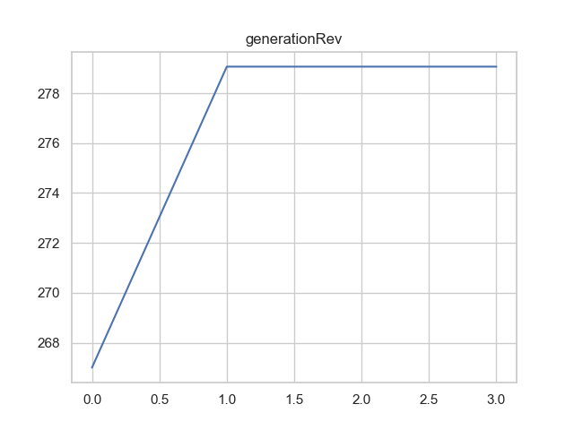
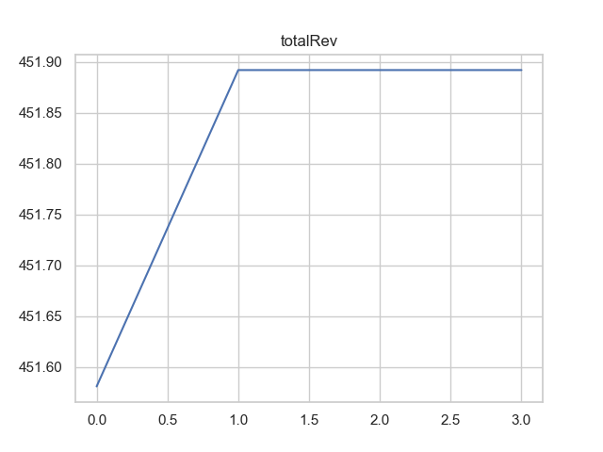
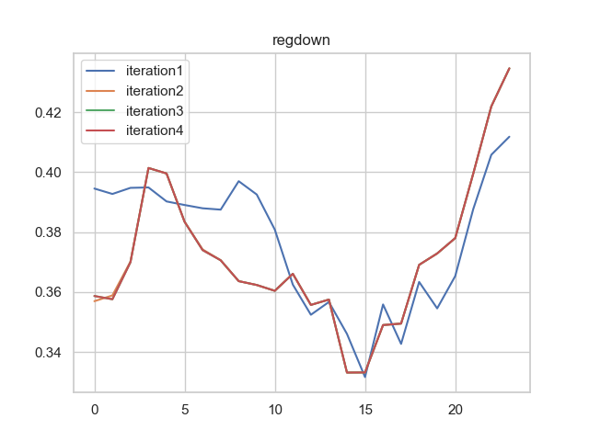
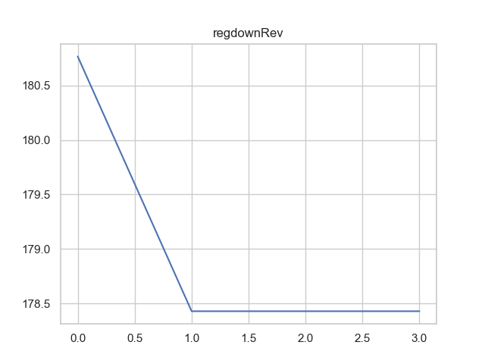
Aug.1- $451,870/day- $3.01/day/vehicle

Slide 3
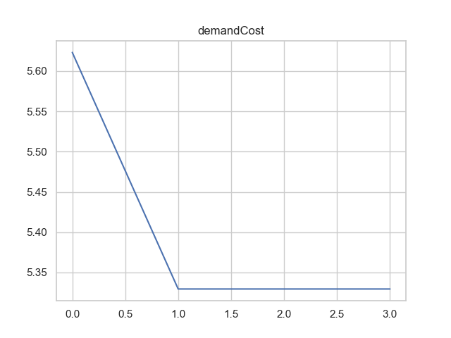
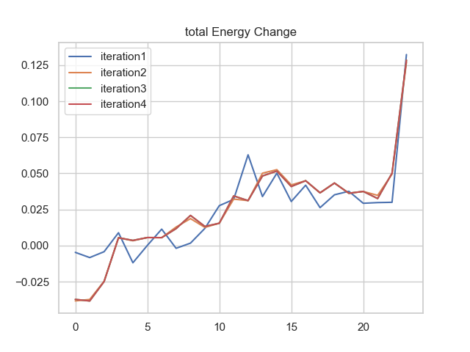
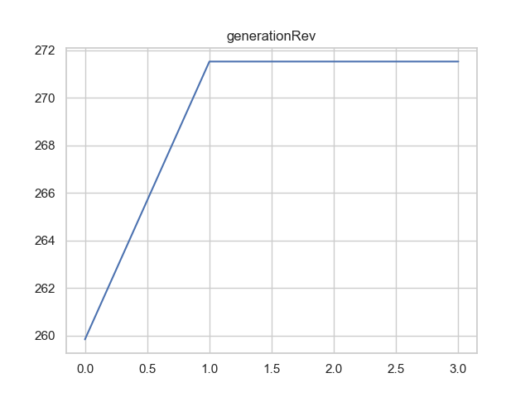
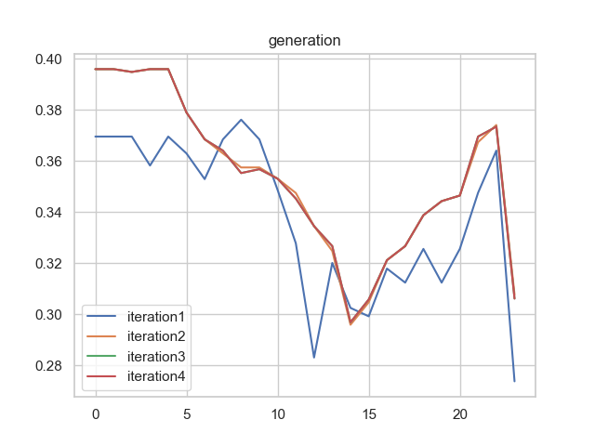
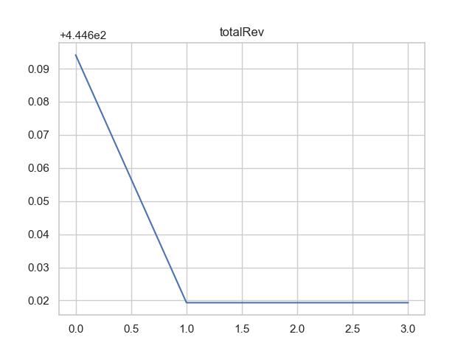
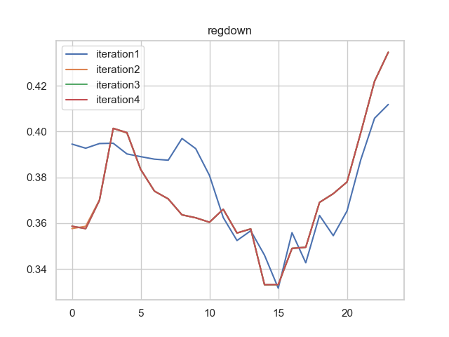
Nov.09 - $446,600/day- $2.98/day/vehicle

Slide 4
Next Step
1. Restructure the code into a top-down design
Run the whole year first
Base Case, the result
2. Design full set of sensitivity analysis
Renewable Percentage: it’s changing
Lower Bound:
Number of Vehicles: sounds good. 50%-100% of mandates
Battery cost: no good grasp of now & uncertainty

