Slide 1
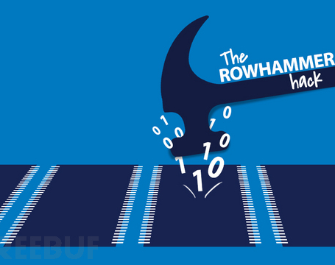
RowHammer: A Summary
CARAS
A r c h & S e c
Presenter: Haowen Liu
Time: 21st Dec. 2020

Slide 2
Outline
Risks in Our Comfort Zone
DRAM Background
Disturbance Error Phenomenon -> RowHammer
Characterization
Exploitation
Mitigation
Conclusion

Slide 3
Risks in Our Comfort Zone
Classical Security issues most focus on software-level security.
Authority control, process isolation, digital signature, cryptosystems, …
Popular tools and methodologies can address most security problems.
Most of these techniques fit well with their "all-round" threat model.
There is nothing new to be addressed in security now. All that remains is to reuse our threat models to address more and more new-born software vulnerabilities.

Slide 4
Risks in Our Comfort Zone
But how about the underlying hardware architecture?
All your threat models are based on the assumption that the underlying architecture is secure enough to support these upper structure security techniques.
Well, it’s intuitively secure enough though, with many years’ demonstration in universal implementations. So there's no need to be paranoid.

Slide 5

Risks in Our Comfort Zone
RowHammer

Slide 6
Risks in Our Comfort Zone
RowHammer can break through most of software security mechanisms.
Authority control: flip authority control bits to obtain authority.
Privilege control: flip instruction bits to escalate privilege.
Process isolation and sandbox: easily corrupt process in adjacent rows by bit flips.
Digital signature and cryptosystems: flip bits in public key to factorize it easily and get the private key.
No comfort zone now, so get up and go to work :-)

Slide 7
DRAM Background: Organization
How to describe a DRAM address of a bit?
a 6-tuple of the form <channel, DIMM, rank, bank, row, column>

Slide 8
DRAM Background: Organization
How to describe a DRAM address of a bit?
a 6-tuple of the form <channel, DIMM, rank, bank, row, column>

