Slide 1
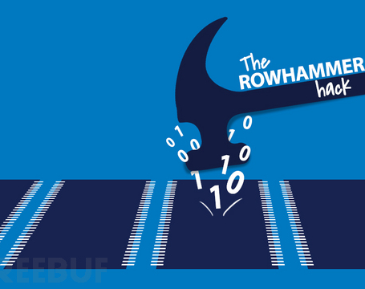
RowHammer: A Summary
CARAS
A r c h & S e c
Presenter: Haowen Liu
Time: 21st Dec. 2020

Slide 2
Outline
Risks in Our Comfort Zone
DRAM Background
Disturbance Error Phenomenon -> RowHammer
Characterization
Exploitation
Mitigation
Conclusion

Slide 3
Risks in Our Comfort Zone
Classical Security issues most focus on software-level security.
Authority control, process isolation, digital signature, cryptosystems, …
Popular tools and methodologies can address most security problems.
Most of these techniques fit well with their "all-round" threat model.
There is nothing new to be addressed in security now. All that remains is to reuse our threat models to address more and more new-born software vulnerabilities.

Slide 4

Risks in Our Comfort Zone
But how about the underlying hardware architecture?
All your threat models are based on the assumption that the underlying architecture is secure enough to support these upper structure security techniques.

Slide 5
Risks in Our Comfort Zone
Is the threat models really all-round?

Slide 6
DRAM Background: Organization
How to describe a DRAM address of a bit?
a 6-tuple of the form <channel, DIMM, rank, bank, row, column>

Slide 7
DRAM Background: Organization
How to describe a DRAM address of a bit?
a 6-tuple of the form <channel, DIMM, rank, bank, row, column>

