Slide 1
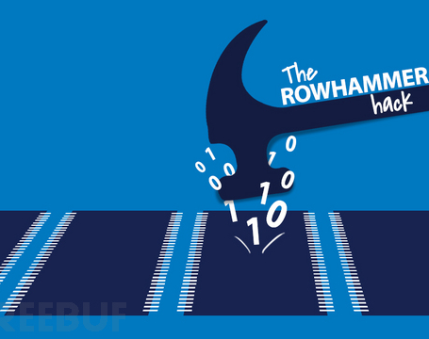
RowHammer: A Summary
CARAS
A r c h & S e c
Presenter: Haowen Liu
Time: 21st Dec. 2020

Slide 2
Outline
Risks in Comfort Zone
DRAM Background
Disturbance Error Phenomenon -> RowHammer
Characterization
Exploitation
Mitigation
Conclusion

Slide 3
Risks in Comfort Zone

Slide 4
Risks in Comfort Zone
Classical Security issues most focus on software-level security.
Authority control, process isolation, digital signature, cryptosystems, …
Popular tools and methodologies can address most security problems.
Most of these techniques fit well with their "all-round" threat model.
There is nothing new to be addressed in security now. All that remains is to reuse our threat models to address more and more new-born software vulnerabilities.

Slide 5
Risks in Comfort Zone
But how about the underlying hardware architecture?
All your threat models are based on the assumption that the underlying architecture is secure enough to support these upper-structure security techniques.
Well, it’s intuitively secure enough though, with many years’ demonstration in universal implementations. So there's no need to be paranoid.

Slide 6

Risks in Comfort Zone
RowHammer

Slide 7
Risks in Comfort Zone
RowHammer can break through most of existing software-level security mechanisms, for it attacks the basis of all of them: DRAM.
Authority control: flip authority control bits to obtain authority.
Privilege control: flip instruction bits to escalate privilege.
Process isolation and sandbox: corrupt processes in adjacent rows by bit flips.
Digital signature and cryptosystems: flip bits in public keys to factorize them.
No comfort zone now, so get up and go to work :-)

Slide 8
DRAM Background

Slide 9
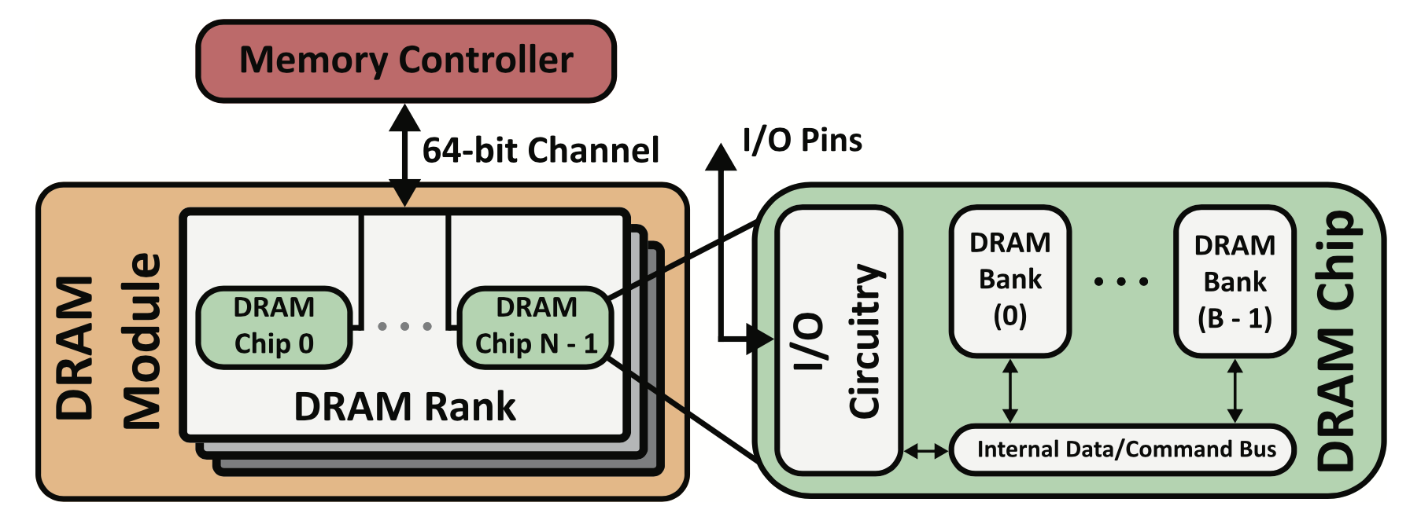
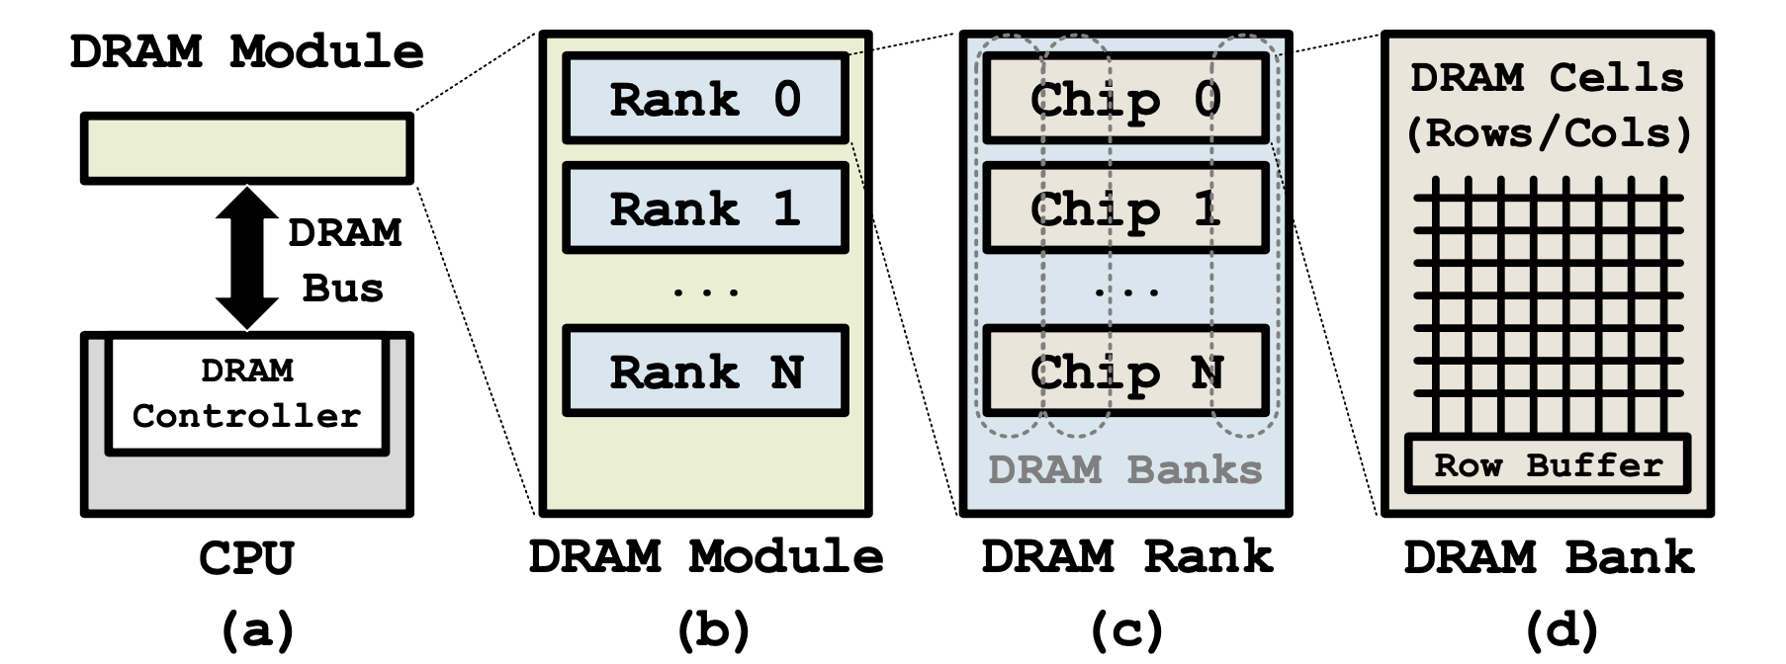
DRAM Background: Organization
How to describe a DRAM address of a bit?
a 6-tuple of the form <channel, DIMM, rank, bank, row, column>

Slide 10
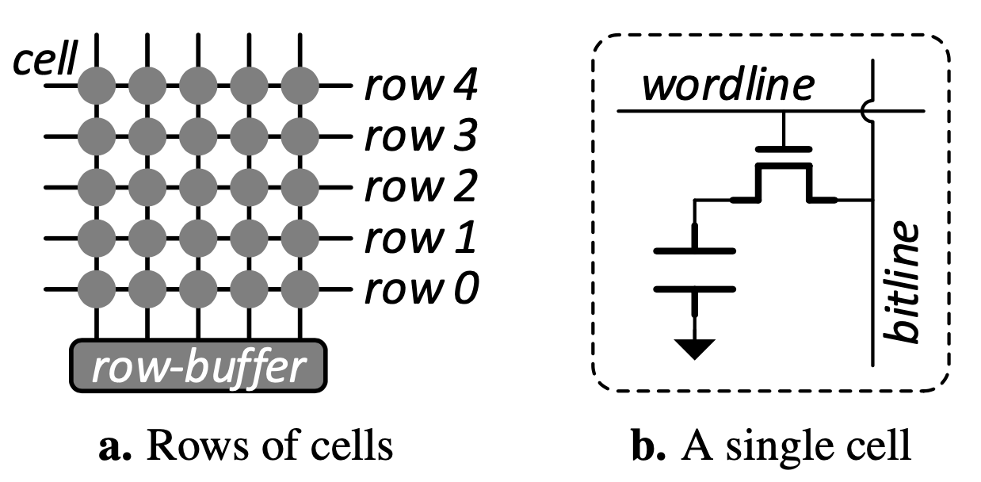
DRAM Background: Organization
Take a closer look to the cells.

Slide 11
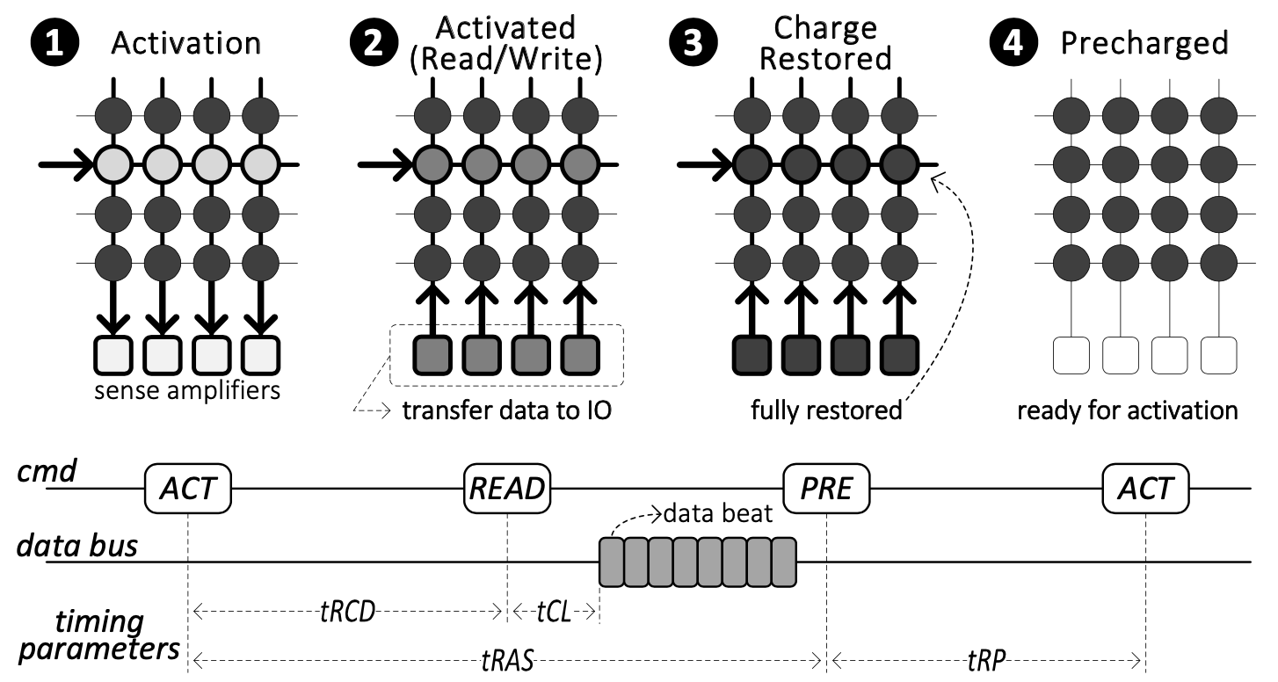
DRAM Background: Operation
Activation, restoration and precharge.

Slide 12
Disturbance Error Phenomenon -> RowHammer

Slide 13
Disturbance Error Phenomenon
DRAM cells leak charge all the time, so refreshed in a certain interval.
Repeated toggling of a DRAM row’s wordline stresses inter-cell coupling effects that accelerate charge leakage from nearby rows. When such a cell loses too much charge in a refresh interval, it experiences a disturbance error.

Slide 14
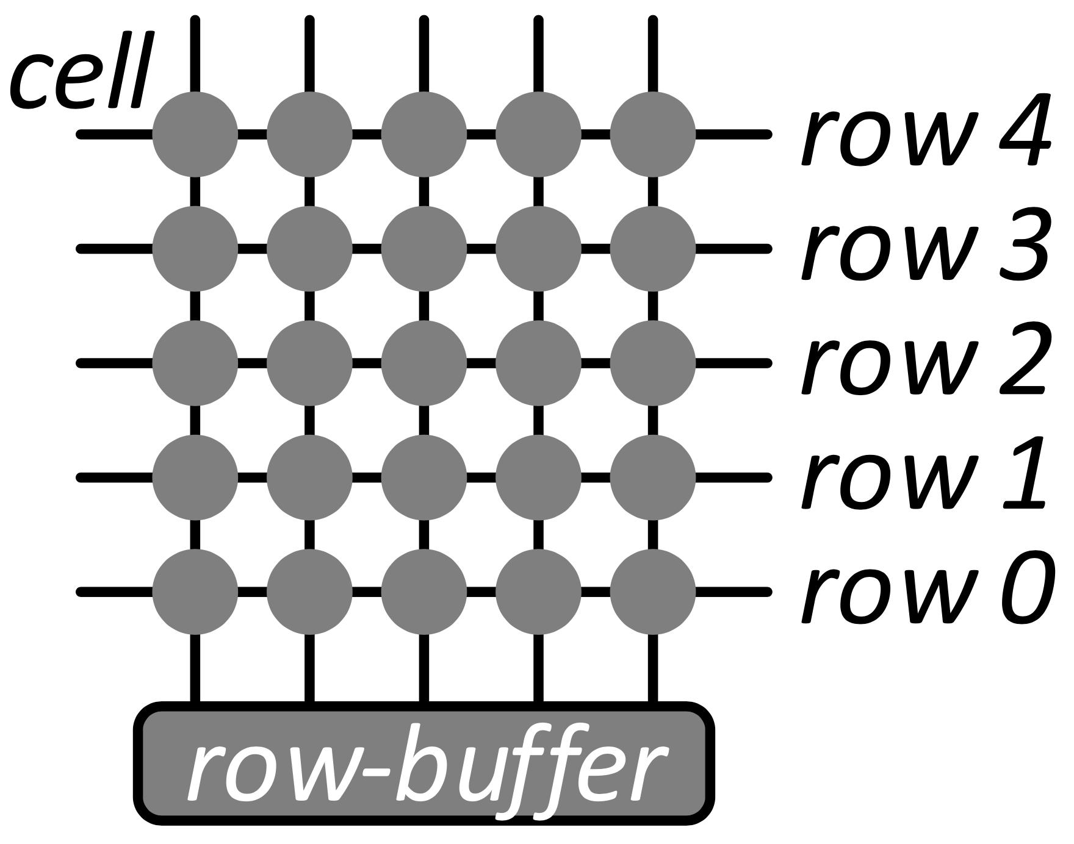
Disturbance Error Phenomenon

Slide 15
RowHammer
Malicious attackers can exploit disturbance error phenomenon to break the memory isolation security principle to cast great threat on computer system.
In later works, the exploitation of disturbance error phenomenon is called RowHammer, meaning repeatedly "hammering" a row induces bit flips into adjacent rows.

Slide 16
Characterization

Slide 17
RowHammer
Malicious attackers can exploit disturbance error phenomenon to break the memory isolation security principle to cast great threat on computer system.
In later works, the exploitation of disturbance error phenomenon is called RowHammer, meaning repeatedly "hammering" a row induces bit flips into adjacent rows.

Slide 18
References
[1]

