Slide 1
Catching a Ride in the Big Apple
Spencer Milbrandt
Rasheeq Jahan
Peter Wang

Slide 2
Questions to be Answered
What are the best neighborhoods to get a taxi?
In what neighborhoods is it more viable to take a different transportation service?
Do fare amounts really change based on trip distances?
What affects the frequency of the pickup and dropoff locations?

Slide 3


Tools Used
SQL (Looking through Database initially)
iPython Notebook
Python Libraries
numpy, scikit, pandas, matplotlib, seaborn, scipy dateutil parser
WEKA: for initial exploration and analysis
SPSS and Orange for classification/clustering

Slide 4
Preprocessing and Correlation of Attributes
Data Cleaning:
Removed any unneeded attributes: VendorID, RatecodeID, payment_type, etc.
Removed any NULL values and filled in any missing values
Data Transformation:
Parsed the timestamps to just hours to get the most common pickup hours

Slide 5
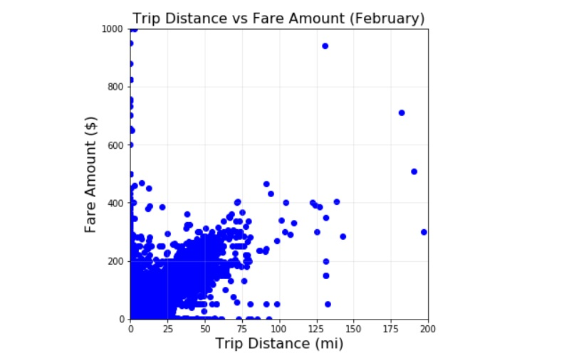
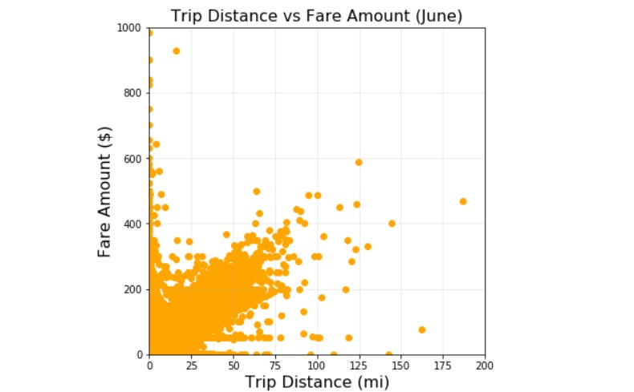
Trip Distance vs. Fare Amount Correlation
Linear Regression Correlation
Corr Coef: 0.96
Season Changes Don’t Affect Trip Distance vs. Fare Amount
Fare Amount Remains Consistent Regardless of Trip Distance
Notes:
When comparing the trip distance vs the fare amount to determine whether or not the amount is fixed or fluctuates based on different affects such as different seasons of the year or trip distance. As you can see here, the correlation between trip distance vs fare amount is 0.96 meaning that the relationship has an almost perfect linear regression model. As such, regardless of trip distance, the fare amounts appear to be stable and consistent at a fixed rate and therefore weather or other affects have no impact on the adjustment rate of the fares.

Slide 6
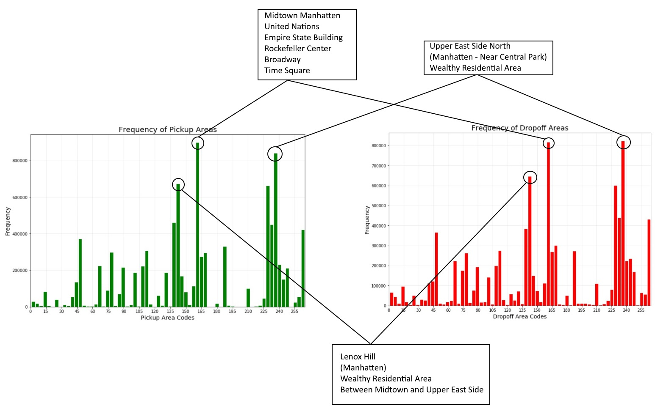
Pickup and Dropoff Frequency
Highest concentration of pickup/drop-offs occurred in wealthy neighborhoods: Upper East Side or Lenox Hill as well as central New York City in Midtown Manhattan
Notes:
When comparing pickup and dropoff locations, the most concentrated areas appear to be Upper East Side and Lenox Hill, which are classified as wealthy neighborhoods, and the central location of New York City being Midtown Manhattan. This is consistent with the hypothesis of pick up areas being focused towards the business sectors of New York City, however, there are a lot more taxis being taken by wealthy individuals than those who have lower income such as individuals living in West Harlem.

Slide 7
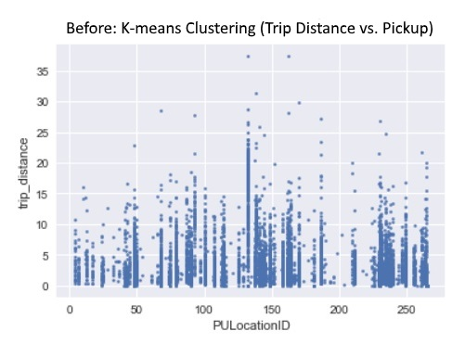
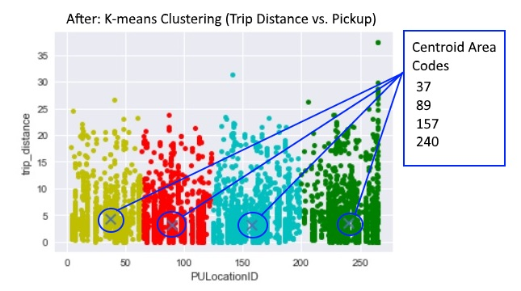
Clustering/Classification with K-Means
Group the trip distances for various pickup locations by the following 4 centroids to organize trips by proximity to centroids
PULocationIDs:
37 = Bushwick South, Brooklyn
89 = Flatbush, Brooklyn
157 = Maspeth, Queens
240 = Van Cortlandt Park, The Bronx

Slide 8
Results and Applications
Provide information to taxi drivers to find neighborhoods with greatest demand to reduce down time.
A pearson correlation analysis: taxi trip distance is strongly correlated to fare amounts, although further analysis on traffic congestion may provide a more accurate picture.
By identifying popular neighborhoods, taxi services can minimize the time needed to find an available passenger.
Notes:
If distance is strongly correlated to fare amounts, this may be influenced by trips during peak periods that would increase fares during short trips.

Slide 9
NYC Taxi Interactive Heatmap
https://upbeat-dijkstra-721484.netlify.com/
Notes:
Add Heatmap hosting link - Will present if we have time

