Slide 1
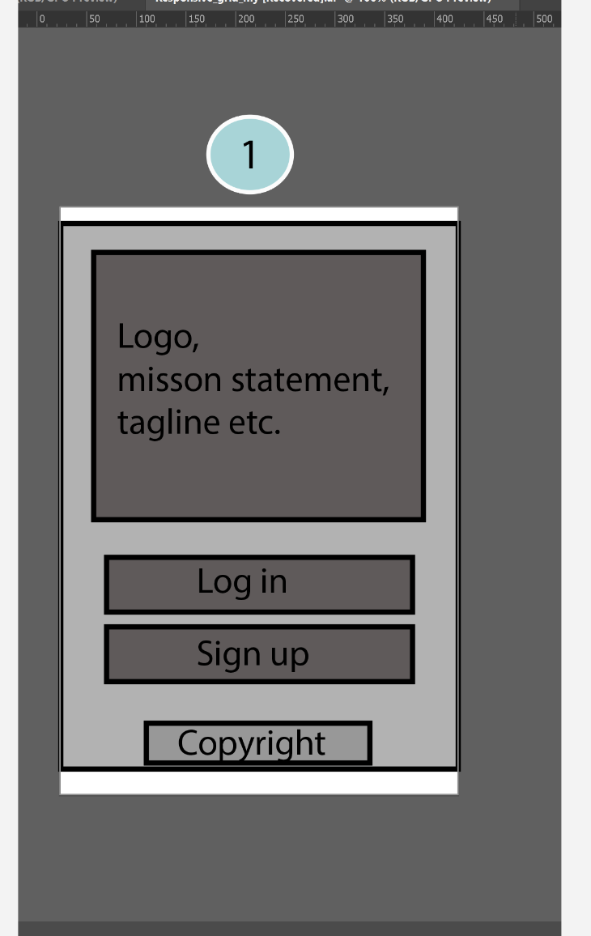
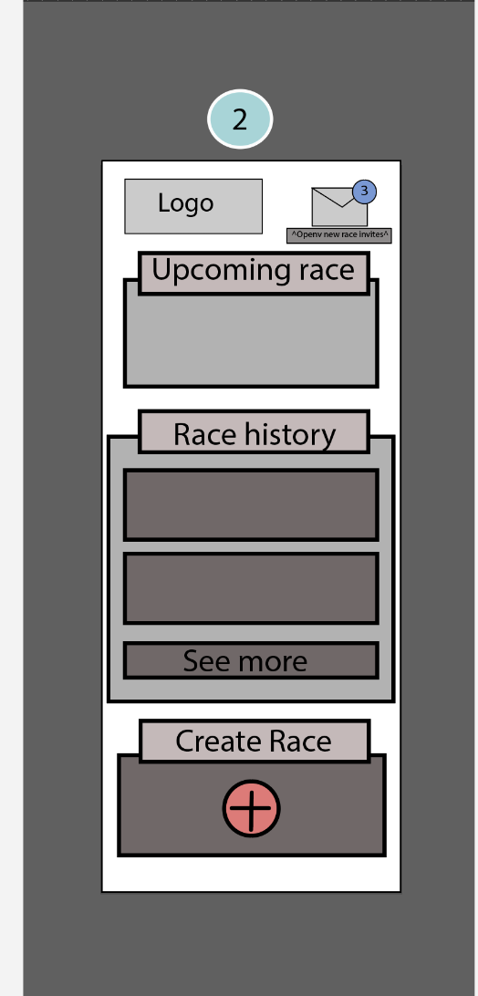
/login

Slide 2
/home
/challenge
Fred’s Challenge
$500 Pot
Players:
A 6000
You 3000
B 2000
Create
Challenge
Profile
Logout
Steps
Chat:
Player A 9/1/10 9:00AM - asfs aasf
Player B -9/1/10 9:30AM - asdfasadf
Fred’s challenge
You are
2nd of 6
Available events
Chat
Event name
Description
Join
Event name
Description
Join
/events

Slide 3
/register
Register
Email Address
Password
Nickname
Cell Phone
Fitness device info
Venmo account
SUBMIT

Slide 4
/create
/moneybet
Create a Challenge
Vemno
Pick one
Buy in
Money
Custom
Step Target
Meal
/custombet
Custom
Challenge
Loser will run a
Half marathon in
6 months

