Slide 1
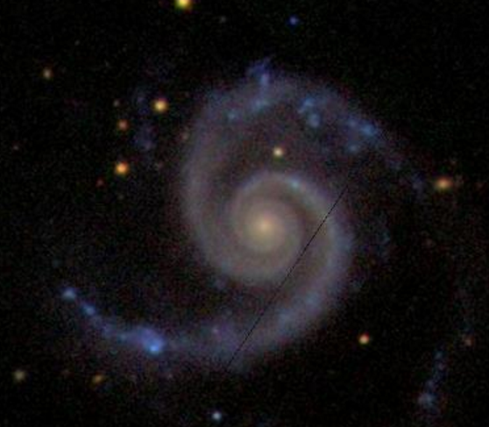
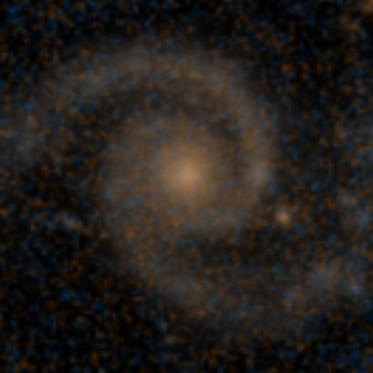
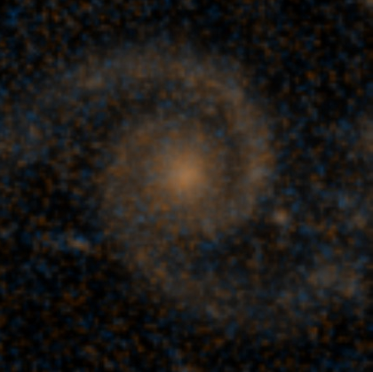
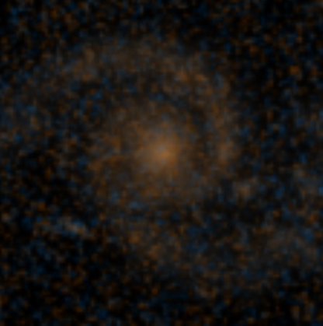
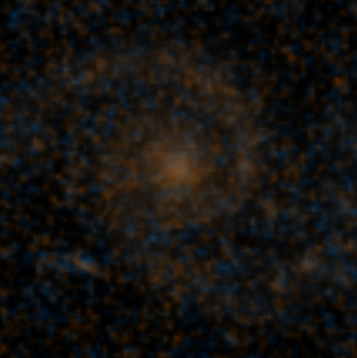
z = 0.01
587735044151509021
p_{features}= 1.0
z = 0.5
p_{features}= 0.96
z = 0.6
p_{features}= 0.93
z = 0.7
p_{features}= 0.88
z = 0.8
p_{features}= 0.75

