Slide 1
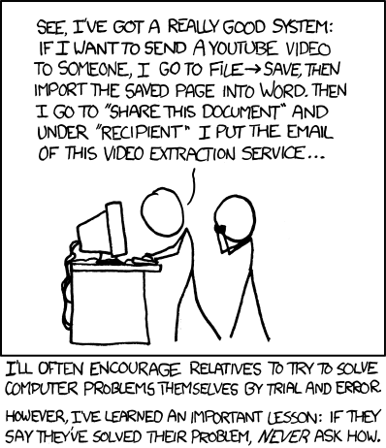
Lab 1 -
Getting Started
Please take a minute to fill out this form:
https://goo.gl/forms/WR0vxKUJLbuu0DLd2

Slide 2
Introduction: About Melissa
Senior studying Computer Science and Math
Favorite things:
Programming
Teaching
Math
Classic rock
Any kind of puzzle
Westworld
Email: mmgeorg@umich.edu
Office hours (usually):
Monday 2 - 3pm
Tuesday 6 - 8pm
Thursday 6 - 7pm

Slide 3
About EECS 280 Lab
When/ where is lab?
Section 24, Friday 2:30pm - 4:30pm 4153 USB
Why come to lab?
Walk through worksheet solutions, time to work on the coding portion of the lab collaboratively
Interactive tutorials on using CAEN, debugging, etc.
Weekly lecture review where we’ll talk about the topics that are important for projects & exams, and I’ll help you with tips to avoid common pitfalls
Written practice problems that will serve as exam prep.
You’ll have an opportunity to ask all of your questions regarding labs, lectures, and projects
How should I prepare for lab?
There are no computers in here - please bring your laptop, or contact eecs280staff@umich.edu so we can help you borrow one!
In the past, my students have found it useful to follow along in my slides. They will be posted every week before class in the “LabReference->Melissa George” folder.

Slide 4
About EECS 280 In General
My tips for success:
Keep up with lecture content
Start projects early
It’s okay to struggle
Google is your friend
Engage on Piazza - ask and answer questions
You CAN succeed in this course - I’m here to help you do that! Take advantage of lab and ask me all of your questions.

Slide 5
ReadMe
Reminders
Agenda
Lab 1 due Sunday, 16 September 2018, 8pm on the autograder
Project 1 due Tuesday, 18 Sep 2018, 8pm
Welcome to EECS 280 Lab!
Mini lecture: CAEN, Git overview
Common project 1 questions
Complete Lab 1
Submit on autograder

Slide 6
Project 1 - Common Questions
Relationship between stats.h, stats.cpp, main.cpp
Working with file I/O?
Doing mode & summarize functions?
How to test your code?

Slide 7
Working in your terminal
mkdir <new directory name> == make new directory with <new directory name>
Directories are like folders - think of the file structure in Finder/ Windows Explorer
cd <name of existing directory> == change into diretory
Changing directories is like moving up and down in Finder/ Windows Explorer folders
cd .. == go up one level
cd /home/uniqname/eecs280/eecs280_lab01
pwd == present working directory
Tells you the answer to the question “what folder am I in right now?”
ls == list what is in this directory
Like when Finder/ Windows Explorer shows you what’s in the folder

Slide 8

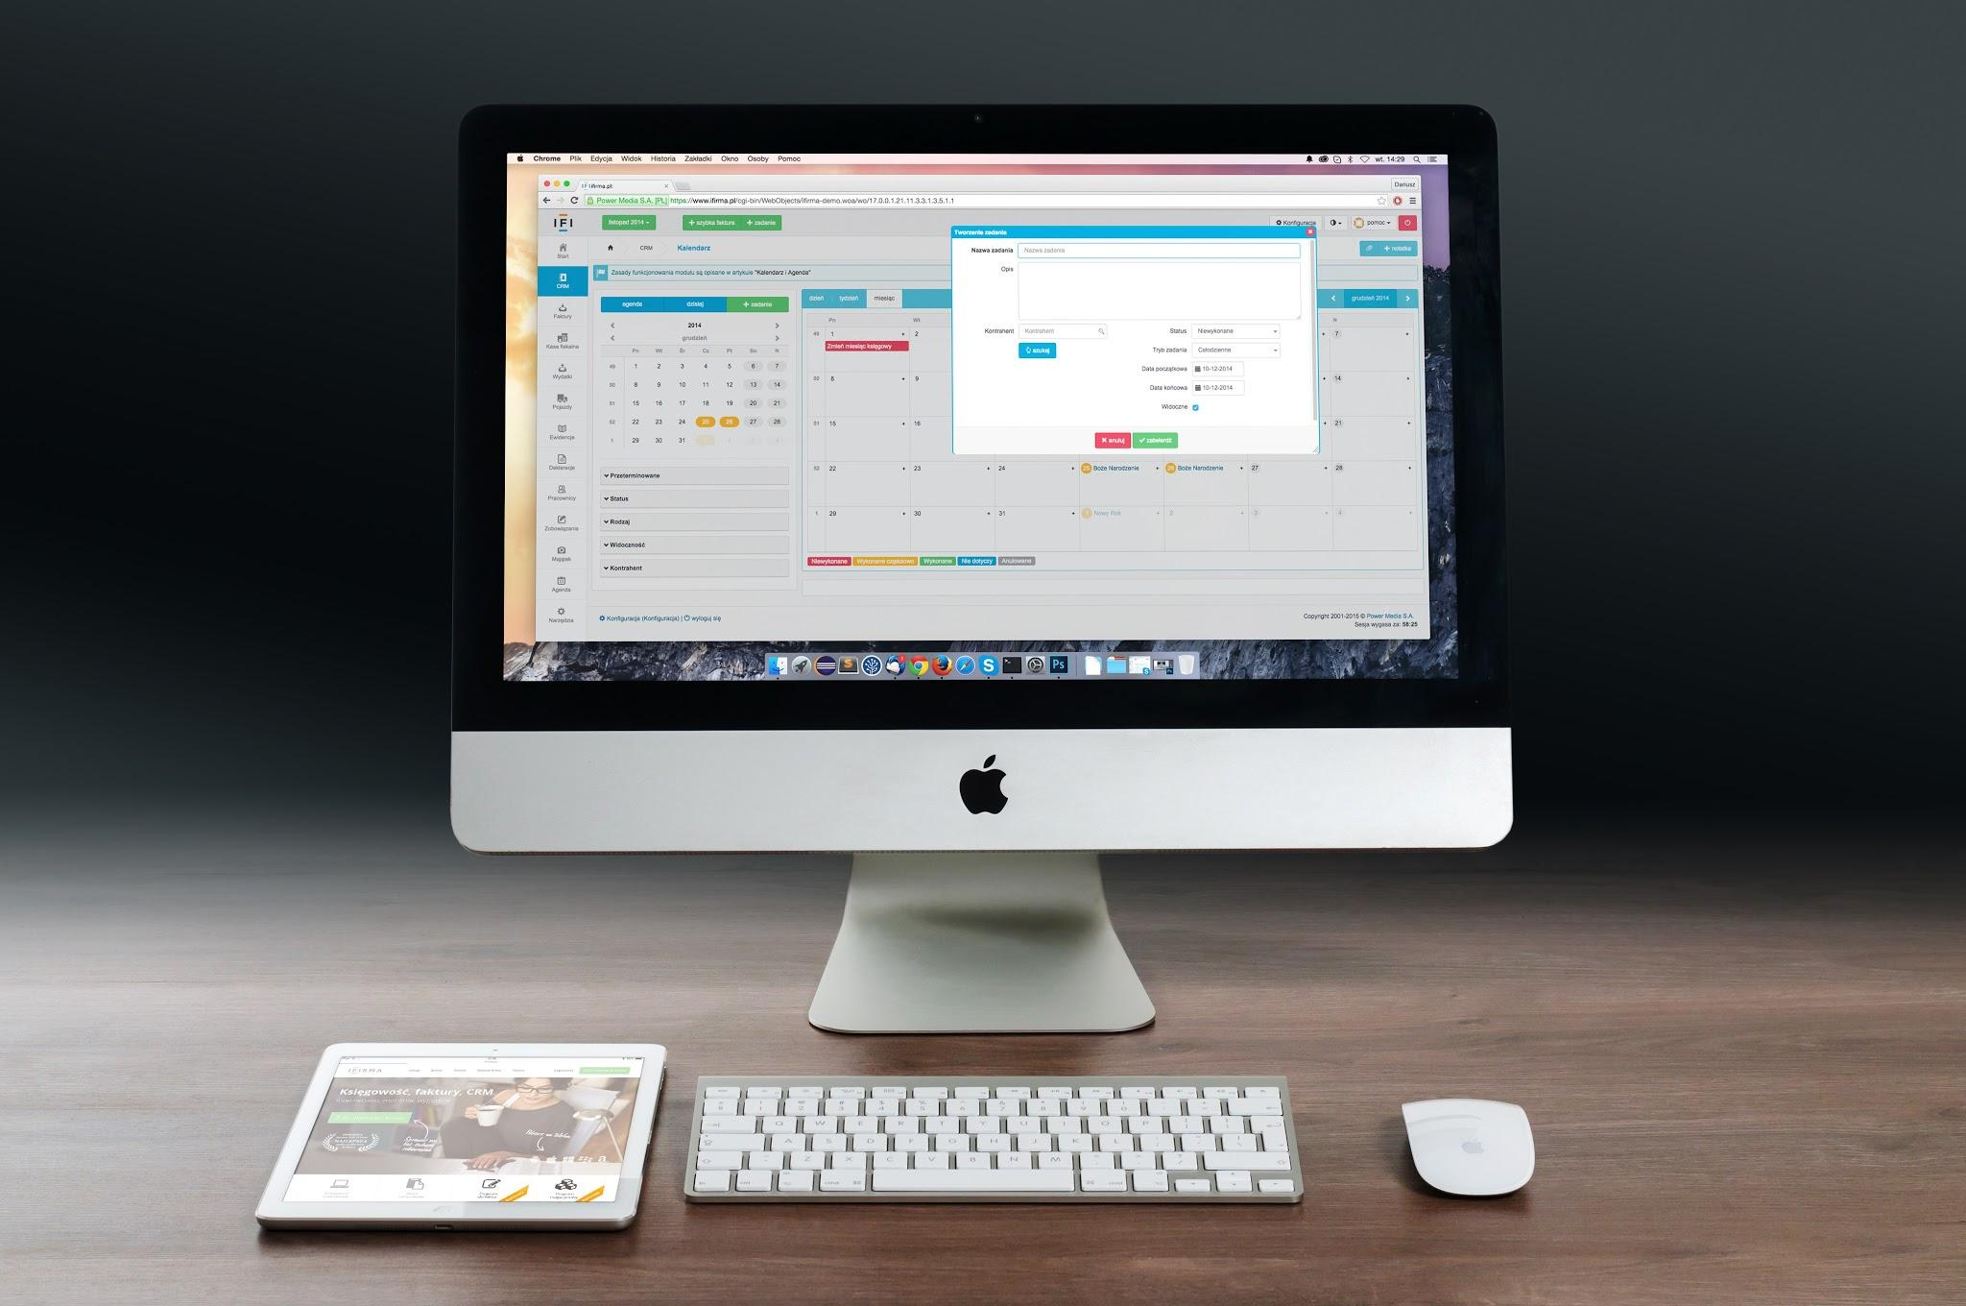
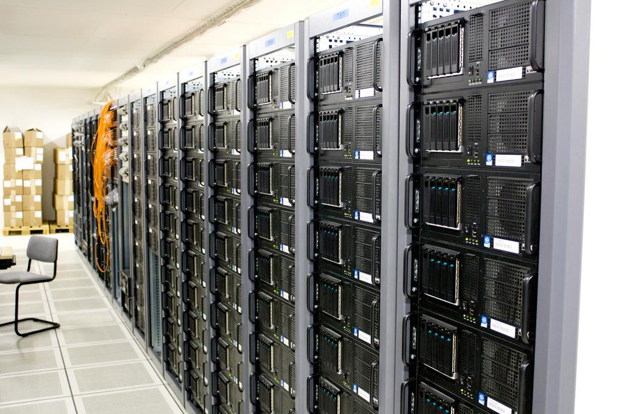



Introduction to CAEN
What is CAEN?
Computer Aided Engineering Network - network of computing resources for students to use (access a computer in person, or remotely access a CAEN server from your personal computer!)
CAEN Linux environment closely replicates the Autograder’s environment - always test your code on CAEN before submitting
You won’t lose your files if they are on CAEN
You can compile and run programs faster on CAEN than on your personal computer!
Note: your computer and CAEN computers don’t share each other’s files
Your
computer’s
files
Your
files on CAEN
remote connection
(ex. SSH)
Your computer
CAEN

Slide 9
Introduction to CAEN
How do I connect to CAEN?
Make sure you have a CAEN account
See setup tutorial
Recommended: access CAEN from a CLI - a command line interface
Mac/ Linux Users:
Open up a new terminal
Type “ssh uniqname@login.engin.umich.edu”
(NOTE: won’t work if you don’t have 2FA set up)
Windows Users:
Can open up Cygwin or WSL and type “ssh uniqname@login.engin.umich.edu”
Can use PuTTy - ssh functionality on Windows
Change IP to CAEN’s hostname and click “open”
OR CAEN VNC - works, but not recommended

Slide 10
Git
Git is basically a version control program
Helps us keep all of our files safe, keep every version of our project
We can return to an old version of our code if we break something
We can “push” to GitLab so that if something bad happens to our computer, our files are still safe
Git ≠ GitLab, but GitLab ≅ GitHub
When you use Git:
You save copies of previous versions in your directory so that you can return to them at any time
When you use GitLab:
You also save copies of previous versions remotely- on GitLab’s servers- so if something goes wrong, you can always get your code back

Slide 11
Committing and pushing your code
“Saves” in git are called “commits.”
Remember these 3 basic steps:
git add -A == “get ready to save all of the files in this directory”
git commit -m “this is my message” == “save all of the added files, and associate this message with that save”
git push -u origin master == “push my new saved code to GitLab so that the remote GitLab knows about the new changes too, not just my computer”

Slide 12


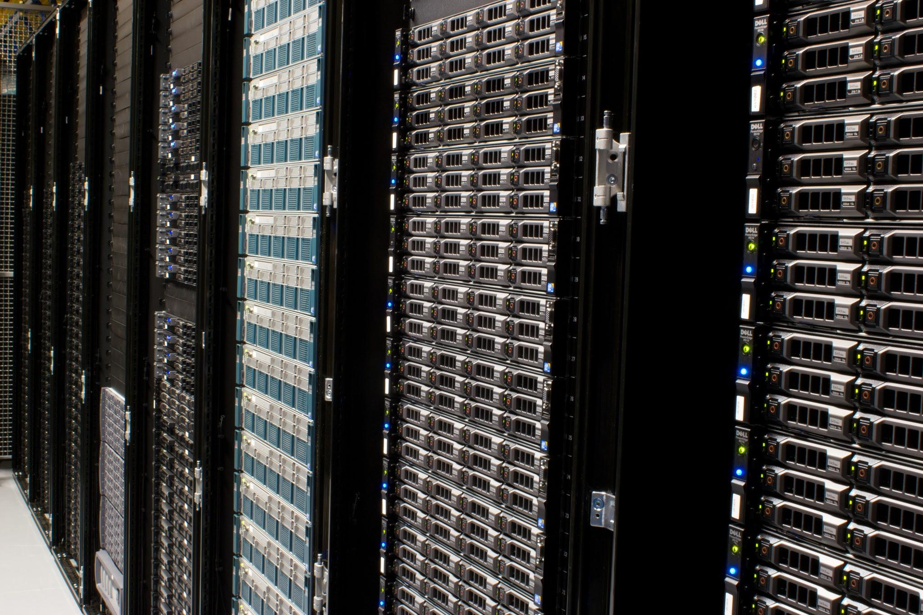
CAEN, GitLab, and You
*scp info in appendix
How to get your files from one place to another
git push
git add
git commit
(local save)
git add
git commit
(local save)
git pull
git pull
git push
scp* (or rsync)
scp* (or rsync)
YOUR COMPUTER
CAEN
Notes:
Note that this slide doesn’t show how to use complete commands- this is just meant to be a diagram demonstrating workflow

Slide 13
More git commands
git log == “show me a record of all of my commits”
git status == “show me a record of the files I’ve changed recently”
git checkout <commit number> <file> == “I want this file from when I made that commit”

