Slide 1
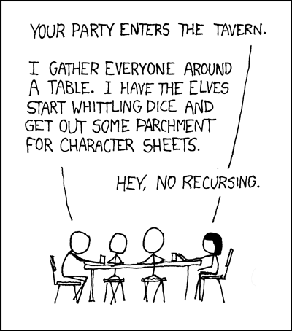
Lab 10 - Recursion

Slide 2
ReadMe
Reminders
Lab 10 due Sunday, December 9th
Project 5 due TODAY
Teaching evaluations on Canvas - I value your feedback!
Final review Sunday 4-6pm - see Piazza announcement
Agenda
Recursion/ error handling
Worksheet
Lab time
Work on lab assignment
Work on project
Do practice final review
https://github.com/MelGeorge/recursion_demo

Slide 3
Recursion
Recall: recursion is whenever a function calls itself.
What do we need for recursion to work?
We’ll need a base case - the recursion has to stop somewhere so our function will return an answer. Don’t forget this!
The problem we’re trying to solve must be able to be split into many self-similar pieces.
Recursion is similar to the idea of mathematical induction. Proofs by induction look like this:
Show something works for n = 1. Now, assume that it works for some value k. Show that if it works for k, it must work for k + 1. Thus, it must work for all n >= 1.
When writing recursive functions, we’ll use the same idea!

Slide 4
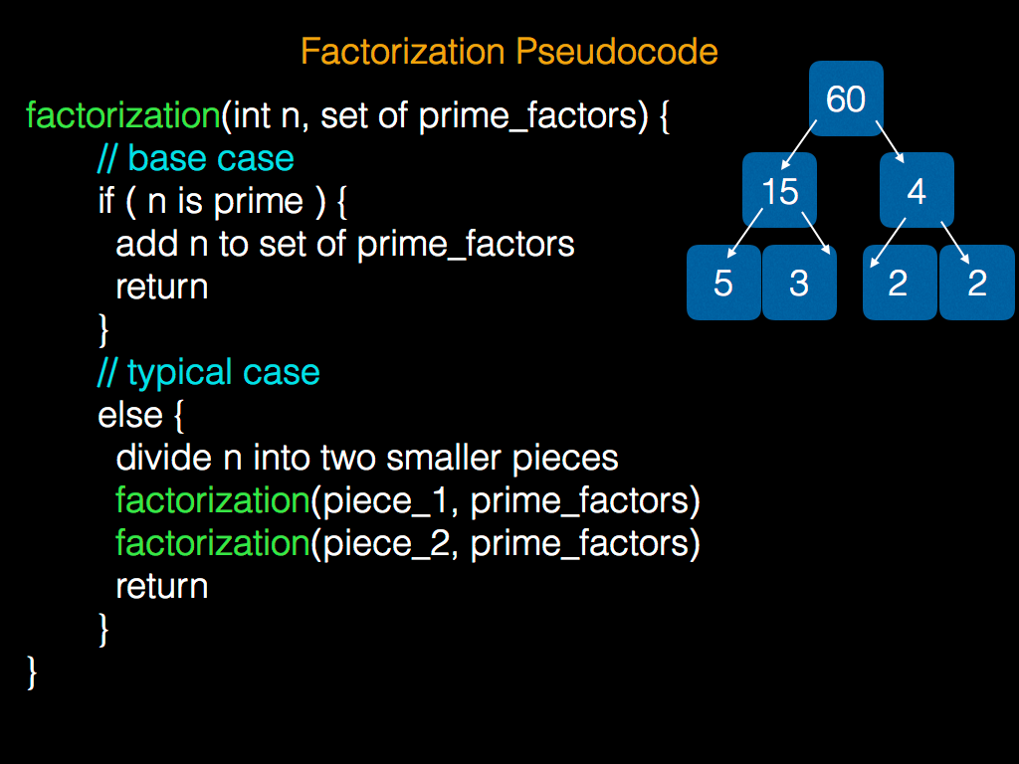

Slide 5
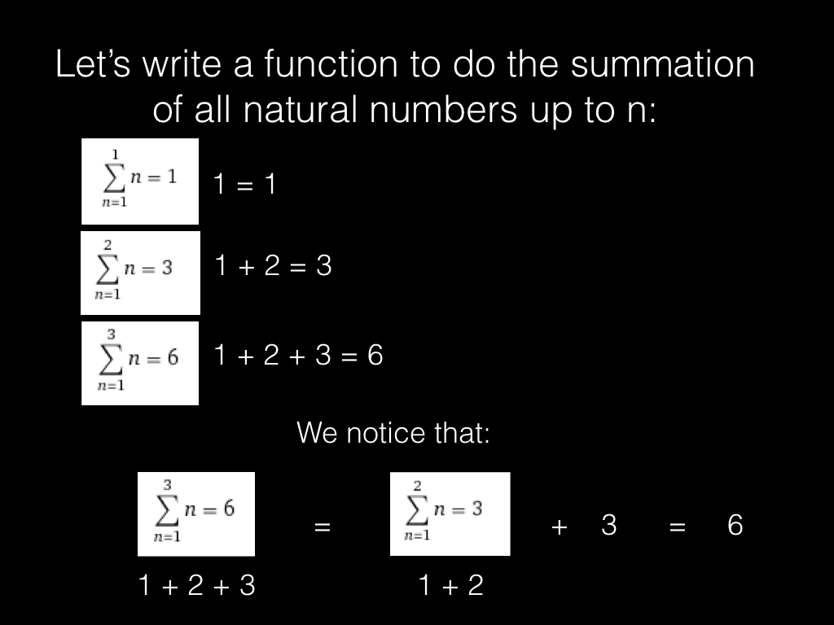

Slide 6
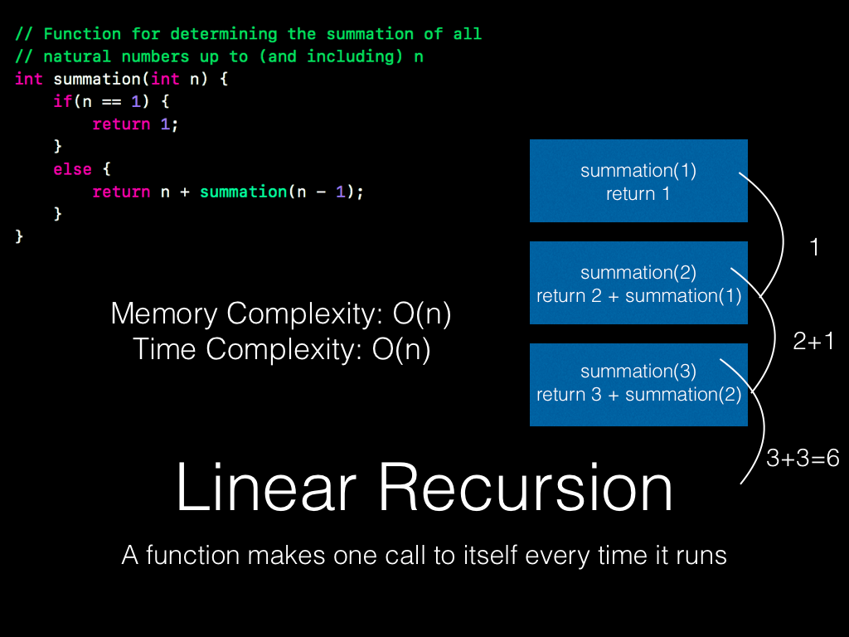

Slide 7
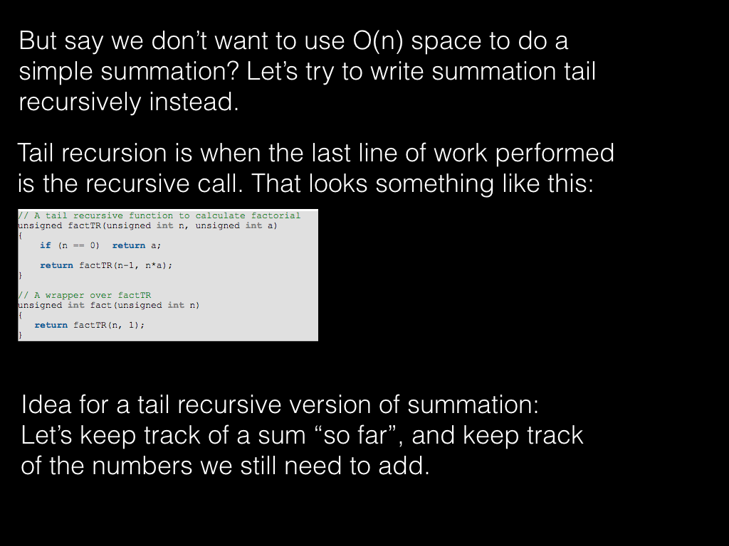

Slide 8
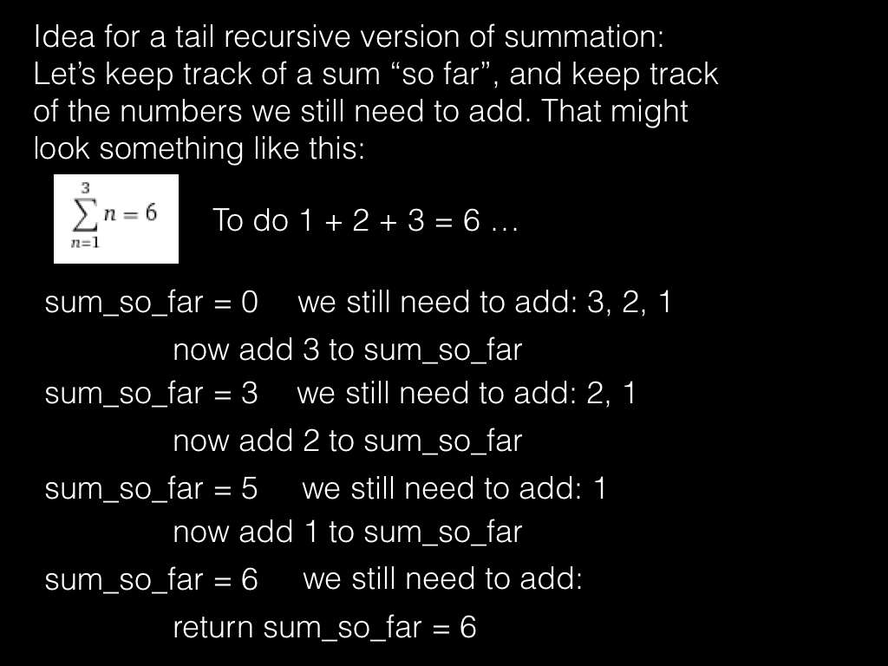

Slide 9
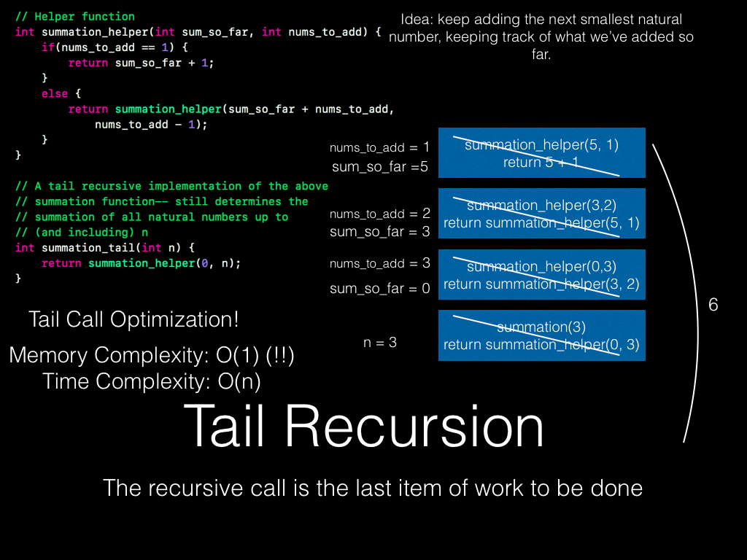

Slide 10
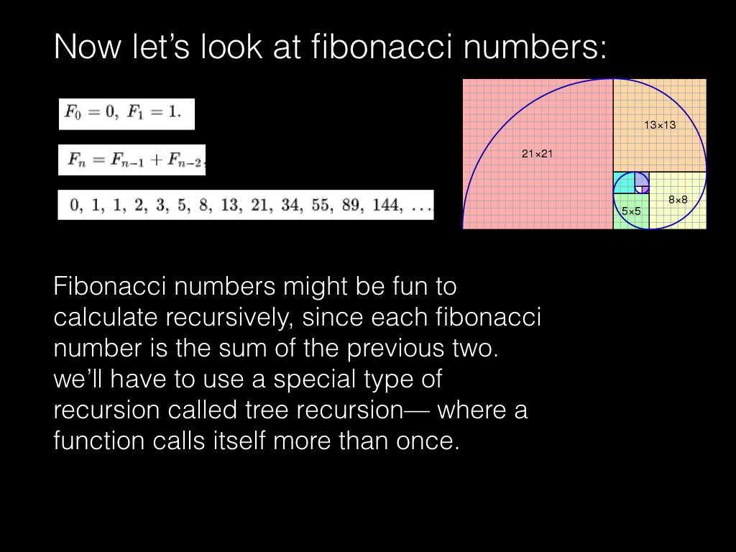

Slide 11
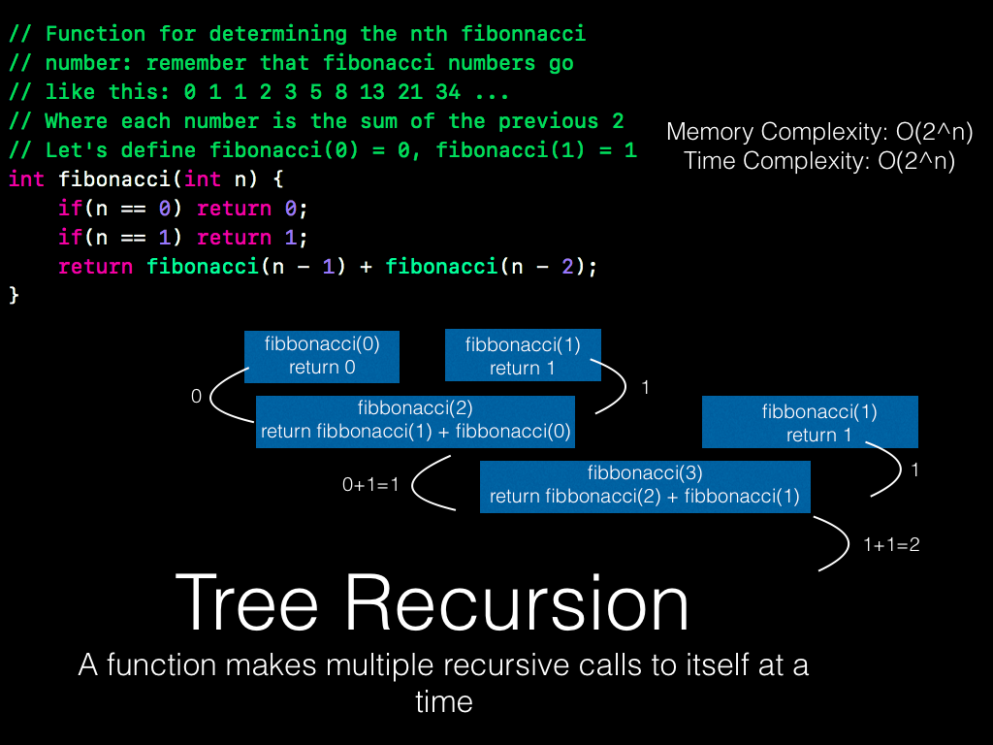

Slide 12
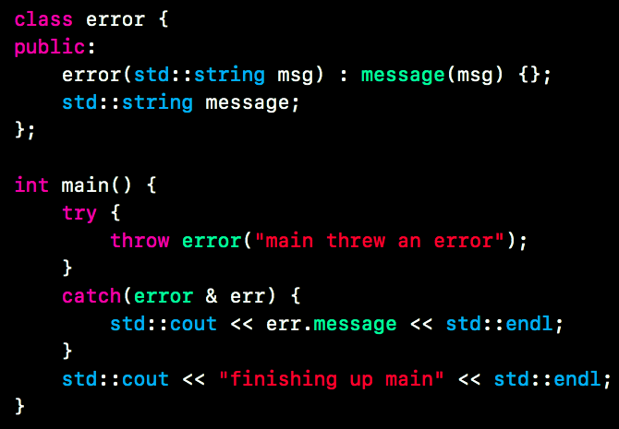
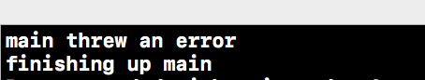
Error Handling -- Exceptions
When we are writing code, we often run into situations where we get an unexpected input, or something goes wrong. When this happens, we would like a safe way to let the function caller/ the user know that something went wrong. It’s also useful to give them a description of *what* went wrong.
Solution-- exceptions.

Slide 13
Try Blocks and Catch Blocks
We surround code that might throw an error in a “try” block
We put matching “catch” blocks at the end of our “try” blocks to catch the errors thrown
We look through the catch blocks one by one (top to bottom) until one matches the type of error thrown-- then we execute the matching catch block code
Note: polymorphism comes into play here!
If no matching catch block exists, the error propagates “outward” through the function calls until one is found
If no matching catch block is ever found, the program crashes

Slide 14
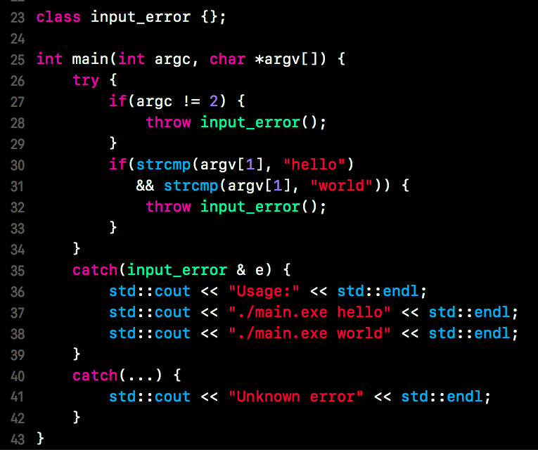
Try Blocks and Catch Blocks -- Example
Say we have a program that can only be run in these two ways:
./main.exe hello
./main.exe world
We can enforce this and handle input errors as is shown here.
Note that
catch(input_error &e)
catches input_errors only, while
catch(...)
catches any other errors.
What would happen if strcmp threw an error?

Slide 15

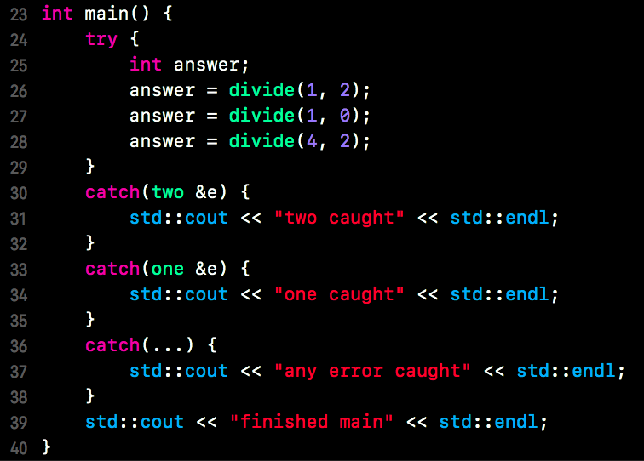
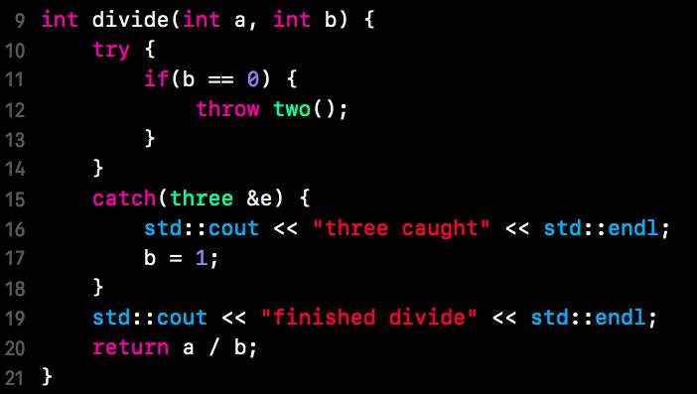
Try Blocks and Catch Blocks-- Practice Question
If I have these 3 error classes, the function on the left, and the main function on the right, what is printed?

Slide 16
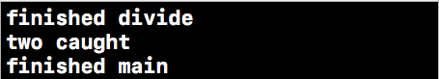
Try Blocks and Catch Blocks-- Answer
Answer:

Slide 17
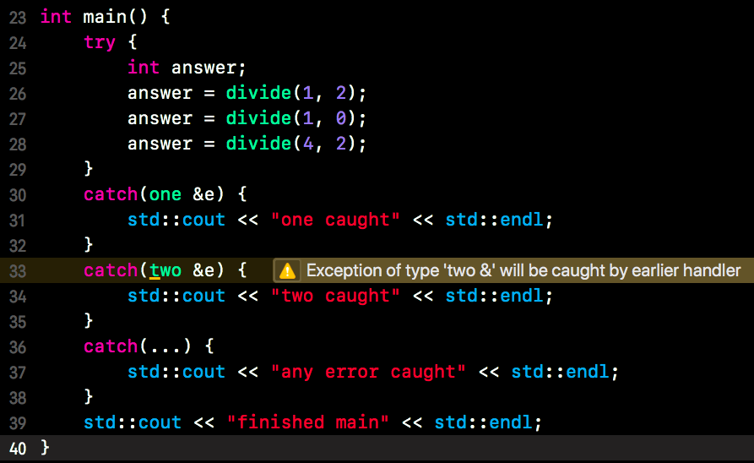
Polymorphism & Exceptions
What happens if we put the “catch(one &e)” block before the “catch(two &e)” block?
Exceptions display polymorphic behavior-- in our previous example, since class “two” inherits from class “one”, the catch block that catches objects of type “one” will also catch objects of type “two”, so this second catch block will never run!

Slide 18
Advice for Reviewing for the Final
Go through all of the lecture slides/ redo examples
If you missed lectures, watch them. If you didn’t miss them, DON’T watch them again.
Make your cheat sheet as you look through the lecture slides
Redo lab activities & glance at projects 3 - 5
Do the practice exams we gave you
Do review session worksheet & maybe attend or watch the recorded review session
Study with friends and make up questions for each other

Slide 19
Notice that our sample exams have:
Short Answer
Dynamic Memory
Lists and Templates
Iterators and Functors
Recursion

Slide 20
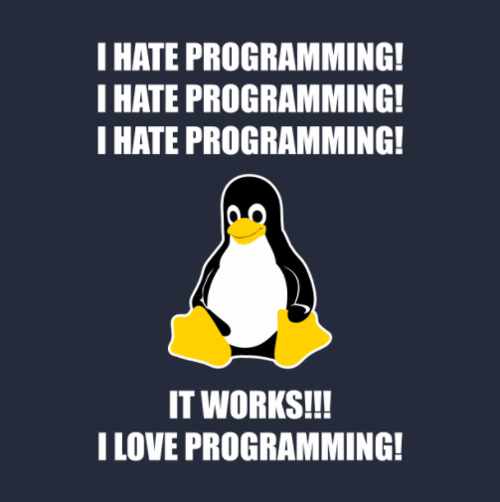
Good luck on the exam!
Thanks for a great semester!
Study hard!

