Slide 1
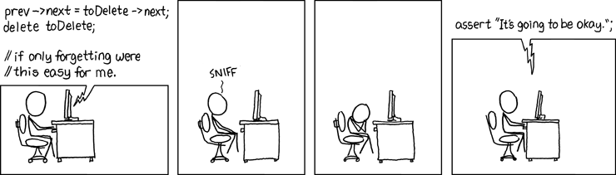
LAB 2 - Pointers and Arrays
Please take a minute to fill out this form:
https://goo.gl/forms/WR0vxKUJLbuu0DLd2

Slide 2
Introduction: About Melissa
Senior studying Computer Science and Math
Favorite things:
Programming
Teaching
Math
Westworld
Email: mmgeorg@umich.edu
Office hours (usually):
Monday 2 - 3pm
Tuesday 6 - 8pm
Thursday 6 - 7pm

Slide 3
About EECS 280 Lab
When/ where is lab?
Section 24, Friday 2:30pm - 4:30pm 4153 USB
Why come to lab?
Walk through worksheet solutions, time to work on the coding portion of the lab collaboratively
Interactive tutorials on debugging, etc.
Weekly lecture review
Written practice problems that will serve as exam prep.
You’ll have an opportunity to ask all of your questions regarding labs, lectures, and projects
How should I prepare for lab?
There are no computers in here - please bring your laptop, or contact eecs280staff@umich.edu so we can help you borrow one!
In the past, my students have found it useful to follow along in my slides. They will be posted every week before class in the “LabReference->Melissa George” folder.
A few more notes:
I am here for YOU -- do what’s best for your own learning
2 halves of lab -- 1st ½ = material, 2nd ½ = ‘office hours’

Slide 4
About EECS 280 In General
My tips for success:
Keep up with lecture content
Start projects early
It’s okay to struggle
Google is your friend
Engage on Piazza - ask and answer questions
Practice and struggling through tough problems will make you great
You CAN succeed in this course - I’m here to help you do that! Take advantage of lab and ask me all of your questions.

Slide 5
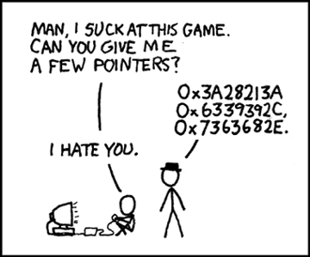
ReadMe
Reminders
Agenda
Lab 2 due Sunday, September 23rd at 8pm
Project 2 due Thursday, October 5th at 8pm
Review pointers and arrays
Lab 02 Worksheet
Unit Test tutorial
Main part of lab

Slide 6
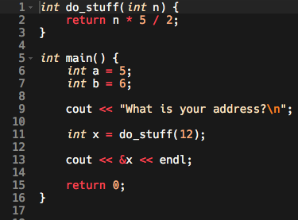
Recall:
Where do objects live?
Practice: draw a diagram representing what happens in memory during the course of this program. Use a stack frame for each function call, draw boxes to represent locations where objects live in memory, and give those locations some addresses.
Objects live at specific addresses in your computer’s memory. It can be useful to draw diagrams of this using stack frames-- one for each function call-- to represent what is happening in memory during your program.

Slide 7
Recall:
Answer:
The stack frames involved in this program would look something like this. At what point in your program should the stack look like this?
do_stuff
n
12
0x24
main
a
b
x
5
6
30
0x04
0x08
0x12

Slide 8
Pointers
A pointer is a type of object that holds an address.
We can declare pointers like this:
int a = 5;
int * ptr = &a;
We can visualize pointers like this:
Or like this:
ptr
a
ptr
a
Int *
0xBC
5
int
Int *
5
int
0x0A
0xBC
0x0A
0xBC
use a * to say it’s a pointer
Take the address of the int a to store in “ptr”
Declare the type of the thing at the end of the pointer

Slide 9
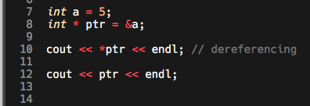
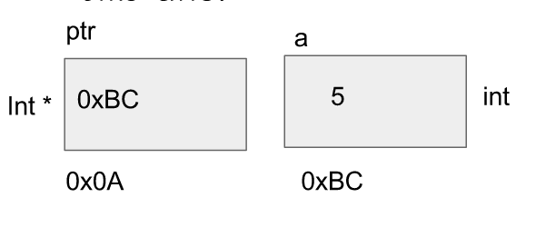

Pointers Continued
When we dereference a pointer, this means:
“follow the pointer and return the value of the object at the end”
“go to the address and return the value of the object stored at that address”
Dereferencing looks like this:

Slide 10
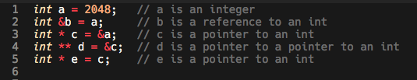
What would this look like in memory?

Slide 11
Answer:
a
c
b
2048
int
0x01
int*
0x01
0x08
What do these lines do?
cout << *c << endl;
cout << *d << endl;
cout << d << endl;
cout << b << endl;
cout << &a << endl;
cout << c << endl;
cout << &e << endl;
cout << e << endl;
cout << *e << endl;
cout << **d << endl;
d
e
0x08
int**
0x01
int*
0x10
0x100

Slide 12
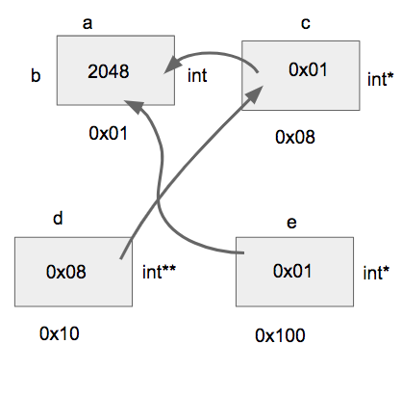
Answer:
What do these lines do?
cout << *c << endl; → 2048
cout << *d << endl; → 0x01
cout << d << endl; → 0x08
cout << b << endl; → 2048
cout << &a << endl; → 0x01
cout << c << endl; → 0x01
cout << &e << endl; → 0x100
cout << e << endl; → 0x01
cout << *e << endl; → 2048
cout << **d << endl; → 2048

Slide 13
Arrays
What are arrays?
Arrays are contiguous blocks of memory that contain objects of the same type
“Contiguous” means “immediately next to one another”
Question -- what’s so special about contiguous memory?
Arrays look like this in memory:
*Note: all of these addresses are “4 apart” - that’s because an integer takes up 4 bytes of memory (usually)
int arr[7] = { 55, 433, 12, 1, 20, 216, 280 }
arr
55
433
12
1
20
216
280
0x000
0x004
0x008
0x00C
0x010
0x014
0x018

Slide 14
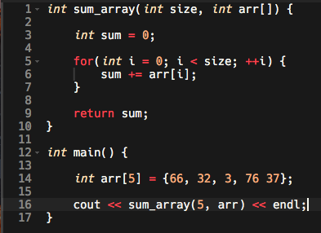
Passing arrays into functions
sum_array
sum
arr
i
0
0
int
0
int
0x30
0x34
main
arr
66
32
3
76
37
0x00
0x04
0x08
0x0C
0x10

Slide 15
Next:
Worksheet in small groups & as a class
Unit Test Framework
Notes:
Find tutorial here: https://eecs280staff.github.io/unit_test_framework/
Work on lab in small groups
Lab:
https://eecs280staff.github.io/lab/lab02/

Slide 16




Reminder : Get started on Project 2!
*deflates slowly*

