Slide 1
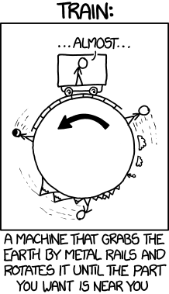
Lab 4 - Abstract Data Types

Slide 2
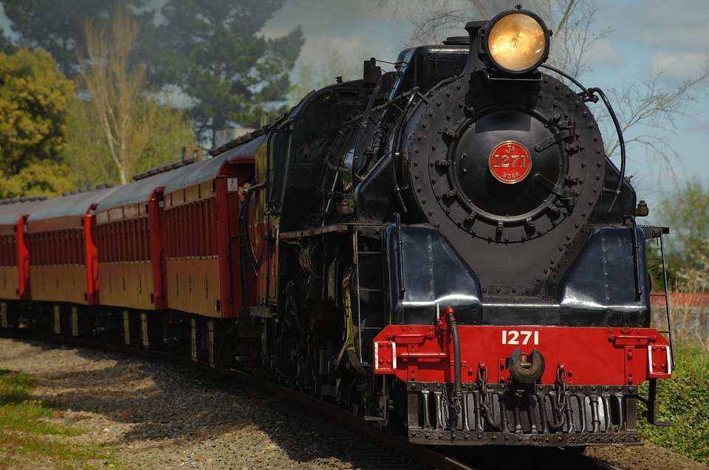
ReadMe
Reminders
Lab 4 due Sunday, October 7th at 8pm on Canvas
Project 2 due TONIGHT at 8pm
DO NOT WAIT UNTIL 8 TO SUBMIT
Agenda
Review: ADTs, structs, classes
Worksheet
Debugging Tutorial
Do lab / ask me questions
Let’s talk about trains*.
*Train example stolen from Jon Juett.

Slide 3

ADTS
Help us organize things in an intuitive way
C - style idea: it is intuitive to us to think about objects as possessing properties:
“A train has cars, wheels, and a station.”
C++ - style idea: it is intuitive to us to think about objects as possessing properties, but also as having associated actions:
“A train has cars, wheels, and a station. But it also runs, burns coal, leaves the station, and whistles.”
The key difference between C-style ADT’s and C++ style ADT’s is that C++ style ADT’s surround the idea that “objects don’t just have properties, they should also have associated actions.”

Slide 4


Structs vs. Classes
C style
Only data -- use as Plain Old Data structures
No constructors -- start off with uninitialized values and then use init functions
Member variable/ function access is public by default
C++ style
Data & functions -- use with data, member functions, inheritance, etc.
Constructors & destructors
Member variable/ function access is private by default

Slide 5
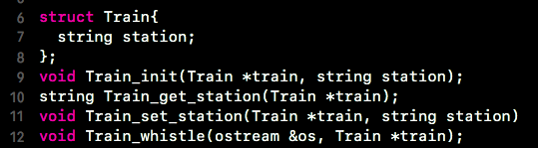
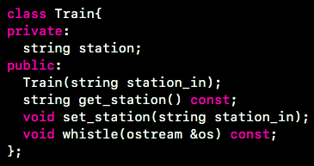
Structs vs. Classes
C-style / struct ADT -- notice how the data (station name) is inside the struct, but the associated functions are separate pieces. Also notice how we have to pass a pointer to the train into these functions.
*Notice, however, that we can do pretty much everything with this object that we can with the class type object shown at the right. Just in different ways!
C++ style / class ADT -- notice how both data and functions are declared inside the class. Notice how we don’t need to pass any train pointer into these functions. That’s because functions in the train class already have a pointer to the train-- the “this” pointer!

Slide 6
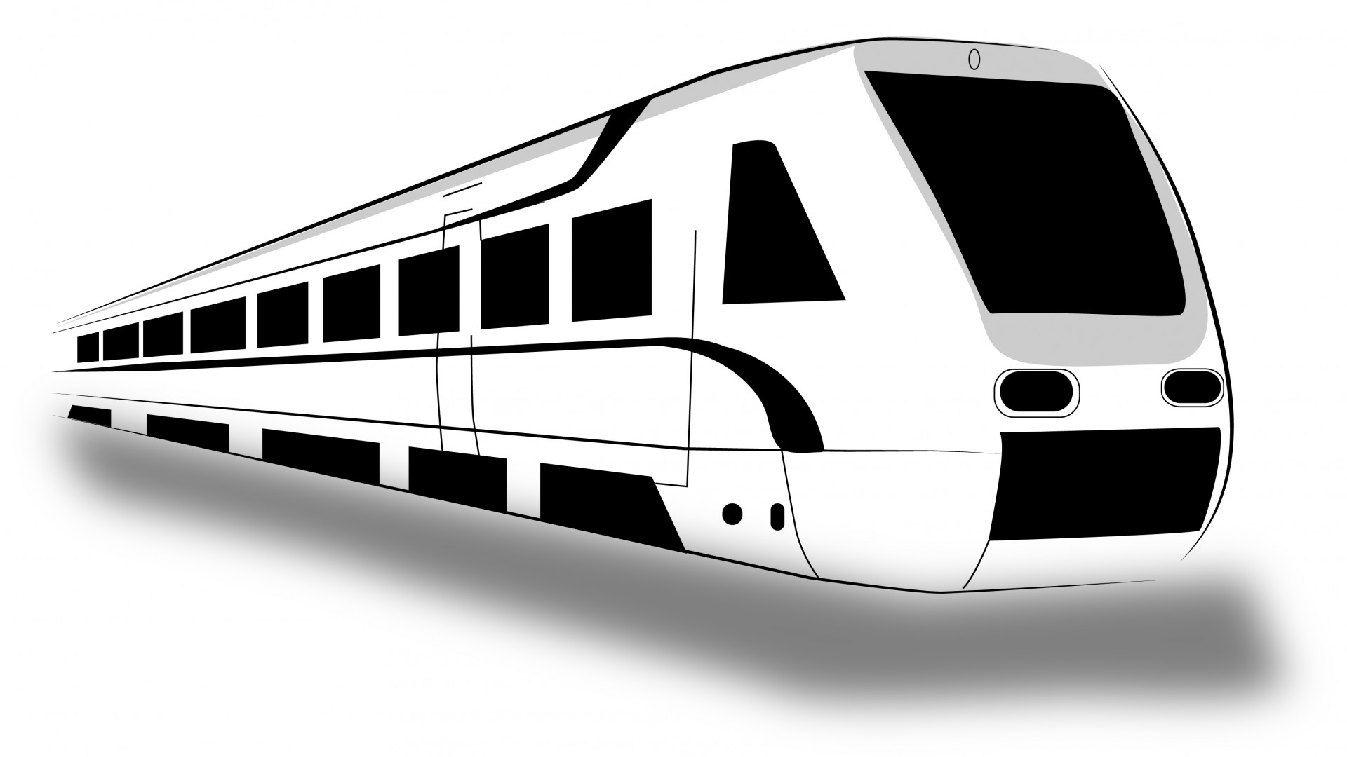
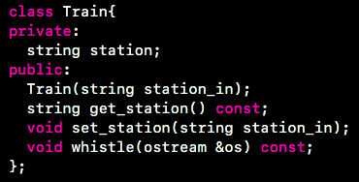
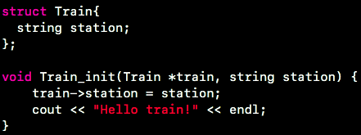

Structs vs. Classes -- Initialization
Pass a pointer to the train you want to initialize
Use the :: operator to define a function outside the class
No scope resolution operator
No member initializer list
Use member initializer list and/ or write code in function body

Slide 7
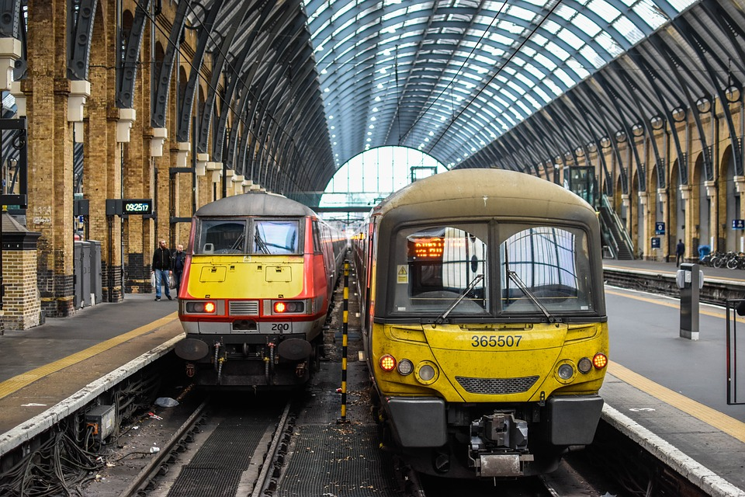
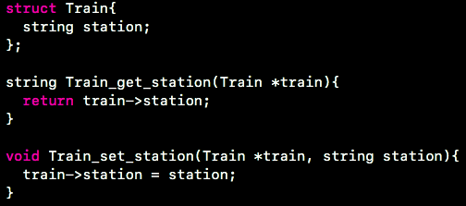
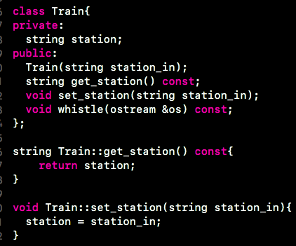
Structs vs. Classes -- Getters and Setters
No scope resolution needed
This “const” prevents get_station() from changing any member variables
Note: in both cases, we are using getter and setter functions to help us separate interface from implementation.
Scope resolution operator

Slide 8
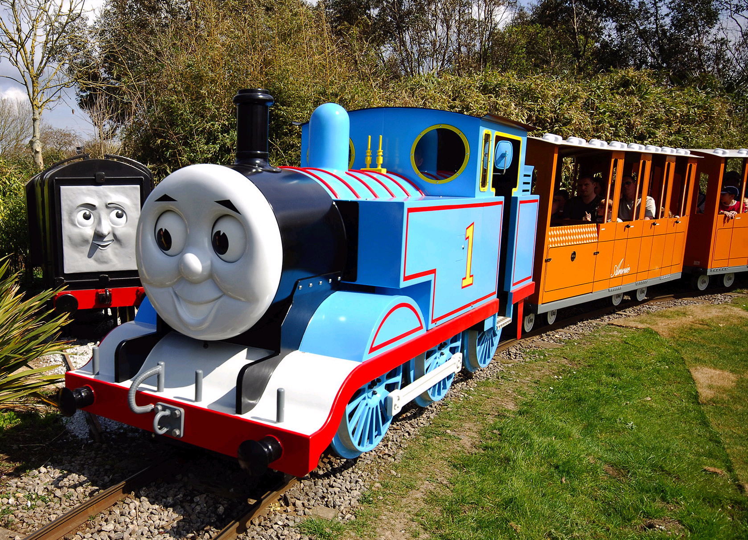
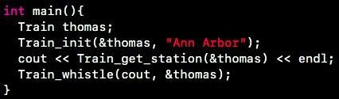
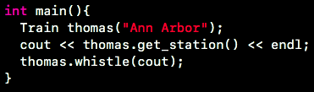
Structs vs. Classes -- Creating & Using Objects
We have to create a new train object, and then initialize it with the init function. When we call the train functions, we have to pass in the train’s address.
We can create & initialize the train object all at once. We use the “dot” operator to call member functions. We do not have to pass in the address.

Slide 9
Worksheet!

Slide 10
The Essence of Debugging
It still doesn’t work!
Program Doesn’t Work
Hypothesize Why it Doesn’t Work
Make Fixes
Re-test
• Test case fails
• Autograder fails
• Compile Error
• Segmentation fault
• Write more tests!
• Study the test case that failed
• Google the error
• Run gdb / your visual debugger
• Print statements
Make informed revisions to your code
• Re-run your tests
• Write a new test case to find the bug
• Step through code with debugger

Slide 11
Time for Lab Assignment!

