Slide 1
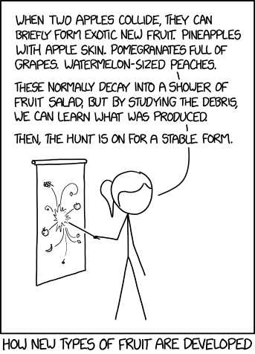
Lab 5 -
C++ Style ADTs

Slide 2
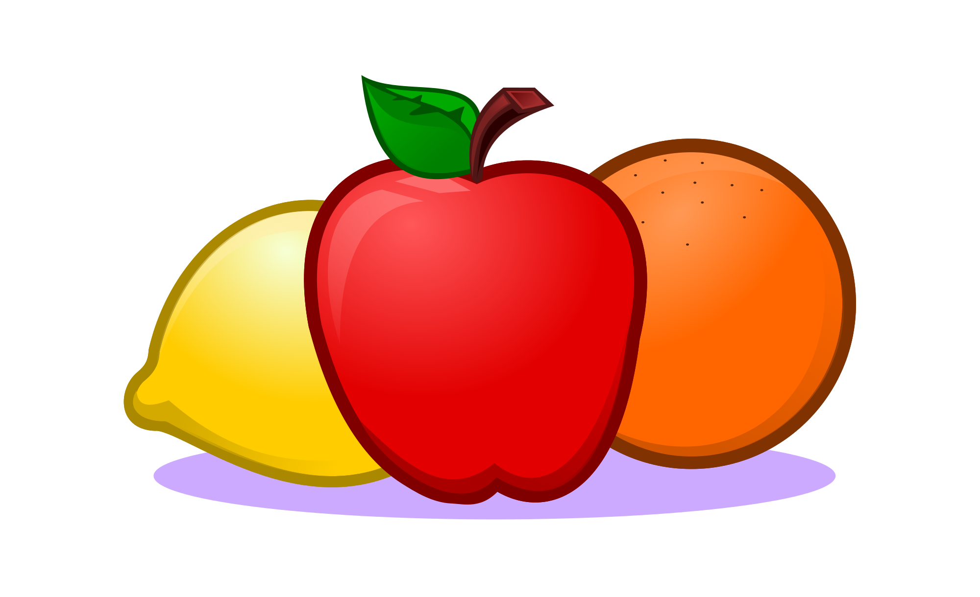
ReadMe
Reminders
Lab 5 due Sunday, October 14th at 8pm
Project 3 due Friday, October 26th at 8pm
NO LAB NEXT WEEK -- Have a great break!
Agenda
Today’s theme:
Fruit!
Brief review Polymorphism + Inheritance
Worksheet
Exam-style Questions
Time for Lab Assignment / Project Questions

Slide 3
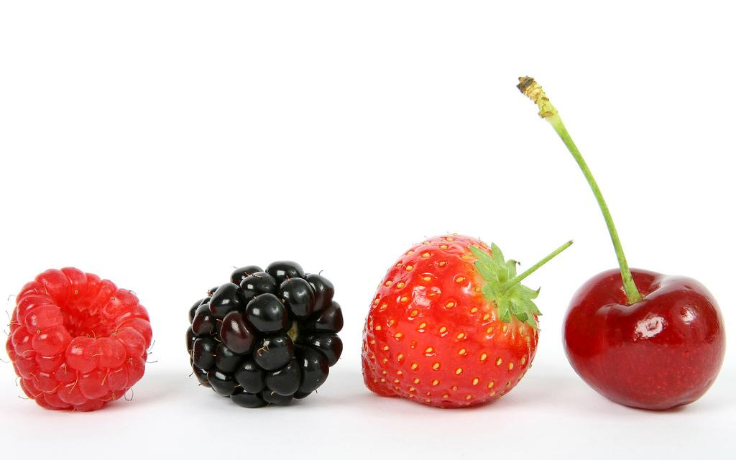
If you want to follow along with today’s example:
git clone https://github.com/MelGeorge/Fruit.git
Create a project with these files in your IDE, or simply view them in a text editor!

Slide 4
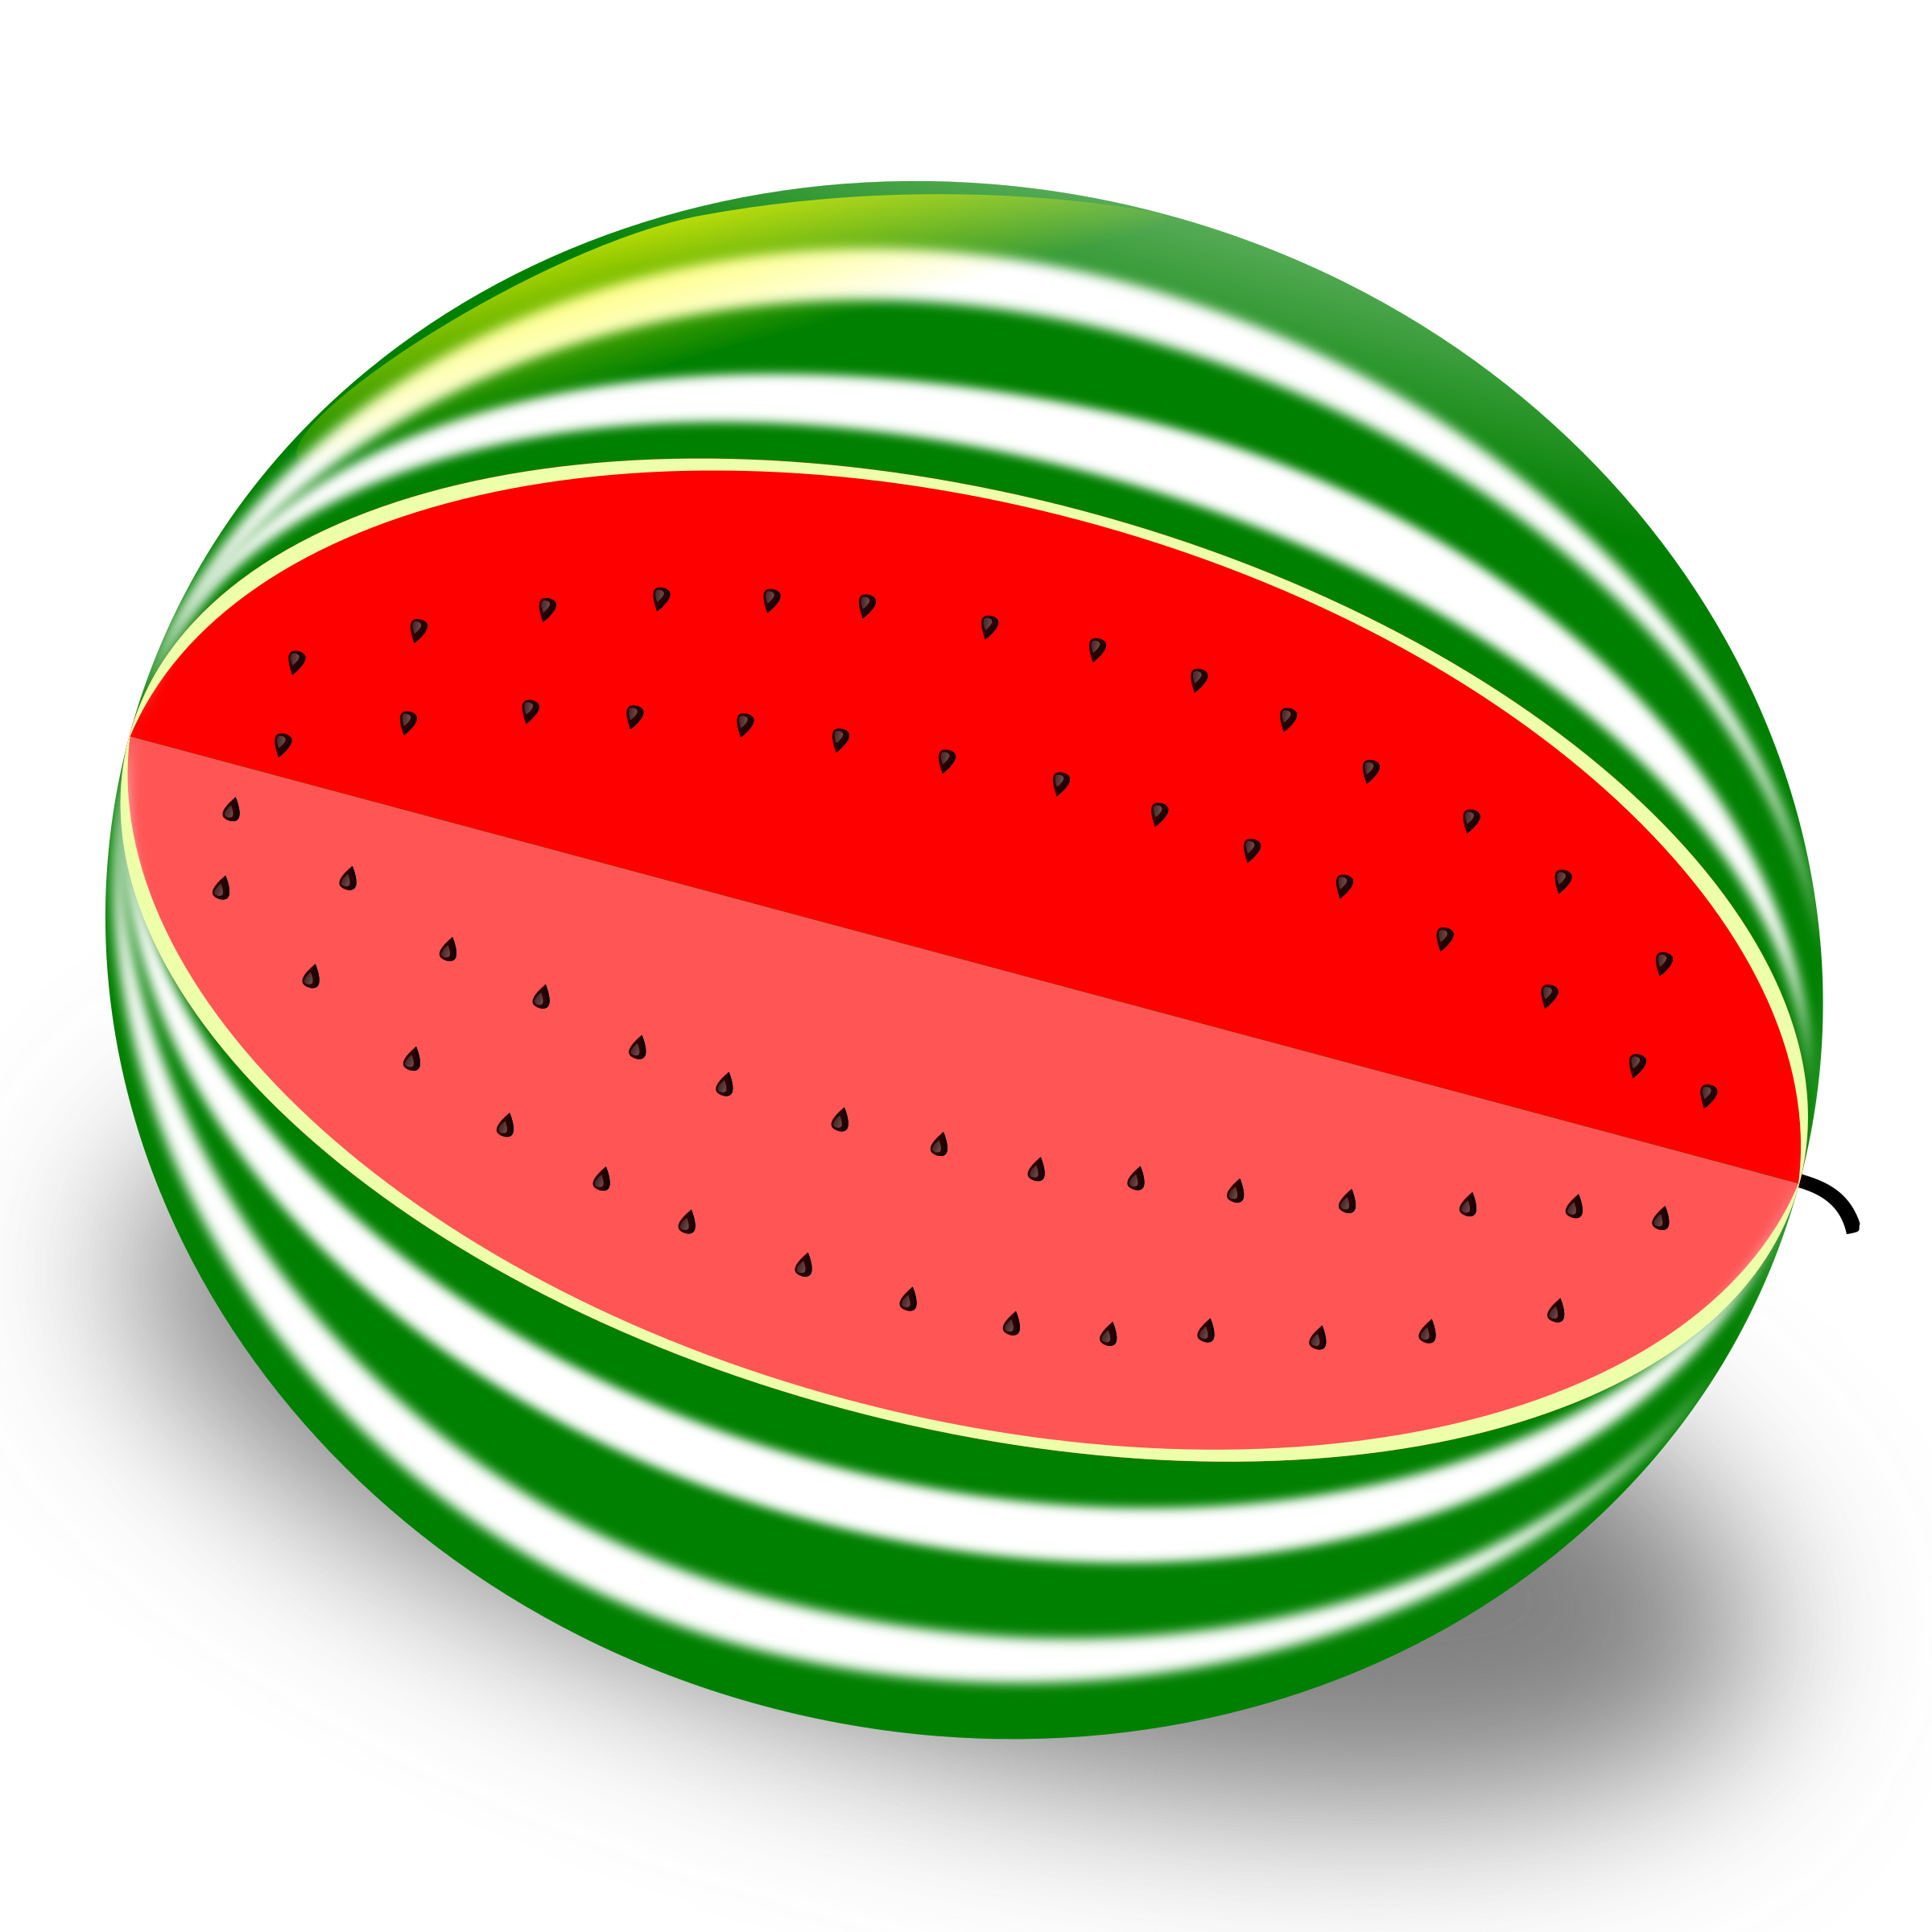
Inheritance
Inheritance is when we have base classes and derived classes. A base class is usually a broad category, whereas a derived class is usually a specific subtype within that category.
For example, we might have a base class called “Fruit” (a large category) and a derived class called “Watermelon” (a type of fruit). A Watermelon “is a” fruit.
FRUITS
WATERMELONS

Slide 5
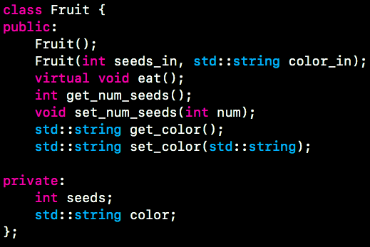
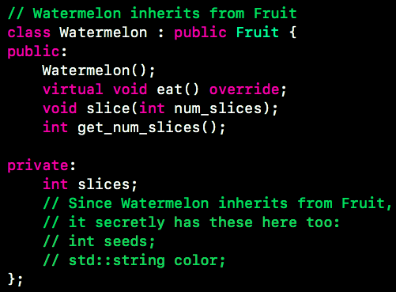
Inheritance - Fruits & Watermelons Example
In memory, these objects look like this:
WATERMELON
FRUIT
FRUIT
int slices
int seeds
string color
int seeds
string color

Slide 6
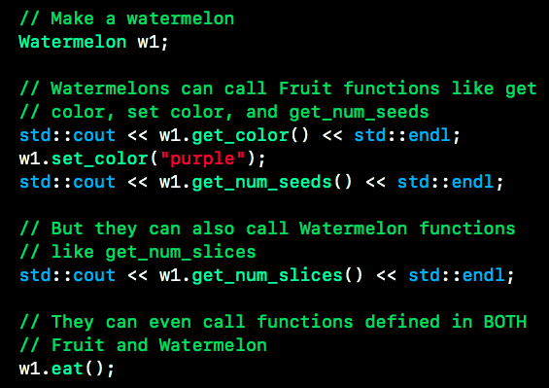
Inheritance
Inheritance is BOTTOM UP-- if both classes have defined the same function, look in the derived class first.

Slide 7
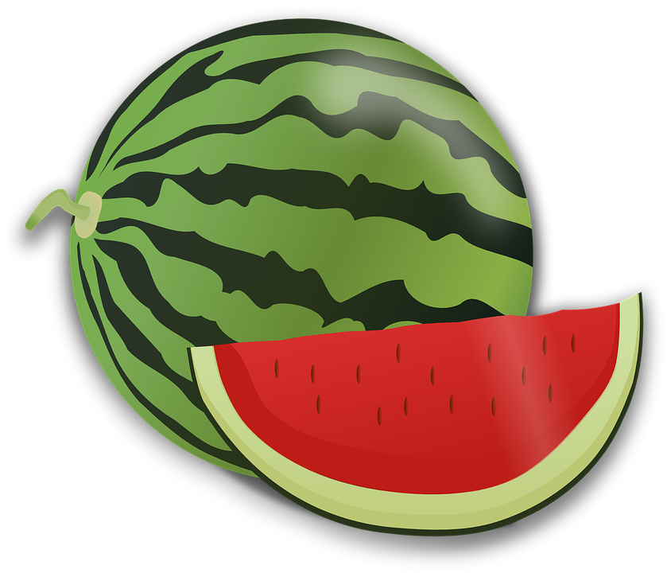
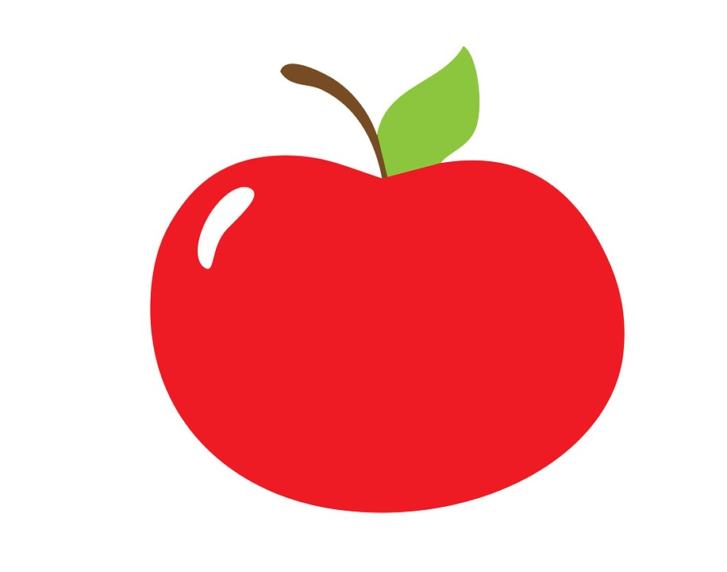
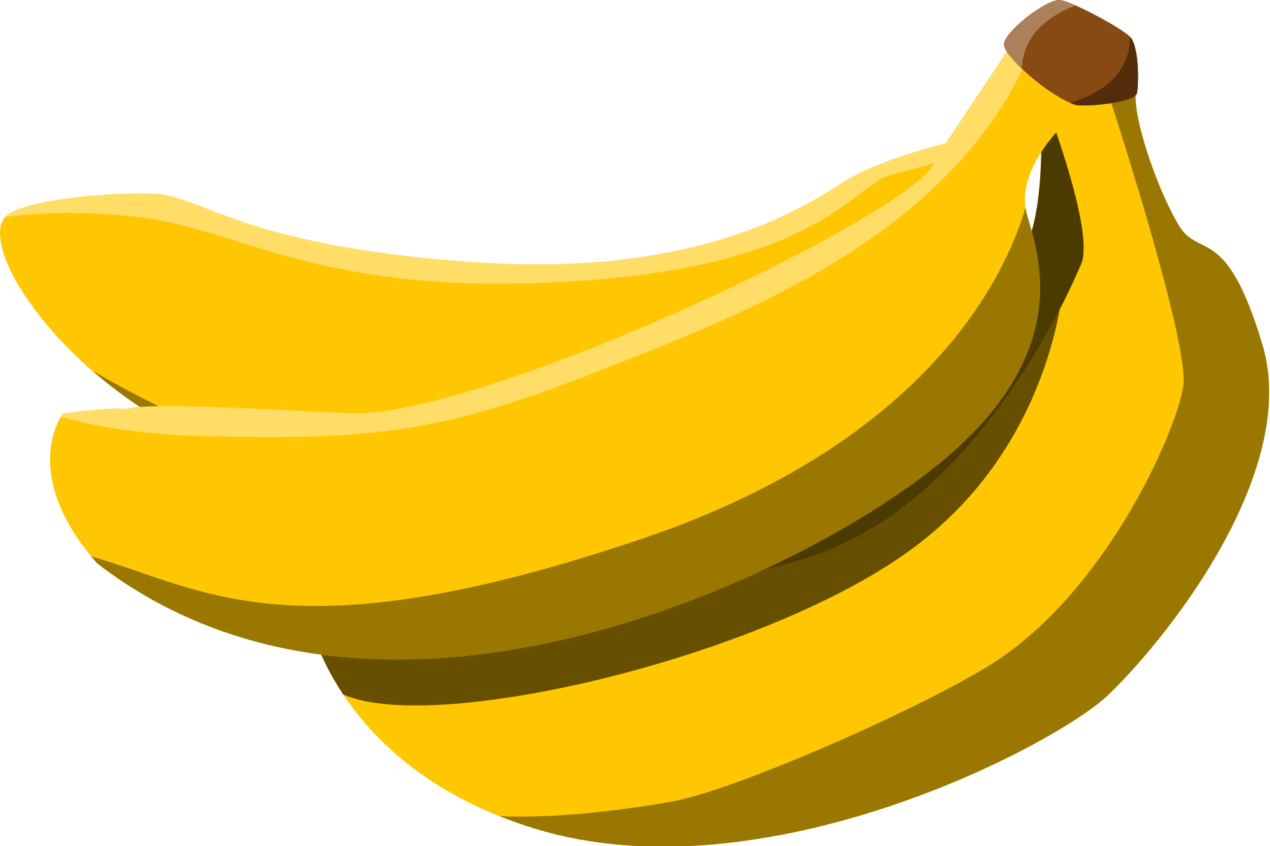
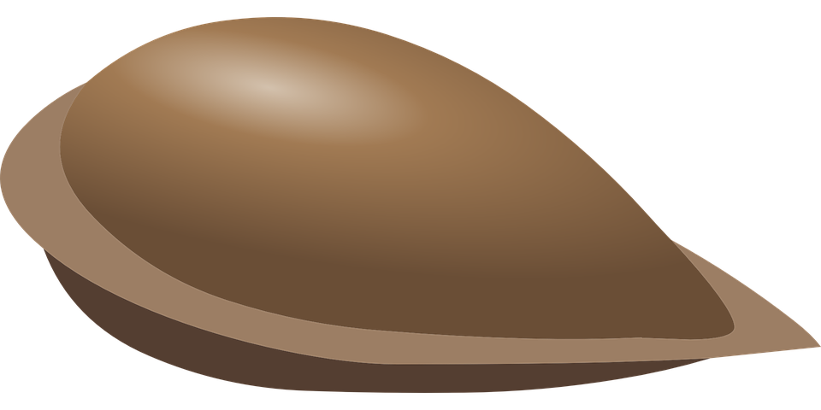
Fruit
Inheritance is for when something “is a” type of something else. Member variables are for when something “has a” part
“Is a”
“Is a”
“Is a”
“has a”
“has a”
“has a”

Slide 8
Polymorphism
Basically, when objects can behave in many different ways, depending on the conditions.
3 types:
Ad-Hoc Polymorphism / Function Overloading : many functions with the SAME NAME but different SIGNATURES
Subtype Polymorphism : a variable of a base type can hold an object of a derived type
Upcasts are safe, downcasts are not -- use the “is a” construct to check!
Static vs. Dynamic Type and Static vs. Dynamic Binding
Parametric Polymorphism : templating! Later <3

Slide 9
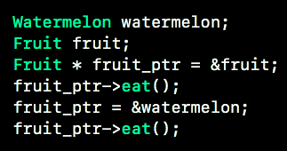
Polymorphism
Polymorphism comes into play when we have pointers to objects. When we access those objects and call their member functions through the pointers, we will see polymorphic behavior.
A Fruit pointer can point to a Watermelon, because all watermelons are fruits.
Fruit ptr will “act more like a fruit”
Fruit ptr will “act more like a watermelon”
fruit_ptr
fruit_ptr
WATERMELON
FRUIT
int seeds
string color
FRUIT
int slices
int seeds
string color
Polymorphism is more TOP DOWN-- look at static type (base class) first

Slide 10



Static Type vs. Dynamic Type
Static type is the type of an object at the beginning / throughout the program.
Dynamic type is the type of an object during run time.
Comes into play when we have virtual functions.
What are the static and dynamic types of fruit_ptr in these two code snippets?
... but its dynamic type is Kitten.
This won’t work. This is a downcast. They’re not safe and they won’t compile.
Why do you think this is?

Slide 11
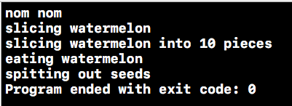
Polymorphism - which function do i choose?
Decide which function to call by doing the following:
Evaluate static and dynamic types
Look at static type’s functions. If the static type has a match, call it. Unless it says virtual - go to step 3
Look at the object’s dynamic type. If there is a function that matches the signature we’re looking for exactly, call that.
Result:
Code:

Slide 12
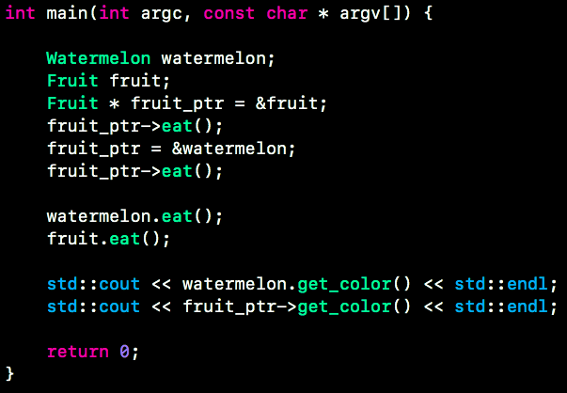
What happens?

Slide 13
When is polymorphism USEFUL?
class Fruit {
…
}
class Banana : public Fruit {
…
}
class Watermelon : public Fruit {
…
}
class Apple: public Fruit {
…
}
Banana banana1();
Banana banana2();
Watermelon watermelon1();
Apple apple1();
Fruit* groceries[4] = {&banana1, &banana2, &watermelon1, &apple1};
for(int i = 0; i < 4; ++i) {
groceries[i]->eat();
//we automatically call the right “eat” function!
}

Slide 14
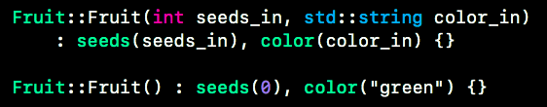


Overriding vs. Overloading
Function OVERLOADING is when we have several functions that may have the same name, but different SIGNATURES
When I call this code with different argument types, different constructors will run!
What happens when I run ...
What about when I run ...

Slide 15
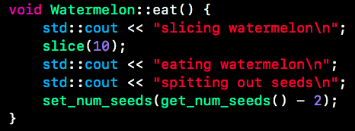

Overriding vs. Overloading
Function OVERRIDING is when a derived class has a function with the same signature as a virtual function in the base class.

Slide 16
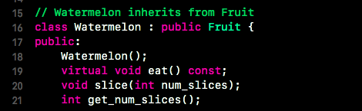
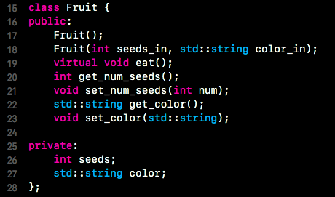
Overriding & the override keyword
The override keyword is used when we are writing a function for a derived class that we want to OVERRIDE a function in the base class.
We use the override keyword because we want the compiler to yell at us if the new function we write doesn’t actually override any base class functions.
Compiler is happy to let us write this new “eat()” function in Watermelon, but it doesn’t override the function in Fruit!

Slide 17
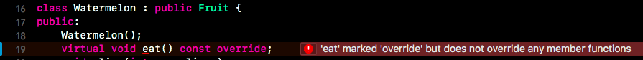
Overriding & the override keyword
The override keyword is used when we are writing a function for a derived class that we want to OVERRIDE a function in the base class.
We use the override keyword because we want the compiler to yell at us if the new function we write doesn’t actually override any base class functions.
Compiler/ IDE yells at us and says we’re not doing what we’ve intended!

Slide 18
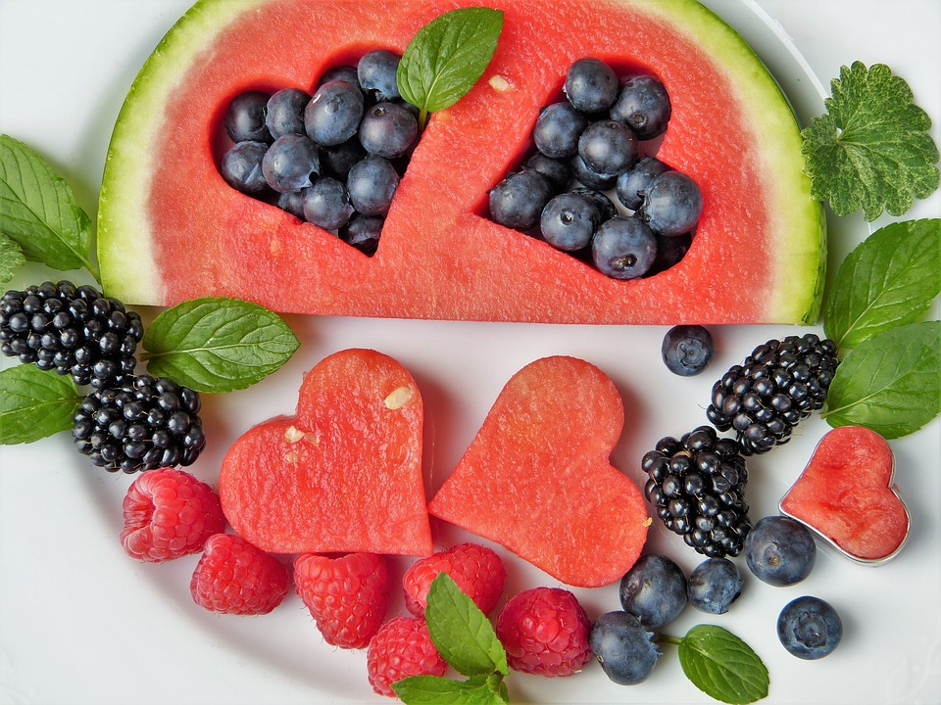
Worksheet
Exam style Q’s
Lab Assignment

