Slide 1
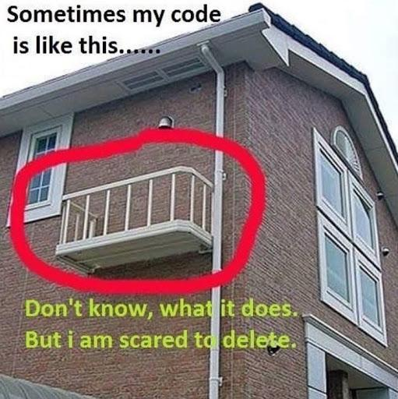
Lab 7 -
Dynamic Memory

Slide 2

ReadMe
Reminders
Lab 7 due Sunday, November 11th at 8pm
Project 4 due Monday, November 19th at 8pm
Agenda
Review - dynamic memory
Worksheet
Discuss Project 4
Lab 7
Slide Credit: Carolyn

Slide 3
What is Dynamic Memory
Dynamic Memory allows you to write programs that can handle memory usage efficiently, and lets us use our computers more effectively.
It lets us do lots of cool things:
Dynamically sized arrays!
Control objects’ lifetimes!
Decide what types of objects we want to use at runtime! (Recall: Euchre project)
We don’t need to know at compile time whether we want to use a Simple Player or a Human Player -- we can decide “on the fly”

Slide 4

Stack
Heap
Globals
Text (the program)
Local variables
are stored here
x
7
VOID
int main{ int x = 7;
}

Slide 5
Stack
The Big Void
Heap
Globals
Text (The program)
ptr1
ptr2
int *ptr1 = new int(7);
Triangle *ptr2 = new Triangle(3,4,5);
If we use the new keyword we store the object that we construct in the heap.
We get back the address of
The object on the heap
7

Slide 6
Stack
The Big Void
Heap
Globals
Text (The program)
ptr
int *ptr = new int(3);
delete ptr;
‘new’ allocates memory on the heap.
‘delete’ deallocates memory on the heap.
It frees the memory so we can now store
new objects at that address
3

Slide 7
Stack
The Big Void
Heap
Globals
Text (The program)
ptr
int *ptr = new int(3);
delete ptr;
int *ptr2 = new int(7);
‘new’ allocates memory on the heap.
‘delete’ deallocates memory on the heap.
It frees the memory so we can now store
new objects at that address
ptr2
7

Slide 8
Dynamically allocated arrays
arr_ptr
int size = 3;
int *arr_ptr = new int [size];
delete[] arr_ptr;
[2]
[1]
Remember to use this special syntax to delete the whole array!
[0]

Slide 9



Dynamic memory problems
Memory leak
Orphaned memory
Double free
Bad delete
Dangling pointer
Pointer

Slide 10
Memory leak
We lose the address of the integer 7. When we lose the address of an object on the heap, the memory is orphaned.
When we don’t free up memory we are no longer using, we have a memory leak.
Orphaned memory -> memory leak
int *ptr = new int(7);
int x = 3;
ptr = &x;
void foo() { int *ptr = new int(7);
return;
}

Slide 11
Double free
A double free occurs when we attempt to free up memory that’s already been freed
int *ptr = new int(3);
delete ptr;
delete ptr;
int *ptr1 = new int(3);
int *ptr2 = ptr1;
delete ptr1;
delete ptr2;

Slide 12
Bad delete
int x = 7;
int *ptr = &x;
delete ptr;
A bad delete is when we attempt to deallocate memory that’s not stored on the heap.

Slide 13
Dangling pointer
int *ptr = new int(3);
delete ptr;
int *ptr2 = new int(7);
cout << *ptr << endl;
A dangling pointer stores a freed memory address.
Solution: set equal to null pointer after deleting to make sure we don’t use it
ptr = nullptr;

Slide 14
The Destructor
Recall that the destructor runs when the class instance goes out of scope.
If a variable goes out of scope - that means it is no longer needed and the compiler will get rid of it.
However if the class managed dynamic memory, the compiler doesn’t deal with freeing it. Instead, the programer must write any necessary code in the destructor, and compiler will make sure to run that at the appropriate time.
Rule of thumb: Often, if new is used in the constructor, delete is used in destructor.

Slide 15
When Should I Use Dynamic Memory?
You will rarely use dynamic memory to allocate individual variables.
Dynamic memory is often used to allocate blocks of memory at a time. It’s most often used in dynamic data structures like vectors and linked lists.

Slide 16
The Amazing Expanding Vector
How are vectors implemented under the hood?
Vectors have a fixed size array as part of the class. This array exists on the heap, while a pointer to the first element, capacity and size are member variables of the class.
When the fixed size array becomes full, it “grows” by moving the data into a new space. This involves allocating enough space, copying over existing elements, and freeing up the new space.
Vectors typically double their array when they grow - this ends up in longer term efficiency.

Slide 17
Vectors: How they expand
call push_back(6) on the vector…
No more room! Expand!
1
2
3
4
5
add new elt to first empty space
6
Pointer to first elt of array
1
2
3
4
5
New array with twice the capacity as the old one.

Slide 18
Next:
Worksheet
Project 4 Questions?
Lab 7

