Slide 1
Express Yourself
Software Development project for CS476
Created by Melanie MacDonald and Iyanu Akinoyemi

Slide 2
Problem and motivations
There are many outlets for free expression available on the internet, but not all of them offer much freedom or accessibility for all audiences
Goal of this project is to create a free and easy to use blog hosting website that gives users of any age or technical background a web-page of their own
Highly customizable

Slide 3
Main functional requirements
View anyone’s blog hosted on the site or create your own
Modify blog content in terms of adding text posts, images, videos, threads for users to comment, and reaction bars. Additionally can alter blog background color and global font style
Comment or react on anyone’s blog
View statistics and compare the popularity between blogs

Slide 4
Software architecture
N-layer architecture (4-layers)
First layer is presentation, second and third apply to business logic, and fourth is the data layer
The second layer is responsible for generating the UI views and displaying information to the user, the third is responsible for communicating with the data layer, communication being 1←→ 2←→3←→4
Well suited to our program as is heavily reliant on retrieving information from the database and displaying it to the user, and having two layers in the business logic helps to simplify and organize this process

Slide 5
Design patterns
Factory Design Pattern – helpful for our program as it needs to create multiple elements for a webpage, and those elements are connected by their similarities, allowing their creation to be simplified
Observer Design Pattern – necessary as our program has multiple views that need information updated, and multiple data stores that need to be read from.

Slide 6
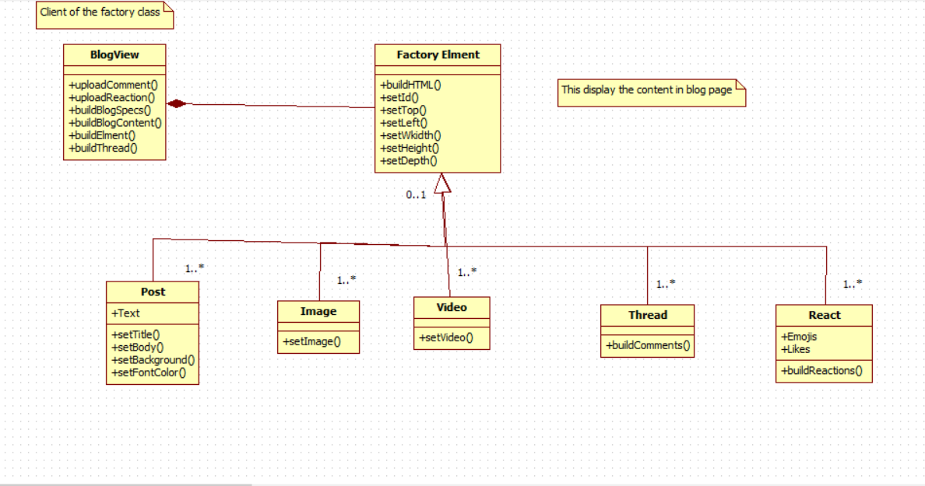

Slide 7
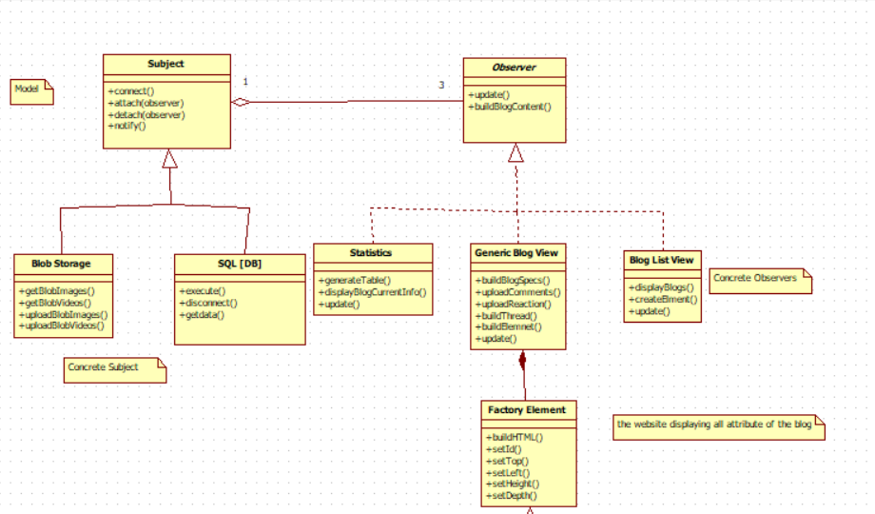

Slide 8
Software development tools
Microsoft Azure
GitHub
Brackets

Slide 9
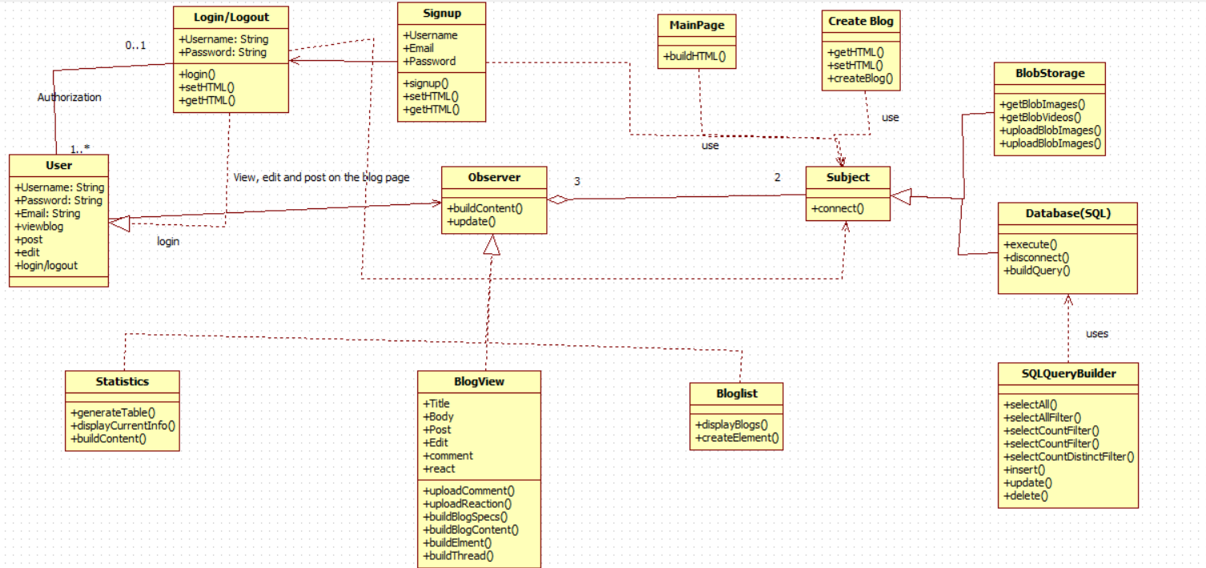

Slide 10
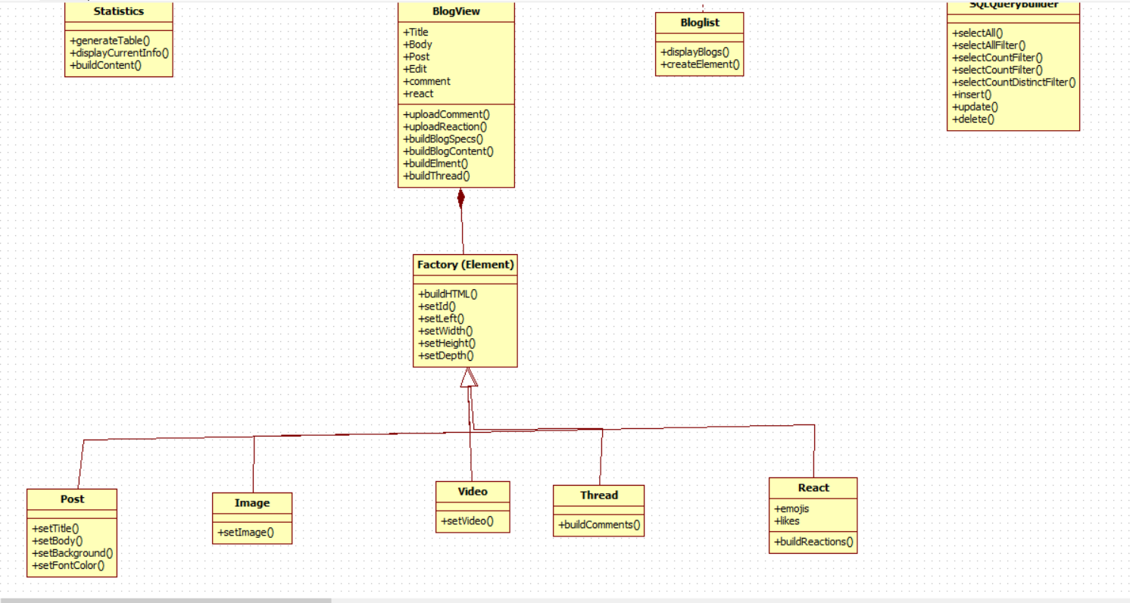

Slide 11
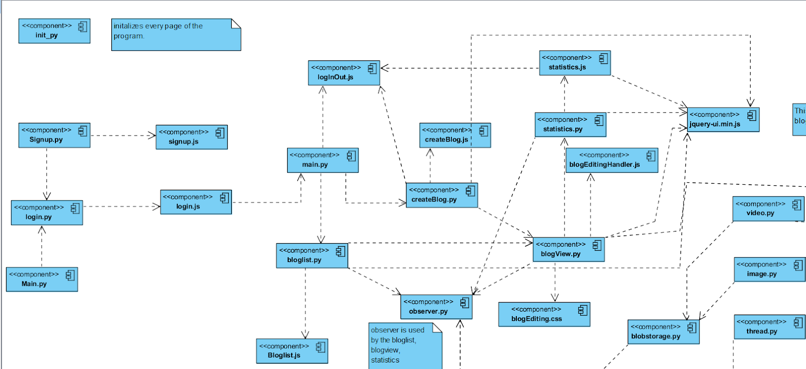

Slide 12
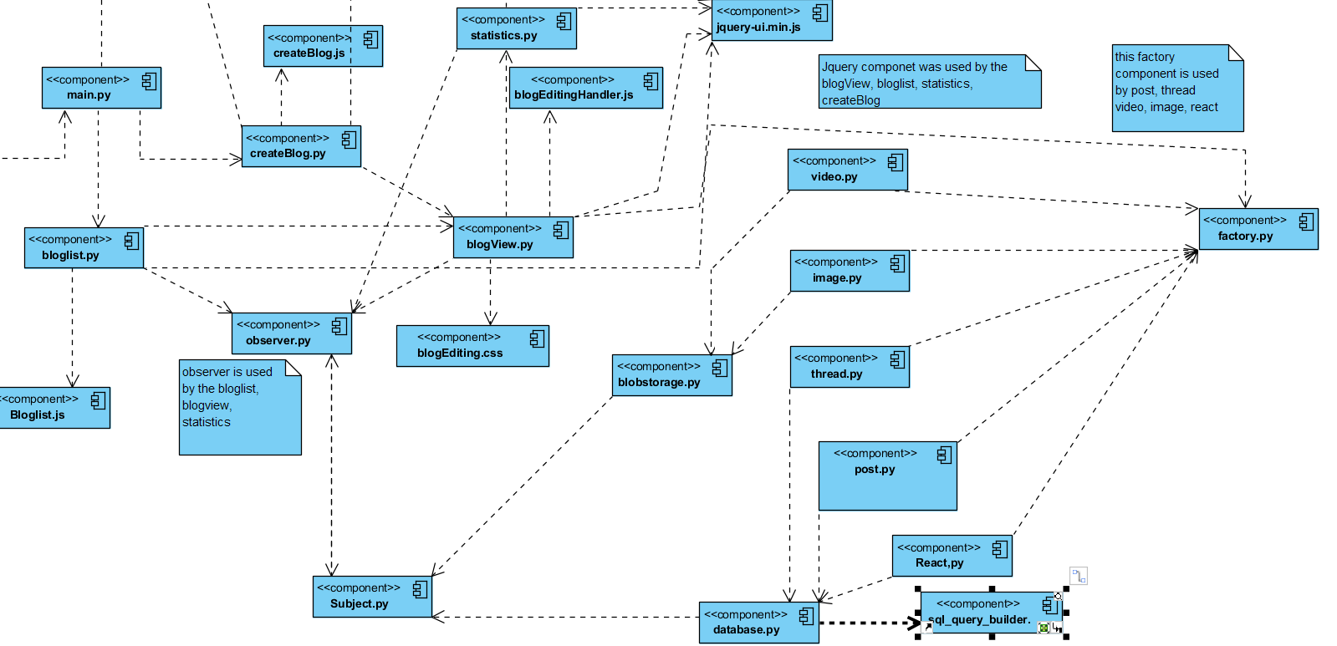

Slide 13
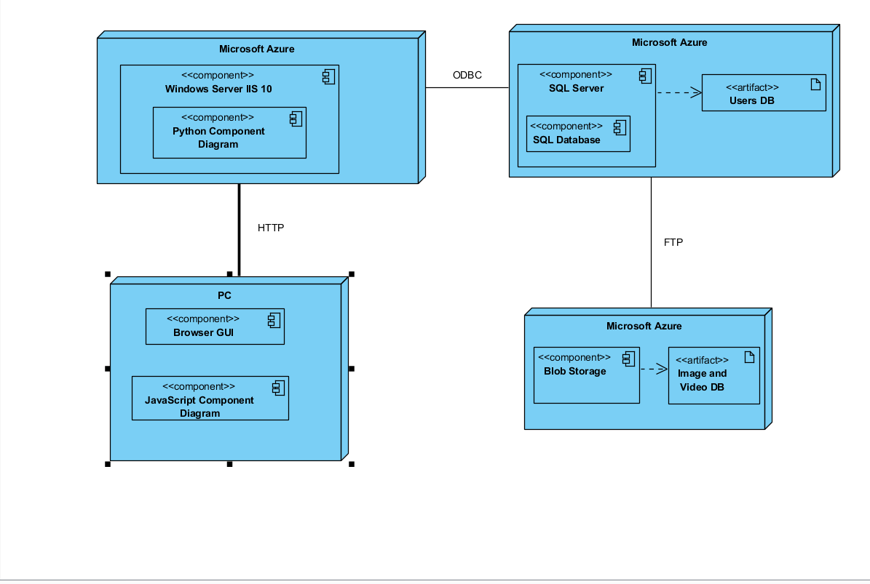

Slide 14
Uml tools
StarUML
AgroUML
Visual Paradigm

