Slide 1
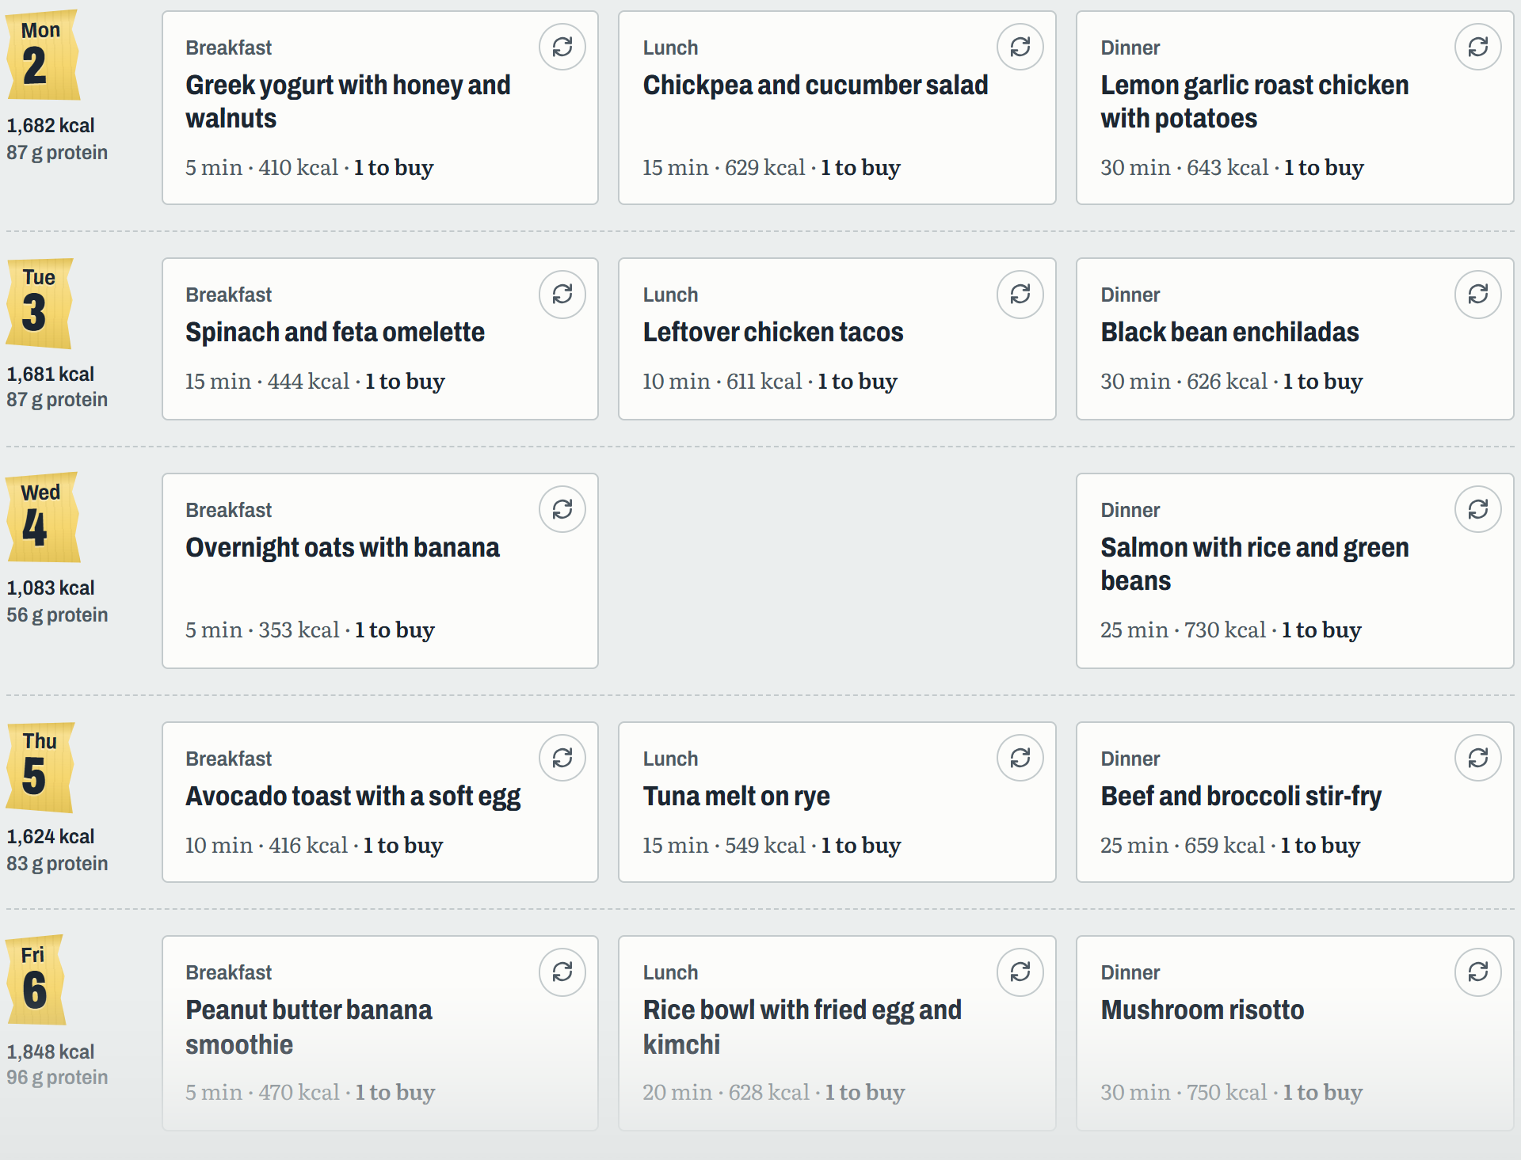
Mise
Plan the week.
Cook from your pantry.
Shop once.
A meal-planning assistant built with Claude
AI Builder Challenge · Live demo
Notes:
[~30 s] Hi! This is Mise, from "mise en place": everything prepared before you cook.
Mise is a web app that plans a household's meals for the week around what's already in the pantry, then writes one shopping list for everything that's missing.
It uses Claude to do the planning and the recipes. Let me show you why I built it, then go straight to a live demo.

Slide 2
Every week, the same three headaches
What do we eat?
Food goes to waste
Shopping is a mess
Planning a week of meals for the whole household, with everyone's restrictions, eats an entire evening.
What's already in the fridge and the pantry gets forgotten, while we keep buying more.
Ingredients scattered across recipes, amounts that don't add up, and things bought twice.
Mise is the prep cook that handles all three.
Notes:
[~45 s] Every household has the same three problems.
First, deciding what to cook for a whole week, with everyone's restrictions, takes a full evening.
Second, what's already in the fridge and the pantry gets forgotten, and we buy more of it.
Third, the shopping list is scattered across recipes, with wrong amounts and things bought twice.
Mise is a prep cook that takes care of all three.

Slide 3
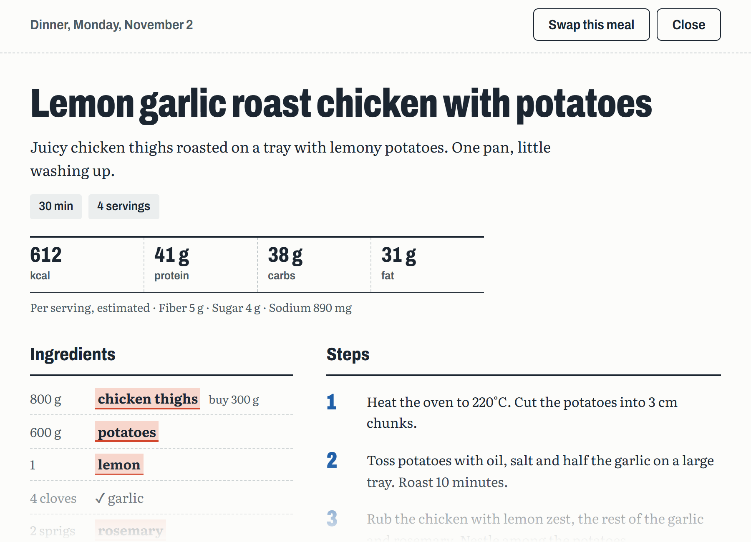
Mise plans around what you already have
A full week in about 40 seconds
Breakfast, lunch and dinner for everyone, within their restrictions, diet and time.
Pantry first
Meals use what you have. Each ingredient shows if you have it, or how much more to buy.
One shopping list
Grouped by aisle, amounts added up and sized to what the store sells.
Help while you cook
Full recipe, nutrition per serving, and a chat to ask or change anything.
Notes:
[~45 s] Mise plans around what you already have.
In about 40 seconds per week, it plans breakfast, lunch and dinner for everyone at the table, respecting restrictions, the diet and how much time you have to cook.
Meals use the pantry first, and every ingredient says whether you have it or exactly how much more to buy.
Everything missing goes into one shopping list, grouped by aisle, with amounts added up and rounded to store packages.
And when you cook, you get the full recipe, nutrition per serving, and a chat to ask questions or change the recipe.

Slide 4
Live demo
1
Add a few things to My pantry
rice, eggs, chicken
2
Create a one-week plan
From an empty pantry to a week of meals and a shopping list, in about two minutes.
for two people, about 40 seconds
3
Open a meal
recipe, nutrition, what to buy
4
Swap a meal, then Undo
nothing is lost
5
Send the week to the shopping list
localhost:8000
grouped by aisle, then back to the pantry
Notes:
[~2 min] LIVE DEMO. Have http://localhost:8000 open, signed in, with a few things in the pantry and a plan already made as a backup.
1. Pantry: type "rice 1 kg, eggs 12, chicken breast 500 g" in Add what you have and press Add. Point out the list on the right.
2. Meal plan: set 2 people, 1 week, press Create meal plan. Weeks appear as they're ready (about 40 s). While it plans, the status changes ("Choosing breakfasts..."). If it's slow, switch to the plan you made before.
3. Click a dinner: the full recipe, the nutrition panel (calories, protein, carbs, fat), ticks for what you have and highlighted items to buy.
4. Close it, press the round arrows on a meal card to swap it, then press Undo in the message at the bottom: the old meal comes back.
5. Press Add to shopping list on the week, open Shopping list: grouped by aisle, amounts added up. Tick two items and press Move checked to pantry.

Slide 5
How it works
Browser
Python server
Claude
HTML, CSS and JavaScript
FastAPI
Haiku 5.5, structured output
Works out what you have and what to buy, every time the pantry changes.
Keeps the API key off the page and checks every request.
Writes plans and recipes as typed JSON the app can trust.
~40 s
1 call
0
Supabase
Accounts and sync, each user sees only their data
to plan a full week
to Claude per week of meals
API keys in the browser
Notes:
[~45 s] How it works, in one picture.
The page is plain HTML, CSS and JavaScript. It does the quick maths itself: which ingredients you have, and how much to buy, recalculated every time the pantry changes.
A small Python server with FastAPI sits in the middle. It holds the Claude API key, so the key never reaches the browser, and it checks every request.
Claude, the Haiku model, writes the plans and recipes as structured output: typed JSON that matches Pydantic models, so the app never has to parse free text.
To keep it fast and cheap, a plan is one call per week with low effort. Accounts and sync across devices use Supabase, with row-level security so each user only sees their own data.

Slide 6
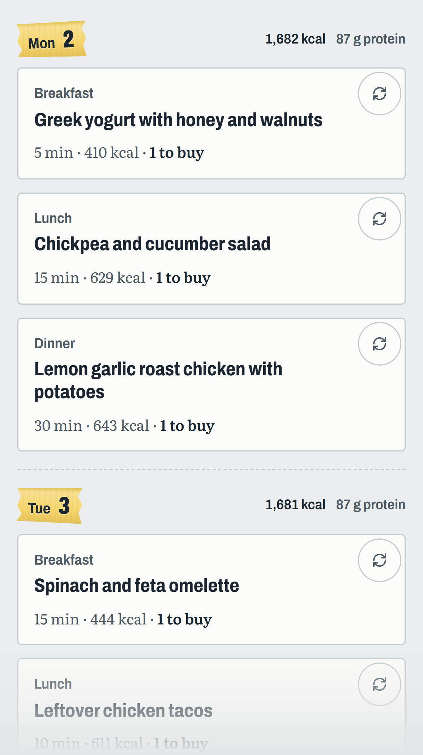
Small details that make it usable
Real amounts
Nutrition
Have 100 g and need 300 g? It says buy 200 g.
Calories and macros per serving, and a total for each day.
Remembers your tastes
Undo
Dishes you didn't like, and similar ones, don't come back.
Swap a meal or mark it cooked, then take it back.
Accounts
Made for the kitchen
Pantry, plans and favorites follow you to any device.
Works on a phone, with a recipe chat while you cook.
Notes:
[~30 s] A few details that make it something you'd actually use.
Real amounts: if you have 100 grams of something and the recipe needs 300, it tells you to buy 200.
Nutrition per serving and per day. It remembers dishes you didn't like, so they don't come back.
You can undo a swap or a cooked meal. With an account, everything syncs across devices.
And it works on a phone: big touch targets, and the pantry folds away.

Slide 7
Mise
What's next
Publish it online
So anyone can plan from any device.
Thank you
Export the plan
To a calendar or a printable PDF.
Questions are welcome.
Cooking mode
One step at a time, big text, screen stays on.
github.com/MelSaFer/AIBuilderChallenge
Notes:
[~30 s] To wrap up: Mise turns "what do we eat this week?" into a plan, recipes and one shopping list, built around what's already at home.
Next steps: publish it online so anyone can use it, export the plan to a calendar or PDF, and a cooking mode that shows one step at a time and keeps the screen on.
Thank you! Happy to take questions.

