Slide 1
Global Layoffs Analysis
Data Analysis Project (SQL + Python + Power BI)

Slide 2
Problem Statement
Understanding layoffs across industries and regions is critical.
Organizations need insights to reduce risk, manage workforce, and improve decisions.

Slide 3
Business Understanding
Analyze layoffs by industry, country, company stage, and time.
Identify patterns, trends, and drivers behind layoffs.

Slide 4
Key KPIs
- Total Laid Off Employees
- Total Companies
- Total Countries
- Layoffs by Industry
- Layoffs Trend Over Time
- Top Companies by Layoffs

Slide 5
Insights
- Consumer industry has highest layoffs
- USA is most affected country
- Layoffs peaked in 2022
- Few companies dominate layoffs

Slide 6
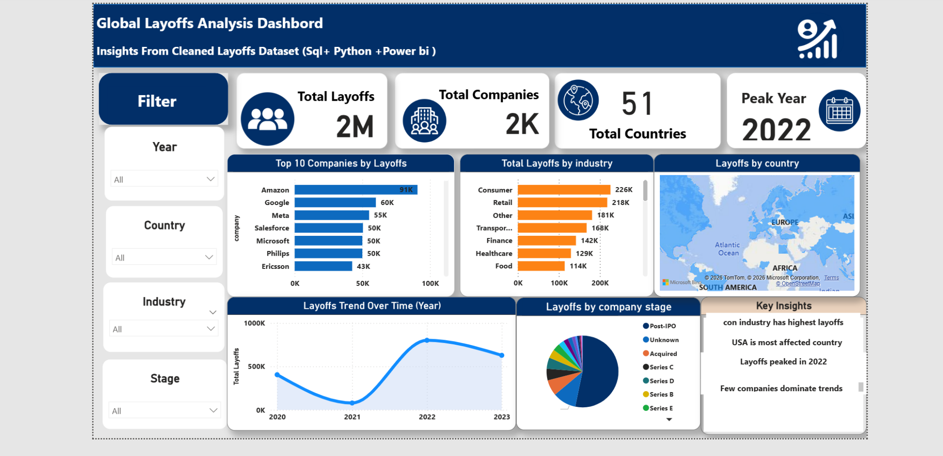
Dashboard Overview

Slide 7
Recommendations
1. Control costs and avoid over-expansion
2. Focus on sustainable growth
3. Monitor funding and spending
4. Improve workforce planning
5. Diversify markets to reduce risk

