Slide 1
Objective
objective

Slide 2
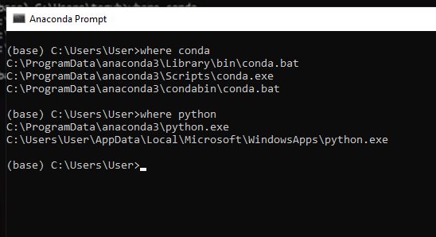
SETTING VSCODE
Sinkronisasi VSCode dengan anaconda

Slide 3
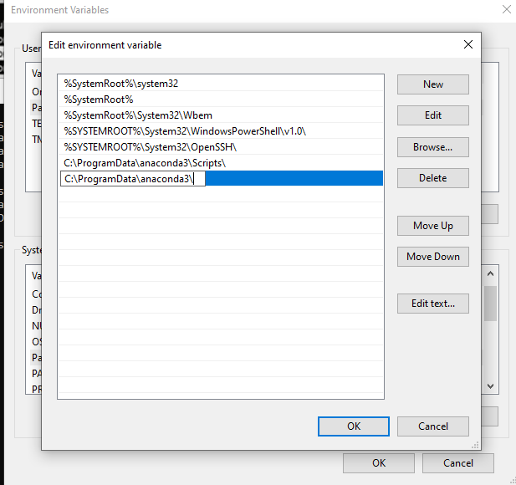

Slide 4
Macos :
setting vscode anaconda

Slide 5
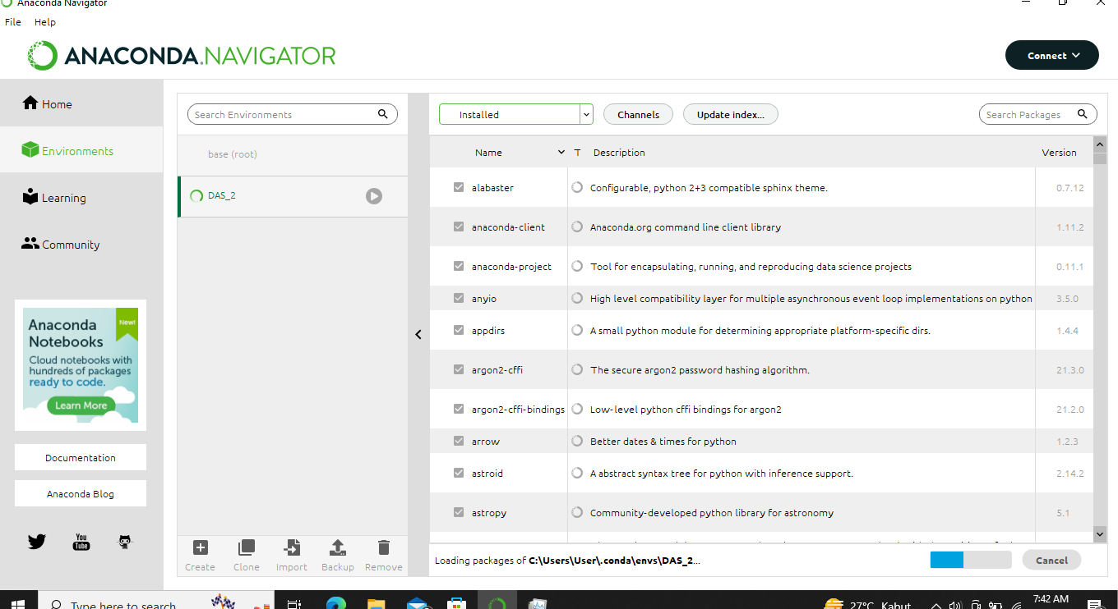
MEMBUAT VIRTUAL ENVIRONMENT

Slide 6
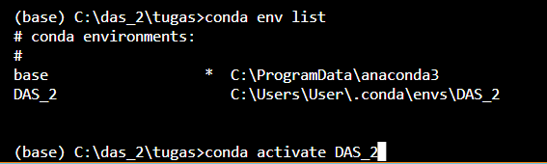
MENGAKTIFKAN VIRTUAL ENVIRONMENT DI TERMINAL VSCODE

Slide 7
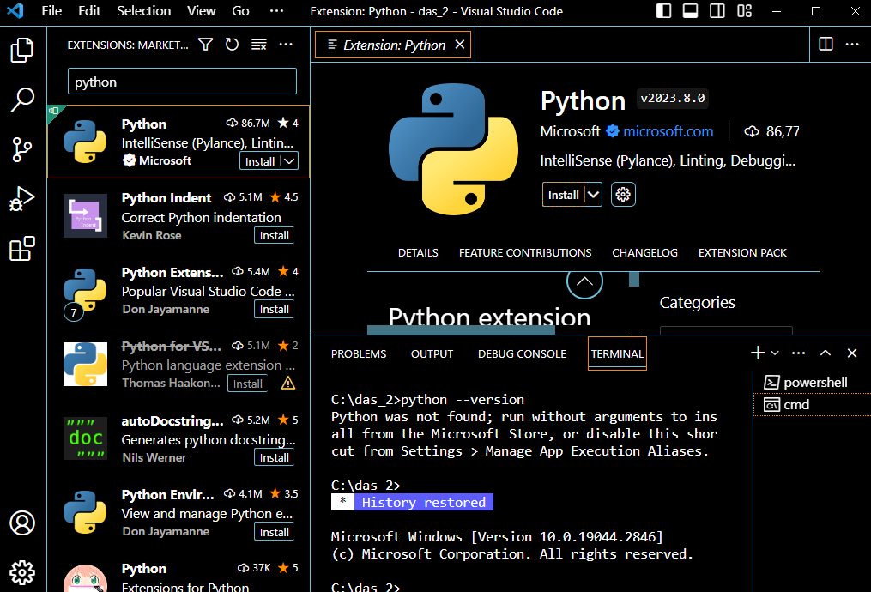
Install paket extension python

Slide 8
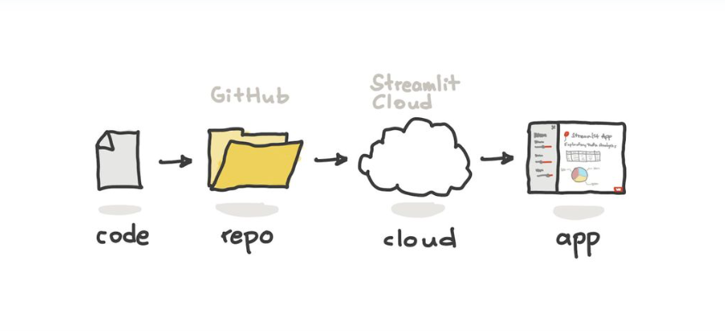
DEPLOY

Slide 9
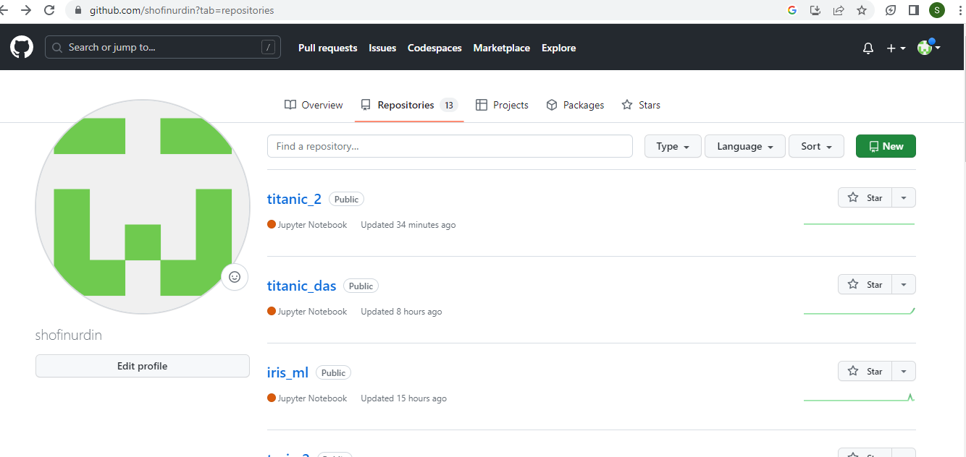
Register github dan buat repository

Slide 10
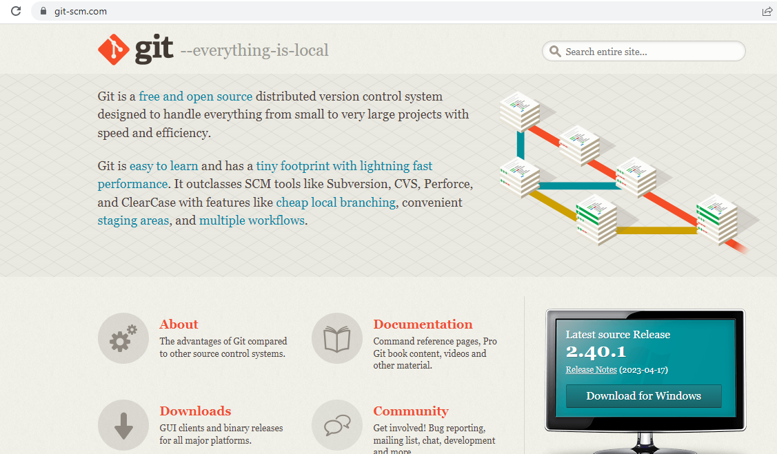
Install git

Slide 11
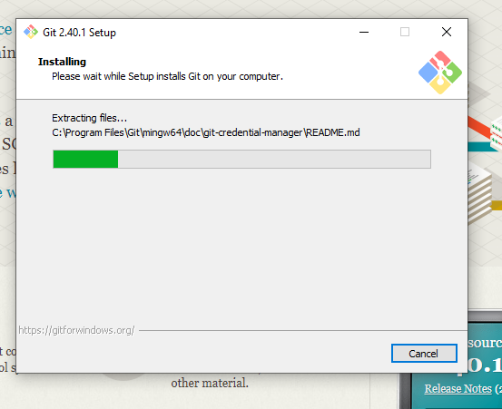

Slide 12



Uplod project

Slide 13
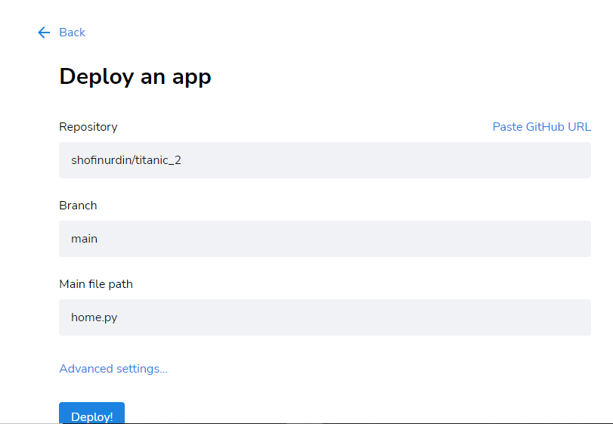
deploy streamlit cloud

Slide 14
Penugasan
LINK PENUGASAN

