Slide 1
Synchronization and data merging between iOS, server and database
A solution for setup of synchronized offline capable crud functionality
Mikael Melander Degree project 2018

Slide 2
Background
Smartphones
Mobile applications
Enterprise
Outside the office
Notes:
* Ever since the smartphone launched the adoption rate has continued to grow exponentially, last year, research in Sweden showed that 76% of the population over the age of 12 used their smartphone everyday.
* Together with the increased smartphones adoption rate the accessibility to internet and mobile specific applications has seen an incredible increase, you have access to data and applications only before seen, in front of a computer.
And the later years have show the smartphone ability to become even more productive within the enterprise market.
people can now work outside the office in a whole new way, you no longer need to be stuck in an office to be able to get computer work done.
This has changed the workflow for companies, that previously was using pen and paper whenever working on the go.

Slide 3
Introduction
Enterprise applications
Offline capabilities
In control of data
Self-hosted
Data privacy, GDPR
Connect client, server and database
Reusable
Notes:
So what demands does an enterprise application have to met?
Well we want, offline capabilities to not loose any productivity or data when working in places without cellular reception, a technician working in a subway for example. In the enterprise world, productivity is key.
Control of data, companies rarely line up to hand their private, user or company data to any third-party, this, together with all the new stricter data privacy laws and regulations, like General data protection regulation that was implemented just a few days ago.
So to be able to meet these demands, what do we have to create?
A self-hosted solution to be in control of the data
To be able to implement offline capabilities we need to connect a the client application together with the server and the online database
And to make it feasible in the market and for companies we need to make it reusable, to be able to keep implementing features and make it cost efficient

Slide 4
Problem formulation
What is the challenges?
Self-Hosted
Client, server and database environments
Frameworks, code languages
Offline data capabilities
Local, online database
Continued development
Open-sourced
Free dependencies
Data corruption
Merge rules
Notes:
So what is the challenges we are facing:
To be able to have the solution be self-hosted
We need to create and setup a client, a server and a database environment
This in turn means we need to decide the best frameworks and code languages for this approach
And to make it feasible in the long run, and against the third-party solutions out there, it needs to be continually developed
To be able to achieve this we want it to be open-sourced
And that means all the dependencies we use, have to be free
And to be able to make it offline capable
we need both an online database as well as a local on device database
But creating an offline capable device might lead to other problems, like data corruption
This is where we need to research and develop a good implementation of merge rules to handle different data versions between clients and the online database

Slide 5
Method
Research
Data merge rules
Implementation
Data structures
Data corruption
Verification and Validation
Requirements
Notes:
So the method we use:
Research the problematics behind data merging
How to implement it and
What data structures is required
And how to mitigate data corruption
We use the verification and validation method, and because this is not a solution developed for a particular customer, meaning we don’t get handed a list of requirements
We need to supply this our self, so by using our problem formulations we create requirements, these requirements have to be easy to answer so no confusion can be made, between different people

Slide 6
Method
Requirements
Requirements | Description
1 | Dependencies are free
2 | Saves data offline
3 | Query data offline
4 | Edit data offline
5 | Removes data offline
6 | Save data online
7 | Query data online
8 | Edit data online
9 | Remove data online
10 | A working implementation of merge rules
11 | Synchronize data between local and online database
Notes:
So by taking our problem formulation these are
* the requirements to make this solution work.
It has to be free
Have full CRUD functionality for both offline and online data
A working implementation for merge rules
And handle synchronization between local and online data, to not cause corruption.
All of these will be tested manually.

Slide 7
Implementation
Parts:
Databases
Server
iOS
Merge rules
Automatic synchronization
Notes:
So to the implementation stage.
All parts need to be working seamlessly together
We have the databases, two, both local and online
The server, that are to implement merge rules and handle crud requests
The developed framework, that is running on our client.
The implementation of the merge rules.
And the Automatic synchronization to mitigate data corruption

Slide 8
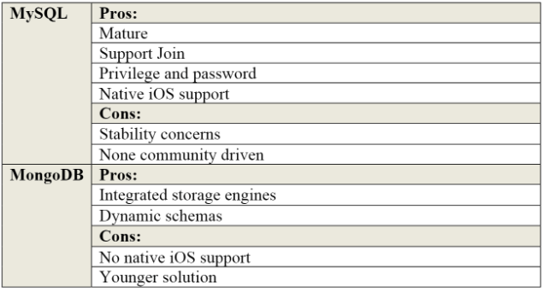
Implementation: Database
Requirements:
Free
Work on both iOS and server
MySQL
Native iOS support
Notes:
So we start with the database, this because this choice will affect what server framework we are able use.
The requirements for the database is
It has to be free, as to the requirements
And it has to both work on the server and the client
Different database frameworks where considered, but the final choice was between MySQL and MongoDB
The choice landed on MySQL, it is well developed and has a long history, its widely used and * iOS nativity supports it

Slide 9
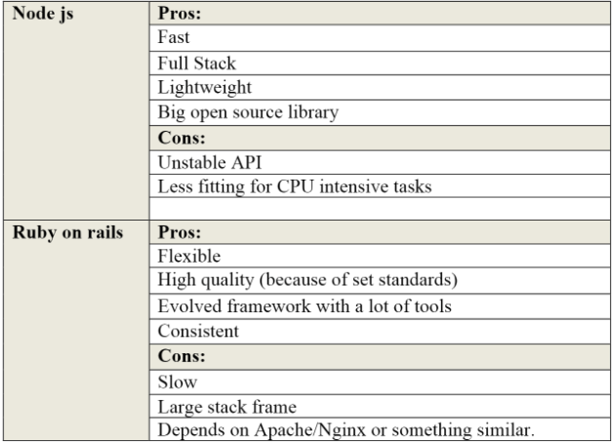
Implementation: Server
Requirements:
Free
Support MySQL
Node.Js
Good open-sourced Community
Fast and lightweight
Full stack
Notes:
So to decide the server framework
We again looked to the requirements and
As the database, it had to be free
And because of our choice to use MySQL, it had to support that as well
The final decision was between Node js that is a full stack JavaScript framework, and Ruby on rails, that is a high quality, evolved framework, but to be able to work as a RESTApi, it depends on something like apache or Nginx
So the choice landed on Node js
It has a good open-sourced community, that is important for this project
It’s fast and lightweight
And is full stack, so no apache or Nginx is need.

Slide 10
Implementation: Server
Provides
RESTApi
Online database
Crud, create, read, upload, delete
Merge rules
Notes:
So what does the server provide us with?
It is the RESTApi that handles all the requests to the online database
It of course gives us the online database
And with that all the crud functionality of it.
But it also has the implementation for the merge rules, that will be explained a bit more later.

Slide 11
Implementation: iOS
Provides
Implements data structure
createdAt, updatedAt
Local database
Crud, create, read, upload, delete
Automatically sync changes
Notes:
So on to the implementation of the client framework, in this case iOS
What does it provide?
Well for merge rules to work, we needed some data structures
The client framework, implements this data structure on all the saved objects
A createdAt column, that is the time of creation of the object, a timestamp, And an updatedAt column, also a timestamp that updates every time the object does.
It also provides the Local MySQL database
So it implements full crud capabilities within iOS as well
And the automatically synchronization that’s needed to avoid data corruption

Slide 12
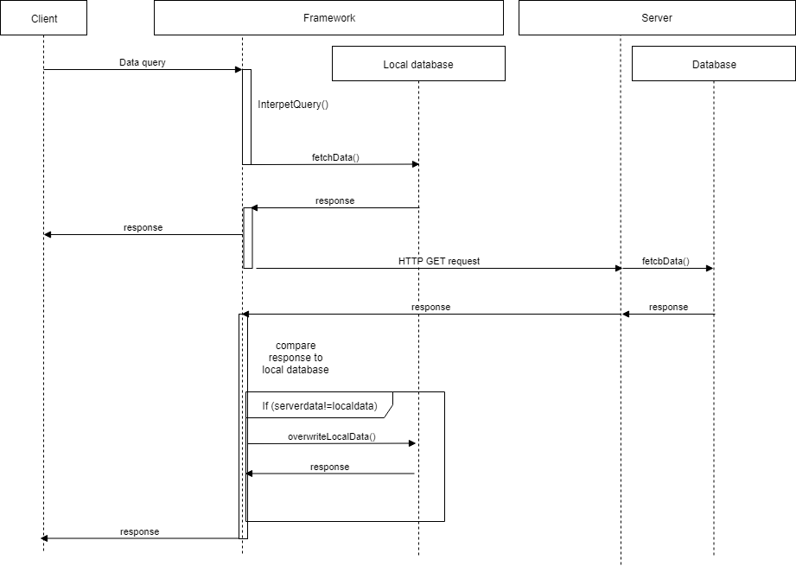
Implementation overview
Query data:
Notes:
Here is a full sequence diagram of a query action, I hope you can see these?
The user, uses the frameworks query function, the framework receives it and interpets it
The framework then fetches the data and returns it to the user, this means the framework can update the application view, reducing loadtimes to the user,
It then sends a HTTP GET request to the server, that fetches the online data, and returns it to the framework
The framework compares the local data to the received online one, and overwrites the local database if needed
Then returning the online data back to the user.

Slide 13
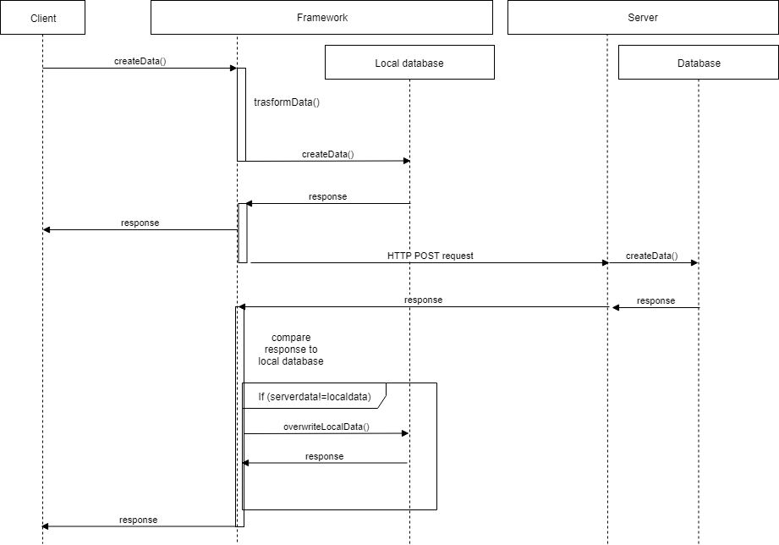
Implementation overview
Save data:
Notes:
Save data
The user sends a save that request to the framework
The framework transforms this object, adding the createdAt, updateAt columns
It then saves the data to the local database
Returns a response, to the user,
The framework then sends a HTTP POST request to the server, the server saves the data and sends a response back to the framework
In a create action there is no need for any merge rules.
Then when the framework then receives the data, it compares it to the local database, if the data is not the same, it overwrites the local data and sends a response back to the client.

Slide 14
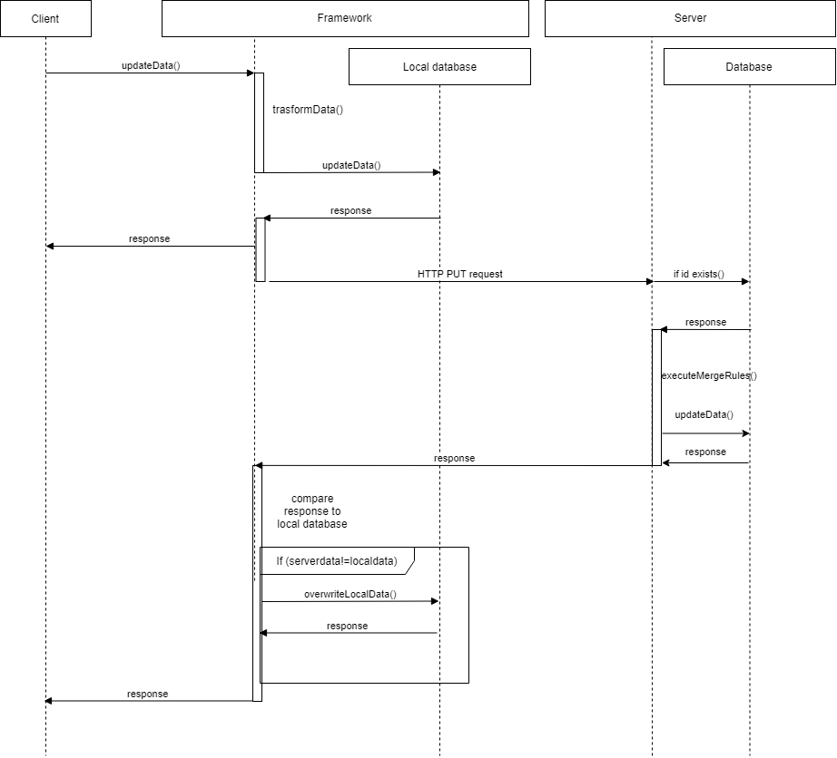
Implementation overview
Update data:
Notes:
So the update sequence
Where it differs is the server, so I am skipping ahead to that here.
The server receives a HTTP PUT request
It then checks if the ID of the object exists in the online database
If it does it responds to the server with the object, the server runs the merge rules
Saves the data online if needed, the returns the object to the framework.
The framework updates the object, if needed, as before and returns it to the user.

Slide 15
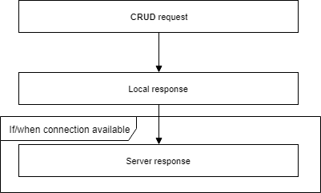
Implementation overview
Notes:
This means that the framework will always respond 2 times, one with the local data and one with the online data, this when the synchronization is complete, meaning when a connection is available

Slide 16
Implementation: Merge rules
Requirements:
Data structure
A server
Provides
Use of merge rules
Implementation for new rules
Notes:
On to the Merge rules
What was required to implement the merge rules where
A valid data structure: which the client framework implemented
A server to be able to run the comparison of objects before they are saved.
It provides us with
Some basic merge rules to verify and validate that the implementation works
Easy expandability for more rules to be implemented

Slide 17
Implementation: Merge rules
Rule | Description
Newest wins | The most recent data timestamp always wins
Server wins | Synching offline data (data older than current time) to the server will be disregarded
Client wins | Overwrites any data in the online database
Notes:
The merge rules that were implemented, are as follows
Newest wins: meaning the most recently updated object wins
Server wins: Old local chages will be disregareded, for example Person A is updating a change to a object, offline, Person B uploads a change to the server, Then Person A comes online and trying to Synchronize the earlier changes to the server, but these are disregarded
Client wins: This rule always lets the client overwrite any data in the online database

Slide 18
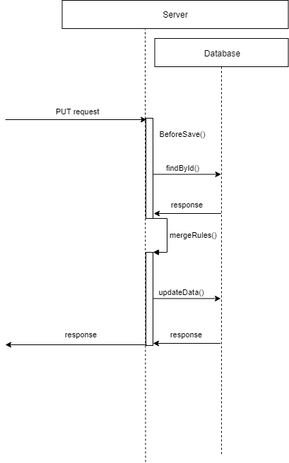
Implementation: Merge rules
Receives PUT request
Before save
Checks database
Compare data
Rule decides
Updates database
Responds
Notes:
Here is the implementation of the merge rules.
The server receives a PUT request, an update to aa object
The server invokes a Before Save function
It looks the current object up in the online database
It runs it through the function MergeRules,
that compares the data given the merge rule that are applicable to the situation
It updates the online database, if needed
It responds to the client with the “winning” object

Slide 19
Implementation: Automatic synchronization
Data corruption?
Use case
Application is terminated by user before the data is sent to the server
Application losing internet connection in the middle of synchronization
Local changes have not been synchronized to the server when the application was terminated. On start-up the application fetches new data from server database
Notes:
To the part of the automatic synchronization
How to prevent data corruption?
There is some example use cases to describe how this can happen,
The application is terminated by the user before the data is sent to the server
Application losing internet connection in the middle of synchronization
Local changes have not been synchronized to the server when the application was terminated, On start-up the application fetches new data from server database

Slide 20
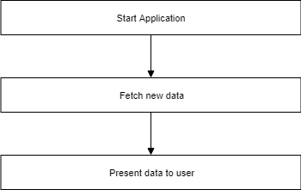
Implementation: Automatic synchronization
Start application
Fetches new data
Overwrites local changes
Notes:
So to explain it a bit simpler.
The user starts the application as normal
The applications starts to fetch the new data from the server
which then overwrites any local changed data that has not yet been synchronized.

Slide 21
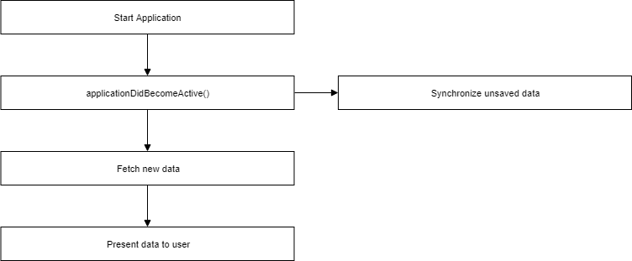
Implementation: Automatic synchronization
Start application
applicationDidBecomeActive()
Synchronize local data
Notes:
This of course is something we do not want to do
To solve this, there is a set of functions provided by iOS
Application did become active, that is called whenever the application is started, or returns from being in the background
So this is used to synchronize all data that has not yet been synchronized to the server
Then the application can fetch the new data without risking overwriting any data.

Slide 22
Results
Server
Online database
RESTApi
Merge rules
iOS
Local database
Implements data structure
CRUD functions
Automatic synchronization
Notes:
So the end results becomes
A server running node js
With an online database running MySQL
This, as a RESTApi to handle crud functionality
That also handles all the merging rules
And also an iOS Framework
That handles the local MySQL database
That automatically implements the timestamp functionality we need
That has a set of functions that handle all CRUD functionality to the local database AND the online requests
That takes care of the automatic synchronizations so there is no data corruption

Slide 23
Results
Requirements | Description | Fulfilled
1 | Dependencies are free | Yes
2 | Saves data offline | Yes
3 | Query data offline | Yes
4 | Edit data offline | Yes
5 | Removes data offline | Yes
6 | Save data online | Yes
7 | Query data online | Yes
8 | Edit data online | Yes
9 | Remove data online | Yes
10 | A working implementation of merge rules | Yes
11 | Synchronize data between local and online database | Yes
Notes:
So just to check the requirements once again.
Everything that was on the list is fulfilled, and has been manually tested

Slide 24
Analysis
Supports requirements
Timestamps
Can become problematic
Merge rules
Basic
Easy to implement
Testing
Use cases
Notes:
To analyze the results.
We have a complete solution that supports the requirements
That is ready to be used as an offline synchronized solution, that has full crud functionality locally and online
It is self-hosted
The dependencies are free
What can become problematic is the timestamp functionality that is needed for the merge rules
The timestamps is set by the device running the application, this in turn means that if a user would to manually change the time of the device, to 1998 for example, then created data on that device would always have incorrect timestamps.
Merge rules
The implemented merge rules are pretty basic, it is more or less to show a proof of concept, that the implementation works and data isn’t corrupted
The implementation of the merge rules however, allows for easy expandability of more and more rules, that as well would not be in danger of any data corruption
So the tests is conducted manually, and is on specific use cases, its tested with different data several times and works as intended
But there is a risk that certain use cases havn’t been thought of, that can cause problems when and if they accour

Slide 25
Conclusion
Working solution
Offline capable
Merge rules
Data corruption
Limited functionality
Node js, npm
Open-sourced
Proof of concept
Self-hosted
Enterprise
Data privacy
Notes:
The conclusion about the project
It is a fully working crud solution
that can handle offline data
Fully functional merge rules
And prevents data corruption
Its functionality for real use is quite limited, most full solutions demands more functionality
Although Node js, has npm, that has open libraries that can be implemented to increase functionality
And it being able to be open-sourced means it has a good chance to be further developed
But it definitely can be seen as a proof of concept
that it is possible to use an in-house solution
And still be sure you can be productive within the enterprise world
And at the same time protect your data

Slide 27
Results: Save data
User input | Framework Conversion | Local response | Server Response
(Växjö-Kalmar,0,0) | (1,Växjö-Kalmar,0,0, 2018-04-29 11:21:01, 2018-04-29 11:.21:01) | (1,Växjö-Kalmar,0,0, 2018-04-29 11:21:01, 2018-04-29 11:.21:01) | (1,Växjö-Kalmar,0,0, 2018-04-29 11:21:01, 2018-04-29 11:.21:02)

Slide 28
Results: Query data
User input | Local response | Server Response
Select * from exampleTable | (1,Växjö-Kalmar,0,0, 2018-04-29 11:21:01, 2018-04-29 11:.21:02) | (1,Växjö-Kalmar,0,0, 2018-04-29 11:21:01, 2018-04-29 11:.21:02)

Slide 29
Results: Update data
Current data | (1, Växjö-Kalmar, 0,0, 2018-04-29 11:21:02, 2018-04-29 11:21:02)
Input data | (1, Växjö-Kalmar, 1,0, 2018-04-29 11:21:02, 2018-04-29 11:30:00)
Newer than last updated at
Rule | Local response | Server Response
Newest wins | (1, Växjö-Kalmar, 1,0, 2018-04-29 11:21:02, 2018-04-29 11:30:00) | (1, Växjö-Kalmar, 1,0, 2018-04-29 11:21:02, 2018-04-29 11:30:01)
Rule | Local response | Server Response
Server wins | (1, Växjö-Kalmar, 1,0, 2018-04-29 11:21:02, 2018-04-29 11:30:00) | (1, Växjö-Kalmar, 0,0, 2018-04-29 11:21:02, 2018-04-29 11:21:02)
Rule | Local response | Server Response
Client wins | (1, Växjö-Kalmar, 1,0, 2018-04-29 11:21:02, 2018-04-29 11:30:00) | (1, Växjö-Kalmar, 1,0, 2018-04-29 11:21:02, 2018-04-29 11:30:00)
Rule | Local response | Server Response
Client wins | (1, Växjö-Kalmar, 1,0, 2018-04-29 11:21:02, 2018-04-29 11:30:00) | (1, Växjö-Kalmar, 1,0, 2018-04-29 11:21:02, 2018-04-29 11:30:00)

Slide 30
Results: Update data
Current data | (1, Växjö-Kalmar, 0,1, 2018-04-29 11:21:02, 2018-04-29 11:45:05)
Input data | (1, Växjö-Kalmar, 1,0, 2018-04-29 11:21:02, 2018-04-29 11:30:00)
Older than last updated at
Rule | Local response | Server Response
Client Wins | (1, Växjö-Kalmar, 1,0, 2018-04-29 11:21:02, 2018-04-29 11:30:00) | (1, Växjö-Kalmar, 1,0 2018-04-29 11:21:02, 2018-04-29 11:30:00)
Rule | Local response | Server Response
Server wins | (1, Växjö-Kalmar, 1,0, 2018-04-29 11:21:02, 2018-04-29 11:30:00) | (1, Växjö-Kalmar, 0,1 2018-04-29 11:21:02, 2018-04-29 11:45:05)
Rule | Local response | Server Response
Newest wins | (1, Växjö-Kalmar, 1,0, 2018-04-29 11:21:02, 2018-04-29 11:30:00) | (1, Växjö-Kalmar, 0,1 2018-04-29 11:21:02, 2018-04-29 11:45:05)

