Slide 1
Spring Boot

Slide 2
Day 1 and Day 2 - Agenda
Spring Boot
Why do you need Spring Boot
Dev. Env. Setup
Maven Introduction
My first Spring Boot project
My first RestController
HTTP basics
Postman basics
Introduction to our microservices.
Consolidated Employee Rating
Implementation of End to End system
Controller - Service - DAO for all three services
CRUD
Consolidation of Result
Implementation of seed data.
Implementing customized function in DAO.

Slide 3
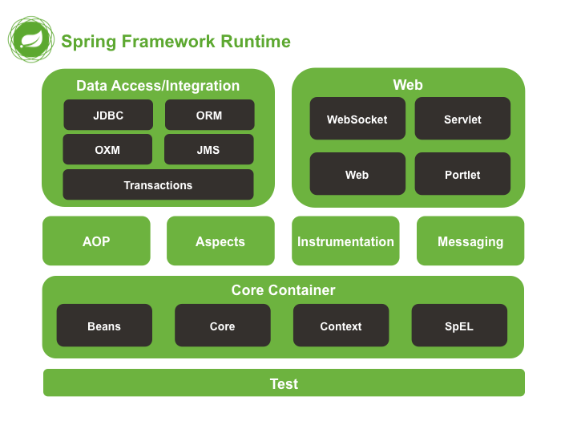
Day 1 - Agenda

Slide 4
Day 1 - Agenda
Java platform
comprehensive infrastructure
for developing Java applications.
Handles the infrastructure
you can focus on your application.
Build applications with POJOs
Inject enterprise services POJOs.
Started by Rod Johnson in 2002
Initially released under Apache in 2003.
Lightweight container
for all kinds of services to serve POJOs.

Slide 5
Dis advantages of Spring
Learning Curve:
Some developers Hard to understand IOC and Dependency Injection.
Due to this they do not realize full potential of Spring.
Changing Nature:
Spring keeps changing over the time.
Annotation based Spring configuration is not an easy thing for everybody to use.
Dependency Injection:
This is a paradox.
Spring promotes Dependency Injection (DI).
But you are tightly bound to Spring

Slide 6
Day 1 - Agenda
Dependency Injection and Inversion of Control
Microservices introduction
Monolith Adv. And Dis adv.
Defining characteristics of Microservices
SOAP and REST
Spring Boot
Why do you need Spring Boot
Dev. Env. Setup
Maven Introduction
My first Spring Boot project
My first RestController
HTTP basics
Postman basics

Slide 7
Day 1 - Agenda
Dependency Injection and Inversion of Control
Microservices introduction
Monolith Adv. And Dis adv.
Defining characteristics of Microservices
SOAP and REST
Spring Boot
Why do you need Spring Boot
Dev. Env. Setup
Maven Introduction
My first Spring Boot project
My first RestController
HTTP basics
Postman basics

Slide 8
Day 1 - Agenda
Dependency Injection and Inversion of Control
Microservices introduction
Monolith Adv. And Dis adv.
Defining characteristics of Microservices
SOAP and REST
Spring Boot
Why do you need Spring Boot
Dev. Env. Setup
Maven Introduction
My first Spring Boot project
My first RestController
HTTP basics
Postman basics

Slide 9
Day 1 - Agenda
Dependency Injection and Inversion of Control
Microservices introduction
Monolith Adv. And Dis adv.
Defining characteristics of Microservices
SOAP and REST
Spring Boot
Why do you need Spring Boot
Dev. Env. Setup
Maven Introduction
My first Spring Boot project
My first RestController
HTTP basics
Postman basics

Slide 10
Day 1 - Agenda
Dependency Injection and Inversion of Control
Microservices introduction
Monolith Adv. And Dis adv.
Defining characteristics of Microservices
SOAP and REST
Spring Boot
Why do you need Spring Boot
Dev. Env. Setup
Maven Introduction
My first Spring Boot project
My first RestController
HTTP basics
Postman basics

