Slide 1
Day 4 - Agenda
How to make your application fault tolerant
Difference between Fault tolerance and resilience
Fault tolerance related challenges with Microservices
Implementing Timeout
Implementing mimicked cached response
Implement Circuit breaker pattern using Hystrix
Mimic fault tolerance and verify that it is working.
Externalizing the properties of Spring boot
Configuring your application
application.properties
Project Lombok
Overview of Project Lombok
Project Lombok Configuration
Project Lombok Examples
Spring MVC

Slide 2
Fault Tolerance and Resilience
Fault tolerance
How much the system can tolerate the failure of a single service.
Resilience
How much the system can resist the failure of various systems.

Slide 3
Fault Tolerance and Resilience
Fault tolerance
Property that enables a system to
continue operating properly in the
event of the failure of some of its components.
Resilience
Ability of a system to rapidly recover and
continue with operations even
when certain failures or errors occur with
limited disruption that
could otherwise affect the progress

Slide 4
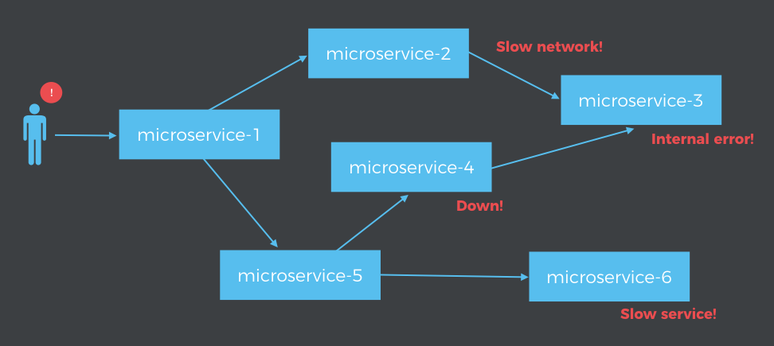
Fault Tolerance and Resilience
How much the system can resist the failure of various systems.

Slide 5
Fault Tolerance and Resilience
One or more service goes down.
One or more service becomes slow.
One service starts throwing specific error.

Slide 6
Fault Tolerance and Resilience
Timeouts
RestTemplate
Circuit Breaker
Hystrix
Rate limiters
Zuul
Retries
Spring Retry
Deadlines or Distributed timeout
Waiting for an established solution

Slide 7
Timeout
Specified period of time which is allowed to wait for some event to occur.
Buses/Train waiting.
RestTemplate timeout

Slide 8
Retry
Similar to restart computer
Spring-retry
from spring family is another utility module which can help us in handle the retry of any specific operation with standard fashion.

Slide 9
Retry – Not a great idea always
A -> B -> C -> D
If each of them are configured for 3 retries and D fails consistently
so B will face 3x load, C — 9x and D — 27x!.
This will create a storm of requests.
Solution:
Distinguish retryable errors from non-retryable.
It’s pointless to retry all request,
when user doesn’t have permissions or payload doesn’t structured properly.
Adopt error budgeting —
Say 3 retries in D fails, A should stop making request. This could be 2nd request of A though.
Isn’t that similar to Circuit breaker???

Slide 10
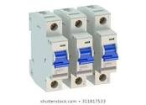
Circuit Breaker
Refer microservices-employee-catalog service
D:\PraiseTheLord\HSBGInfotech\Others\vilas\microservices\training\4\CircuitBreaker
\Instructions.txt

Slide 11
Timeouts
By default RestTemplate uses SimpleClientHttpRequestFactory
depends on default configuration of HttpURLConnection.
Infinite timeout by default.

Slide 12
Timeouts
Can be configured while starting jvm
-Dsun.net.client.defaultConnectTimeout=<TimeoutInMiliSec>
-Dsun.net.client.defaultReadTimeout=<TimeoutInMiliSec>
RestTemplate restTemplate = new RestTemplate(getClientHttpRequestFactory());
//Override timeouts in request factory
private SimpleClientHttpRequestFactory getClientHttpRequestFactory()
{
SimpleClientHttpRequestFactory clientHttpRequestFactory
= new SimpleClientHttpRequestFactory();
//Connect timeout
clientHttpRequestFactory.setConnectTimeout(10_000);
//Read timeout
clientHttpRequestFactory.setReadTimeout(10_000);
return clientHttpRequestFactory;
}

Slide 13
Deadlines/distributed timeouts
A -> B -> C -> D
If A and B are both waiting for 5 seconds.
If B has already completed waiting for 5 seconds, then there is no point for A to continue waiting. A should exit in such a case.
This is very complex to implement.
More details can be found at
https://itnext.io/5-patterns-to-make-your-microservice-fault-tolerant-f3a1c73547b3

Slide 14
Externalize Configurations
What is configuration
Traditional best practices:
Seperate code and config
db connection details.
port, host ect..
File names
profiles user details ect..
Feature flags.
Don't hard code it
Move it to a configuration file.
Make a change
Inject without building.
Files supported
.properties
.yaml
.json for some configurations

Slide 15
Externalize Configurations
Why do you need it?
Generally why do you need property files?
Additionally in microservices
Multiple microservices
Multiple instances of same service running.
Some created earlier and some latter.
Define your microservices externalization goals.
A template could be as follows
Externalized
Move the configuration out
Environment specific
db string can very in dev, test, stage, production
Consistent
All instances should be referring to same configuring.
Version history
Should be able to track the changes
Real-time management
Say you want to modify the server listening port.
Want to do this with Zero downtime. E.g. threadCount

Slide 16
Externalize Configurations
Property file
application.properties
We have been using it.
Could have been an yaml file as well.
Refer to training\day4\ExternalizingConfiguration\InstructionsForValues.txt

Slide 17
Project Lombok
Automatically generate java bytecode
Based on some small configurations
Some of the important code that can be auto-generated
@NonNull
Ensure that code doesn't throw NPE.
@Getter/@Setter
Generate getter/setter methods.
@ToString
Generate to string
@EqualsAndHashCode
Generates hashCode and equals implementations from the fields of your object..
@NoArgsConstructor, and @AllArgsConstructor
Constructors made to order:
Generates
no args constructors
one argument per final / non-nullfield, or one argument for every field.

Slide 18
Project Lombok
@Data
A shortcut for
@ToString,
@EqualsAndHashCode,
@Getter on all fields,
and @Setter on all non-final fields, and @RequiredArgsConstructor!
@Value
Immutable classes
@Synchronized
synchronized done right: Don't expose your locks.
Refer day4\ProjectLombok\InstructionsForLombok.txt

Slide 19
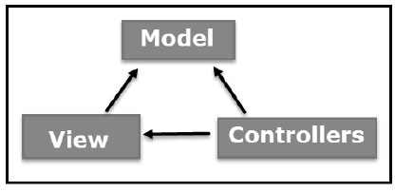
MVC

Slide 20
MVC
Model:
Corresponds to all the data-related logic that the user works with.
Can represent either the data that is being transferred
between the View and Controller components
or
other business logic-related data.
View
Used for all the UI logic of the application.
Controller
Acts as an interface between Model and View components
to process all the business logic and
incoming requests, manipulate data using the Model component and
interact with the Views to render the final output.
Refer training\day4\mvc\InstructionsMVC.txt

